Slide 1
Impacts of inclusion of foreign data in genomic evaluation of dairy cattle
K. M. Olson¹, P. M. VanRaden² , D. J. Null², and M. E. Tooker²
¹National Association of Animal Breeders
Columbia, MO
²AIPL, ARS, USDA
Beltsville, MD
katie.olson@ars.usda.gov

Slide 2
Background
Genomic evaluations accuracy increases with additional predictor animals
Some breeds with smaller population rely on genetic information from foreign populations
Work across country borders
  North America Alliance/Partners
  EuroGenomics
  Brown Swiss Intergenomics

Slide 3

Background
Large amounts of genetic information from foreign animals could degrade domestic results
  Poor genetic correlations and ties between animals from domestic country and foreign country
  Traits are really different between countries

Slide 4
Objectives –
To investigate the affect foreign data has on domestic genomic evaluations
To investigate methods for including foreign data in genomic evaluations

Slide 5
Overview - Methods
Domestic - estimated SNP effects within US proven animals only (control group)
All Country - used a common set of SNP effects from the combined country genotypes and phenotypes
Multi-country- used a correlated SNP effects using a multi-trait method

Slide 6
Materials & Methods – Animals
Animals genotyped
  Holsteins and Brown Swiss
  Used 42,503 SNP for both breeds
The predictor data set - animals were proven by August 2007
The validation data set - animals were unproven as of August 2007 and proven by June 2011 (Holsteins) or Jan. 2011 (Brown Swiss)
  Holsteins – 3,812
  Brown Swiss - 115

Slide 7
Materials and Methods
Breeds were analyzed separately
Domestic Only
  US proven animals
    9,063 Holsteins and 741 Brown Swiss
All Country
  All predictor animals treated as one population
    There were 12,656 predictor animals for Holstein and 1,473 for Brown Swiss
  Foreign bulls phenotype information was obtained through Interbull

Slide 8
Multi-Country Method
Two categories by trait – Domestic or Foreign
Bulls with US daughters considered domestic
Genetic correlations were determined as weighted average of genetic correlations from Interbull
Brown Swiss had 50% Foreign animals in predictor
  Germany, Austria, and Switzerland accounted for 80% of the foreign information in Brown Swiss

Slide 9
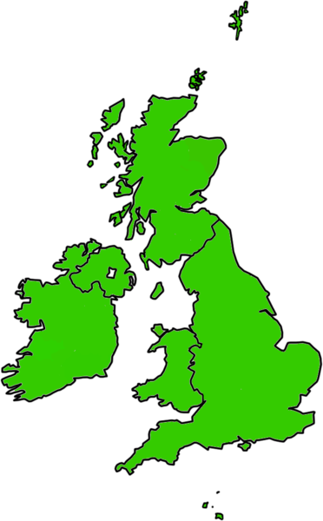
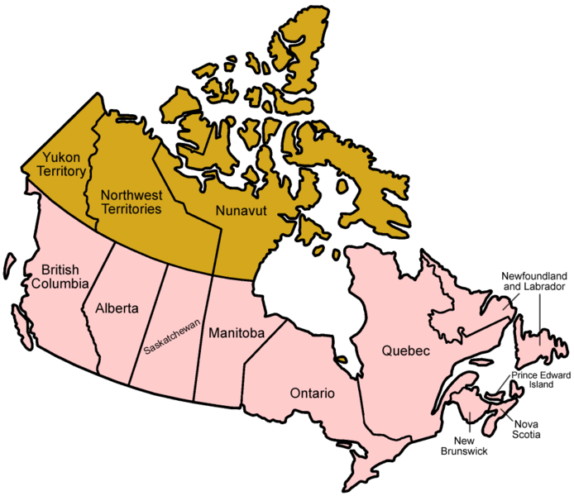
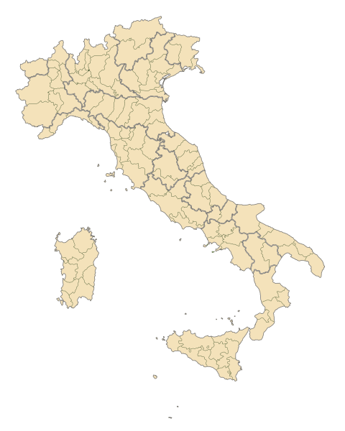
Holstein Predictor Pop. (non-US dtrs)
3,593 animals in the Holstein predictor population that
had no US information (28% of the total predictor)
Canada
1,321
Great Britain
247
Italy
1,677

Slide 10
Genetic Correlations – Multi-Country
Trait | Brown Swiss | Holstein
Milk | 0.86 | 0.93
Fat | 0.86 | 0.93
Protein | 0.86 | 0.91
Productive Life | 0.74 | 0.82
SCS | 0.86 | 0.92
Dtr. Preg. Rate | 0.60 | 0.88
Final Score | 0.72 | 0.88
Stature | 0.93 | 0.90
Sire Calving Ease | 0.65 | 0.69

Slide 11
Gains in reliability - Brown Swiss
Trait | Domestic
Milk | 0.156
Fat | 0.103
Protein | 0.135
Productive Life | 0.049
SCS | 0.050
Dtr. Preg. Rate | 0.098
Final Score | 0.027
Stature | 0.128
Sire Calving Ease | 0.019

Slide 12
Gains in reliability - Brown Swiss
Trait | Domestic | All Country
Milk | 0.156 | 0.209
Fat | 0.103 | 0.114
Protein | 0.135 | 0.162
Productive Life | 0.049 | 0.065
SCS | 0.050 | 0.042
Dtr. Preg. Rate | 0.098 | 0.068
Final Score | 0.027 | 0.093
Stature | 0.128 | 0.215
Sire Calving Ease | 0.019 | 0.087

Slide 13
Gains in reliability - Brown Swiss
Trait | Domestic | All Country | Multi-Country
Milk | 0.156 | 0.209 | 0.206
Fat | 0.103 | 0.114 | 0.125
Protein | 0.135 | 0.162 | 0.166
Productive Life | 0.049 | 0.065 | 0.075
SCS | 0.050 | 0.042 | 0.066
Dtr. Preg. Rate | 0.098 | 0.068 | 0.073
Final Score | 0.027 | 0.093 | 0.157
Stature | 0.128 | 0.215 | 0.242
Sire Calving Ease | 0.019 | 0.087 | 0.066

Slide 14
Gains in reliability - Holstein
Trait | Domestic
Milk | 0.266
Fat | 0.290
Protein | 0.202
Productive Life | 0.195
SCS | 0.237
Dtr. Preg. Rate | 0.175
Final Score | 0.222
Stature | 0.294
Sire Calving Ease | 0.088

Slide 15
Gains in reliability - Holstein
Trait | Domestic | All Country
Milk | 0.266 | 0.287
Fat | 0.290 | 0.313
Protein | 0.202 | 0.225
Productive Life | 0.195 | 0.218
SCS | 0.237 | 0.272
Dtr. Preg. Rate | 0.175 | 0.213
Final Score | 0.222 | 0.240
Stature | 0.294 | 0.340
Sire Calving Ease | 0.088 | 0.104

Slide 16
Gains in reliability - Holstein
Trait | Domestic | All Country | Multi-Country
Milk | 0.266 | 0.287 | 0.286
Fat | 0.290 | 0.313 | 0.311
Protein | 0.202 | 0.225 | 0.223
Productive Life | 0.195 | 0.218 | 0.222
SCS | 0.237 | 0.272 | 0.272
Dtr. Preg. Rate | 0.175 | 0.213 | 0.212
Final Score | 0.222 | 0.240 | 0.241
Stature | 0.294 | 0.340 | 0.339
Sire Calving Ease | 0.088 | 0.104 | 0.097

Slide 17
Conclusions
Adding foreign bulls increased the accuracy of genomic predictions
  About 5% for Brown Swiss
  2% for Holstein
  Real gains actually larger due to animals having domestic proofs
  Consistent with results from adding one country at a time (results not shown)
Multi-trait was beneficial for Brown Swiss on most traits but was not beneficial for Holstein

Slide 18
Future Research
Predicting bulls on other countries scales
Investigate high levels of foreign data impacts
Possible classification for multi-country categories
  High correlation
  Intermediate correlation
  Low correlation

Slide 19
Acknowledgements
Canada – Canadian Dairy Network and University of Guelph
Italy – Associazone Nazionale Allevatori Frisona Italiana
United Kingdom – Agriculture and Horticulture Development Board, Dairy Co division
Switzerland – Swiss Brown Cattle Breeders’ Federation
Germany – Bavarian State Research Center for Agriculture

Slide 20
Questions

