Slide 1
Current levels of compliance with EU bulk-tank SCC standards and proposed (but rejected) US standards based on data from four Federal Milk Marketing Orders
J.E. Lombard¹, H.D. Norman², C.A. Kopral¹, J.M. Rodriguez¹, and J.R. Wright².
¹USDA:APHIS:VS:Centers for Epidemiology and Animal Health, Fort Collins, CO USA
²USDA:ARS: Animal Improvement Programs Laboratory, Beltsville, MD USA

Slide 2
Bulk-tank Somatic Cell Counts
Increases with intramammary infections
Associated with milk quality
Lower BTSCC
Increases shelf life
Increases cheese yield

Slide 3
Bulk-tank Somatic Cell Counts
Maximum levels
400,000 cells/mL in most of EU, Australia, and New Zealand
500,000 cells/mL in Canada
750,000 cells/mL in US
Differences in implementation / calculation
Geometric mean vs. arithmetic mean
Number of months / tests above the limit

Slide 5
EU Regulations on Imports
Were
Truck load or silo at plant had to satisfy 400,000 cells/mL limit
Now
Each farm has to satisfy 400,000 cells/mL limit
When
Originally, October 1, 2010 → December 1, 2010

Slide 6
Objective
Evaluate noncompliance of herds and milk for current and proposed US BTSCC limits -National Milk Producers Federation proposal
750,000 cells/mL – current standard
600,000 cells/mL in January 2012
500,000 cells/mL in January 2013
400,000 cells/mL in January 2014

Slide 7
Federal Milk Marketing Orders

Slide 8
Material and Methods
Data Source
Four Federal Milk Marketing Orders
FMO | % Monitored Milk | % US Milk Supply | % Herds (Shipments)
Upper Midwest | 48.1 | 21.9 | 61.6
Central | 15.9 | 7.2 | 11.4
Mideast | 19.2 | 8.8 | 24.6
Southwest | 16.8 | 7.7 | 2.4
Total | 100.0 | 45.6 | 100.0

Slide 9
Materials and Methods (cont)
Noncompliance
Current and proposed US
3 of 5 tests above the limit
Current EU standard
Rolling 3 month geometric average
15 months of test data were required

Slide 10
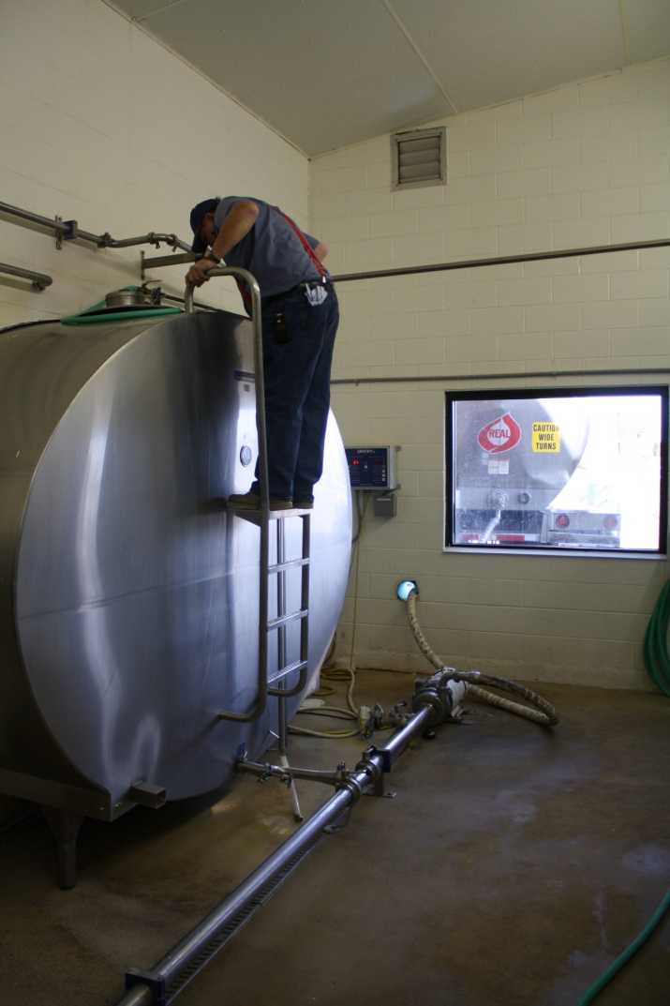
Materials and Methods (cont)
Annual milk shipped used as proxy for herd size
<900 metric tons (<100 cows)
900-4,500 mt (100-499 cows)
4,501-9,000 mt (500-999 cows)
>9,000 mt (1000 cows or more)

Slide 11
BTSCC Noncompliance - Herd

Slide 12
BTSCC Noncompliance - Herd
Notes:
Comparison of DHI and FMO data – DHI is dashed so easy to distinguish

Slide 13
BTSCC Noncompliance – Milk
Notes:
Important to note that the percent of milk noncompliant is much lower than the percent of herds. There is a herd size effect that is displayed in the next slide.

Slide 14
BTSCC Noncompliance – Size

Slide 15
Discussion/Conclusions
Historical view of noncompliance
BTSCC continue to decline annually
Percent of herds noncompliant will be considerably higher if tougher standards are implemented

Slide 16
Discussion/Conclusions
FMO analysis
Higher percent of FMO herds are noncompliant compared with DHI herds
More milk shipped (larger herds ) = lower noncompliance rate
The NMPF’s proposed 400K limit is much more restrictive than the EU’s

Slide 17
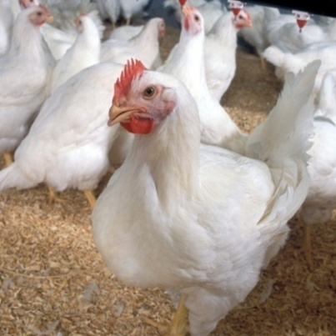
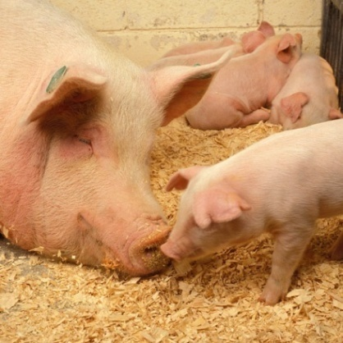
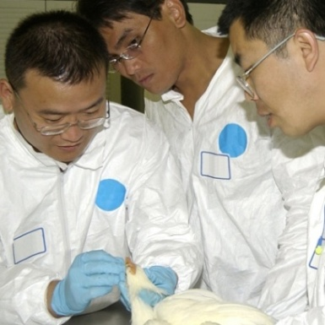
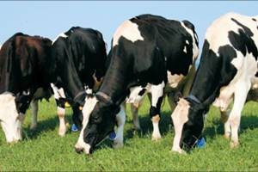
Questions?

