Slide 1
Properties of different density genotypes used in dairy cattle evaluation

Slide 2
Topics
Chips available
  3K, 50K_v1, 50K_v2, HD, others
Selection of SNPs from each chip
  Edits for conflict and missing rates
  Properties of chosen SNPs
Corrections to map locations
Accuracy of imputation

Slide 3
Why Multiple Chips?
More SNPs can increase accuracy
Fewer SNPs can decrease cost
Different animals are worth more
Full sequence = 3 billion bases
More laboratories may read DNA
  Perhaps similar to milk meters

Slide 4
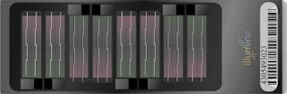
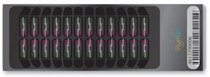
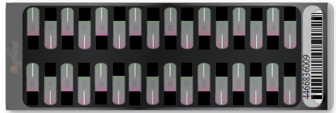
Illumina chips are [mostly] nested
Bovine HD (777K)
Contains 87% of the V1 SNP
Contains 90% of the V2 SNP
Bovine SNP50 (50K)
SNP50 v 2 (V2)
Contains 99.5% of 3K SNP
Contains 97% of the 3K SNP
Bovine LD (3K)
Notes:
Properties of the 777K chip are similar to the 50K chips.

Slide 5
How do we deal with other chips?
Impute to highest density
Account for loss of accuracy due to imputation error
Store only observed genotypes
Label evaluations with source of genotype

Slide 6
SNP Edits
SNPs from each chip kept if:
  > 1% minor allele frequency (MAF) in any breed (polymorphic)
  < 10% missing genotypes
  < 2% parent-progeny conflicts
A SNP is excluded:
  if it has a high call rate, but also has a high parent-progeny conflict

Slide 7
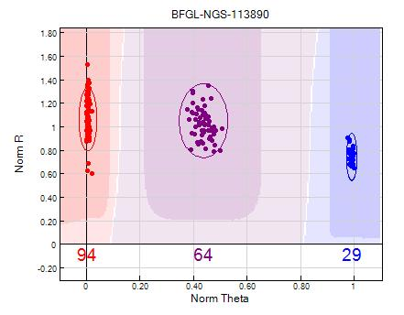
Good Clustering

Slide 8
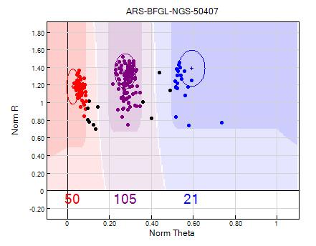
Not-So-Good Clustering
Notes:
This is an example of a SNP that is on the edge of useable. AIPL would rather call a SNP missing instead of calling it wrong.

Slide 9
Hardy-Weinberg-Chetverikov
AA p² AB 2pq BB q²
  Random mating, no selection, unlimited population size, no random genetic drift, no gene flow, etc.
  Compute ratios within breed, then combine ratios
SNP deleted: (observed/expected)
  Heterozygous < .3 or > 1.3
  Homozygous < .1 or > 10

Slide 10
SNPs Selected
Chip | Animals | SNPs Available | SNPs Selected
777K | 1,170 | 777,962 | 614,012
50K v1 | 57,916 | 56,947 | 43,598
50K v2 | 15,270 | 54,609 | 43,293
3K | 34,849 | 2,900 | 2,683
Version 2 SNP selected only if version 1 usable
Additional 2,269 version 2 SNP could be used

Slide 11
Properties of Selected SNP
Chip | Missing % | Parent-progeny conflict %
777K | 0.2 | 0.004
50K v1 | 0.4 | 0.014
50K v2 | 0.4 | 0.011
3K | 0.5 | 0.078

Slide 12
Correction of Map Locations
Some misplaced SNP on UMD3.0 (Zimin, 2009)
50K SNP locations fixed by cooperation between:
  AIPL / BFGL
  Univ of Maryland
  Univ of Missouri
  Univ of Guelph

Slide 13
Correction of Map Locations
For 777K chip, misplaced SNP are simply deleted
Count haplotypes per 50 marker segment
Get SNP correlations with segment
Remove least correlated SNP blocks (140 markers deleted)
Notes:
You would expect that a group of SNP, (haplotype) inherited together would be highly correlated

Slide 14
SNP Correlation Matrix
 | g1 | g2 | g3 | g4 | g5 | g7 | g8 | g9 | g10 | g11 | g12 | g13 | g14 | g15
g1 | 1 | -0.65 | -0.65 | -0.25 | 0.25 | -0.49 | -0.5 | 0.51 | 0.12 | 0.33 | 0.19 | 0.55 | -0.33 | 0.33
g2 | -0.65 | 1 | 1 | 0.38 | -0.36 | 0.31 | 0.31 | -0.32 | 0.18 | -0.52 | -0.69 | -0.34 | 0.52 | -0.52
g3 | -0.65 | 1 | 1 | 0.38 | -0.36 | 0.31 | 0.31 | -0.32 | 0.18 | -0.52 | -0.69 | -0.34 | 0.52 | -0.52
g4 | -0.25 | 0.38 | 0.38 | 1 | -0.97 | 0.16 | 0.16 | -0.16 | 0.55 | 0.26 | -0.31 | -0.15 | -0.26 | 0.26
g5 | 0.25 | -0.36 | -0.36 | -0.97 | 1 | -0.15 | -0.16 | 0.15 | -0.54 | -0.27 | 0.3 | 0.15 | 0.27 | -0.27
g7 | -0.49 | 0.31 | 0.31 | 0.16 | -0.15 | 1 | 0.99 | -0.98 | 0.24 | -0.14 | -0.39 | -0.9 | 0.14 | -0.14
g8 | -0.5 | 0.31 | 0.31 | 0.16 | -0.16 | 0.99 | 1 | -0.99 | 0.24 | -0.14 | -0.38 | -0.91 | 0.14 | -0.14
g9 | 0.51 | -0.32 | -0.32 | -0.16 | 0.15 | -0.98 | -0.99 | 1 | -0.24 | 0.14 | 0.39 | 0.92 | -0.14 | 0.14
g10 | 0.12 | 0.18 | 0.18 | 0.55 | -0.54 | 0.24 | 0.24 | -0.24 | 1 | 0.5 | -0.54 | -0.25 | -0.5 | 0.5
g11 | 0.33 | -0.52 | -0.52 | 0.26 | -0.27 | -0.14 | -0.14 | 0.14 | 0.5 | 1 | 0.46 | 0.16 | -1 | 1
g12 | 0.19 | -0.69 | -0.69 | -0.31 | 0.3 | -0.39 | -0.38 | 0.39 | -0.54 | 0.46 | 1 | 0.41 | -0.46 | 0.46
g13 | 0.55 | -0.34 | -0.34 | -0.15 | 0.15 | -0.9 | -0.91 | 0.92 | -0.25 | 0.16 | 0.41 | 1 | -0.16 | 0.16
g14 | -0.33 | 0.52 | 0.52 | -0.26 | 0.27 | 0.14 | 0.14 | -0.14 | -0.5 | -1 | -0.46 | -0.16 | 1 | -1
g15 | 0.33 | -0.52 | -0.52 | 0.26 | -0.27 | -0.14 | -0.14 | 0.14 | 0.5 | 1 | 0.46 | 0.16 | -1 | 1
Notes:
SNPs are inherited

Slide 15
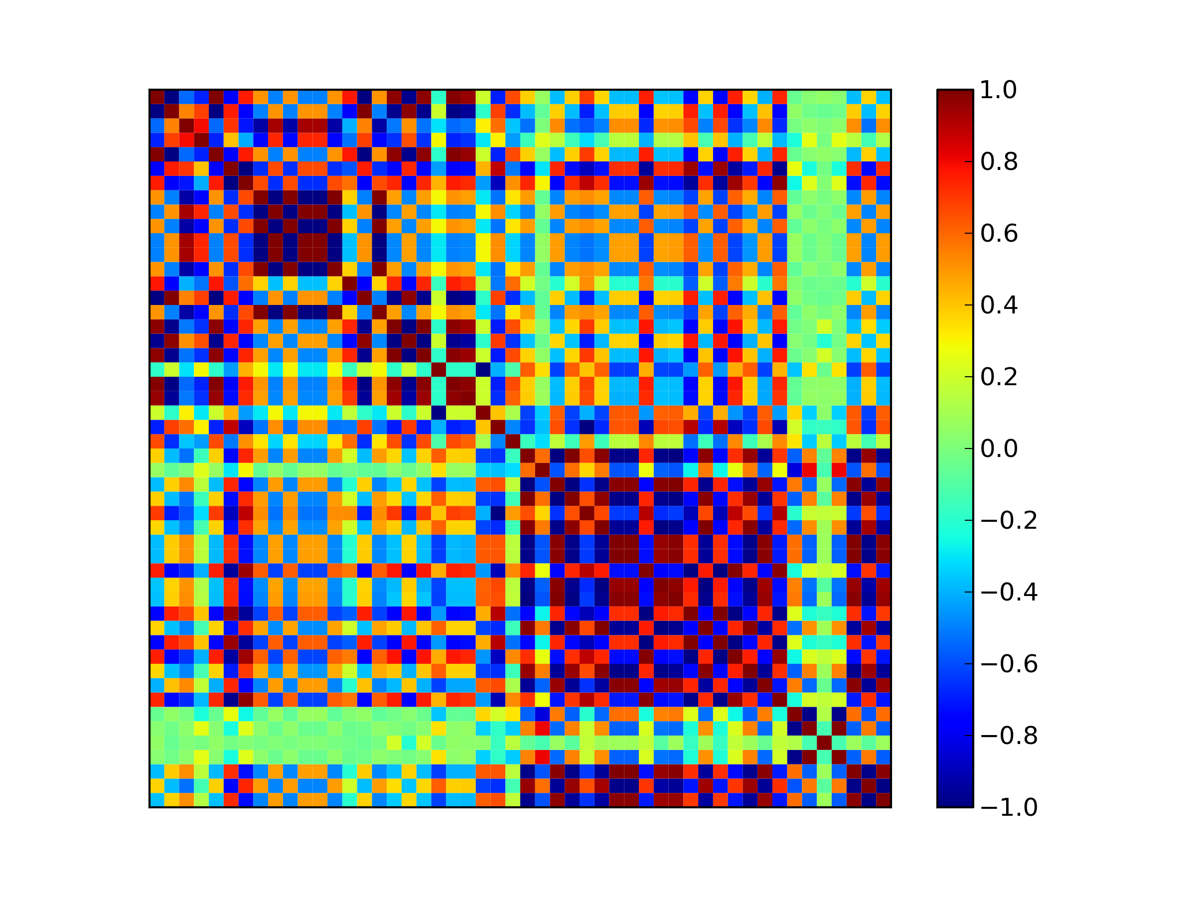
Heat Map Correlations

Slide 16
3K vs. 50K Reliability
Compare 319 regenotyped animals
  3K chip in December 2010
  50K chip in April 2011
Correct imputation = 96.3% of SNP
Correlations of PTAs = .94 to .97
Reliability of NM$ = 32% for PA, 60% for 3K, and 65% for 50K
Notes:
Katie has the info, the lowdown, the nitty gritty.

Slide 17
Other Chips
Affymetrix
  650K, 25K, 10K
Illumina
  Bovine LD 6.5K (replacing 3K)
Parentage Only

Slide 18
Summary / Conclusions
Many chips are now available
  More choices in the future
Different chips must be comparable
  In the past year, three new chips added, and SNP edits are automated.
Increase reliabilities for less cost

Slide 19
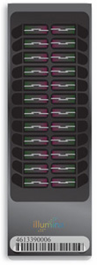
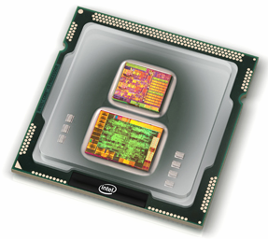
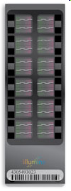
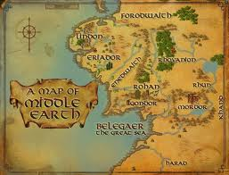
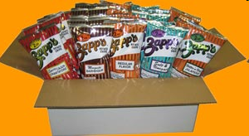
Questions about Chips or Maps?
Notes:
Map of Middle Earth is from the game Lord of the Rings Online and was copied from Google Images.

