Slide 1
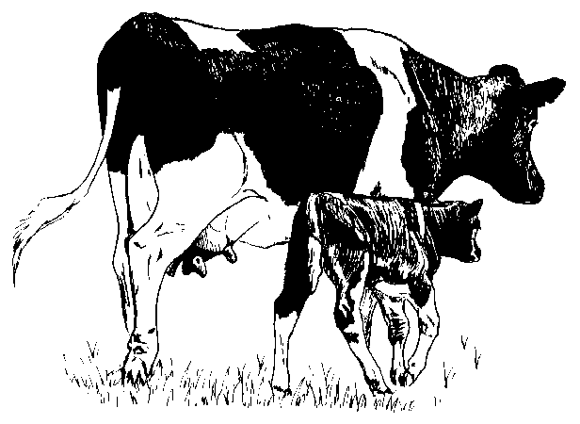

Effects of dam’s dry period length on heifer development
H. D. Norman and J. L. Hutchison*
Animal Improvement Programs Laboratory, Agricultural Research Center, USDA, Beltsville, MD 20705-2350
Abstr. M66
2011
INTRODUCTION
Considerable research has been done to determine effects of dry period on cow’s later performance. Few studies have looked at dam’s dry period on heifer development. However, over 50% of in utero calf weight gain occurs during the last 2 months of gestation.
RESULTS
DISCUSSION
Dam’s calving difficulty
  Increased linearly as dam’s DD increased until 66 d and then leveled off
  Difference between DD categories were all significantly different (P < 0.0001) when compared to 56-60 and 61-65 DD, although differences were small ranging 0.11 between 0-30 and 91-120 DD
  When GL and milk were included in the model, calving difficulty still increased as dam’s DD increased
Dam’s stillbirth
  Optimal at 51-65 DD
  Short (≤35 d) and long (≥71 d) DD were detrimental to calf survival
Heifer’s age at first breeding
  Increased 5 d when dam had 0-30 DD compared to 56-60 DD
  Differences were significant between 0-30 DD and 56-60 DD (P < 0.05) but not significant between 56-60 and 91-120 DD
Heifer’s survival to first calving
  Decreased 2.9 and 3.3 percentage points when dam had 0-30 DD and 1.1 and 1.6 percentage points for 91-120 DD compared to 56-60 and 61-65 DD
  Differences were significant between 0-30 and 56-60 DD (P < 0.0001) and between 56-60 and 91-120 DD (P < 0.05)
  When stillborn calves were removed, heifers were still more likely to survive to first lactation when their dam’s had a 56-65 DD
DD group | Dam’s DD |  | Number of records
 |  |  | CD | SB | AFB¹ | SURVI
1 | 0-30 |  | 13,487 | 4,506 | 549 | 6,147
2 | 31-35 |  | 16,227 | 6,674 | 811 | 7,649
3 | 36-40 |  | 42,530 | 18,904 | 2,402 | 18,505
4 | 41-45 |  | 91,965 | 40,019 | 4,631 | 37,070
5 | 46-50 |  | 164,562 | 64,722 | 7,368 | 64,389
6 | 51-55 |  | 241,816 | 84,854 | 8,809 | 95,568
7 | 56-60 |  | 263,659 | 83,705 | 7,424 | 104,602
8 | 61-65 |  | 188,091 | 54,125 | 4,313 | 73,291
9 | 66-70 |  | 91,265 | 24,148 | 1,829 | 34,664
10 | 71-80 |  | 62,231 | 15,745 | 1,561 | 24,259
11 | 81-90 |  | 30,804 | 7,602 | 876 | 11,924
12 | 91-120 |  | 41,207 | 11,106 | 1,250 | 15,684
Total |  |  | 1,247,844 | 416,110 | 41,823 | 493,752
OBJECTIVES
To investigate effect of dam’s days dry (DD) on:
Calving difficulty (CD), scored 1-5 (higher score=more difficulty)
Stillbirth rate (SB), calf livability to 48 hours
Age at first breeding of heifer calf (AFB)
Survival to first calving of heifer calf (SURV1), 0=no first lactation, 1=had a first lactation
¹ Small number of records for AFB due to heifer breeding records not stored until 2003 and reporting is minimal
Dam’s calving difficulty
Dam’s stillbirth
DATA & METHODS
Holstein calving and breeding records from January 1997 through December 2010
Data edits
  Dam’s first calving after January 1997
  Dam’s calving date within 10 d of expected calving date
  For AFB and SURV1, heifer’s birth date before January 2008 to allow time for first lactation
Dam’s DD categorized into 12 groups (0-30, 31-35, 36-40, …, 66-70, 71-80, 81-90, 91-120 d)
Linear fixed-effects models
  Same model for CD and SB
    Dam’s calving herd-year, dam’s calving year-state-month, parity of dam, calf sex, and dam’s DD category
    Gestation length (GL) and milk yield were added to CD model to see if effect remained
  AFB = heifer’s breeding herd-year, heifer’s breeding year-state-month, and dam’s DD category
  SURV1 = dam’s calving herd-year, dam’s calving year-state-month, parity of dam, heifer parent average DPR, and dam’s DD category
Heifer’s age at first breeding
Heifer’s survival to first calving
CONCLUSION
Dam’s dry period length is associated with calf and heifer survivability. These results support avoiding the use of extreme dry period lengths, either short (≤35 d) or long (≥71 d), to maximize calf survival.
http://aipl.arsusda.gov

