Slide 1
Overview of current genomic selection in dairy cattle populations

Slide 2
Topics - 1
Current status of dairy genomics
  Data available within each breed
  Potential of cow reference genotypes
  National vs. international evaluation
Future strategies
  All-breed and crossbred evaluation
  Higher density marker sets

Slide 3
Topics - 2
Potential for genotype imputation
  Number of high density genotypes required per breed
  Impute 1.2 million from 2 different 600K chips
  Impute 3K and 6K together
  Impute sequence from high density
New recessive defects discovered

Slide 4
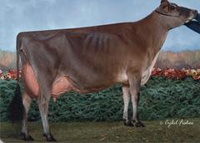
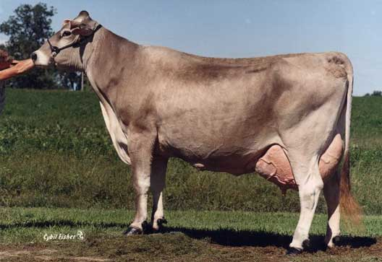
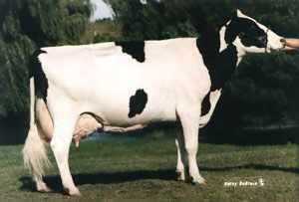
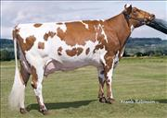
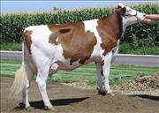
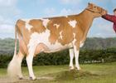
Dairy Breeds and Crosses

Slide 5
Reference Bulls by Breed
Breed | Bulls | Database
Holstein | 16,000 | North America+ (USA-CAN-ITA-GBR)
 | 18,000 | EuroGenomics (DEU-FRA-NLD-DFS)
 | 10,000 | Not yet merged (many other countries)
Red Dairy Cattle | 8,000 1,000 | Scandinavia (DNK-FIN-SWE-NOR) Not yet merged (CAN, NZL)
Jersey | 6,000 | Not yet merged (USA, DNK, NZL)
Brown Swiss | 5,000 | Interbull (DEU-CHE-ITA-USA-FRA-SLV)
Fleckvieh | 3,000 | (DEU-AUT)
Montbeliarde | 2,000 | (FRA)
Others | 0 | Not started yet

Slide 6
Gain in Genomic Reliability for young animals
Reference | Heritability
Bulls | .30 | .10 | .03
50,000 | +49 | +50 | +52
15,000 | +35 | +34 | +34
5,000 | +20 | +18 | +17
1,500 | +8 | +7 | +6
500 | +3 | +2 | +2
Parent Avg REL | 37 | 34 | 30
Traditional REL | 90 | 75 | 65

Slide 7
Cows in Reference Population
More females than males are being genotyped and will get phenotypes
  70,687 females as of July 2011
  50,393 males, most will be culled
1-step method will include cows
Test reliability from cow genotypes
Cows only, Bulls only, Cows+Bulls

Slide 8
Correlations with Bull-Only GPTA
 | Genetic Evaluation From:
Trait | Traditional | Cows Only | Cows + Bulls
Milk | .73 | .81 | .97
Protein | .76 | .79 | .96
Fat Percent | .62 | .90 | .98
Productive Life | .67 | .75 | .97
Som. Cell Score | .56 | .75 | .97
Dtr Preg Rate | .66 | .61 | .96
Final Score | .78 | .85 | .96
Stature | .75 | .87 | .98
Udder Depth | .58 | .78 | .98

Slide 9
National vs. International Delivery
Simple genotype exchange
  < 6 months to deliver results
  Flexible implementation by countries
  Same schedule + monthly updates
Interbull Brown Swiss project
  > 2 years to deliver results, no monthly
  Poor schedule, no 3K predictions
  Disconnected from other breeds

Slide 10
All-Breed Genomic Evaluation
All breeds in same database
Multi-trait, correlated SNP effects
  50K data = ~.3 corr, +1% REL
  700K data = ~.7 corr, +10% REL (guess)
Potential to genotype crossbreds
  Useful for introgression or synthetic
Will major breed subsidize minor?

Slide 11
Accuracy of Imputing High Density
HD genotypes simulated within each breed

Slide 12
High Density Imputation
Accuracy of HD imputation ~1% less using young animals vs. famous bulls
Two different chips >600K are now available (Illumina, Affymetrix)
  Overlap 50K chip + 60K other SNPs
  Test if double genotyping of some animals is needed

Slide 13
Imputation with Two 600K Chips
 |  | Bulls with both chips (n)
 |  | 0 | 50 | 200 | 500
Chip | Animals | Imputation accuracy
50K | 61,615 | 98.53 | 98.56 | 98.59 | 98.52
600K chip 1 | 1,000 | 98.96 | 99.12 | 99.38 | 99.49
600K chip 2 | 1,000 | 98.02 | 99.38 | 99.39 | 99.43
Both 600K chips | n | N/A | 99.76 | 99.83 | 99.88
Optimum imputation if 200 bulls genotyped with both 600K chips

Slide 14
Simulated Sequences
Impute 30 million SNPs from 600K
  2.9 billion monomorphic removed
Animals: 217 sequenced, 100 HD
Computer time and memory:
  1 hr simulation, 3.3 hr imputation
  25 Gbytes simulation, 30 imputation
Accuracy = 99.2% correct

Slide 15
Imputation with 3K and 6K
Possible new 6K chip with double the markers of 3K, higher accuracy
  99% for 6K vs. 96% for 3K for HO
  98% for 6K vs. 95% for 3K for JE
  98% for 6K vs. 94% for 3K for BS
Include 3K SNPs or choose new?
Imputation best with most overlap

Slide 16
Recessive Defect Discovery
Check for homozygous haplotypes
  7 to 90 expected but none observed
  5 of top 11 are potentially lethal
  936 to 52,449 carrier sire by carrier MGS fertility records
  3.1% to 3.7% lower conception rates
  Some slightly higher stillbirth rates
Confirmed Brachyspina same way

Slide 17
Potential Recessive Lethals
Name | Chrom-osome | Loca-tion | Carrier Freq | Source Ancestors
 | BTA | Mbase | %
HH1 | 5 | 58-66 | 4.5 | Pawnee Farm Arlinda Chief
HH2 | 1 | 92-97 | 4.6 | Willowholme Mark Anthony
HH3 | 8 | 90-95 | 4.7 | Glendell Arlinda Chief, Gray View Skyliner
JH1 | 15 | 13-18 | 23.4 | Observer Chocolate Soldier
BH1 | 7 | 41-47 | 14.0 | West Lawn Stretch Improver

Slide 18
Conclusions - 1
Small populations cannot keep up with Holsteins
All-breed genomic evaluations:
  Benefit all breeds if sufficient animals genotyped and phenotyped in each
  Enable crossbred or synthetic breed selection
  Identify favorable alleles in other breeds not yet present in Holstein

Slide 19
Conclusions - 2
Data collected should be exchanged to increase return on investment
  Reduce costs via experimental design
  Cow genotypes are useful if numbers of bulls are small
Accurate imputation key to success:
  Can impute between two different 600K chips within breed
  Need ~1000 higher density genotypes in each breed
Recessive defects found in each breed

Slide 20
Acknowledgments
Dan Null, Katie Olson, and Jana Hutchison for discovering harmful recessive haplotypes
George Wiggans for testing 6K marker sets

