Slide 1
Comparison of daughter performance of New Zealand and North American sires in US herds
Abstr. 714
H.D. Norman,*¹ J.R. Wright,¹ R.L. Powell,¹
T.J. Lawlor,² and C.W. Wolfe³
¹Animal Improvement Programs, Agricultural Research Service, USDA, Beltsville, MD
²Holstein Association USA Inc., Brattleboro, VT
³American Jersey Cattle Association, Reynoldsville, OH
duane.norman@ars.usda.gov

Slide 2
Background
Increasing interest in grazing to reduce costs (machinery, feed, labor)
Increased importance of fertility to seasonalize calvings, thus maximizing availability of grazing forages
New Zealand (NZ) has used grazing as the standard practice for decades

Slide 3
Assumptions
US producers have used adequate semen from some NZ bulls to draw useful conclusions
Usage probably intended to capitalize on selection for grazing conditions
Value of NZ bulls might be for better fertility or milk trait yields on pasture

Slide 4
Objective
Compare US performance of AI daughters of NZ Holstein-Friesian or Jersey AI bulls with their contemporaries by North American (NA) AI sires
Traits
Milk, fat, and protein yields
Somatic cell score (SCS)
Days open
Calving ease and stillbirth
Conformation (type appraisal traits)

Slide 5
Holstein data
438 US herds with daughters of 54 NZ bulls and NA-sired contemporaries
1,443 US daughters of NZ bulls and 26,444 US daughters of 3,055 NA bulls
Phenotypes for yield, SCS, days open, calving ease, and stillbirth for parities 1 to 5
First-parity conformation scores
(205 NZ-sired and 1,758 NA-sired US cows)

Slide 6
Jersey data
538 US herds with daughters of 65 NZ bulls and NA-sired contemporaries
2,714 US daughters of NZ bulls and 76,281 US daughters of 1,631 NA bulls
Phenotypes for yield, SCS, and days open for parities 1 to 5
First-parity conformation scores
(1,267 NZ-sired and 33,371 NA-sired US cows)

Slide 7
Model
Trait = herd – calving year – season
+ parity (1–5)
+ sire origin (NA or NZ)
+ residual (random)
calving years (2002–10)
6-mo seasons (Apr–Sept, Oct–Mar)

Slide 8
Daughter performance (all herds)
 | NZ-sired daughters  NA-sired daughters
Trait | Holstein |  | Jersey
Milk (kg) | 497*** |  | 264***
Fat (kg) | 1 |  | 2**
Protein (kg) | 6*** |  | 3***
SCS | 0.15*** |  | 0.08***
Days open | 9.9*** |  | 1.3
Calving ease | 0.01 |  | —
Stillbirth (%) | 0.02 |  | —
**P < 0.01; ***P < 0.001

Slide 9
Daughter performance (all herds)
 | NZ-sired daughters  NA-sired daughters
Trait | Holstein |  | Jersey
Stature | 1.5** |  | 0.8***
Strength | 0.6 |  | 1.1***
Dairy form | 0.6 |  | 1.2***
Thurl width | 1.0 |  | 1.0***
Fore udder attachment | 1.9** |  | 1.0***
Rear udder height | 2.2*** |  | 1.7***
Rear udder width | 0.0 |  | 0.9***
Udder depth | 2.9** |  | 1.4***
**P < 0.01; ***P < 0.001

Slide 10
Seasonal subset
Herds with seasonal calving
25 calvings/year
60% of calvings in any consecutive 3 mo from January to June
(Jan–Mar, Feb–Apr, Mar–May, or Apr–Jun)
Holstein: 22 US herds with 199 daughters of 23 NZ bulls and 2,216 contemporaries by 166 NA bulls
Jersey: 26 US herds with 271 daughters of 22 NZ bulls and 4,549 contemporaries by 194 NA bulls

Slide 11
Daughter performance (seasonal herds)
 | NZ-sired daughters  NA-sired daughters
Trait | Holstein |  | Jersey
Milk (kg) | 367*** |  | 109***
Fat (kg) | 3 |  | 6***
Protein (kg) | 4* |  | 1
SCS | 0.20*** |  | 0.15***
Days open | 7.6*** |  | 1.5
*P < 0.05; ***P < 0.001

Slide 12
Conclusions
For all herds, NZ daughters produced less milk and protein and had higher SCS
NZ Holstein daughters had fewer days open than NA daughters. However, Jerseys strains were not significantly different for days open
Daughters of NZ bulls were smaller in stature, with deeper and more poorly attached udders than NA daughters

Slide 13
Conclusions (continued)
For seasonal calving herds, results were similar
If NZ semen was used to improve fertility and reduce body size in grazing operations, this was successful in Holstein herds
The benefit of the choice of strains should be determined by the response in individual traits and the economic merit of each in the overall objective of the herd

Slide 14
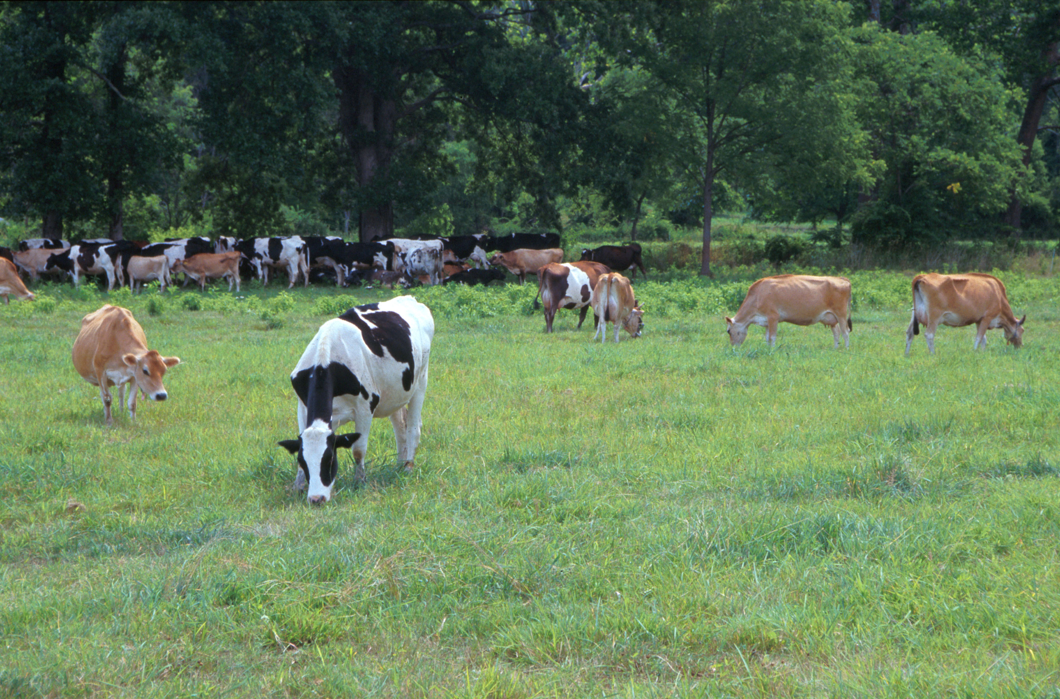
Questions?
AIPL web site:
http://aipl.arsusda.gov
Holstein and Jersey crossbreds graze on American Farm Land Trust’s Cove Mountain Farm in south-central Pennsylvania.
Source: ARS Image Gallery, image #K8587-14; photo by Bob Nichols

