Slide 1
An international overview of the recording and use of functional traits in dairy breeding and management
Notes:
1
1
1

Slide 2
Recording and use of functional traits
Growing emphasis on functional traits
  No direct economic value, but economically important because they impact other traits
Challenges with functional traits
  Inconsistent trait definitions
  Limited knowledge of international activities
Notes:
2
2

Slide 3
Increased emphasis on functional traits
Trait | Relative emphasis on traits in index (%)
 | PD$ 1971 | MFP$ 1976 | CY$ 1984 | NM$ 1994 | NM$ 2000 | NM$ 2003 | NM$ 2006 | NM$ 2010
Milk | 52 | 27 | –2 | 6 | 5 | 0 | 0 | 0
Fat | 48 | 46 | 45 | 25 | 21 | 22 | 23 | 19
Protein | … | 27 | 53 | 43 | 36 | 33 | 23 | 16
PL | … | … | … | 20 | 14 | 11 | 17 | 22
SCS | … | … | … | –6 | –9 | –9 | –9 | –10
UDC | … | … | … | … | 7 | 7 | 6 | 7
FLC | … | … | … | … | 4 | 4 | 3 | 4
BDC | … | … | … | … | –4 | –3 | –4 | –6
DPR | … | … | … | … | … | 7 | 9 | 11
SCE | … | … | … | … | … | –2 | … | …
DCE | … | … | … | … | … | –2 | … | …
CA$ | … | … | … | … | … | … | 6 | 5
Notes:
3
3

Slide 4
Functional traits working group (FTWG)
ICAR working group (authors)
  7 members from 6 countries
Standards and guidelines for functional traits
  Recording schemes
  Evaluation procedures
  Breeding programs
Notes:
4
4

Slide 5
ICAR FTWG survey – rationale
International experiences with functional traits (FT)
  Definitions in participating countries
  Strategies to improve functionality
  Exchange of information and experiences
Goals for Working Group
  Needs of participants
  Priorities
Notes:
5
5

Slide 6
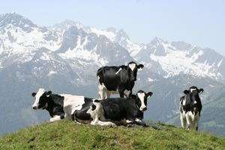
ICAR FTWG survey – responses
E-mail to all 52 ICAR member countries
27 countries responded
  N = 2 countries without FT programs
  N = 25 countries with FT programs
Species breakdown
  N = 1 only beef
  N = 12 only dairy
  N = 12 dairy and beef
Notes:
6
6

Slide 7
ICAR FTWG survey – design
20 questions in 4 sections
Groups of functional traits
  Calving, fertility, longevity, & mobility
  Indirect health traits, e.g., SCC
  Direct health traits, e.g., veterinary diagnoses
  Others traits, e.g., feed intake
Notes:
7
7

Slide 8
I. General role of functional traits
 | Routine Evaluations
Trait group | Traditional | Genomic | Developing
Calving | 18 | 9 | 4
Fertility | 20 | 9 | 6
Longevity | 17 | 8 | 4
Feet & legs | 17 | 8 | 7
Indirect health | 20 | 9 | 4
Direct health | 7 | 2 | 4
Other | 5 | 4 | 0
Notes:
8
8

Slide 9
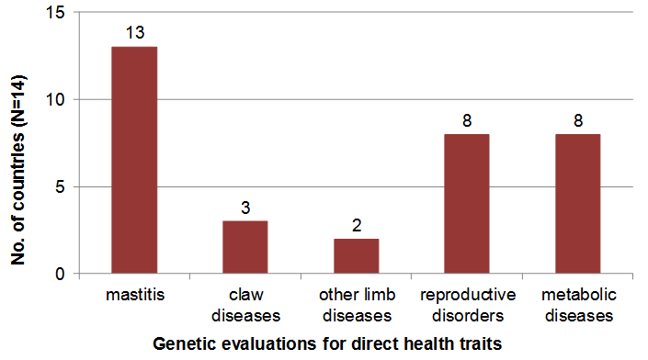
What traits receive genetic evaluations?
Notes:
9
9

Slide 10
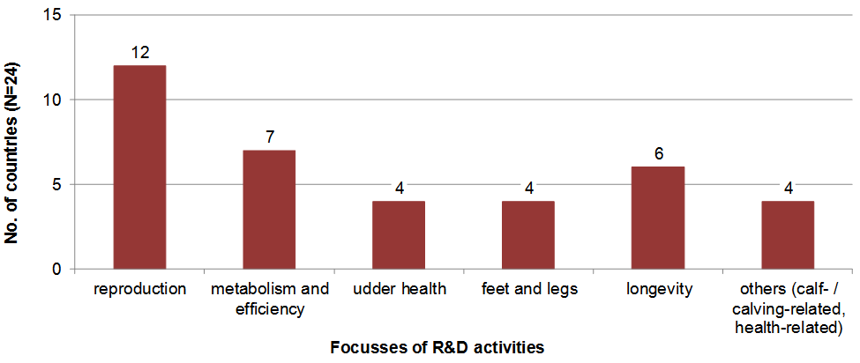
What new traits are being studied?
Notes:
10
10

Slide 11
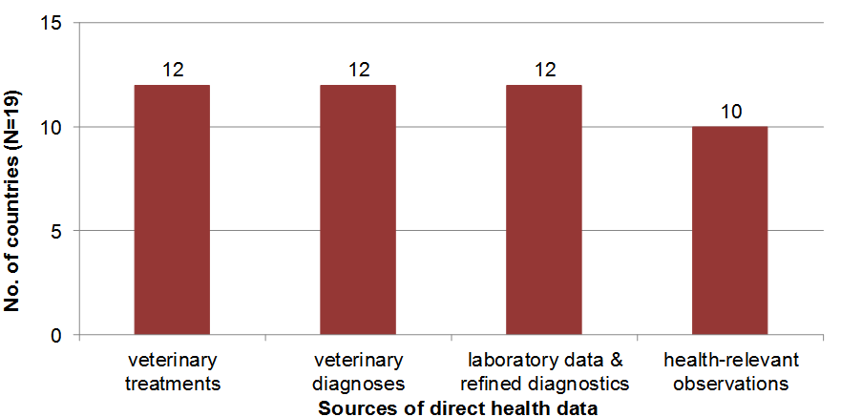
Where do the data come from?
>2/3 of countries use multiple sources
Notes:
11
11

Slide 12
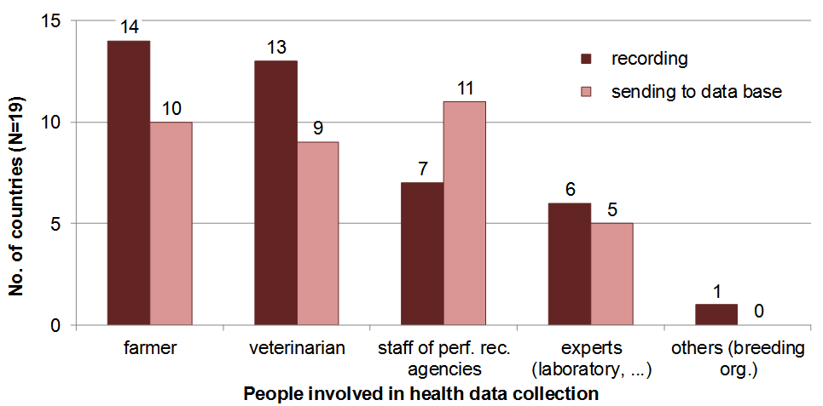
Who collects the data?
2/3 of respondents use multiple groups
Notes:
12
12

Slide 13
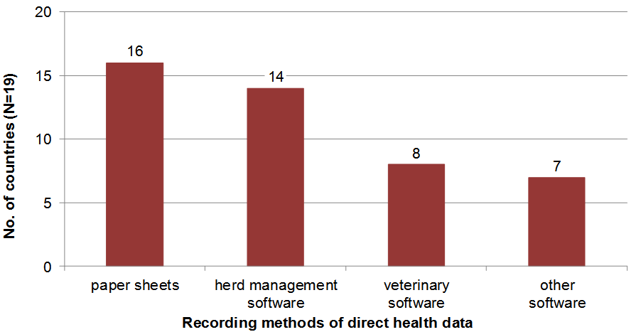
How are the data recorded?
>2/3 of respondents use multiple methods
Notes:
13
13

Slide 14
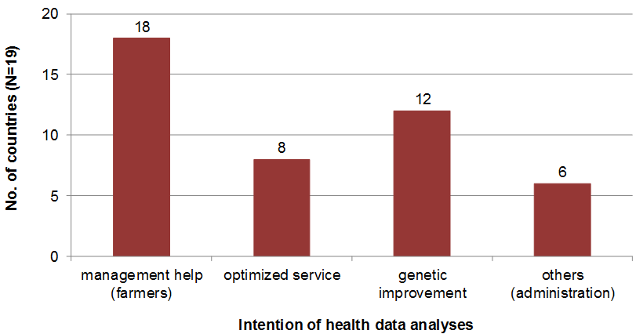
What are the data used for?
Notes:
14
14

Slide 15
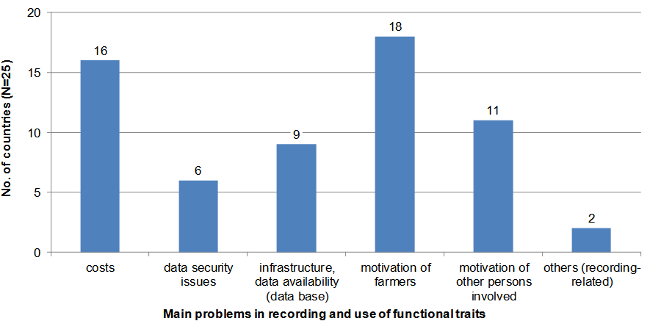
Concerns of data providers
Notes:
15
15

Slide 16
Survey conclusions
Functional traits are important
Lots of research underway
  24 countries planning health analyses
People want to exchange knowledge
  Lots of interest in workshops
  Some interest in new guidelines
Notes:
16
16

Slide 17
Current FTWG activities
“Recording, Evaluation and Genetic Improvement of Health Traits”
  Accepted by the ICAR General Assembly 38th ICAR Biennial Session
  Included in the 2012 ICAR Guidelines
“Recording, Evaluation and Genetic Improvement of Female Fertility”
  Under development
Notes:
17
17

Slide 18
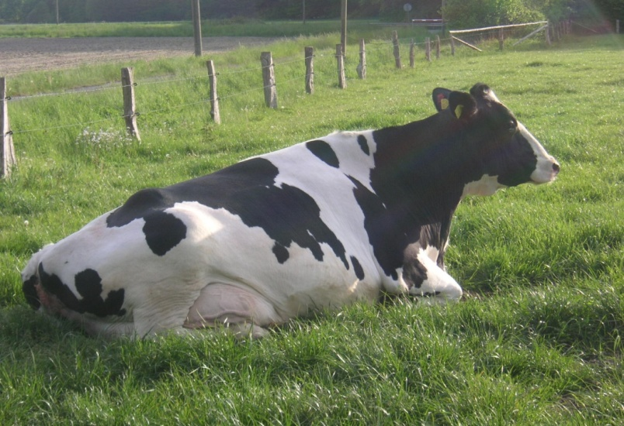
Thanks to our participants!
Argentina, Australia, Austria, Belgium, Canada, Chile, Croatia, Czech Republic, Denmark, Estonia, Finland, France, Germany, Greece, Hungary, Ireland, Island of Jersey, Korea, Lithuania, The Netherlands, Norway, Poland, Portugal, Romania, Slovenia, South Africa, United States, Uzbekistan
Notes:
18
18

Slide 19
It's not too late to respond!
Submissions accepted through 30 September, 2012
Download PDF from FTWG website
  http://www.icar.org/pages/working_groups/wg_functional_traits.htm
Complete form and return by e-mail
  icar@icar.org
Notes:
19
19

