Slide 1

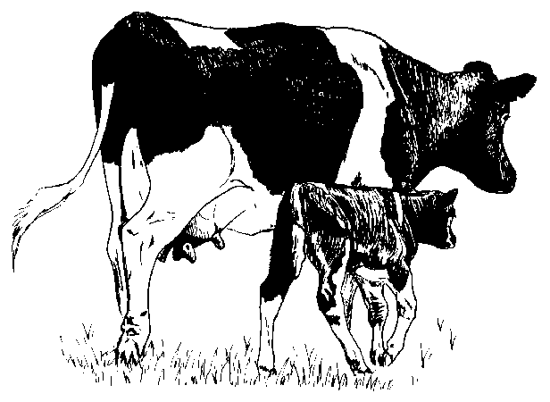
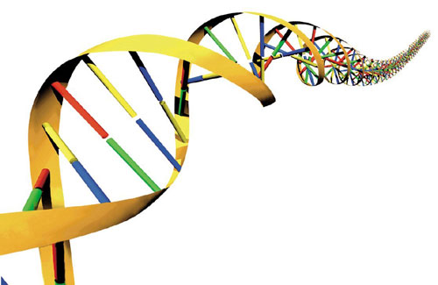
Adjustment of selection index coefficients and polygenic variance to improve regressions and reliability of genomic evaluations
P. M. VanRaden, J. R. Wright*, and T. A. Cooper
Animal Improvement Programs Laboratory, Agricultural Research Service, USDA, Beltsville, MD 20705-2350
Abstr.
W56
2012
INTRODUCTION
When genomic PTA were first computed in November 2007 few bulls’ ancestors were genotyped
To increase accuracy it was necessary to blend information from genotyped and non-genotyped ancestors in the current multi-step evaluation
Two possible solutions to blend:
  Regressions for direct genomic values (DGV; sum of SNP effects)
  Selection index (combine 3 terms by reliabilities computed from the amount of missing information)
    DGV including polygenic effects (DGV + poly)
    Traditional evaluation (PTA)
    Subset evaluation estimated from pedigree relationships (SPTA)
        GPTA = w₁(DGV + poly) +w₂ PTA + w₃ SPTA
Adjusting the weights may increase regressions and reliabilities and is relatively easy to do
In contrast, adjustment to the polygenic variance requires a re-estimation of marker effects so more computation is needed
METHODS (cont.)
RESULTS (cont.)
SELECTION INDEX EXAMPLES
(before change)
  Dam not genotyped, low genomic reliability
GPTA = 0.99 (DGV+poly) + 0.41 PTA - 0.40 SPTA
  Dam not genotyped, high genomic reliability
GPTA = 0.99 (DGV+poly) + 0.11 PTA - 0.10 SPTA
  Dam is genotyped
GPTA = 1.00 (DGV+poly) + 0.00 PTA - 0.00 SPTA
Regression and change in reliability of predicting future genomic (August 2011) on past (August 2008) by DGV weight for Jerseys
Trait |  | Weight on Direct Genomic Value
 | Expected regression | Regression |  |  |  | Reliability change
 |  | 1.0 | 0.9 | 0.8 |  | 1.0 | 0.9 | 0.8
Milk | 1.00 | 0.82 | 0.84 | 0.86 |  | 0.15 | 0.16 | 0.15
Fat | 1.00 | 0.79 | 0.82 | 0.84 |  | 0.10 | 0.10 | 0.11
Protein | 1.00 | 0.76 | 0.77 | 0.79 |  | 0.12 | 0.12 | 0.12
Daughter Pregnancy Rate | 0.99 | 1.06 | 1.09 | 1.12 |  | 0.25 | 0.24 | 0.23
Somatic Cell Score | 1.00 | 0.73 | 0.74 | 0.77 |  | 0.16 | 0.16 | 0.15
Productive Life | 0.99 | 1.10 | 1.14 | 1.17 |  | 0.25 | 0.24 | 0.23
Overall conformation score | 0.99 | 0.75 | 0.77 | 0.80 |  | 0.15 | 0.16 | 0.16
Udder depth | 1.00 | 0.92 | 0.94 | 0.97 |  | 0.32 | 0.32 | 0.31
(after weights shifted from DGV to SPTA)
  Dam not genotyped, low genomic reliability
GPTA = 0.90 (DGV+poly) + 0.41 PTA - 0.31 SPTA
  Dam not genotyped, high genomic reliability
GPTA = 0.90 (DGV+poly) + 0.11 PTA - 0.01 SPTA
  Dam is genotyped
GPTA = 0.90 (DGV+poly) + 0.10 PTA - 0.00 SPTA
Regression and change in reliability of predicting future genomic (August 2011) on past (August 2008) by DGV weight for Brown Swiss
Trait |  | Weight on Direct Genomic Value
 | Expected Regression | Regression |  |  |  | Reliability change
 |  | 1.0 | 0.9 | 0.8 |  | 1.0 | 0.9 | 0.8
Milk | 0.93 | 0.89 | 0.90 | 0.92 |  | 0.16 | 0.16 | 0.15
Fat | 0.95 | 0.61 | 0.63 | 0.65 |  | 0.08 | 0.08 | 0.07
Protein | 0.94 | 0.66 | 0.67 | 0.68 |  | 0.11 | 0.11 | 0.10
Daughter Pregnancy Rate | 0.98 | 0.89 | 0.91 | 0.94 |  | 0.10 | 0.10 | 0.10
Somatic Cell Score | 0.96 | 0.89 | 0.93 | 1.00 |  | -0.03 | -0.02 | -0.01
Productive Life | 0.95 | 1.03 | 1.07 | 1.11 |  | 0.04 | 0.04 | 0.04
Sire calving ease | 0.96 | 0.14 | 0.21 | 0.29 |  | -0.22 | -0.21 | -0.20
Daughter calving ease | 0.99 | 0.09 | 0.11 | 0.14 |  | -0.09 | -0.08 | -0.08
Overall conformation score | 0.91 | 0.31 | 0.32 | 0.33 |  | 0.00 | 0.00 | 0.00
Udder depth | 0.96 | 0.83 | 0.85 | 0.88 |  | 0.15 | 0.15 | 0.14
OBJECTIVE
Determine which alternative selection index weights are optimal to increase reliability and regression
RESULTS
METHODS
Choose a maximum weight w_{max} such that adjusted w₁ = min (w₁, w_{max})
The difference w₁ – adjusted w₁ is added to w₃ so that the sum of weights = 1
The difference w₁ – adjusted w₁ is added to w₂ instead if adjusted w₃ would be positive
Regression and change in reliability of predicting future genomic (August 2011) on past (August 2008) by DGV weight for Holsteins
Trait |  | Weight on Direct Genomic Value
 | Expected Regression | Regression |  |  |  | Reliability change
 |  | 1.0 | 0.9 | 0.8 |  | 1.0 | 0.9 | 0.8
Milk | 0.93 | 0.91 | 0.94 | 0.98 |  | 0.26 | 0.26 | 0.25
Fat | 0.88 | 0.82 | 0.85 | 0.87 |  | 0.30 | 0.29 | 0.27
Protein | 0.88 | 0.82 | 0.84 | 0.87 |  | 0.21 | 0.20 | 0.20
Daughter Pregnancy Rate | 0.87 | 0.85 | 0.90 | 0.96 |  | 0.24 | 0.25 | 0.26
Somatic Cell Score | 0.83 | 0.89 | 0.93 | 0.97 |  | 0.29 | 0.29 | 0.28
Productive Life | 0.83 | 0.90 | 0.94 | 0.98 |  | 0.22 | 0.22 | 0.22
Sire Calving Ease | 0.88 | 0.72 | 0.76 | 0.81 |  | 0.12 | 0.12 | 0.13
Daughter Calving Ease | 0.81 | 0.71 | 0.75 | 0.80 |  | 0.14 | 0.14 | 0.14
Sire Stillbirth | 0.92 | 0.74 | 0.79 | 0.84 |  | -0.01 | 0.00 | 0.01
Daughter Stillbirth | 0.98 | 0.92 | 0.97 | 1.01 |  | 0.19 | 0.19 | 0.19
Overall conformation score | 0.78 | 0.75 | 0.78 | 0.80 |  | 0.25 | 0.25 | 0.24
Udder depth | 0.86 | 0.90 | 0.97 | 1.05 |  | 0.46 | 0.46 | 0.45
CONCLUSIONS / APPLICATIONS
Theoretical selection index weights currently in use are close to ideal.
Index adjustments can help pass genomic validation tests by removing small biases in regression.
Maximum DGV weight values implemented beginning with the April 2012 evaluations were:
  Health traits 0.95 Yield (Jersey, Brown Swiss) 0.80
  Calving traits 0.75 Yield (Holstein) 0.90
  Type traits 0.90
Genomic PTA for the highest young Holstein bulls decreased 45 kg for milk, 2 kg for fat, 1 kg for protein, 0.2 mo for productive life, 0.15 points final score, and $20 for net merit in April 2012 evaluations.
http://aipl.arsusda.gov

