Slide 1
Tools to Exploit Sequence data to find new markers and Disease Loci in Cattle
D. M. Bickhart, H. A. Lewin and G. E. Liu

Slide 2
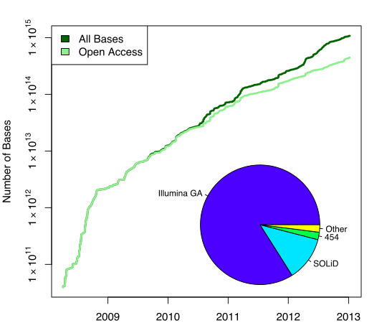
Amount of sequence data
~ 312500 Human
genome equivalents
~ 312.5 Human
genome
equivalents
SRA chart From Wikipedia Commons

Slide 3
Why sequence DNA?
Best genotyping tool
BovineHD chip (~0.03% of the genome)
Whole Genome Seq (~90% of the genome)
New Disease Discovery
Low frequency variants
Sometimes not SNPs
Arrays are cost effective

Slide 4
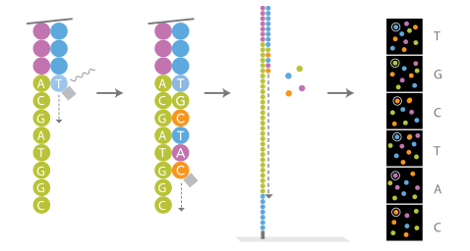
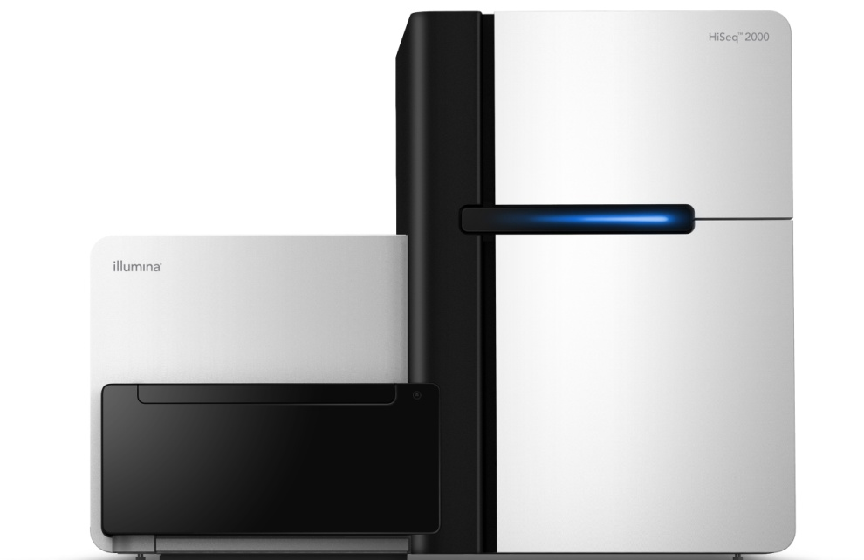
Sequencing Stage
Whole Genome Sequencing
Based on Genomic DNA
Samples turned into “libraries”
Illumina HiSeq 2000 Sequencer
Takes ~10-14 days for 100 x 100
Minimal hands-on time
Produces 600 gigabases

Slide 5
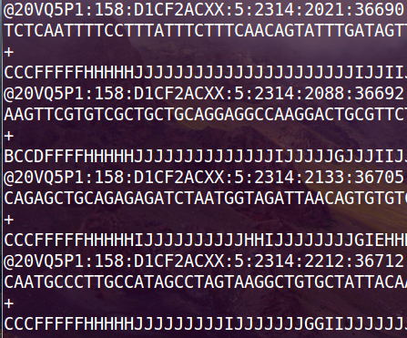
Reads must be aligned to a reference genome
Raw Sequencer Output
Alignment to the Genome
Variant Detection
This analysis is very disk-IO intensive.

Slide 6
So you decided to start sequencing
Total Time (sample to sequence): 3 weeks
That’s assuming nothing went wrong!
More realistic: months
Total Cost: ~$2400 per sample
Resulting Data
Large text files
~300 gigabytes compressed
Analysis
Often underestimated
Can take months as well

Slide 7
Why you need to use a Pipeline
Automates analysis
Maximizes resource consumption
You don’t want to burn out your PostDoc

Slide 8
CoSVarD
Easy Config File Input
“Divide and Conquer”
Flexible and customizable
Excel spreadsheets
Summary Statistics
All Variants

Slide 9
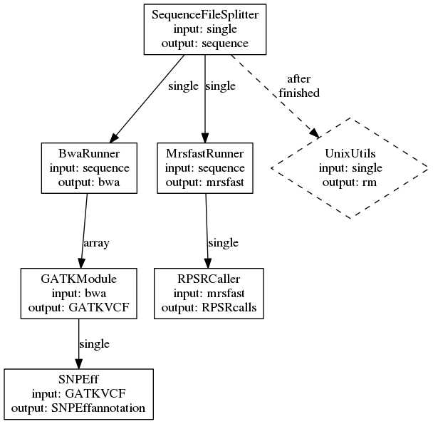
Configuration File Input

Slide 10
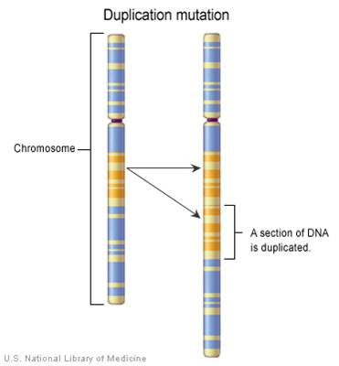
Output Summary
Full Sequence Alignment
CNVs, SNPs, INDELs
Genome-wide Copy Number
Gene Annotation

Slide 11
Holstein Bulls Sequenced
Dataset | Number of Animals | Millions of Reads | Avg X coverage
Low Cov. | 24 | 3,269 | 5 X
High Cov. | 9 | 2,539 | 20 X
Server: 100 GB Ram, 24 processor cores
Processing time:
Low Cov. 415 CPU days
High Cov. 317 CPU days
17.3 real days
13.2 real days

Slide 12
Identifying interesting SNPs
Type (alphabetical order) | Count | Percent
DOWNSTREAM | 641,623 | 4.034%
EXON | 5,765 | 0.036%
INTERGENIC | 10,483,570 | 65.911%
INTRON | 3,993,921 | 25.11%
NON_SYNONYMOUS_CODING | 47,634 | 0.299%
NON_SYNONYMOUS_START | 5 | 0%
SPLICE_SITE_ACCEPTOR | 473 | 0.003%
SPLICE_SITE_DONOR | 479 | 0.003%
START_GAINED | 870 | 0.005%
START_LOST | 58 | 0%
STOP_GAINED | 725 | 0.005%
STOP_LOST | 36 | 0%
SYNONYMOUS_CODING | 54,817 | 0.345%
SYNONYMOUS_STOP | 33 | 0%
UPSTREAM | 641,381 | 4.032%
Stop Gain
Notes:
One heterozygote. DDX25 is involved in spermatogenesis.

Slide 13
Genetic impact of Copy Number
 | 1 | 2 | 3 | 4 | 5 | 6 | 7 | 8 | 9 | 10 | 11 | 12 | 13 | 14 | 15 | 16 | 17 | 18 | 19 | 20 | 21 | 22 | 23 | 24
PRP1
ODC
Ferritin
FABP2
Copy Number Color Scale | 9 | 7 | 5 | 3 | 2
Notes:
PRP1 is an important spliceosome complex. ODC is the Ornithine decarboxylase gene important in cell growth because it produces putrescine, spremidine and spermine all of which can be used to stabilize DNA. Ferritin is a gene devoted to iron uptake and sequestration. FABP2 is expressed in the intestine and is related to fatty acid uptake.

Slide 14
Conclusions
Sequencing is a powerful tool
Not useful for everything
Future is in Whole Genome Seq
Analysis is a huge concern
Cosvard
Flexible and customizable
Powerful
Expected Public Release: End of Year

Slide 15
Acknowledgements
BFGL
George Liu
Lingyang Xu
AIPL
George Wiggans
Tabatha Cooper
Jana Hutchison
Paul VanRaden
John Cole
Fernando Garcia of UNESP
Harris Lewin of University of Illinois
Jerry Taylor and Bob Schnabel of University of Missouri
Funded by National Research Initiative (NRI) Grant No. 2007-35205-17869 and 2011-67015-30183 from USDA-NIFA

Slide 16
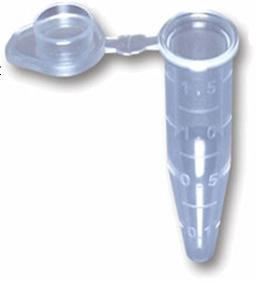
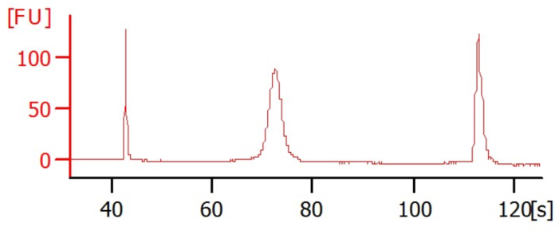
Sample Preparation Time is Substantial
DNA Extraction: ~12 hours (30 mins)
DNA QC: ~1-2 hours (1-2 hours)
Library Construction: 48 hours (12 hours)
Library QC: ~2-4 hours (1 hour)
Total: 3-4 days (15.5 hours)
*Parentheses indicate “hands-on” time

Slide 17
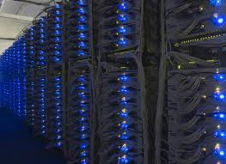
Storage Concerns
What to save?
Raw data?
Processed results?
How much workspace?
Suggestions:
Workspace: 10 x compressed files
Save alignments
Backup REGULARLY!!!

Slide 18
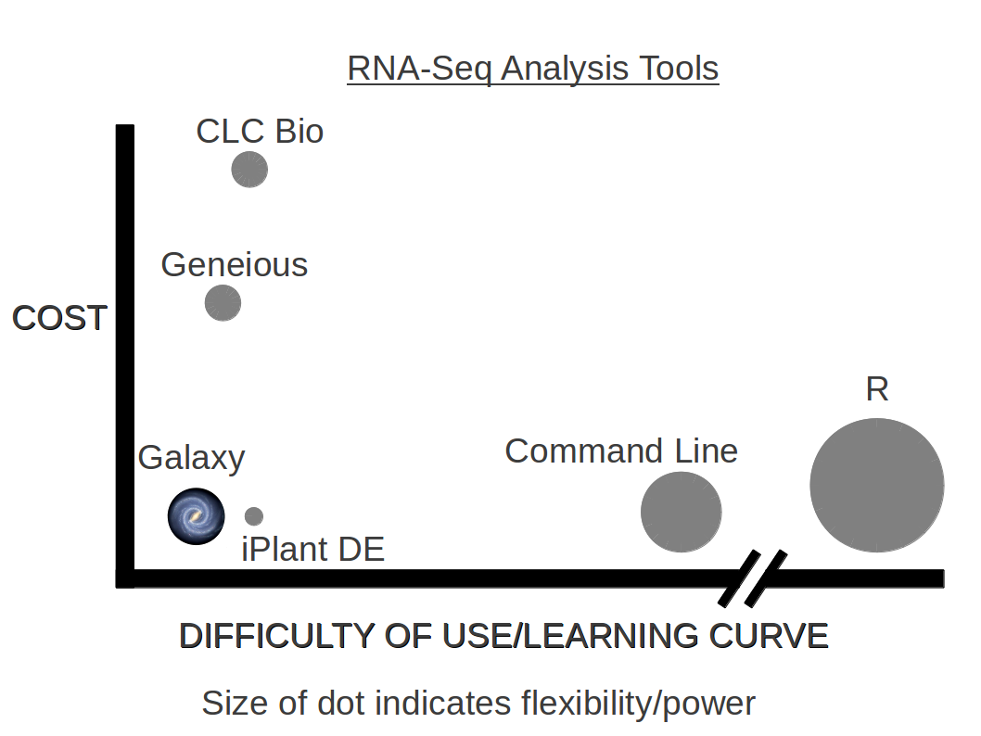
We are here

Slide 19
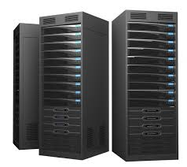
Computational Logistics
Desktop computers
Viable for single lanes
Long computation time
Servers
Best solution
>100 gb Ram and > 16 processor cores
Cloud
Amazon web services (http://aws.amazon.com/lifesciences/)
IAnimal/IPlant (http://www.iplantcollaborative.org/)
Bottlenecks to consider
alignment: disk-IO
variant calling: memory & cpu

