Slide 1
Genomic divergence of indicine and taurine cattle identified through high-density SNP genotyping
Laercio R. Porto-Neto, Tad S. Sonstegard, George E. Liu, Derek M. Bickhart, Cedric Gondro, Marcos V.B. da Silva, Yuri T. Utsunomiya, Jose F. Garcia, Curtis P. VanTassell

Slide 2
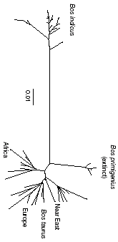
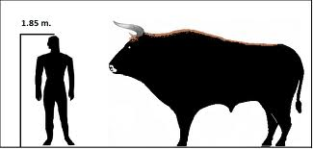
Introduction
Two sub-species of cattle
Bos primigenius taurus
Bos primigenius indicus (Zebu)
Diverged from common ancestor
330K to 2M yrs. Ago
Under different natural selection pressures pre-domestication
Notes:
Natural selection has shaped the genome of all living creatures in our planet, including domesticated animals. Nearly all modern cattle can be associated with one of two types or sub-species. This division between the types Bos primigenius taurus (taurine cattle) and Bos primigenius indicus (zebu cattle) is estimated to have occurred from a common ancestor between 330,000 and 2 million years ago. Since divergence, cattle types have accumulated different genetic variations, which have contributed to highly differentiated phenotypes.

Slide 3
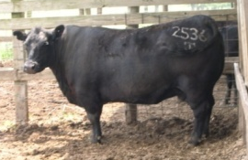
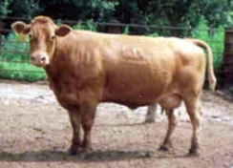
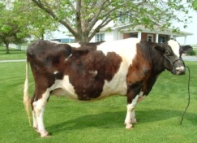
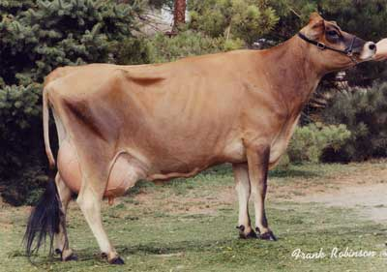
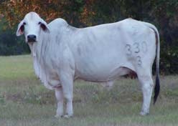
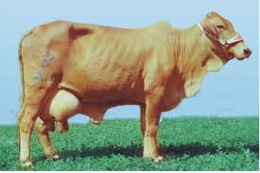
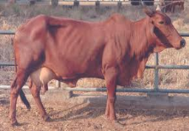
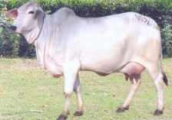
Taurine & Indicine
10K yrs. Ago – fertile crescent
Adapted to temperate climate
some tropical adaptation
Selection for breed formation in 19th century
Beef, dairy, dual purpose
Intense use of A.I. and artificial selection in some breeds
7K yrs. Ago – indus river valley
Tropically adapted
Hump, extra hide for cooling
Tolerant of endemic pests
Under soft selection until 20th century
draft
Exported to Africa, Australia, S. America, and southern U.S.
Crossbreeding/composites
Notes:
It is assumed that the divergence between cattle types was long before domestication, which is estimated to have occurred between 10,000 to 7,000 BC in two separate locations: the Fertile Crescent (taurine cattle) and the Indus Valley (zebu cattle). After domestication human-oriented selection added further complexity to the evolution

Slide 4
Hypothesis
Human selection exponentially intensified differences between cattle types post-domestication
Genome-wide SNP will reveal genomic regions potentially under divergent selection
Zebu vs. taurine
Beef vs. dairy
Tropical vs. temperate

Slide 5
Why do we care?
ZEBU
ZEBU
ZEBU
Notes:
2/5 of the worlds cattle are zebu; and zebu ar eprevalent in these regions

Slide 6
Materials and Methods
505 Animals – 339 taurine & 166 zebu
10 taurine breeds (HapMap) – Angus (44), Brown Swiss (24), Charolais (37), Guernsey (21), Hereford (36), Holstein (63), Jersey (39), Limousin (47), Nor. Red (17), Red Angus (11)
3 Zebu breeds (HapMap/Brazil) – Nelore (91), Gir (50), Guzera (25)
Excluded tropically adapted taurine (N’Dama), composites, and Brahman (taurine cow base)

Slide 7
Materials and Methods
Genotypes derived from Illumina’s BovineHD 777K SNP)
SNP QC parameters
Animal SNP call rates >= 98%
SNP call rate >= 95% across all animals
Animal filtering - PI_HAT > 0.8
Population structure
Prune SNP markers based on LD in PLINK
Used ~38K SNP for Admixture and PC analyses

Slide 8
Materials and Methods
Signatures of selection
Estimation of SNP F_{ST} based on a pure drift model
F_{ST} smoothed across Bovine genome reference assembly model UMD
15 SNP bandwidth = average extent of LD
CNV
Mostly Balancing selection regions
Immune genes under positive selection

Slide 9
Results – Informative HD SNP

Slide 10
Results – Informative HD SNP

Slide 11
Results – Population Substructure
Notes:
The estimated proportion of each cluster (y) is given for each individual. #1-91 Nelore, #92-141 Gir, #142-166 Guzera, #167-187 Guernsey, #188-226 Jersey, #227-270 – Angus, #271-281 Red Angus, #282-317 Hereford, #318-364 Limousin, #365-401 Charolais, #402-425 Brown Swiss, #426-488 Holstein, #489-505 Norwegian Red. B-C) Principal components analysis (PCA1 vs PCA2), taurine and zebu animals are plotted B) by cattle type zebu (blue) and taurine (red), and C) by breed.

Slide 12
Results – PC by Breed
Notes:
Notice Dominette and Domino in bottom right corner and Jersey separates taurus into two groups.

Slide 13
Results – Signatures of Selection
Notes:
For the signatures of selection slides, what are the take-home points on the haplotype diagrams and the FST plot?
The take home points are the largest signature on Chr 7 was found before using the SNP50 and it resides over a region with genes involved in reproductive gene pathways. Many of the other signals are new-see paper for details. The peak on Chr 14 is over a region also implicated to be different between cattle races and involved in reproduction and stature – same as work shown by Yuri and Michel Georges (PLAG 1 gene).
Of note-Chr 21 microRNA cluster near centromere and probably involved in dairy production. Chr 23 balancing selection over MHC locus. Proves cannot breed for specific MHC since nature has selected for diversity.
Do you have any additional points for the discussions section?
Please take from the manuscript.
For the acknowledgements, I was going to list you, Curt, Juca and the other co-authors. Am I missing anyone that needs to also be acknowledged?
No need to acknowledge-we are co-authors.

Slide 14
Results – Signatures of Selection

Slide 15
Conclusions
48 regions under positive selection
Reproduction
Stature
Immune genes under balancing selection
Hypothesis testing for new breeding programs

Slide 16
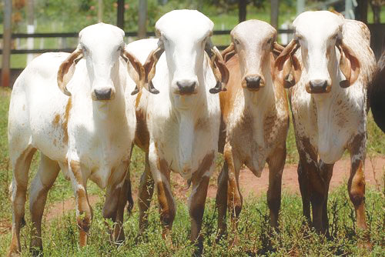
Acknowledgements
The University of Queensland, School of Veterinary Science, Animal Genetics Laboratory, Gatton Australia
University of New England, School of Environmental and Rural Science, Armidale, Australia
United States Department of Agriculture, Agricultural Research Service, Bovine Functional Genomics Laboratory – CRIS 104
Bioinformatics and Animal Genomics Laboratory, Embrapa Dairy Cattle, Juiz de Fora, Minas Gerais, Brazil.
Bovine Hapmap Consortium
CRV Lagoa and Alta Genetics do Brasil ltda for donation of semen doses from Guzera bulls
The Next-Generation BioGreen 21 Program (No. PJ008196), Rural Development Administration, Republic of Korea
This project was also partially supported by FAPESP (2010/52030-2) and CNPq (475914/2010-4), Brazil.

