Slide 1
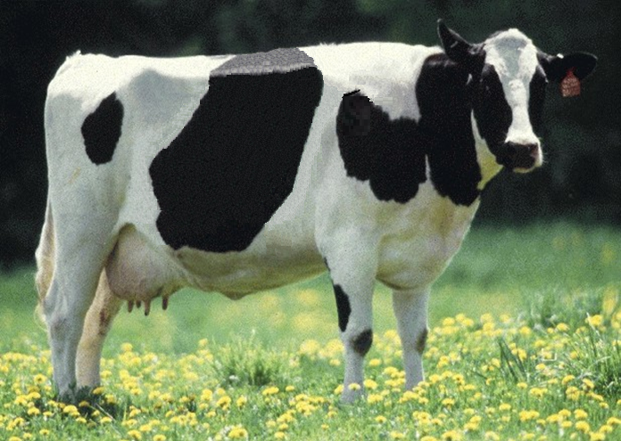
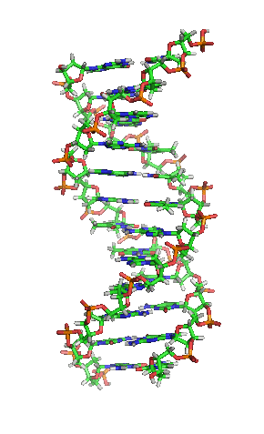
Calculation and delivery of US genomic evaluations for dairy cattle
Abstr. 152

Slide 2
New laboratory
Animal Improvement Programs Laboratory (AIPL) and Bovine Functional Genomics Laboratory (BFGL) were merged to form Animal Genomics and Improvement Laboratory (AGIL)
Animal Improvement Program (AIP) is one of 4 AGIL projects and continues in the same location with the same staff and some increase in funding
Dr. Erin Connor is AGIL Research Leader

Slide 3
AGIL sequencing collaborators
George Liu
Steve Schroeder
Tad Sonstegard
Curt Van Tassell

Slide 4
Collaboration with industry
Council on Dairy Cattle Breeding (CDCB) responsible for receiving data and for computing and delivering US genetic evaluations for dairy cattle
AIP responsible for research and development to improve the evaluation system
CDCB and AIP employees co-located in Beltsville
Dr. João Dürr is CDCB CEO

Slide 5
Council on Dairy Cattle Breeding
CDCB
PDCA
NAAB
DRPC
DHI
Purebred Dairy
Cattle Association
National Association of Animal Breeders
Dairy Records
Processing Centers
Dairy Herd
Information
3 board members from each organization
Total of 12 voting members
2 nonvoting industry members

Slide 6
Funding
CDCB evaluation calculation and dissemination funded by fee system
Based on animals genotyped
87% of revenue from bulls
Higher fees for herds that
contribute less information
AIP research and development funded by U.S. Federal Government
$

Slide 7
Accomplishments (last 12 mo)
Introduction of imputed indicators for inherited defects of dairy cattle
Introduction of genomic evaluations for Ayrshires
Discovery of additional haplotypes that affect fertility
Improved accuracy of genomic evaluations by an increase to 60,671 DNA markers
Improved weighting of cow evaluations
Multitrait traditional evaluations for heifer and cow conception rates

Slide 8
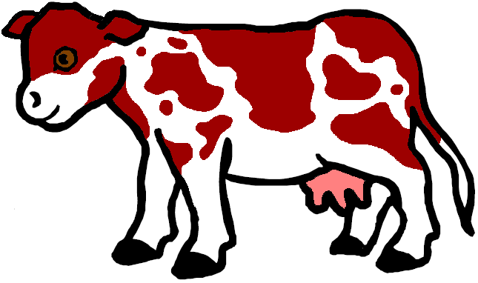
Gene tests (imputed and actual)
Bovine leucocyte adhesion deficiency (BLAD)
Complex vertebral malformation (CVM)
Deficiency of uridine monophosphate synthase (DUMPS)
Syndactyly (mulefoot)
Weaver Syndrome, spinal dismyelination (SDM), spinal muscular atrophy (SMA)
Red coat color
Polledness

Slide 9
New fertility haplotype for Jerseys (JH2)
Chromosome 26 at 8.8–9.4 Mbp
Carrier frequency
14–28% in decades before 1990
Only 2.6% now
Estimated effect on conception rate of –4.0% ± 1.5%
Additional sequencing needed to find causative genetic variant

Slide 10
Research projects
Discovery of causative genetic variants
Accounting for genomic pre-selection
Net merit update
Grazing index
Genomic mating program
Contribution of predictor population subsets
Preliminary evaluations when genotypes loaded

Slide 11
Genotypes received since July 2013
Breed | Female | Male | All animals | % female
Ayrshire | 1,359 | 229 | 1,588 | 86
Brown Swiss* | 892 | 6,253 | 7,145 | 12
Holstein | 172,956 | 31,657 | 204,613 | 85
Jersey** | 26,434 | 4,804 | 31,238 | 85
All | 201,641 | 42,943 | 244,584 | 82
*Includes >5,000 bulls added from Interbull in June 2014
**Includes 1,068 Danish bulls added in November 2013

Slide 12
Growth in bull predictor population
Breed | May 2014 | 12-mo gain
Ayrshire | 678 | 30
Brown Swiss | 5,862 | 366
Holstein | 25,276 | 2,361
Jersey | 4,262 | 1,391

Slide 13
Reliability gains
Reliability (%) | Ayrshire | Brown Swiss | Jersey | Holstein
Genomic | 37 | 54 | 61 | 70
Parent average | 28 | 30 | 30 | 30
Gain | 9 | 24 | 31 | 40
Reference bulls | 680 | 5,767 | 4,207 | 24,547
Animals genotyped | 1,788 | 9,016 | 59,923 | 469,960
Exchange partners | Canada | Canada, Interbull | Canada, Denmark | Canada, Italy, UK
SOURCE: VanRaden, Advancing Dairy Cattle Genetics: Genomics and Beyond presentation, Feb. 2014

Slide 14
Parent ages for marketed Holstein bulls

Slide 15
Genetic merit of marketed Holstein bulls
Average gain:
$85.60/year
Average gain:
$52.00/year
Average gain:
$19.77/year

Slide 16
Conclusions
Genomic evaluation has dramatically changed dairy cattle breeding
Rate of gain has increased primarily because of large reduction in generation interval
Genomic research is ongoing
Detect causative genetic variants
Find more haplotypes that affect fertility
Improve accuracy

Slide 17
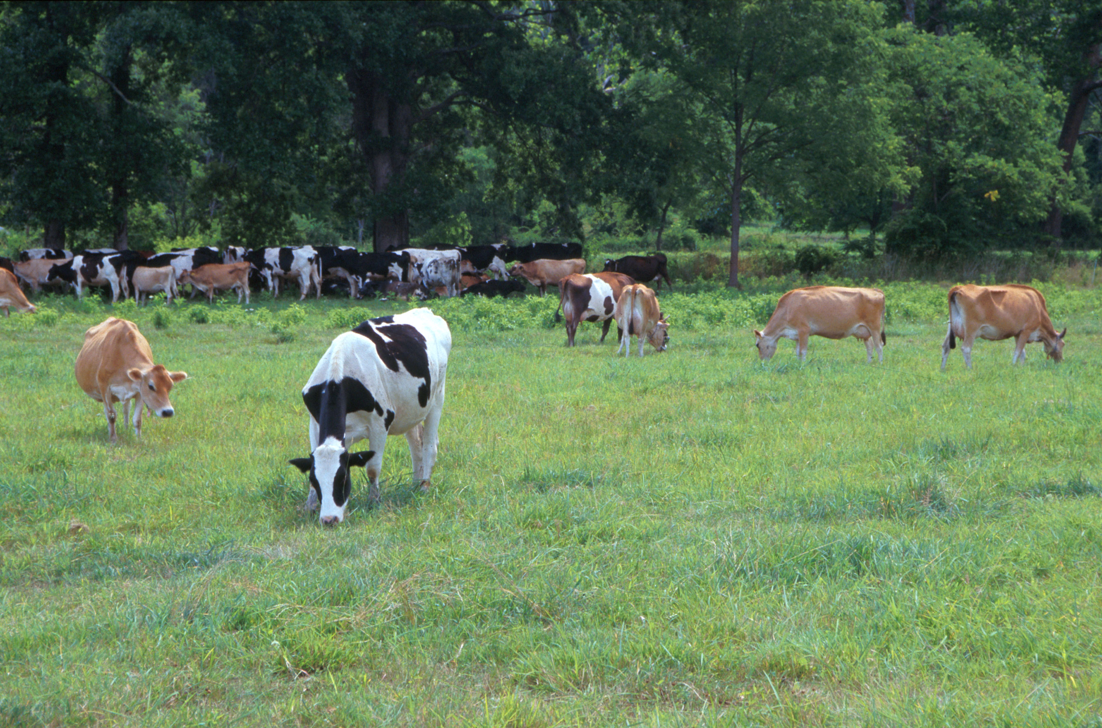
Questions?
AIP web site:
http://aipl.arsusda.gov
Holstein and Jersey crossbreds graze on American Farm Land Trust’s
Cove Mountain Farm in south-central Pennsylvania
Source: ARS Image Gallery, image #K8587-14; photo by Bob Nichols

