Slide 1

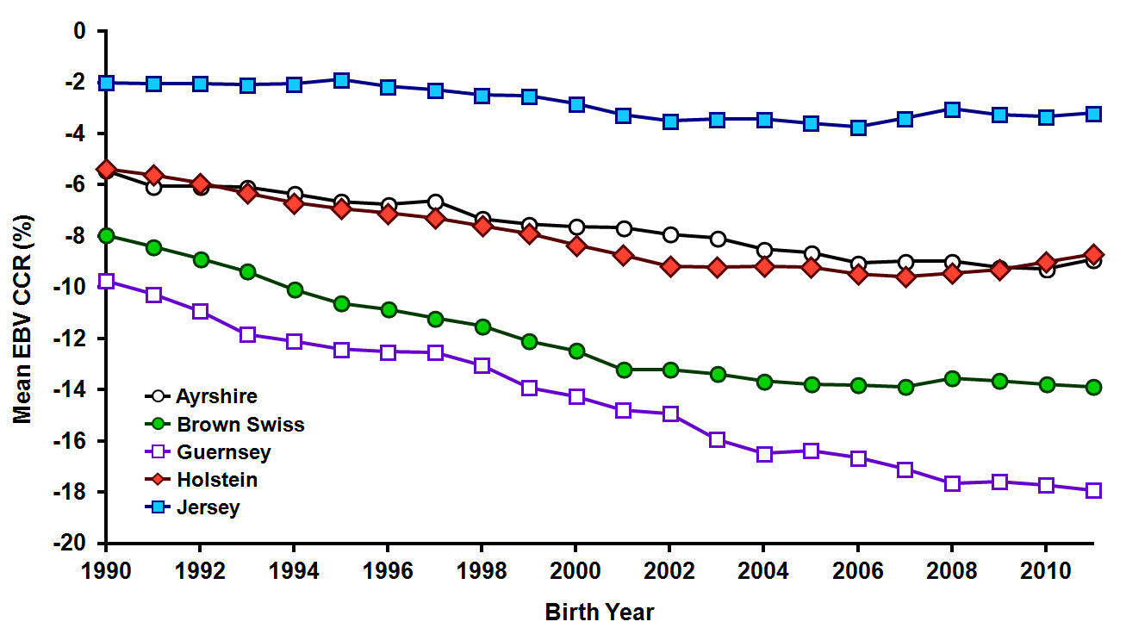

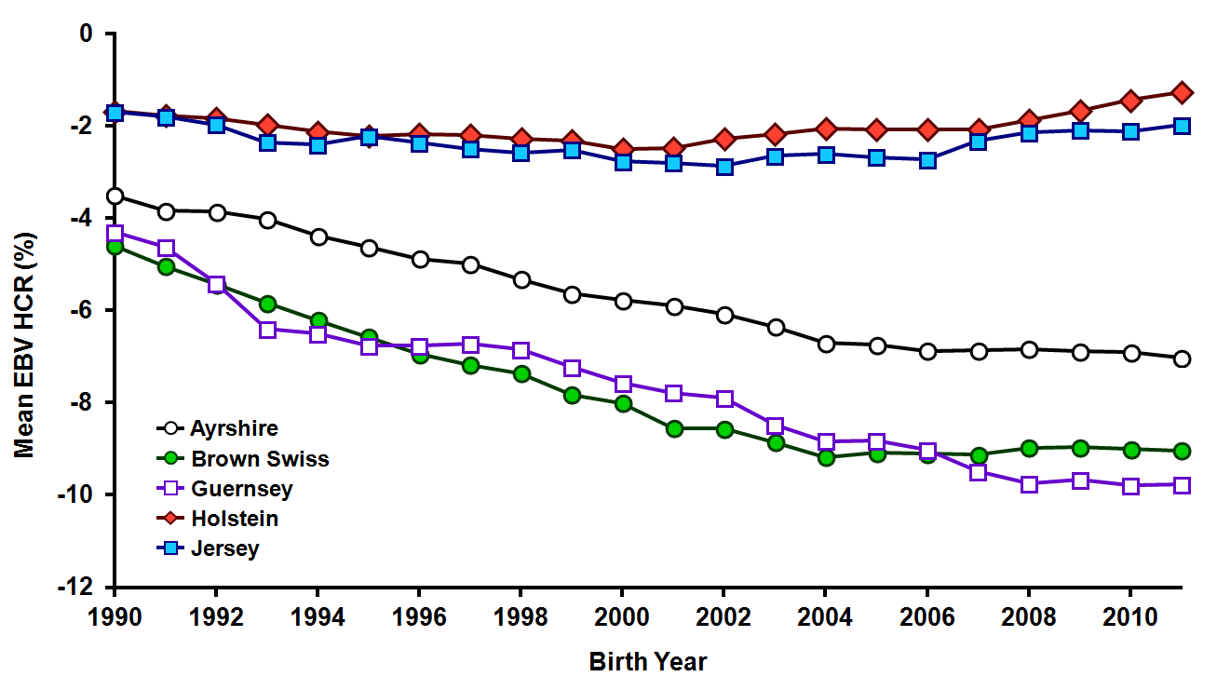
Multi-trait, multi-breed conception rate evaluations
P. M. VanRaden¹, J. R. Wright¹*, C. Sun², J. L. Hutchison¹ and M. E. Tooker¹
¹Animal Genomics & Improvement Laboratory, Agricultural Research Service, USDA, Beltsville, MD 20705-2350
²National Association of Animal Breeders, Columbia, MO 65205
Poster T044
Abstract #946
ADSA-ASAS-CSAS Joint Meeting
July 22, 2014, Kansas City, MO
http://aipl.arsusda.gov
INTRODUCTION
  Cow conception rate (CCR) and heifer conception rate (HCR) evaluations have been calculated since 2010
  Definitions:
    The percent of inseminated heifers (HCR) or cows (CCR) that become pregnant at each service
    Daughter pregnancy rate (DPR): The percent of non-pregnant cows that become pregnant in each 21-day time interval
  Previous model:
    Single breed BLUPF90 model software (Misztal). No crossbred cows included, only crossbred breeding
    Modeled with multiple binary success per lactation (e.g. no, no, yes)
    Model included adjustments for permanent environment, management group (herd-year-season-parity-registry status), year-state-month of breeding, service number, mating type, short cycle, age group at breeding and lactation number
    Breeding records only available since 2003
  New model:
    All breeds combined; crossbreds included
    Pre-adjusted for region-month of breeding, service number, mating type, short cycle effects and combined into a single lactation record
    Permanent environment and management group kept in the model
    Effects for inbreeding and heterosis added to the model
    DPR included as a correlated trait (data available since 1960)
DATA & METHODS
US national dairy database as of August 2013
Individual breeding records combined to create 13 million CCR lactation records, 3.8 million HCR records
66 million DPR records (correlated trait)
Pedigree records (64.9 million) included old, young and disconnected animals not included previously
Birth year groups before 2000 were combined
Model included:
  27 million permanent environment effects
  6.8 million herd management groups
  274,795 heifer management groups
  495 age-parity groups
  5 parity groups
  6 heifer age groups
  300 unknown parent groups
  2 regressions for inbreeding and heterosis
RESULTS (cont.)
FUTURE / ADDITIONAL WORK
  Correlations of previous evaluation and single trait (ST) and multi-trait (MT) model evaluation for HCR and CCR for bulls born 1996 or later with >50% reliability
Additional models combining 6 other traits (milk, fat, and protein yield, somatic cell score, productive life and DPR) were run with the new software on 76.8 million lactations and compared with previous results
All-breed models and genetic parameters were similar to those used in current software
Trait / Breed | Correlation with previous evaluation |  |  |  | Correlation of ST and MT EBV from new software | Number of bulls
 | All-breed ST |  | All-breed MT
HCR:
Holstein | 0.980 |  | 0.961 |  | 0.986 | 2,107
Jersey | 0.910 |  | 0.892 |  | 0.988 | 157
Brown Swiss | 0.954 |  | 0.957 |  | 0.999 | 7
CCR:
Holstein | 0.973 |  | 0.952 |  | 0.958 | 15,556
Jersey | 0.943 |  | 0.904 |  | 0.954 | 1,390
Brown Swiss | 0.880 |  | 0.859 |  | 0.961 | 122
  Correlations of previous evaluation and single and multi-trait model evaluation from new software for 9,476 Holstein* bulls born 2000-2008 with >50 daughters
Trait | Correlation with previous evaluation |  |  | Correlation of ST and MT EBV from new software
 | ST |  | MT
Milk | 0.996 |  | 0.994 | 0.998
Fat | 0.996 |  | 0.994 | 0.998
Protein | 0.995 |  | 0.993 | 0.998
Somatic cell score | 0.999 |  | 0.996 | 0.996
Dau preg. rate | 0.995 |  | 0.971 | 0.976
Productive life (ST) | 0.988 |  | 0.951 | 0.974
Productive life (MT) | 0.967 |  | 0.967 | 0.974
RESULTS
Genetic trends by breed for CCR on all-breed scale
Multi-trait genetic correlations (above diagonal), heritabilities (on diagonal), and phenotypic correlations (below diagonal)
Phenotypic and breeding value means for conception rate of heifers and cows born in 2005 expressed as a difference from Holsteins
* Other breeds slightly lower
Correlations were higher between previous and ST because previous evaluations were ST
 | HCR | CCR | DPR
HCR | 0.01 | 0.45 | 0.36
CCR | 0.10 | 0.016 | 0.86
DPR | 0.10 | 0.70 | 0.04
Genetic trends by breed for HCR on all-breed scale
CONCLUSIONS
Multi-trait processing with DPR makes CCR and HCR more accurate
Multi-breed processing allows CCR and HCR evaluations to be available for crossbred animals
The new software allows for different models for different traits and enables easier testing of potential changes to model
Implementation of new software for a MT model for fertility traits was initiated in December 2013
Implementation is scheduled to begin later this year of a multi-trait yield model, and single trait models for somatic cell score and productive life
A remaining challenge is to affordably include genotype information in the software
Breed | Females with records (no.) |  |  |  | Phenotypic mean (%) |  |  |  | Breeding value mean (%)
 | HCR |  | CCR |  | HCR |  | CCR |  | HCR |  | CCR
Holstein | 302,007 |  | 543,491 |  | 56.0 |  | 31.8 |  | 0.0 |  | 0.0
Jersey | 11,533 |  | 32,007 |  | 50.9 |  | 37.8 |  | −0.8 |  | +5.7
Brown Swiss | 1,620 |  | 4,449 |  | 44.1 |  | 28.3 |  | −7.1 |  | −4.5
Guernsey | 612 |  | 1,742 |  | 44.8 |  | 26.1 |  | −6.7 |  | −7.1
Ayrshire | 574 |  | 1,444 |  | 47.6 |  | 38.1 |  | −4.7 |  | +0.7
Milking Shorthorn | 422 |  | 836 |  | 47.4 |  | 40.4 |  | 0.0 |  | +4.0
OBJECTIVES
Compare the accuracy of conception rate evaluations from the previous (BLUPF90) and the new software
Examine applications of new software to other traits
All breeds passed Interbull method 1 trend test for CCR and all passed method 3 for CCR and HCR, except for Ayrshire CCR
Estimated genetic correlations with other Interbull countries were similar for Holstein; slightly different for other breeds

