Slide 1
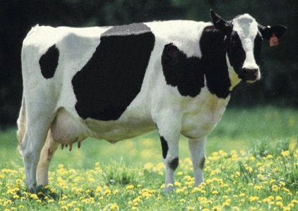
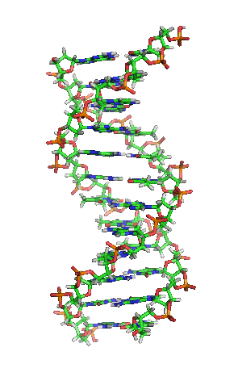
Effect of increasing the number of SNP from
60,000 to 85,000 in genomic evaluation of Holsteins Abstr. 537

Slide 2
Why more SNPs?
Accuracy of genomic evaluations should improve if more SNPs track causative genetic variants better
Improving chip technology provides more SNPs for the same price
Improving computer technology and methods enable processing more SNPs
Sequence data provides more SNPs

Slide 3
History of reasons for SNP set changes
Create a single list across breeds
Remove poor performing SNPs
Change in SNP selection criteria
Update in assembly changing SNP locations
Add QTLs as discovered
Change in SNP set prevents use of prior haplotype library (takes over a week for Holsteins)

Slide 4
Background
Bead pool for GeneSeek’s Genomic Profiler HD (77K) chip nearing exhaustion
GeneSeek willing to consider substantial increase in SNP count
How many SNPs to add?
  30,000 for backward compatibility
  Up to 140K for improved accuracy
  Avoid increase in cost from additional SNPs

Slide 5
Which SNPs to add?
  50K SNPs not on 77K chip
  SNPs from LD chips
  SNPs with lower MAF to track causative variants better
  Specific SNPs suggested by research
  Possible functional mutations

Slide 6
Issues in adding SNPs
Will added SNPs increase accuracy enough to overcome imputation errors?
  As genotypes accumulate, problem decreases
Which SNPs should be included?
  Are all new SNPs equally valuable?
  Should all SNPs currently being used be retained?

Slide 7
140K chip
GeneSeek decided to include 140,000 SNPs
Delivery began in April 2015
138,942 SNPs routinely provided

Slide 8
How to benefit from 140K chip
Change SNPs used in evaluation
  Add informative SNPs from 140K
  Replace SNPs with little effect with more informative SNPs
Use only SNPs on 140K chip or widely used LD chips
Initial set of 85,000 reduced to 77,327 to minimize increase in processing time

Slide 9
Plan
Run genomic evaluation with 134,511 SNPs
Choose SNPs among those with largest effect for some breed-trait combination
  Top 5,000 for Holsteins
  Top 1,000 for Jerseys
  Top 500 for Brown Swiss and Ayrshires
Cutoff study using August 2011 data to predict April 2015 performance

Slide 10
Chips, SNPs, and genotypes for testing
Chip | SNP |  |  |  | Genotypes
 | No. |  | % of all |  | No. |  | % of all
BovineSNP50 | 32,093 |  | 41.5 |  | 51,882 |  | 6.58
BovineSNP50-v2 | 31,708 |  | 41.0 |  | 64,967 |  | 8.23
Bovine3K | 2,675 |  | 3.5 |  | 48,401 |  | 6.13
BovineHD | 73,896 |  | 95.6 |  | 2,485 |  | 0.31
Affymetrix | 32,160 |  | 41.6 |  | 19 |  | 0.00
BovineLD | 6,819 |  | 8.8 |  | 154,313 |  | 19.56
GeneSeek Genomic Profiler | 8,148 |  | 10.5 |  | 48,806 |  | 6.19
GeneSeek Genomic Profiler-HD | 48,496 |  | 62.7 |  | 27,249 |  | 3.45
Gene Seek Genomic Profiler-v2 | 11,516 |  | 14.8 |  | 77,359 |  | 9.80
Zoetis LD | 10,373 |  | 13.4 |  | 105,906 |  | 13.42
Zoetis MD | 28,949 |  | 37.4 |  | 2,568 |  | 0.33
European LD | 7,671 |  | 9.9 |  | 786 |  | 0.10
BovineLD-v2 | 6,833 |  | 8.8 |  | 12,314 |  | 1.56
Gene Seek Genomic Profiler-v3 | 16,600 |  | 21.5 |  | 65,150 |  | 8.26
Zoetis LD-v2 | 11,540 |  | 14.9 |  | 126,201 |  | 16.00
Zoetis MD-v2 | 30,081 |  | 38.9 |  | 318 |  | 0.04
GeneSeek Genomic Profiler-HD-v2 | 76,374 |  | 98.8 |  | 268 |  | 0.03
All | 77,327 |  | 100.0 |  | 788,892 |  | 100.00

Slide 11
Holstein genomic evaluation reliabilities
Trait | Reliability (%) |  |  |  | Reliability gain (77K – 61K)
 | 61K |  | 77K
Milk yield | 71.2 |  | 72.9 |  | 1.7
Fat yield | 71.3 |  | 72.6 |  | 1.3
Protein yield | 64.1 |  | 65.5 |  | 1.4
PL | 67.4 |  | 69.1 |  | 1.7
SCS | 70.6 |  | 71.4 |  | 0.8
DPR | 60.8 |  | 62.4 |  | 1.6
Final score | 62.7 |  | 63.8 |  | 1.1
Stature | 72.2 |  | 73.5 |  | 1.3
All traits | 67.1 |  | 68.5 |  | 1.4

Slide 12
Jersey genomic evaluation reliabilities
Trait | Reliability (%) |  |  |  | Reliability gain (77K – 61K)
 | 61K |  | 77K
Milk yield | 54.8 |  | 54.9 |  | 0.1
Fat yield | 57.0 |  | 57.5 |  | 0.5
Protein yield | 53.2 |  | 53.6 |  | 0.4
PL | 61.6 |  | 61.9 |  | 0.3
SCS | 55.8 |  | 56.3 |  | 0.5
DPR | 41.2 |  | 41.2 |  | 0.0
Final score | 54.0 |  | 54.6 |  | 0.6
Stature | 64.2 |  | 65.2 |  | 1.0
All traits | 57.7 |  | 58.3 |  | 0.6

Slide 13
Future
When causative genetic variants are discovered and placed on chips, SNPs will be added when enough genotypes exist to support imputation
As cost/SNP genotype declines, benefit from larger SNP sets will be evaluated
Lower-cost sequence data expected to accelerate discovery of causative genetic variants

Slide 14
Conclusions
Mean gain in reliability across traits of 1.4 percentage points for Holsteins
Before implementation of 77K SNPs, CDCB will conduct timing tests and acceptance testing of change impact

