Slide 1
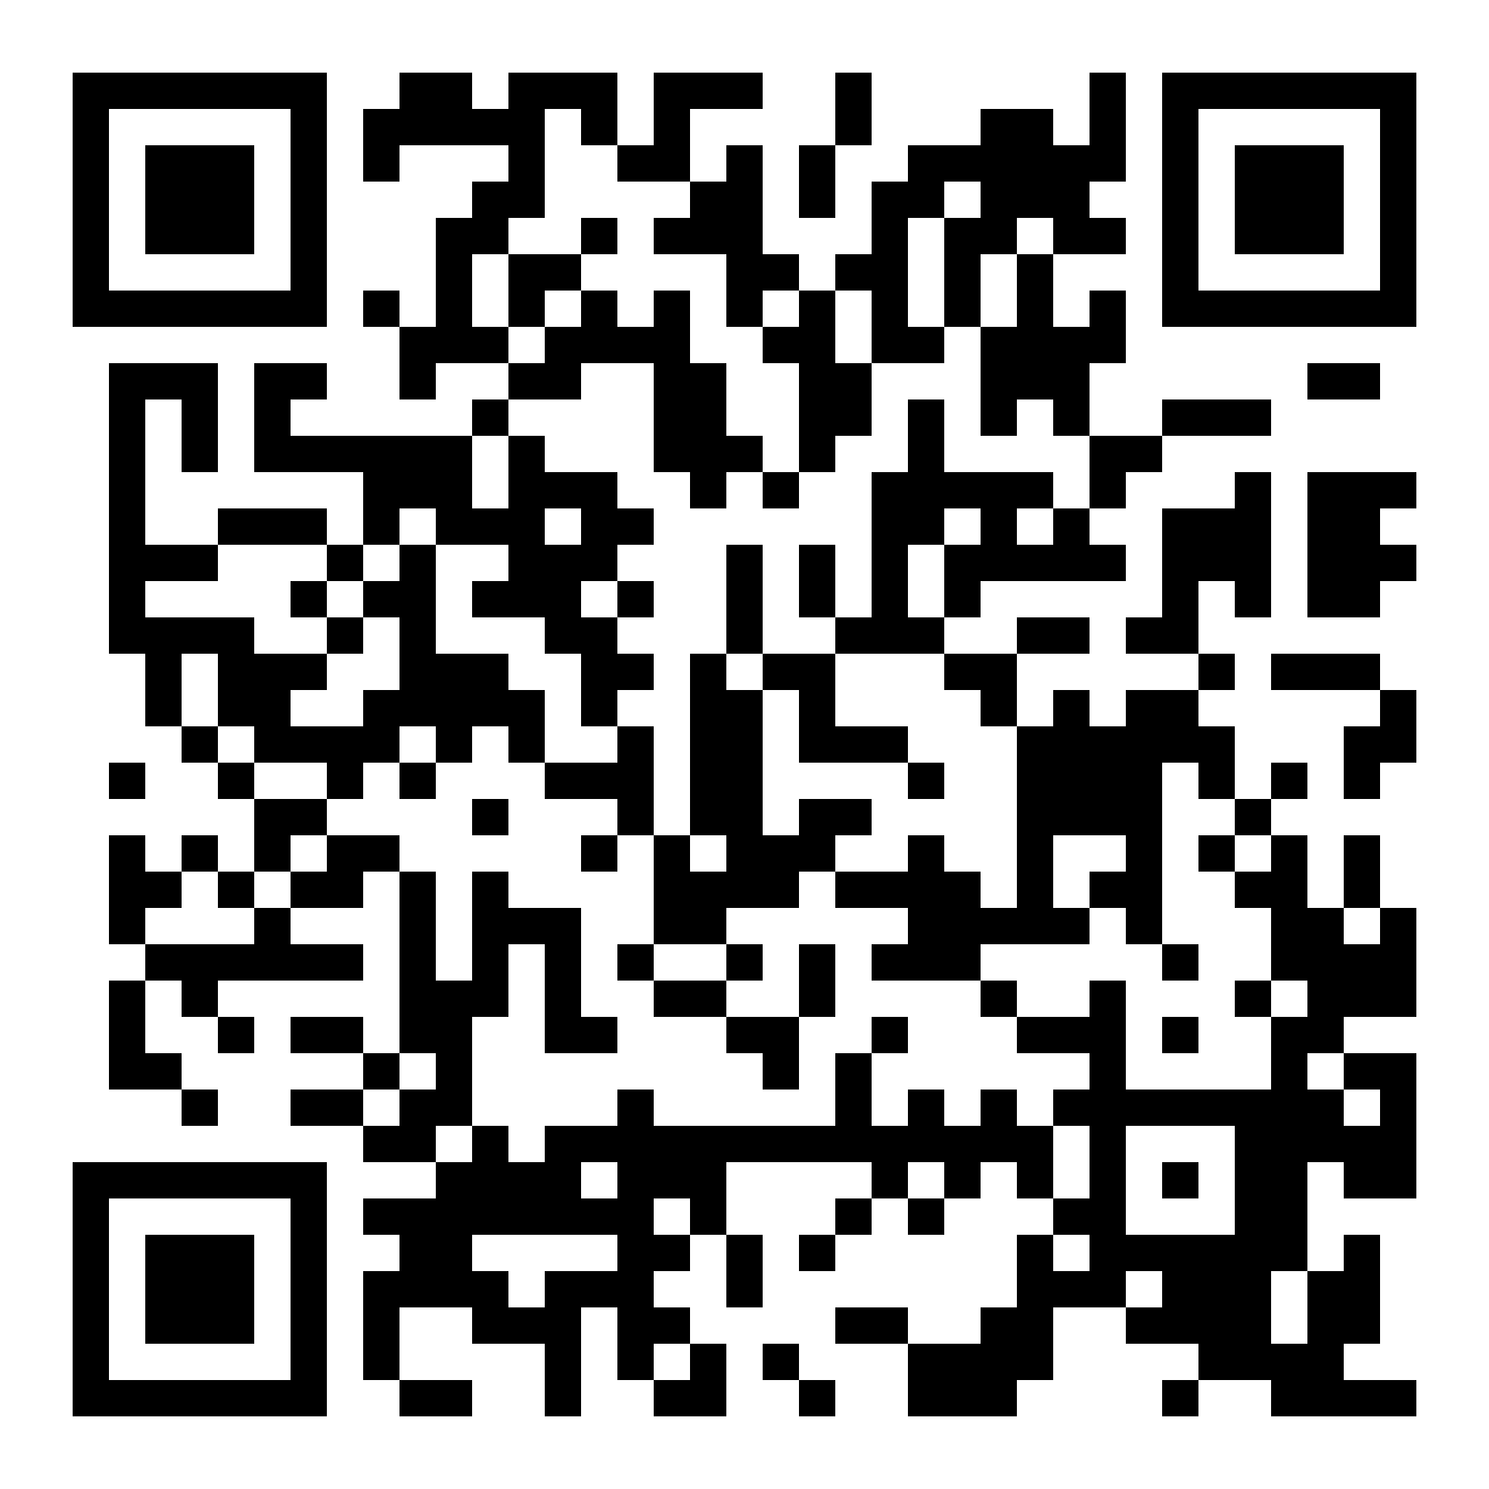
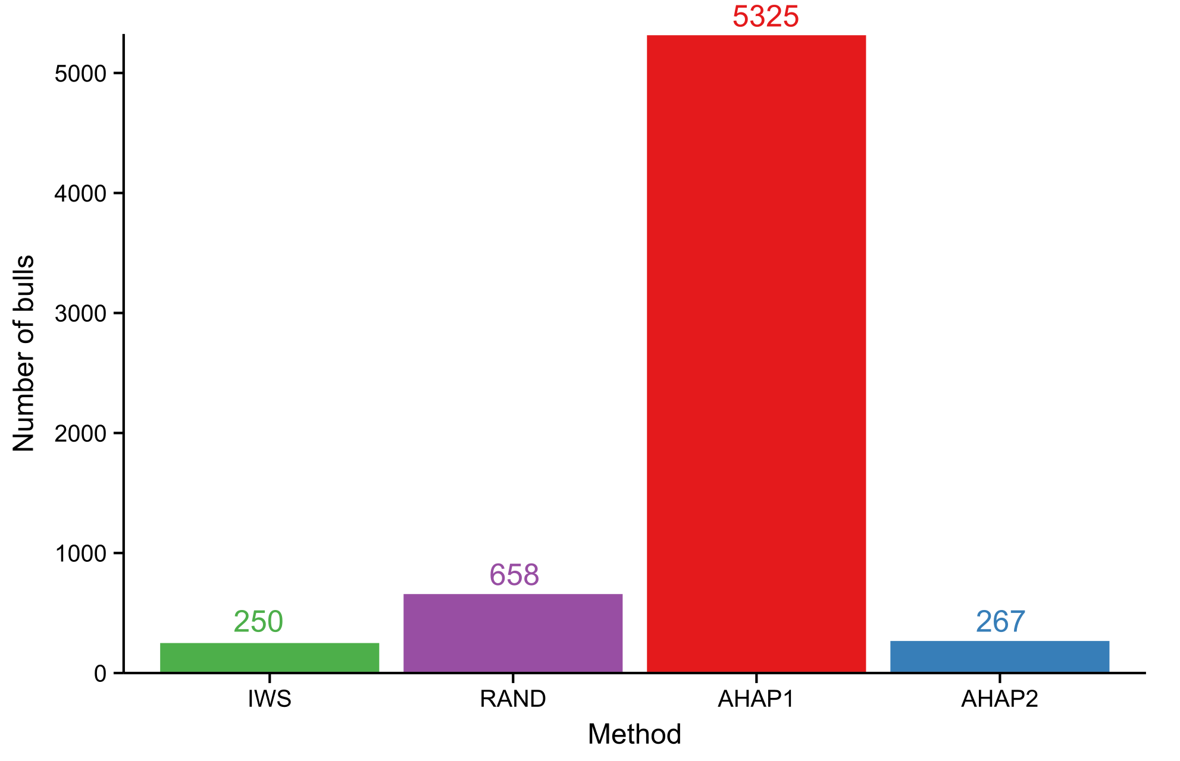
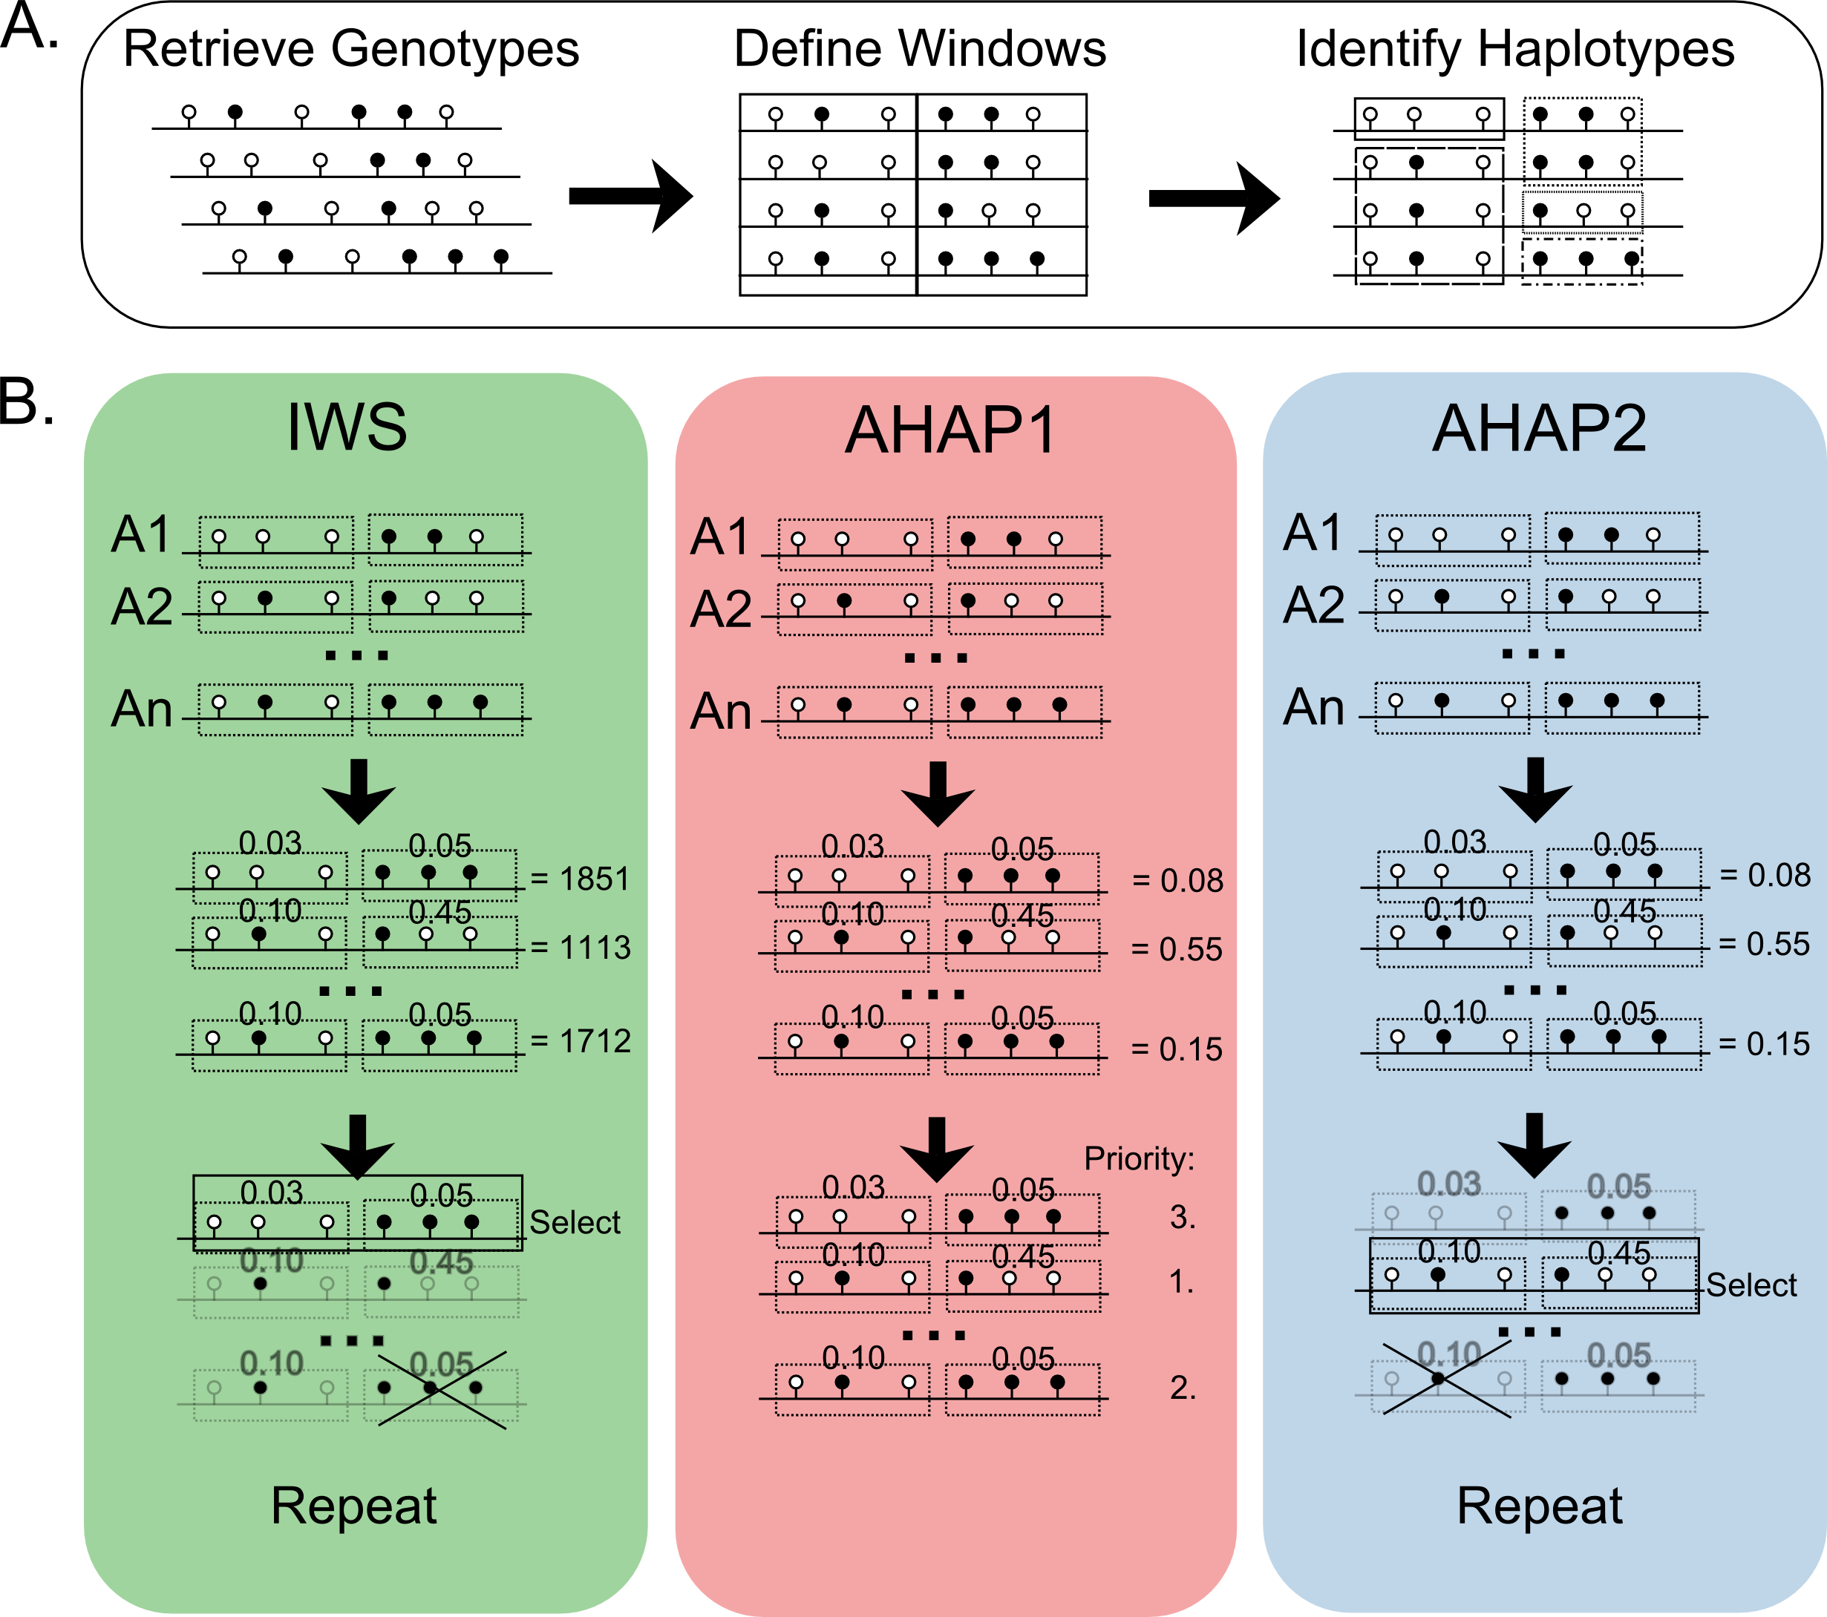
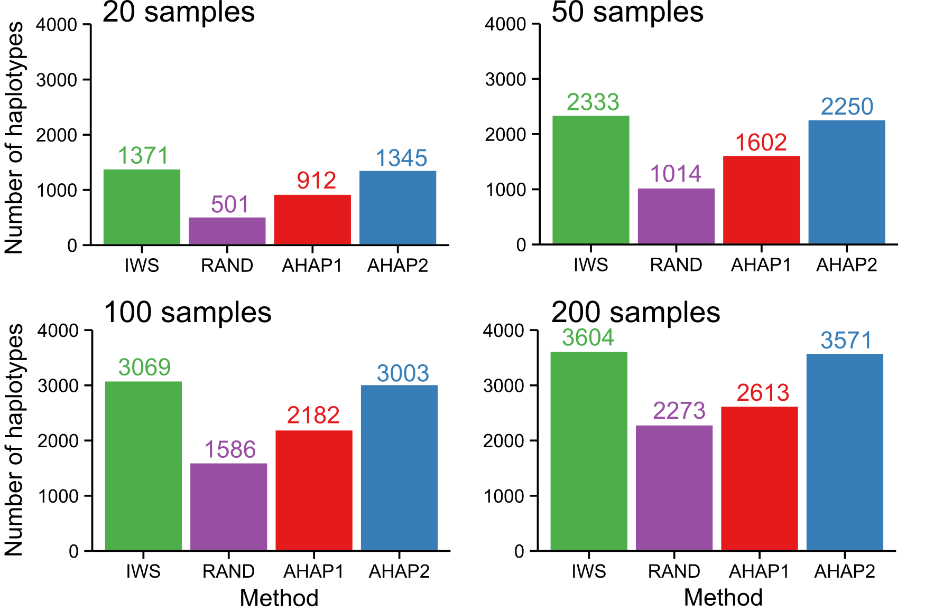
Animal selection for whole-genome sequencing by quantifying the unique contribution of homozygous haplotypes sequenced
D. M. Bickhart, J. B. Cole, and J. L. Hutchison*
Animal Genomics and Improvement Laboratory, Agricultural Research Service, USDA, Beltsville, MD 20705-2350
Poster W86
Abstract #64193
2015 ADSA-ASAS Joint Meeting
http://aipl.arsusda.gov
INTRODUCTION
Major whole genome sequencing projects promise to identify rare and causal variants within livestock species; however, the efficient selection of animals for sequencing remains a major problem.
RESULTS
DISCUSSION
Number of bulls needed to sequence in order to account for all 3,680 unique homozygous haplotypes in the U.S. national database
IWS had the least number of bulls followed by AHAP2 and RAND methods
AHAP2 was a big improvement over AHAP1, dropping nearly 20x the number of bulls needed to sequence
AHAP1 required the highest number of bulls to select all haplotypes
At a cost of $920 to sequence each animal at 10x coverage, the total cost for the IWS method is $230,000, saving $15,640 compared to using the AHAP2 method
Number of rare haplotypes (≤ 4% freq)
Selecting rarer haplotypes, incidentally, is a sign of efficiency
AHAP1 had the highest number of rare haplotypes but required sequencing far more animals to do so
IWS had the highest ratio of rare haplotypes discovered compared to number of bulls, and was the most efficient
Completion strategy
Compared the number of unique haplotypes for each method when a specific number of animals were sequenced
For budgeting purposes and multi-year projects
IWS showed the greatest number of haplotypes at each completion strategy
When 50 animals were sequenced, more than 60% of the total number of targeted haplotypes were covered (83% for 100 animals and 98% for 200 animals)
AHAP2 had the second highest number of haplotypes at each completion strategy
Number of bulls that were selected by each method to account for all 3,680 homozygous haplotypes in the U.S. national database
OBJECTIVES
To develop a library of high accuracy genetic variants found within diverse haplotypes using an inverse weight function
To select an effective number of unique homozygous haplotypes with the fewest number of animals
DATA & METHODS
A. Data from U.S. national database
484,522 genotyped Holstein animals
3,680 haplotypes (75 SNP) were targeted
Methods
IWS: Inverse weight selection = 1000 * freq² - 2000 * freq + 1000
RAND: Randomly selecting animals, an average of 10 replicate trials
AHAP1: Maximizing haplotypes coverage from the population [1]
AHAP2: A modified version of AHAP1 with recursion
All methods used the following edits:
Homozygous haplotypes with > 4% frequency
Imputed haplotypes and 3K chips removed from consideration
Homozygous haplotypes from previously sequenced animals removed from consideration
Number of "incidental" rare haplotypes (≤ 4% freq) that were discovered by each method by accident
Method | Number of rare haplotypes | Ratio of rare haplotypes and number of bulls
IWS | 3,400 | 13.6
RAND | 5,094 | 7.7
AHAP1 | 6,362 | 1.2
AHAP2 | 3,367 | 7.6
The most efficient discovery of rare haplotypes
Diagram of animal selection algorithms
Number of unique homozygous haplotypes (> 4% freq) using a completion strategy
At 20% of the animals sequenced, more than 60% of the total number of targeted haplotypes were covered
CONCLUSIONS
Benefits of calculating an iterative summed score based on the inverse value of an animal’s unsequenced haplotypes:
Quickly determine the value of sequencing a new individual
Avoid sequencing redundancy in highly related populations
Obtain a high number of rare haplotypes
REFERENCES
¹Druet. T., I.M. Macleod, and B.J. Hayes. 2014. Heredity. 112:39-47.
ACKNOWLEDGEMENTS
Bickhart and Hutchison were supported by USDA CRIS project 1265-31000-101-00D. Bickhart was also supported by USDA CRIS project 1265-31000-104-00D. Part of this project was also supported by USDA NIFA grant project number: 2015-67015-22970.

