Slide 1
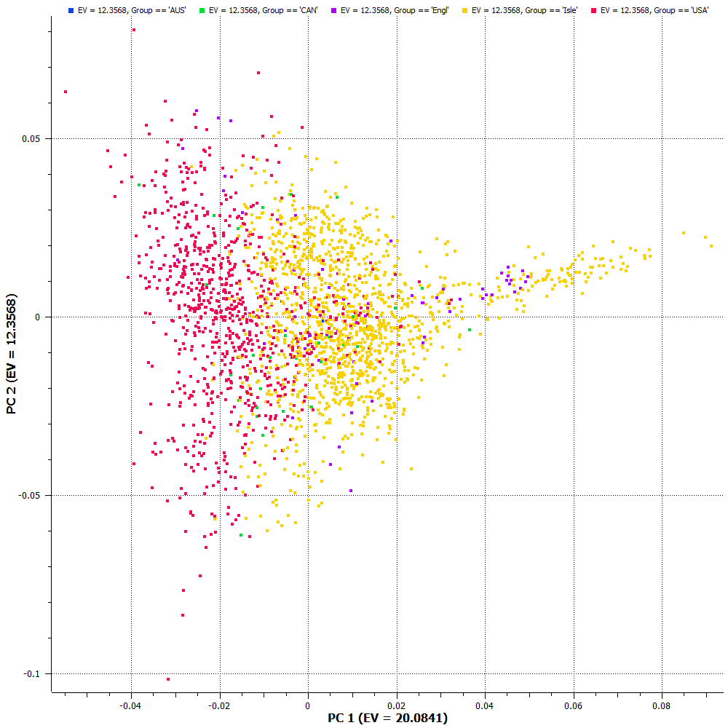
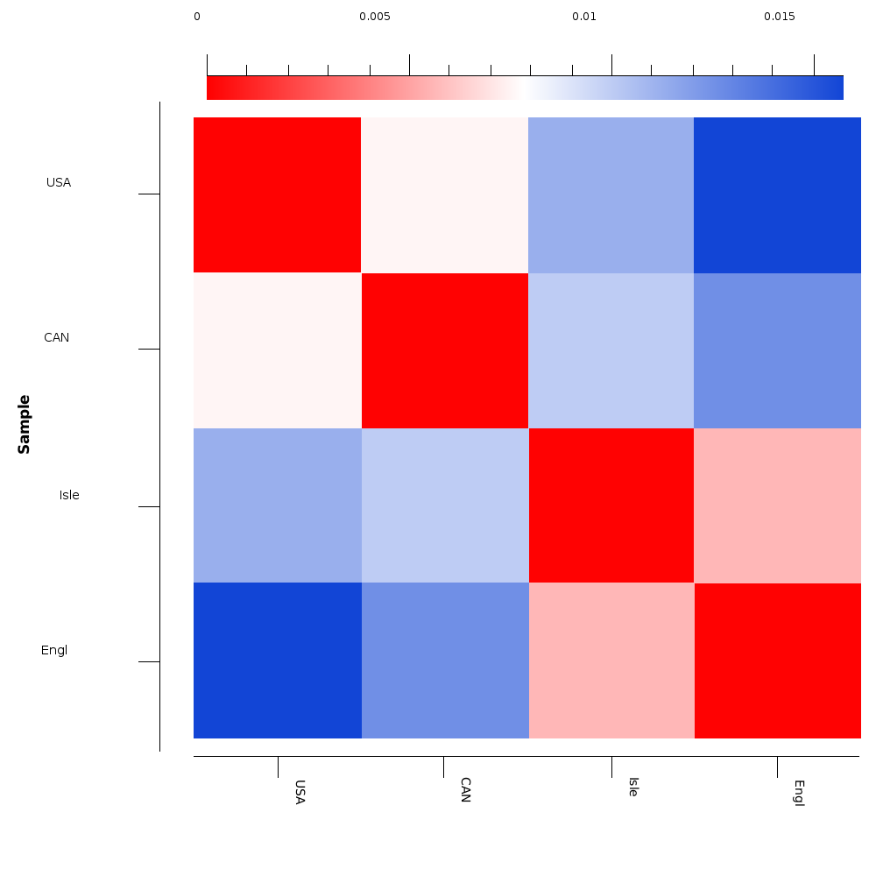
Genomic evaluation, breed identification, and population structure of North American,
English and Island Guernsey dairy cattle
T. A. Cooper*¹, S. A. E. Eaglen², G. R. Wiggans¹, J. Jenko², H. J. Huson³, D. M. Morrice⁴, M. Bichard⁵, W.G. de L. Luff⁶, and J. A. Woolliams²
¹Animal Genomics and Improvement Laboratory, Agricultural Research Service, USDA, Beltsville, MD 20705-2350
²The Roslin Institute, Royal (Dick) School of Veterinary Studies, University of Edinburgh, Easter Bush, Midlothian EH25 9RG, United Kingdom
³Department of Animal Science, Cornell University, Ithaca, NY 14853
⁴Edinburgh Genomics, Ashworth Laboratories, The University of Edinburgh, Edinburgh, EH9 3JT, United Kingdom
⁵English Guernsey Cattle Society, Launceston, Cornwall PL15 9DP, United Kingdom
⁶World Guernsey Cattle Federation, Castel, Guernsey GY5 7JD, Channel Islands
T88
#62986
INTRODUCTION
Genomic evaluations of dairy cattle in the United States have been available for Brown Swiss, Holsteins, and Jerseys since 2009 and for Ayrshires since 2013.
As of February 2015, 2,281 Guernsey bulls and cows had genotypes from collaboration between the United States, Canada, England, and the island of Guernsey; contributions from England and the island of Guernsey were made possible by the European Commission’s Gene2Farm project.
RESULTS
Gain in reliability over parent average, averaged across 10 trials and standard deviations for Guernsey yield, functional and confirmation traits.
Principle components analysis (PCA) of North American, Island and English Guernsey
PC1 versus PC2
Traits | Parent Average | Gain in Reliability | Standard Deviation
Milk | 32.4 | 4.3 | 7.1
Fat | 36.6 | 1.6 | 6.3
Protein | 32.9 | 1.0 | 6.7
Fat % | 36.5 | 24.2 | 9.9
Protein % | 32.9 | 18.1 | 9.3
Yield Trait Average |  | 9.8
Productive Life | 32.7 | 22.4 | 12.1
Somatic Cell Score | 32.7 | 0.9 | 10.7
Daughter Pregnancy Rate | 30.7 | 3.8 | 11.1
Functional Trait Average |  | 9.0
Final Score | 36.6 | 12.4 | 4.0
Stature | 39.3 | 24.0 | 5.4
Strength | 37.8 | 25.1 | 11.3
Dairy Form | 38.2 | 21.1 | 6.3
Foot Angle | 34.9 | 15.0 | 5.9
Rear Legs (side) | 36.1 | 4.1 | 6.0
Rump Angle | 38.6 | 10.3 | 7.0
Rump Width | 38.2 | 24.8 | 5.3
Fore Udder Attachment | 38.0 | 22.1 | 4.7
Rear Udder Height | 37.7 | 14.7 | 6.1
Udder Depth | 38.6 | 21.8 | 4.0
Udder Cleft | 35.2 | 17.1 | 8.5
Front Teat Placement | 36.1 | 20.3 | 9.6
Teat Length | 36.4 | 7.5 | 4.9
Conformation Trait Average |  | 17.2
Overall Average |  | 14.4
Eng
CAN
USA
Isle
DATA & METHODS
Genomic evaluations based on 60K SNP were calculated using methods of VanRaden, 2008.
Evaluation accuracy was assessed using 4-fold cross-validation, where 25% of bulls were designated as the validation set and all cows and the remaining bulls were the training set.
Cross-validation was repeated 10-fold, and gains in reliability over parent average were averaged.
Twenty-two traits were analysed: 5 yield traits, 3 functional traits, and 14 conformation traits.
Breed specific SNP were determined by comparing the allele frequencies of Guernsey genotyped animals to allele frequency found in Holstein, Jersey, Brown Swiss and Ayrshire.
Haplotypes affecting fertility were identified by investigating areas of the genome with a lack of expected homozygous haplotypes (VanRaden et al., 2011).
Fixation index (F_{ST}) of
North American, Island and English Guernsey
0.008
0.016
0.011
0.010
0.013
0.006
Single nucleotide polymorphisms used for Guernsey breed and their homozygous genotype frequencies for Holstein, Jersey, Brown Swiss, Ayrshire and Guernsey
*Lower values indicate closer relationship
SNP Name | Homozygous genotype frequency (%)
 | Holstein |  | Jersey |  | Brown Swiss |  | Ayrshire |  | Guernsey
 | AA | BB | AA | BB | AA | BB | AA | BB | AA | BB
BTB-00157833 | 17 | 34 | 0 | 85 | 21 | 29 | 9 | 50 | 90 | 1
ARS-BFGL-NGS-119744 | 18 | 33 | 2 | 73 | 15 | 36 | 21 | 28 | 93 | 0
BovineHD0500031803 | 17 | 34 | 20 | 30 | 7 | 53 | 18 | 36 | 94 | 0
Hapmap43470-BTA-114677 | 6 | 57 | 3 | 69 | 0 | 100 | 3 | 71 | 91 | 0
BTA-26162-no-rs | 14 | 39 | 12 | 44 | 30 | 20 | 6 | 54 | 90 | 0
BovineHD0600016649 | 25 | 25 | 26 | 25 | 47 | 9 | 23 | 29 | 0 | 95
Hapmap38986-BTA-80731 | 42 | 11 | 32 | 21 | 43 | 11 | 23 | 26 | 0 | 96
ARS-BFGL-NGS-35201 | 47 | 9 | 61 | 5 | 24 | 26 | 36 | 17 | 1 | 92
BovineHD0800006578 | 50 | 9 | 21 | 28 | 46 | 10 | 46 | 11 | 0 | 97
ARS-BFGL-NGS-113446 | 35 | 17 | 42 | 12 | 68 | 2 | 37 | 14 | 0 | 95
ARS-BFGL-NGS-115008 | 28 | 21 | 39 | 13 | 40 | 15 | 81 | 1 | 2 | 93
ARS-BFGL-NGS-10428 | 39 | 14 | 25 | 24 | 21 | 29 | 45 | 12 | 0 | 97
UA-IFASA-6619 | 3 | 69 | 23 | 26 | 19 | 48 | 5 | 61 | 94 | 0
ARS-BFGL-NGS-114087 | 26 | 24 | 38 | 14 | 58 | 5 | 54 | 7 | 0 | 91
BovineHD1300024905 | 26 | 23 | 19 | 32 | 17 | 34 | 16 | 39 | 94 | 1
ARS-BFGL-NGS-27072 | 9 | 48 | 30 | 21 | 7 | 56 | 29 | 23 | 96 | 0
BovineHD1600011268 | 17 | 36 | 24 | 25 | 22 | 27 | 29 | 21 | 95 | 0
ARS-BFGL-NGS-116491 | 2 | 72 | 24 | 27 | 10 | 47 | 7 | 54 | 93 | 0
BovineHD2200010169 | 61 | 5 | 29 | 20 | 19 | 29 | 23 | 27 | 0 | 92
BTB-00869068 | 29 | 21 | 17 | 34 | 3 | 69 | 28 | 21 | 93 | 0
DISCUSSION and CONCLUSION
Across all traits, mean gain in reliability over parent average was 14.4 percentage points; corresponding gains for Ayrshires, Brown Swiss, Holsteins, and Jerseys were 9, 24, 40, and 31 percentage points, respectively calculated using traditional 4 year cut off studies.
For Guernsey, the highest gains were for strength (25.1), rump width (24.8), and fat percentage (24.2), and the lowest gains were for somatic cell score (0.9), protein yield (1.0), and fat yield (1.6).
Twenty-one single nucleotide polymorphisms were useful for Guernsey breed determination and are used in routine genotype quality control to confirm breed and identify crossbreds.
No haplotypes affecting fertility were identified in Guernsey
PCA1 shows divergence of US and Island Guernsey populations. The overlap of populations indicates the presence of gene flow.
REFERENCES
VanRaden, P.M. J. Dairy Sci. 91(11):4414-4423. 2008.
VanRaden, P.M., Olson, K.M., Null, D.J., and Hutchison, J.L. J. Dairy Sci. 94(12):6153–6161. 2011.
ACKNOWLEDGEMENTS
The authors would like to acknowledge the European Union’s Seventh Framework Programme for research, technological development and demonstration under grant agreement n° 289592 - Gene2Farm as well as Select Sires and the US Guernsey Association for their contributions to the project.

