Slide 1
Selection of sequence variants to improve dairy cattle genomic predictions
Abstr. 15440

Slide 2
Genetic markers in genomic selection
Notes:
April 2016 CDCB used 60,671 snp. Not an actual SNP chip, but 50K and lower chips imputed up to 60K

Slide 3
1000 Bulls Genome Project
1000 bull genomes project is a cooperative, international sequencing project that seeks to pool resources in order to impute sequence-derived genetic variants across a wide range of cattle breeds
To join the project you are required to contribute a minimum of 25 animals sequenced at 10.5X coverage and be approved by the project steering committee
Increasing size of dataset greatly increases variant calling runtimes (see VanRaden et al.'s presentation)
Notes:
The USA contributed 72 total bulls to the project, 26 were Holstein

Slide 4
1000 Bulls Genome Project (continued)
Sequence alignment map created according to set specifications and collected from partners
SAMtools identifies SNP and indels and produces genotype probabilities
Project used heavily processed and hard filters
Developing field, no ‘gold’ standard as to best way to select variants
Notes:
SAM (Sequence Alignment/Map), BAM (Binary Alignment/Map)

Slide 5
SNP vs Sequence (SEQ) variants
Single base substitutions (SNPs), where one letter (A, C, G, or T) replaces another
Previous SNP chips only include these
SEQ data has many insertions/deletions (indels)
Many lengths of indels
Other variant classes, such as Copy Number Variants, were not identified from the raw data
Notes:
Other examples; inversions, translocations, fusions, stop gain, upstream, downstream and many others. Most indels over 50bp can be considered structural variations

Slide 6
Methods for HD+ and HD+Indels
Using the current HD chip:
HD chip has 312,614 usable SNP, was reduced by removing over half of the SNP due to LD
HD+ : 481,904 candidate sequence SNP added; consisting of 107,471 exonic, 9,422 splice, 35,242 untranslated regions at beginning and end of genes, and 329,769 SNP upstream or downstream of genes
HD+I : Also added 249,966 indels in or near genes to HD+

Slide 7
Edits to 39 million variants
Edit | Actual remaining (millions)
Original variants called | 39
Remove MAF < 0.01 | 19
Remove for linkage > 0.95 | 6
Remove for imputation accuracy | 3
Remaining after edits | 3

Slide 8
Methods for imputation
Quality of imputation assessed by keeping 404 of the SEQ Holsteins, and using 40 as a test. (40 bulls were reduced to HD and then imputed back to SEQ)
High- density (HD) imputed genotypes for 26,970 progeny-tested Holstein bulls
Findhap was designed for equally spaced markers, but the selected markers are now bunched together near genes

Slide 9
Imputation accuracy
Notes:
Chromosome 30 is the pseudoautosomal region (PAR) is a short region of homology between the X and Y chromosomes. It is also the only spot where the X and Y recombine, and it is likely misassembled on the UMD3.1 cattle reference assembly.
Chromosome 12 has a big gap in the middle of the HD SNP, and haplotype window may have been too small? The gap may be due to using an older Baylor map, and not the newer (unavailable) UMD map when designing the chip.

Slide 10
Selecting the best sequence variants
HD+ results used to choose 1000 variants with large effects for each trait
SNP near DGAT1 and other QTL, duplicates, and SNP not in the SEQ data but on the 60K chip were not used
Selected 17,000 SEQ SNP added to 60K chip, 77,000 total SNP
Choosing a SNP with a large effect for one trait will also use that SNP’s effect for other traits

Slide 11
Chromosome 5 NM example
Before Edits: 1,719 SNP
Notes:
The units of the Absolute effect is based on SD of the SNP effects. Chromosome 5 has about 1.8 million raw variants

Slide 12
Chromosome 5 NM example
Notes:
The units of the Absolute effect is based on SD of the SNP effects

Slide 13
Gains in REL
Trait | HD + candidate SNP |  |  |  |  | 60K + selected
 | HD only | HD + 482K | Differ-ence | HD + indels | Differ-ence | 60K only | 60K + 17K | Differ-ence
Milk | 34.1 | 33.9 | –0.2 | 33.9 | –0.2 | 34.3 | 35.7 | 1.4
Fat | 33.7 | 34.0 | 0.3 | 33.4 | –0.3 | 34.3 | 35.1 | 0.8
Protein | 27.9 | 27.0 | –0.9 | 26.7 | –1.2 | 27.5 | 28.2 | 0.7
Fat % | 49.2 | 52.7 | 3.5 | 52.4 | 3.2 | 52.9 | 54.8 | 1.9
Protein % | 42.1 | 41.6 | 0.5 | 43.0 | 0.9 | 41.6 | 44.3 | 2.7

Slide 14
Gains in REL (continued)
Trait | HD + candidate SNP |  |  |  |  | 60K + selected
 | HD only | HD + 482K | Differ-ence | HD + indels | Differ-ence | 60K only | 60K + 17K | Differ-ence
PL | 36.1 | 35.8 | –0.3 | 36.4 | 0.3 | 35.6 | 38.2 | 2.6
SCS | 35.9 | 36.1 | 0.2 | 37.1 | 1.2 | 35.1 | 37.0 | 1.9
DPR | 30.8 | 30.0 | –0.8 | 31.2 | 0.4 | 29.0 | 33.0 | 4.0
CCR | 28.7 | 28.1 | –0.6 | 28.8 | 0.1 | 28.9 | 31.8 | 2.9
HCR | 19.0 | 20.3 | 1.3 | 19.7 | 0.7 | 20.5 | 21.5 | 1.0

Slide 15
Gains in REL (continued)
Trait | HD + candidate SNP |  |  |  |  | 60K + selected
 | HD only | HD + 482K | Differ-ence | HD + indels | Differ-ence | 60K only | 60K + 17K | Differ-ence
Final score | 24.7 | 25.5 | 0.8 | 25.8 | 1.1 | 24.6 | 27.8 | 3.2
Stature | 30.4 | 32.4 | 2.0 | 32.8 | 2.4 | 30.3 | 34.7 | 4.3
Strength | 29.9 | 31.8 | 1.9 | 31.8 | 1.9 | 29.9 | 34.5 | 4.6
Dairy form | 33.8 | 35.3 | 1.5 | 35.8 | 2.0 | 35.0 | 38.2 | 3.2
Net merit | 23.8 | 24.3 | 0.5 | 24.4 | 0.6 | 23.4 | 24.7 | 1.3

Slide 16
Overall Gains in REL
Trait Group | HD + candidate SNP
 | HD + 482K | HD + indels | 60K + 17K
Production | 0.6 | 0.5 | 1.5
Health | –0.1 | 0.5 | 2.5
Calving | –0.6 | –1.8 | 3.3
Type | 1.0 | 0.8 | 3.2
All traits | 0.6 | 0.5 | 2.7

Slide 17
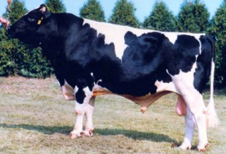
Summary
Sequenced genotypes from 444 Holsteins
Imputed 27,000 reference bulls
700,000 candidate loci plus 300,000 HD SNP
17K SNP with largest effects added to 60K routinely used; averaged REL gain of 2.7 percentage points across traits

Slide 18
The Future ?
The 1000 bulls project covered many breeds, and 1500 bulls
1000 Bulls Genome project Run 6 will have 3000 bulls
Editing and procedures used to choose SNP to be added to lower density chips need further review and testing

Slide 19
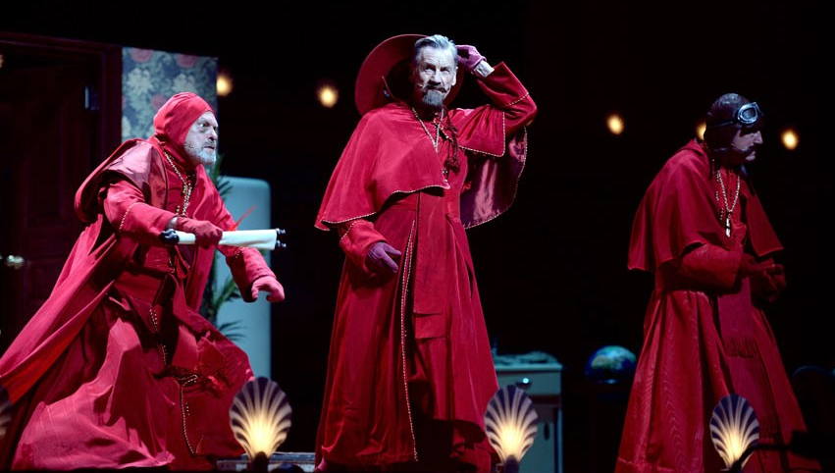
Questions?
Presentation available: http://aipl.arsusda.gov/publish/present.htm
Notes:
No one expects the Spanish Inquisition! Our chief weapon is surprise, fear and surprise; two chief weapons, fear, surprise, and ruthless efficiency!
Picture: Dave J Hogan/Getty Images retrieved from http://www.telegraph.co.uk/culture/culturepicturegalleries/10939991/Monty-Python-Live-Mostly-at-Londons-O2-Arena-in-pictures.html?frame=2961214

