Slide 1


Sexed-semen usage for Holstein AI in the United States
J. L. Hutchison* and D. M. Bickhart
Abstract 17255
Animal Genomics and Improvement Laboratory, Agricultural Research Service, USDA, Beltsville, MD 20705-2350  http://aipl.arsusda.gov
INTRODUCTION
RESULTS
RESULTS (cont.)
  Sexed-semen is used in the US dairy industry to reduce the chance that a breeding results in an undesirable bull calf.
  Usage of sexed-semen has increased since 2007, especially in heifers (virgin cows).
  The sexing process compromises conception rate (CR); although technology has recently improved.
Extent of sexed-semen usage
Sexed-semen usage in cow breedings
Breeding Year |  | Conventional semen |  |  | Sexed semen
 |  | Number | % |  | Number | %
 |  | Heifer breedings
2007 |  | 399,203 | 90.6 |  | 41,482 | 9.4
2009 |  | 443,135 | 81.1 |  | 103,281 | 18.9
2011 |  | 558,181 | 77.7 |  | 160,250 | 22.3
2013 |  | 649,959 | 77.5 |  | 188,171 | 22.5
2015 |  | 426,782 | 69.3 |  | 188,666 | 30.7
 |  | Cow breedings
2007 |  | 4,113,215 | 99.8 |  | 8,049 | 0.2
2009 |  | 4,251,540 | 99.4 |  | 25,231 | 0.6
2011 |  | 5,080,739 | 99.3 |  | 34,147 | 0.7
2013 |  | 5,146,659 | 99.5 |  | 25,734 | 0.5
2015 |  | 3,996,000 | 99.0 |  | 41,910 | 1.0
Service Number |  | % Sexed-semen breedings
 |  | Lactation number
 |  | 1 | 2 | 3 | 4 | 5
1 |  | 38 | 15 | 8 | 4 | 2
2 |  | 11 | 5 | 3 | 1 | 1
3 |  | 4 | 2 | 1 | 1 | 0
>4 |  | 3 | 2 | 1 | 0 | 0
  49% of sexed-semen breedings occurred in first 2 services in first lactation; 69% occurred within first 2 lactations and first 2 services
  Very few sexed-semen breedings after second service and second lactation
DATA & METHODS
Breeding records were provided by the Council of Dairy Cattle Breeding (CDCB)
Data included Holstein breedings from January 2007 through December 2015
5,963,876 heifer breedings (1,323,721 with sexed-semen)
42,232,502 cow breedings (253,586 with sexed-semen)
The outcome for each breeding was coded as a failure (0) or a success (1), and was the basis for deriving CR
  Sex ratio for conventional and sexed-semen was: 50 and 89% for heifers and 48 and 87% for cows
Service Number |  | Conception rate (%) |  |  |  |  |  |  | All lactations
 |  | Lactation number
 |  | 1 | 2 | 3 | 4 | 5
 |  | Conventional semen
1 |  | 36 | 34 | 32 | 29 | 25 |  | 32
2 |  | 31 | 31 | 30 | 29 | 26 |  | 32
3 |  | 30 | 30 | 30 | 28 | 25 |  | 30
>4 |  | 28 | 29 | 29 | 27 | 24 |  | 29
All services |  | 33 | 30 | 29 | 28 | 27 |  | 31
 |  | Sexed-semen
1 |  | 28 | 26 | 24 | 20 | 19 |  | 25
2 |  | 23 | 22 | 22 | 19 | 16 |  | 24
3 |  | 21 | 21 | 21 | 21 | 18 |  | 22
> 4 |  | 20 | 20 | 19 | 19 | 16 |  | 20
All services |  | 27 | 23 | 21 | 20 | 19 |  | 24
  Trend toward increasing usage of sexed-semen from 2007 through 2015; from 9% to 31% in heifers
  84% of sexed-semen inseminations were on heifers
Use of sexed-semen in heifers over multiple service attempts
Service Number |  | % Sexed-semen breedings |  | % of total breedings |  |  | Conception rate (%)
 |  |  |  | Conventional | Sexed |  | Conventional | Sexed
1 |  | 76 |  | 45 | 16 |  | 59 | 44
2 |  | 19 |  | 20 | 4 |  | 56 | 40
3 |  | 4 |  | 9 | 1 |  | 52 | 36
> 4 |  | 1 |  | 4 | 0 |  | 47 | 33
  24% of heifer breedings were to sexed-semen (76% in first service); 95% of sexed-semen breedings occurred within the first 2 services
  First service mean CR with sexed-semen was 44% (59% for conventional), and decreased in later services
  Mean CR achieved was 24% for sexed-semen (31% for conventional semen)

Slide 2
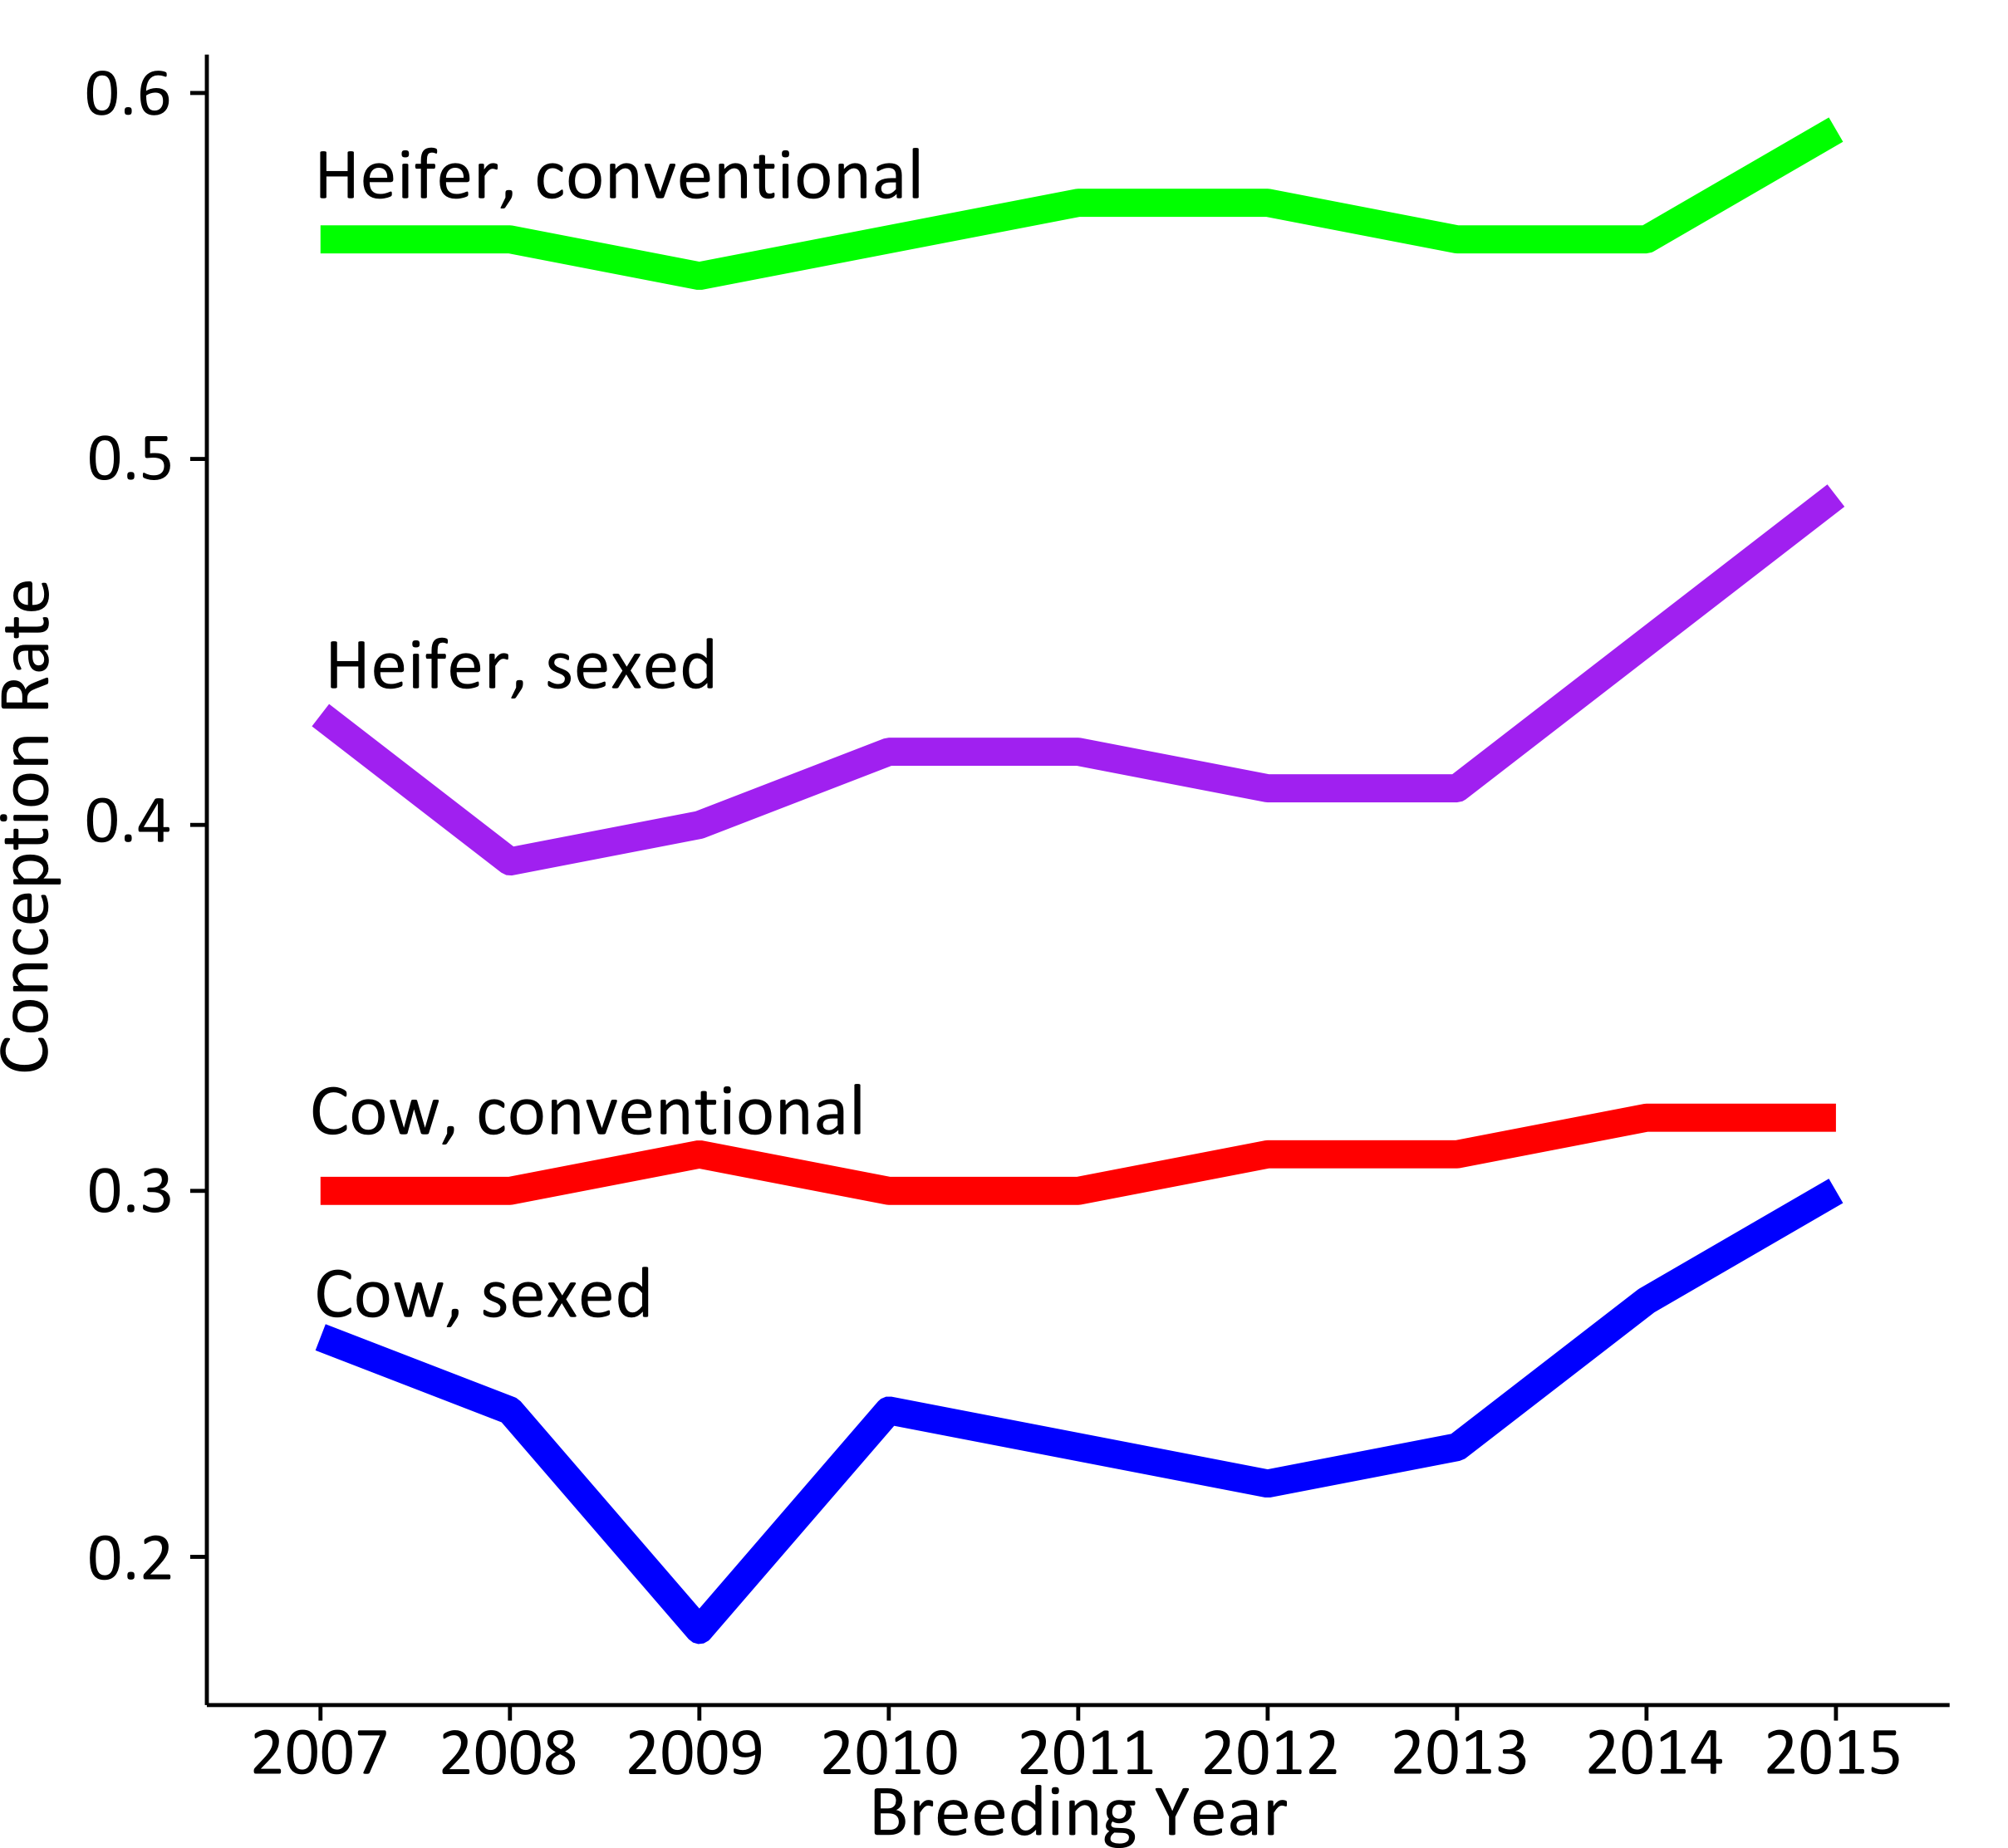
Sexed-semen usage for Holstein AI in the United States
J. L. Hutchison* and D. M. Bickhart
Abstract 17255
Animal Genomics and Improvement Laboratory, Agricultural Research Service, USDA, Beltsville, MD 20705-2350  http://aipl.arsusda.gov
RESULTS (cont.)
CONCLUSIONS
CR for conventional and sexed-semen
  Trends show increasing usage of sexed-semen, especially in heifers, from 9% in 2007 to 31% 2015.
  93% of all sexed-semen breedings were to either heifers (84%) or first lactation cows (16%), where CR are typically higher.
  Mean CR for both cow and heifer sexed-semen breedings has recently increased due to improved technology; however, sexed-semen CR still lags behind conventional semen by approximately 10 percentage points.
  Animals that fail to conceive after the first service often don't warrant another use of sexed semen. This may be the breeder hedging bets against using high cost technology on poor fertility animals.
  Breeders appear to be using sexed-semen on heifers to take advantage of their higher fertility, to maximize on their output to produce female calves, and to reduce dystocia.
  Mean conception rate for heifers show large differences between conventional and sexed-semen, but in recent years, becoming smaller
  Both cow and heifer conception rate for sexed-semen has improved in recent years
ACKNOWLEDGEMENTS
Services per pregnancy
JLH and DMB were both supported by funds provided by USDA CRIS project number 1265-31000-096-00. DMB was also supported in part by USDA CRIS project number 1245-31000-104-00. Any mention of trade names is for information purposes only. The USDA does not endorse any products or services.
Breeding Year |  | Heifer breedings |  |  | Cow breedings
 |  | Conventional | Sexed |  | Conventional | Sexed
2007 |  | 1.5 | 1.7 |  | 2.1 | 2.2
2009 |  | 1.5 | 1.8 |  | 2.1 | 2.4
2011 |  | 1.5 | 1.8 |  | 2.1 | 2.3
2013 |  | 1.5 | 1.8 |  | 2.1 | 2.2
2015 |  | 1.4 | 1.6 |  | 1.8 | 1.9
  Data categorized based on first service mating type; last service was required to have a confirmed pregnancy
  There is a 0.2 to 0.3 increase for services/pregnancy when using sexed semen on heifers; 0.1 to 0.3 increase for cows

