Slide 1
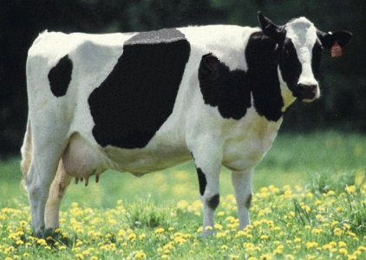
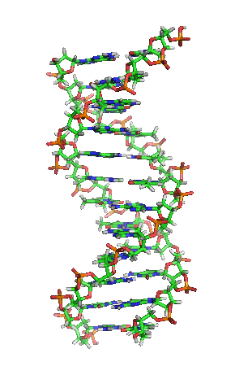
Strategy for incorporating newly discovered causative genetic variants into genomic evaluations
Abstr. 16462

Slide 2
Causative variants
Benefits of knowing causative variant
  Supports an exact test
  (particularly useful for undesirable conditions)
  No linkage decay when used in evaluation
  Increased reliability of genomic evaluations as causative variants replace less informative SNP
  May be informative across breeds
Likelihood of discovery increased by greater availability of sequence data
Notes:
2

Slide 3
Steps to add causative variant
Recommend that genotyping laboratories add variant in next chip update
Monitor genotype submissions to determine when sufficient genotypes with new SNP have been submitted
  Benefit of new SNP degraded if imputation error rate is high
Add to set of SNP used in genomic evaluation

Slide 4
Project to find causative variants
Use sequence data from 1000 Bull Genomes Project
Impute Holstein reference bulls to sequence using 444 sequenced bulls
Use a posteriori granddaughter design on 75 bulls with 100 progeny-tested genotyped sons
  Identify heterozygous haplotypes for which son groups differ significantly
  Search for variants in concordance across all bulls
Alternatively, estimate effects of 481,904 SNP and pick those with largest effects

Slide 5
Use of sequence data
Causative variant present in sequence data
Combine sequence data with medium- and high-density genotypes of reference bulls
Impute ~30,000 bulls to full sequence
Extract SNP to be used in evaluation (including new causative variants)
Use these imputed genotypes in place of observed genotypes in monthly imputation for genomic evaluations

Slide 6
Benefits of 2-step imputation
Improved imputation accuracy because imputing to full sequence considers all SNP in a haplotype
Computing time not excessive because only ~30,000 reference bulls processed
Accurate imputation of new SNP for all animals supported because reference bulls are related to most animals in the evaluation

Slide 7
Changing SNP set in evaluation
Imputation most time consuming part of evaluation
  Previous month’s output used as priors
Change in SNP set prevents use of priors
Running without priors consumes excessive computing resources
Priors can be generated in reasonable time for 100,000 genotypes

Slide 8
Test of priors from 100K genotypes
Select ~100,000 Holstein genotypes
  Reference bulls
  Most cows with genotyped progeny
Impute without priors (1 day of computing)
Re-do imputation for December 2015 official evaluation using this run as priors
Evaluate accuracy by comparing with imputed genotypes from official evaluation

Slide 9
Results
Imputation for official Dec 2015 evaluation included genotypes of 978,987 Holstein bulls and cows
Nearly 60 billion comparisons
  Identical, 97.7%
  1 allele different, 1%
  1 missing, 1.2%
Method not perfect
  Uses current programs
  Direct augmentation of priors might be more accurate
Notes:
9

Slide 10
Conclusions
New SNP can be added as soon as discovered
  Saves time to place on chip
  Saves time to accumulate genotypes
Adding causative variants may permit removal of less informative SNP
Elimination of low information SNP may reduce “noise”
Adding markers that are causative variants should increase prediction accuracy

Slide 11
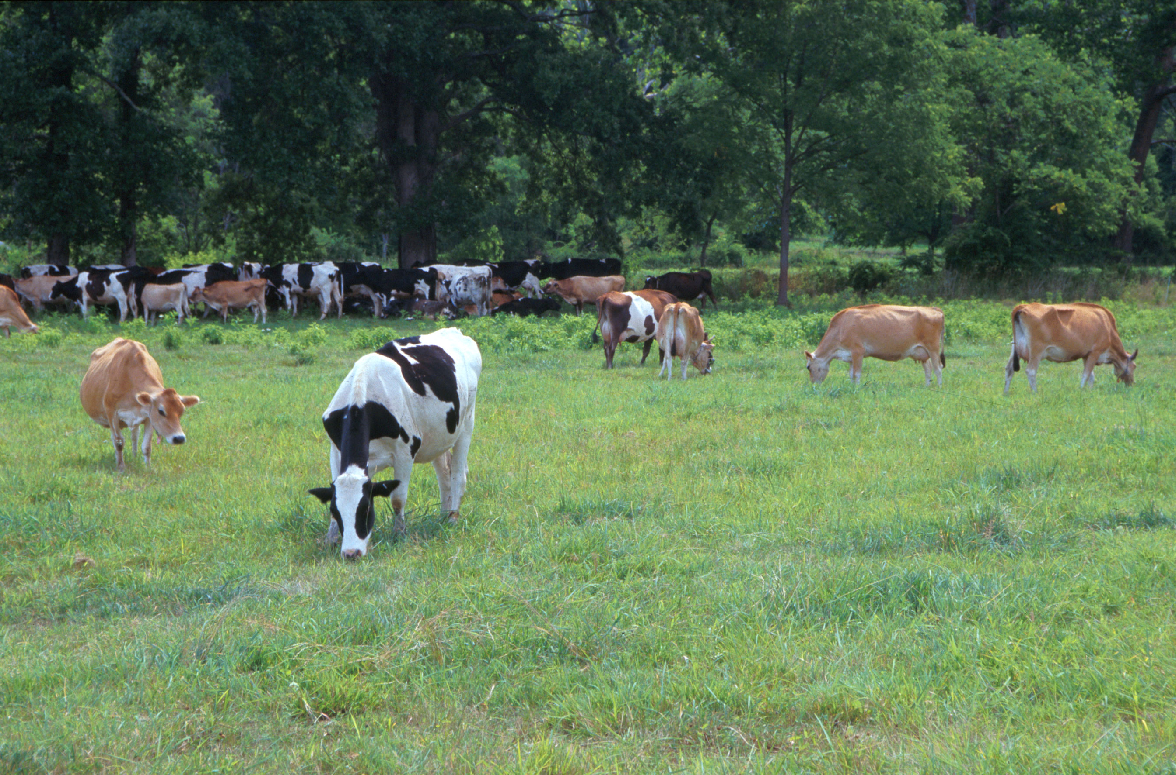
Questions?
AIP web site:
http://aipl.arsusda.gov
Holstein and Jersey crossbreds graze on American Farm Land Trust’s
Cove Mountain Farm in south-central Pennsylvania
Source: ARS Image Gallery, image #K8587-14; photo by Bob Nichols

