Slide 1
Possibilities in an age of genomics: The future of the breeding index
Abstract #274
John B. Cole* and Paul M. VanRaden
USDA, Agricultural Research Service
Henry A. Wallace Beltsville Agricultural Research Center
Animal Genomics and Improvement Laboratory
Beltsville, MD 20705-2350
john.cole@ars.usda.gov

Slide 2
Introduction
What are breeding indices?
Why do we use them?
How do we construct them?
What traits are in current indices?
What traits should be in future indices?
Are there alternatives to breeding indices?

Slide 3
Many things affect performance
P = G + E
Additive effects
Dominance effects
Epistasis
Housing
Climate
Unknown
What about G×E?
Effects generally small in the US (e.g., Wright and VanRaden, 2015)

Slide 4
What is the value of genetic selection?
In 2015: 1957 base was 44% of total fat,
management was 28% of gains, and
genetics was 28% of gains

Slide 5
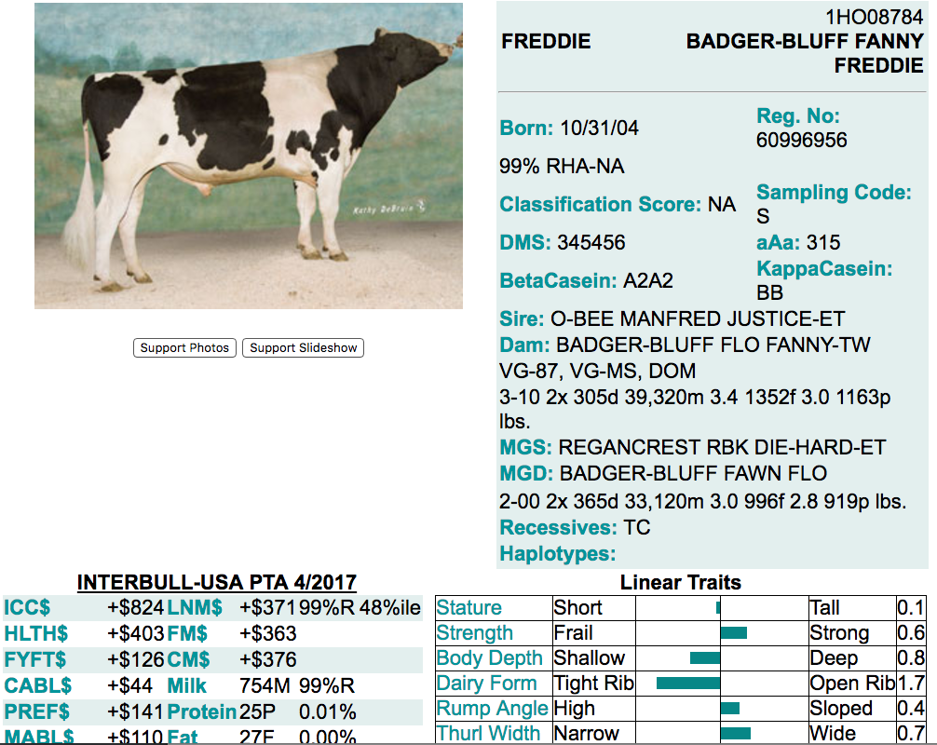
What is a breeding index?
A single number based on information about many traits used for making selection decisions
ICC$ = Ideal commercial
cow index
LNM$ = Lifetime net merit
FM$ = Fluid merit
CM$ = Cheese merit
Source: Genex

Slide 6
Indices may include sub-indices
Sub-indices summarize data so that breeders do not have to know details of every trait (31 in NM$)
NM$ = Production $ + Longevity $ + Fertility $ + Type $ + Calving $
Milk
Fat yield
Fat %
Protein yield
Protein %
Productive life
Cow livability
SCS
Daughter pregnancy rate
Heifer conception rate
Cow conception rate
Feet & legs (4)
Udder (7)
Body size (5)
Calving ease (2)
Stillbirth rate (2)

Slide 7
Sub-indices are flexible
Traits can be added to sub-indices (or new sub-indices added) without changing how the index is used
NM$ = Production $ + Longevity $ + Fertility $ + Type $ + Calving $ + Health $
Milk
Fat
Protein
Productive life
Cow livability
SCS
Daughter pregnancy rate
Heifer conception rate
Cow conception rate
Age at first calving
Feet & legs
Udder
Body size
Calving ease
Stillbirth rate
Gestation length
Mastitis
Metritis
Retained placenta
Ketosis
Displaced abomasum
Milk fever

Slide 8
Why select for more than one trait?
To make use of more information
Correlations among traits are rarely 0
Several traits may have economic value
Farmers may receive a quality premium
Some traits need to be improved and others maintained
Selection for only yield would reduce fertility
Balanced selection improves traits according to their economic values

Slide 9
Selection for only yield reduces fertility
Selection only for yield will produce a decrease in fertility because of unfavorable correlations

Slide 10
Traits evaluated
Year | Trait | Year | Trait
1926 | Milk & fat yields | 2006 | Stillbirth rate
1978 | Conformation (type) | 2006 | Bull conception rate²
1978 | Protein yield | 2009 | Cow & heifer conception rates
1994 | Productive life | 2016 | Cow livability
1994 | SCS (udder health) | 2017 | Cow health (research)³
2000 | Calving ease (dystocia)¹ | 2017 | Residual feed intake (research)³
2003 | Daughter pregnancy rate | 2017 | Gestation length (research)³
¹Sire calving ease evaluated by Iowa State University (1978–99)
²Estimated relative conception rate evaluated by DRMS in Raleigh, NC (1986–2005)
³Research trait … no official evaluations yet

Slide 11
Conformation (type) phenotypes
Stature
Strength
Body depth
Dairy form
Rump angle
Thurl width
Rear legs (side view)
Rear legs (rear view)
Foot angle
Feet & legs score
Fore udder attachment
Rear udder height
Rear udder width
Udder cleft
Udder depth
Front teat placement
Rear teat placement
Teat length

Slide 12
Selection objectives and criteria
The selection objective is the set of traits that we wish to improve
e.g., lifetime profitability
The selection criterion is the set of traits that we measure and use to make selection decisions
e.g., milk yield, daughter pregnancy rate, body size composite
Traits may appear in both the objective and the criterion

Slide 13
What goes into an index?
P
C
G
a
Phenotypic (co)variances among traits in the criterion
Genetic (co)variances among traits in the objective
Genetic (co)variances among traits in the criterion and objective
Economic weights

Slide 14
Where do economic weights come from?
Quantitative analysis
Research and field reports to quantify incomes and expenses
Driven by empirical factors
Used in the calculation of NM$
Qualitative analysis
Target for breed improvement developed by experts
Driven by empirical and subjective factors
Used in calculation of Holstein Association USA’s TPI

Slide 15
How do we compute an index?
b
P^{–1}
G
a
= × ×

Slide 16
Current genetic-economic indices (2017)
Trait | Relative value (%)
 | NM$ | CM$ | FM$ | GM$
Milk yield | –0.7 | –7.9 | 20.4 | –0.5
Fat yield | 23.7 | 20.1 | 24.3 | 20.7
Protein yield | 18.3 | 22.0 | 0.0 | 16.0
Productive life (PL) | 13.4 | 11.4 | 13.8 | 7.8
Somatic cell score (SCS) | –6.5 | –7.0 | –3.2 | –5.5
Udder composite (UC) | 7.4 | 6.3 | 7.6 | 7.5
Feet/legs composite (FLC) | 2.7 | 2.3 | 2.8 | 2.8
Body weight composite (BWC) | –5.9 | –5.0 | –6.0 | –6.1
Daughter pregnancy rate (DPR) | 6.7 | 5.7 | 6.9 | 17.9
Heifer conception rate (HCR) | 1.4 | 1.2 | 1.4 | 2.5
Cow conception rate (CCR) | 1.6 | 1.4 | 1.7 | 4.4
Calving ability index (CA$) | 4.8 | 4.1 | 4.9 | 4.5
Cow livability (LIV) | 7.4 | 6.2 | 7.5 | 5.0

Slide 17
Index changes over time
Trait | Relative emphasis on traits (%)
 | PD$ 1971 | MFP$ 1976 | CY$ 1984 | NM$ 1994 | NM$ 2000 | NM$ 2003 | NM$ 2006 | NM$ 2010 | NM$ 2014 | NM$ 2017
Milk | 52 | 27 | –2 | 6 | 5 | 0 | 0 | 0 | –1 | –1
Fat | 48 | 46 | 45 | 25 | 21 | 22 | 23 | 19 | 22 | 24
Protein | … | 27 | 53 | 43 | 36 | 33 | 23 | 16 | 20 | 18
PL | … | … | … | 20 | 14 | 11 | 17 | 22 | 19 | 13
SCS | … | … | … | –6 | –9 | –9 | –9 | –10 | –7 | –7
UC | … | … | … | … | 7 | 7 | 6 | 7 | 8 | 7
FLC | … | … | … | … | 4 | 4 | 3 | 4 | 3 | 3
BWC | … | … | … | … | –4 | –3 | –4 | –6 | –5 | –6
DPR | … | … | … | … | … | 7 | 9 | 11 | 7 | 7
SCE | … | … | … | … | … | –2 | … | … | … | …
DCE | … | … | … | … | … | –2 | … | … | … | …
CA$ | … | … | … | … | … | … | 6 | 5 | 5 | 5
HCR | … | … | … | … | … | … | … | … | 1 | 1
CCR | … | … | … | … | … | … | … | … | 2 | 2
LIV | … | … | … | … | … | … | … | … | … | 7

Slide 18
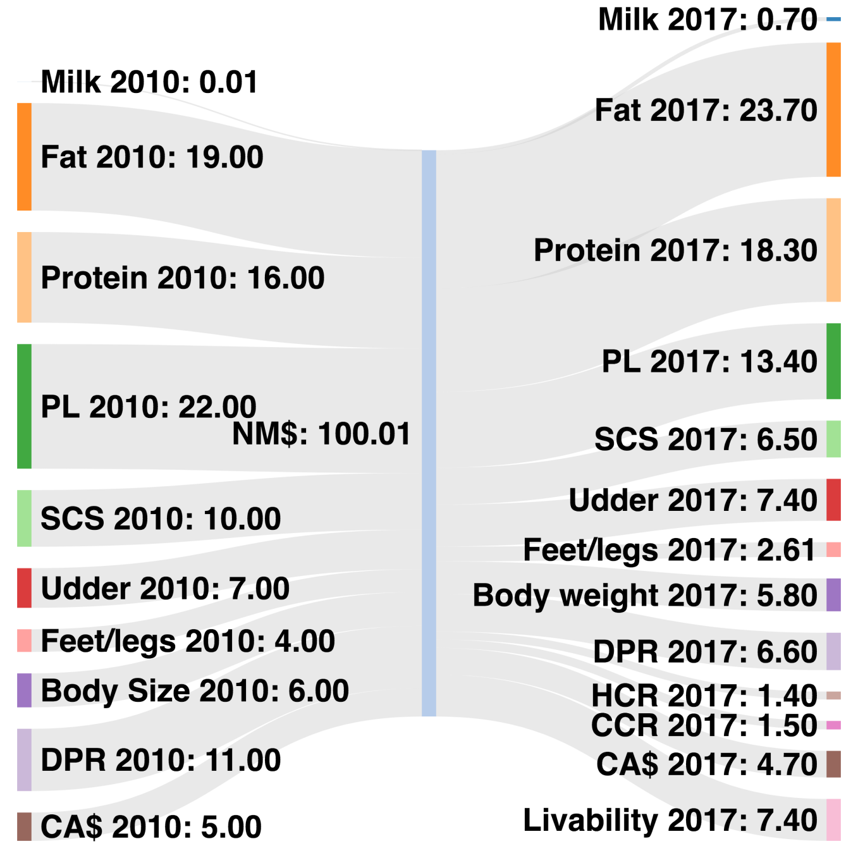
Changes in NM$ (2010 – 2017)
Trait | Change
Milk | –0.7
Fat | –4.7
Protein | +2.3
PL | –8.6
SCS | –3.5
UC | +0.4
FLC | –1.39
BWC | –1.8
DPR | –4.4
CA$ | –0.3
HCR | +14
CCR | +1.5
LIV | +7.4

Slide 19
Genetic trend (NM$)

Slide 20
What do others include in their TMI?

Slide 21
Should you trust breeding indices?
2010 NM$ calculations included approximately 160 different numbers
Genetic and phenotypic correlations
Breed means and standard deviations
Milk and components prices
Replacement, feed, and health costs
Etc.
Uncertainty associated with most of them
Can you trust the resulting index?

Slide 22
Predicted vs. actual Class III milk prices
Indices should be updated regularly to correct incorrect assumptions

Slide 23
Sensitivity analysis (2010 NM$)
Trait | Relative value (%)
 | NM$ | CM$ | FM$
Milk yield | 0 | −15 | 19
Fat yield | 19 | 13 | 20
Protein yield | 16 | 25 | 0
Productive life (PL) | 22 | 15 | 22
Somatic cell score (SCS) | −10 | −9 | −5
Udder composite (UC) | 7 | 5 | 7
Feet/legs composite (FLC) | 4 | 3 | 4
Body weight composite (BWC) | −6 | −4 | −6
Daughter pregnancy rate (DPR) | 11 | 8 | 12
Calving ability index (CA$) | 5 | 3 | 5

Slide 24
Sensitivity analysis (2010 NM$)
Trait | Index weights |  |  |  | PTA change/year
 | Official | Actual | Difference |  | Official | Actual | Difference
Milk | 0 | 8 | 8 |  | 86 | 66 | −20
Fat | 19 | 18 | −1 |  | 3.8 | 2.8 | −1.0
Protein | 16 | 12 | −4 |  | 2.6 | 2.0 | −0.6
PL | 22 | 21 | −1 |  | 0.3 | 0.4 | −0.10
SCS | −10 | −10 | 0 |  | −0.0017 | −0.02 | 0.00
UC | 7 | 7 | 0 |  | 0.04 | 0.03 | 0.01
FLC | 4 | 4 | 0 |  | 0.03 | 0.03 | 0.01
BWC | −6 | −6 | 0 |  | −0.04 | −0.05 | 0.01
DPR | 11 | 11 | 0 |  | 0.07 | 0.10 | −0.03
CA$ | 5 | 5 | 0 |  | 1.3 | 2.0 | −0.7

Slide 25
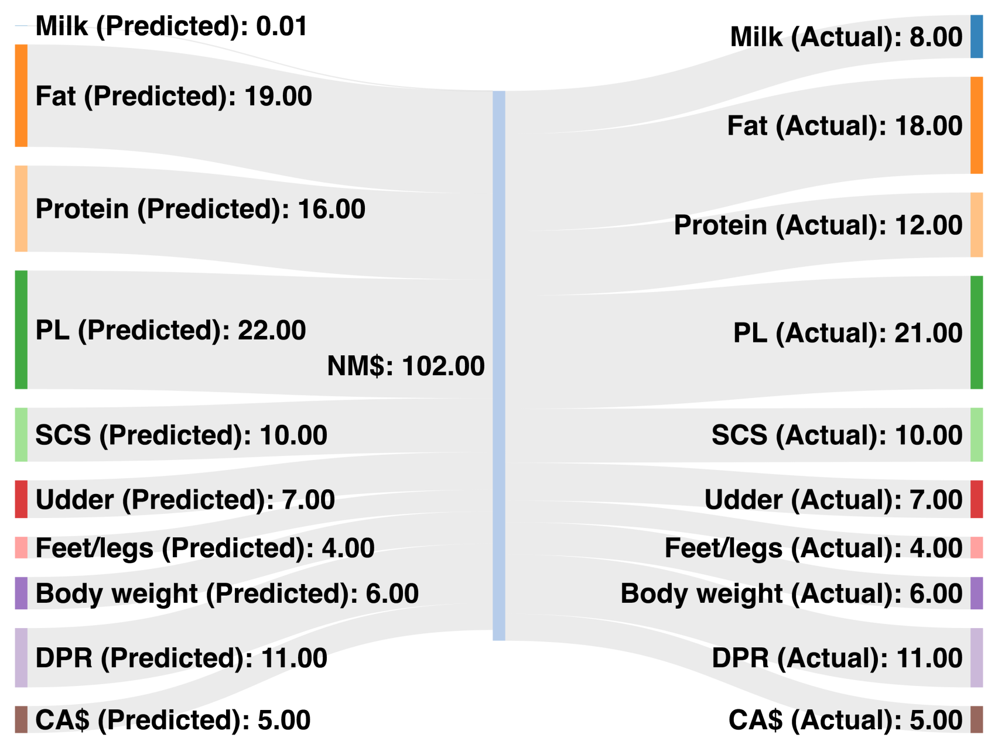
Predicted vs. actual 2010 NM$
Trait | Change
Milk | 8
Fat | −1
Protein | −4
PL | −1
SCS | 0
UC | 0
FLC | 0
BWC | 0
DPR | 0
CA$ | 0

Slide 26
Why do we need new traits?
Changes in production economics
Technology produces new phenotypes or reduces costs of collecting them
New traits can be predicted on all genotyped animals without collecting progeny records
Phenotyping costs are shared among millions of animals
Better understanding of biology
Recent review by Egger-Danner et al. (Animal, 2015)

Slide 27
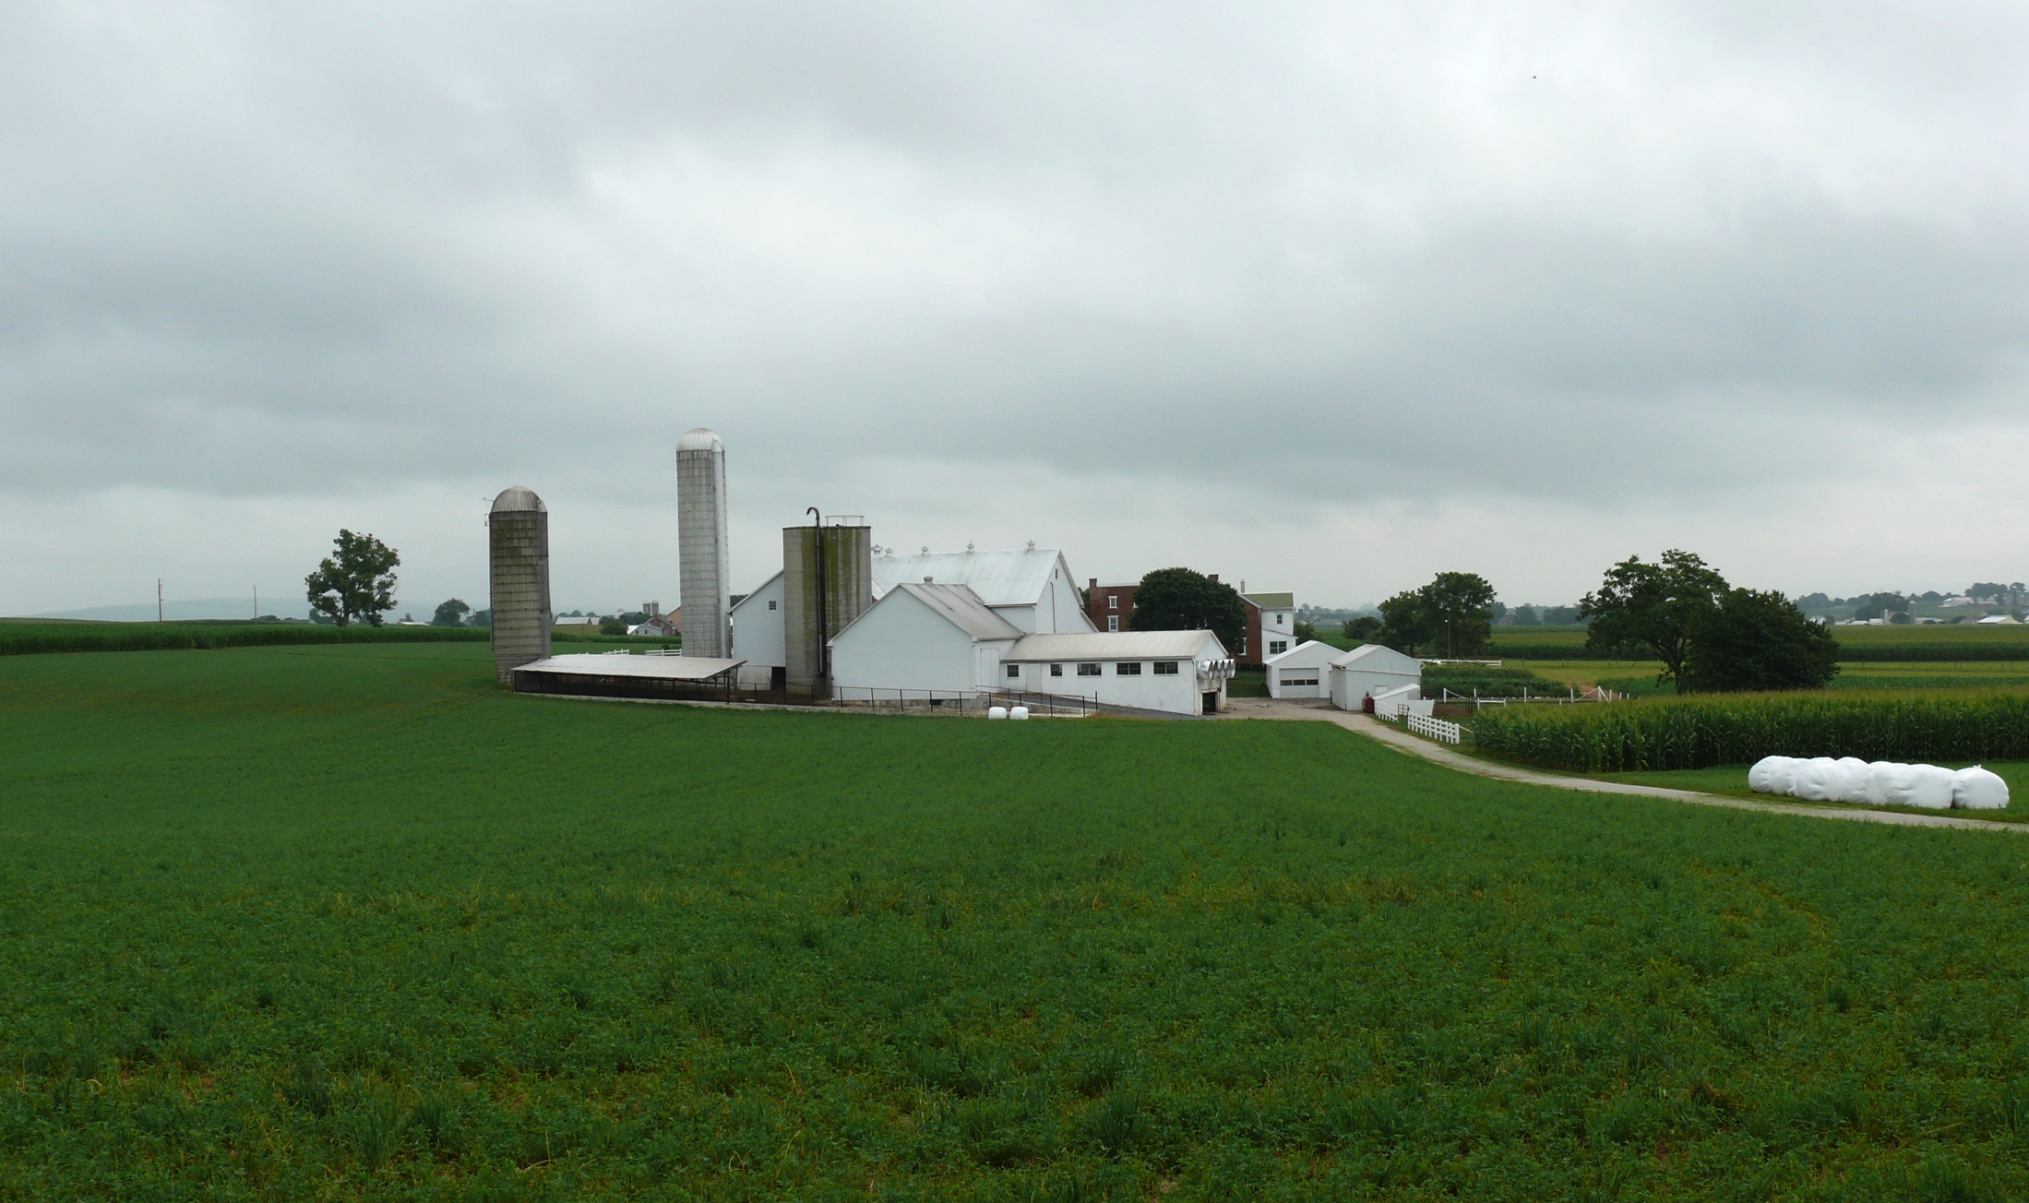
Where do new traits come from?
Barn: Flooring type, bedding materials, density, weather data
Cow: Body temperature, activity, rumination time, feed & water intake
Herdsmen/consultants: Health events, foot/claw health, veterinary treatments
Parlor: yield, composition, milking speed, conductivity, progesterone, temperature
Silo/bunker: ration composition, nutrient profiles
Pasture: soil type/composition, nutrient composition
Laboratory/milk plant: detailed milk composition, mid-infrared spectral data
Source: http://commons.wikimedia.org/wiki/File:Amish_dairy_farm_3.jpg

Slide 28
Examples of new phenotypes
Claw health
(Van der Linde et al., 2010)
Cow health
(Parker Gaddis et al., 2013)
Embryonic development
(Cochran et al., 2013)
Immune response
(Thompson-Crispi et al., 2013)
Methane production
(de Haas et al., 2011)
Milk fatty acid composition (Soyeurt et al., 2011)
Persistency of lactation
(Cole et al., 2009)
Thermoregulation
(Dikmen et al., 2013)
Residual feed intake
(Connor et al., 2013)
Cheesemaking properties
(De Marchi et al., 2009)
Superovulation & embryo transfer
(Parker Gaddis et al., 2017)
Adaptation to automated (robotic) milking (Vosman et al., 2014)
Metabolic diseases
(Pryce et al., 2016)
Udder health
(Soyeurt et al., 2012)
Cow temperament
(Kramer et al., 2013)
Milking efficiency
(Lovendahl et al., 2012)

Slide 29
New traits should add more information
Novel phenotypes include some new information | Novel phenotypes contain little new information
Novel phenotypes include much new information | Novel phenotypes include some new information
High
Phenotypic correlation
with existing traits
Low
Low
High
Genetic correlation with existing traits

Slide 30
New traits should have value to farmers
Milk yield | Feed intake
Conformation | Greenhouse gas emissions
High
Phenotype value
Low
Low
High
Measurement cost

Slide 31
What do current phenotypes look like?
Low dimensionality
Usually few observations per lactation
Close correspondence of phenotypes with values measured
Easy transmission and storage
Costs of data recording are relatively low

Slide 32
What do new phenotypes look like?
High dimensionality
Example: MIR produces 1,060 points/observation
Disconnect between trait and measurement
More resources needed for transmission, storage, and analysis
Phenotyping costs can be high (e.g., feed intake)

Slide 33
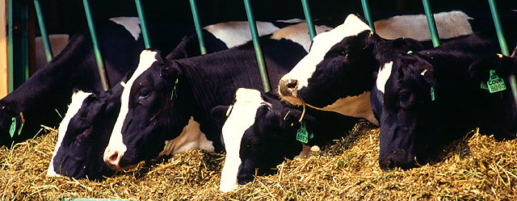
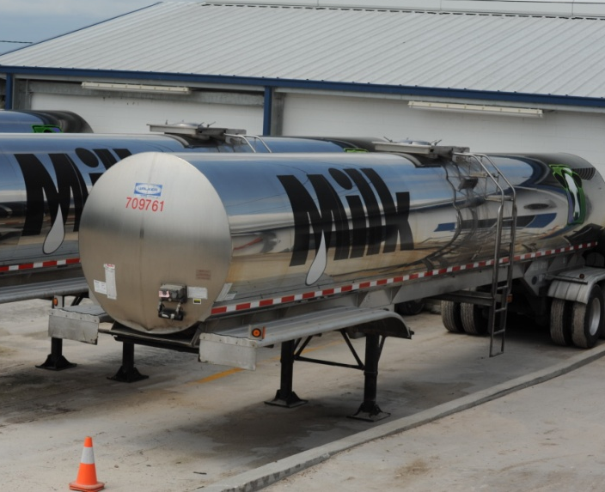
Traditional phenotyping scheme
Current milk recording
Many farms participate
Low-intensity phenotyping (few measurements per cow)
Well-suited to traits with low recording costs
Source: ARS, USDA
Source: North Florida Holsteins
Source: J.B. Cole

Slide 34
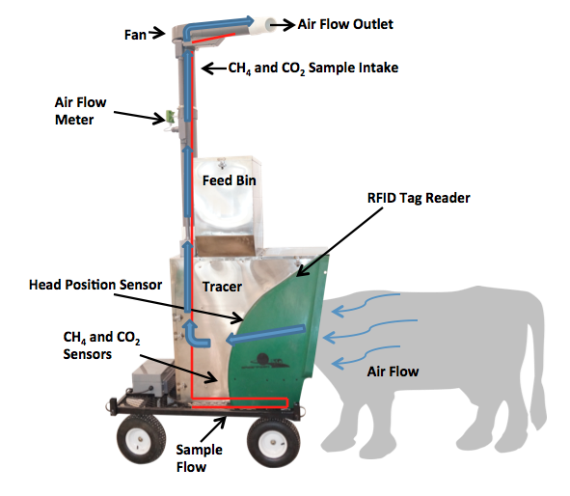
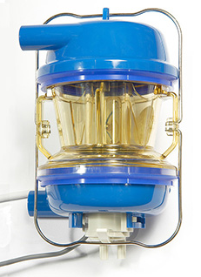
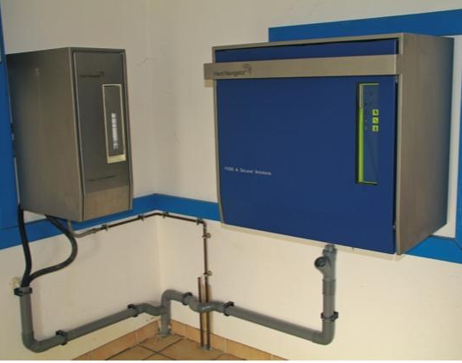
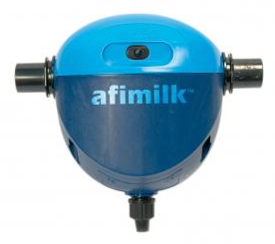
Alternative phenotyping scheme
Few farms
Intensive phenotyping (many measurements per cow)
Use cases
Expensive-to-measure traits
Developing countries
Source: J.B. Cole
Source: http://c-lockinc.com/
Source: http://www.afimilk.com/
Source: http://goo.gl/wu8YtR

Slide 35
Conclusions
Information from many sources can be combined into a single quantity using selection index methodology
Selection indices are robust to modest differences between predicted and actual values
Ideal phenotyping strategies vary with the cost and difficulty of data recording
Phenotypes may need to be collected differently than in the past to produce reliable evaluations for new traits

Slide 36
Disclaimers
USDA is an equal opportunity provider and employer
Mention of trade names or commercial products in this presentation is solely for the purpose of providing specific information and does not imply recommendation or endorsement by USDA

Slide 37
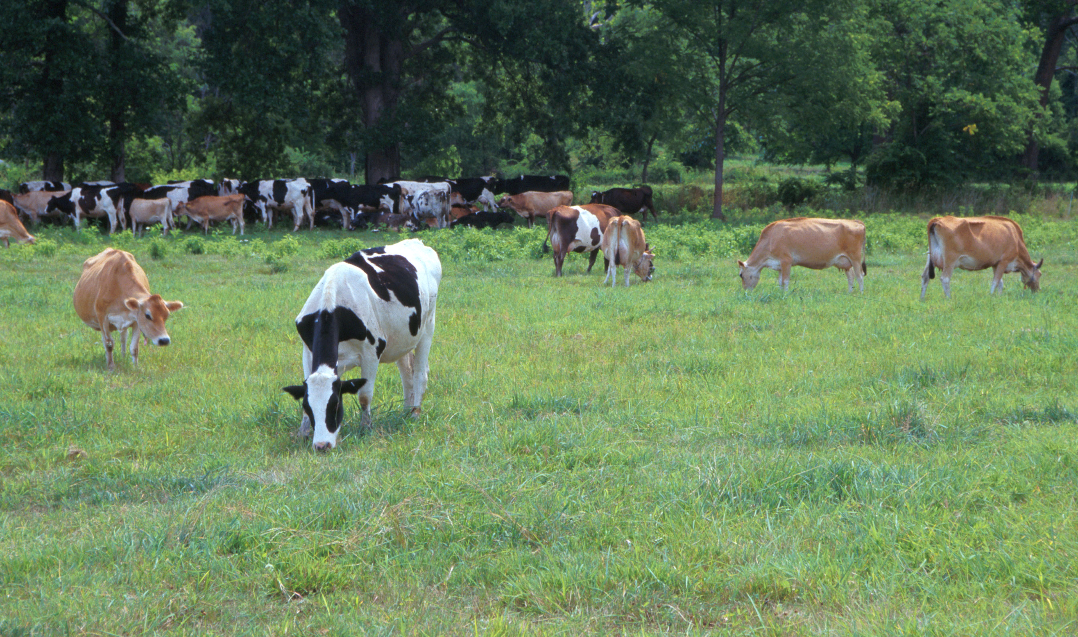
Questions?
AIP web site:
http://aipl.arsusda.gov
Holstein and Jersey crossbreds graze on American Farm Land Trust’s
Cove Mountain Farm in south-central Pennsylvania
Source: ARS Image Gallery, image #K8587-14; photo by Bob Nichols

