Slide 1

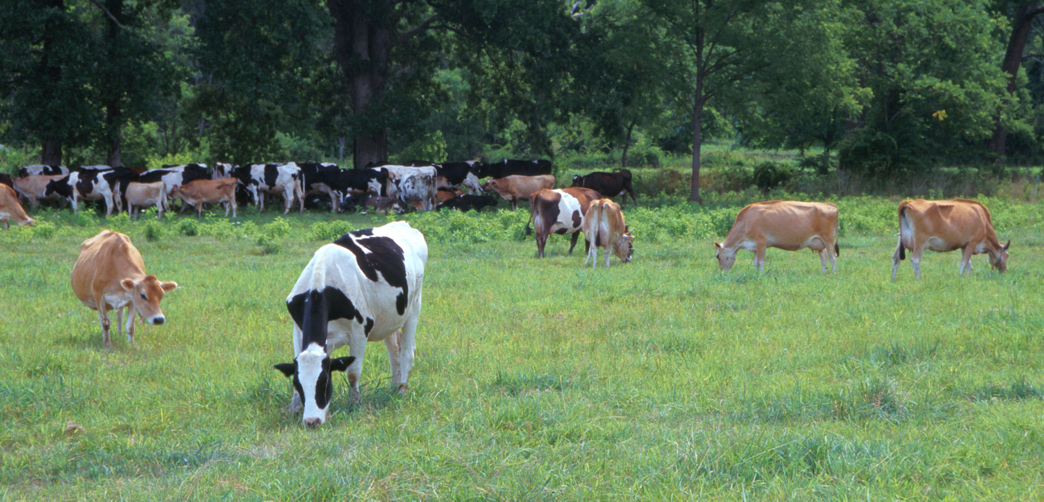

Poster M100
Abstract #69862
2017 ADSA Meeting
Pittsburgh, PA
Genetic Evaluation of Gestation Length
as a Trait of the Service Sire
J.R. Wright, P.M. VanRaden,* and J.L. Hutchison
Animal Genomics & Improvement Laboratory, Agricultural Research Service, USDA, Beltsville, MD 20705-2350
https://aipl.arsusda.gov
INTRODUCTION
  Gestation length (GL) can affect calving traits, age at first calf, calving interval, and other traits
  Genetic evaluations of GL from US data were previously computed for research as a trait of the service sire or the cow’s sire (Norman et al., JDS, 2009)
  Genetic correlations between the two were high (near 0.80)
RESULTS
Time truncation test
  Predictions for August 2016 from August 2013 data for bulls with no progeny in 2013 but calves born by 2016
  Traditional and genomic evaluations both had regressions close to expected value of 1.0
  Reliability means for genomic predictions
    65% for young Holsteins,
    54% for Jerseys,
    33% for Brown Swiss,
    35% for Ayrshires
    28% for Guernseys
Heritability computed as 4 times service sire variance
  Estimates of 0.48 from heifers and 0.44 from all lactations (heifers and cows)
  Variance estimation by REML
    3.3 million Holstein GL records
    4,997 Holstein sires
GL PTA for recent Holstein bulls (born 1995 or later with 90% or higher reliability)
  Minimum of –5.6 d
  Maximum of +6.4 d
  SD of ~1.4 d
Jersey and Brown Swiss bulls also had PTA SD of ~1.4 d but smaller PTA ranges than Holstein after adjustment to within-breed bases because of fewer bulls
  –4.2 to +5.0 d for Jerseys
  –3.6 to +5.6 d for Brown Swiss
Short GL favorably correlated by ~0.38 with daughter calving ease PTA and by ~0.24 – 0.29 with yield and productive life PTA
RESULTS – continued
GL genetic trend on all-breed scale
Mean Holstein calf and sire GL PTA
Animal model for GL as a trait of the calf might provide higher reliability by using maternal genetic relationships for dams
Focus was on service-sire direct genetic effects, which were nearly 4 d shorter for Holstein and Jersey calves than for Brown Swiss and Guernsey calves
APPLICATION / FUTURE WORK
Sire effects, dam effects, and mean gestation length (d) by breed for calves born in 2010
Calf GL estimated as Holstein mean + sire breed effect + PTA sire + dam breed effect + PTA dam
  Example
  For Brown Swiss sire with PTA of +2.5 d mated to Holstein dam with PTA of –1.0 d ,
  Calf GL = 278 + 4.5 + 2.5 + 0 – 1.0 = 284 d
If dam is not genotyped, calf GL estimated as Holstein mean + sire breed effect + PTA sire + dam breed effect + 0.5 PTA maternal grandsire
If embryos are genotyped, PTA includes their own Mendelian sampling and is more accurate,
  Should be doubled to obtain breeding value effect on GL
  Embryo’s age at implantation should be subtracted to account for difference of ET from AI
Breed | Sire | Dam | Mean GL
Ayrshire | 2.1 | 0.7 | 281
Brown Swiss | 4.5 | 3.4 | 286
Guernsey | 4.2 | 1.9 | 284
Holstein | 0.0 | 0.0 | 277
Jersey | 1.1 | 0.2 | 278
Milking Shorthorn | 1.5 | 0.2 | 279
OBJECTIVES
Develop routine genetic rankings and genomic predictions of GL
Estimate paternal and maternal breed differences from Holstein
DATA & METHODS
Data used in August 2016 US national evaluations
Initial GL edits gave 20.5 million records of 10.8 million cows and included GL after either heifer or cow inseminations
Preliminary analysis revealed very negative genetic trend in the last 2 yr (toward shorter gestation), causing concerns about effects of unreported embryo transfer (ET) or sexed semen
Further edits required a sex code from the calving ease database and a pedigree record for each calf to determine its ET status (reducing data to 12.4 million records of 6.8 million cows born since 1990)
All-breed model included effects of conception month, age-parity of dam, breed of dam, offspring code, herd-year-season, service sire, permanent environment of dam, and error
Predicted transmitting abilities (PTA) were computed for all 73 million animals in the pedigree file from their additive relationships to sires
Genomic PTA computed for 1.8 million animals using the same multistep methods as for other traits
CONCLUSIONS
GL PTA developed for all dairy breeds and crossbreds
Strong selection for correlated traits already decreased GL in recent years
GL can be useful in mating programs to group all birth dates together for:
  Seasonal calving
  Managing maternity pens
  Improving calving ease as a correlated trait
Official GL evaluations to be implemented in August 2017
  Service-sire PTA for all bulls (format 38)
  Genomic PTA for all genotyped animals (monthly and weekly evaluations)
  Female PTA (format 105) could be available by December 2017
Jan Wright
1958–2017

