Slide 1
Discovery of a haplotype affecting fertility in Ayrshire dairy cattle and identification of a putative causal variant
Abstract #205
Daniel J. Null,*^{,1} Jana L. Hutchison,¹ Derek M. Bickhart,² Paul M. VanRaden,¹ and John B. Cole¹
USDA, Agricultural Research Service
¹Henry A. Wallace Beltsville Agricultural Research Center, Animal Genomics and Improvement Laboratory, Beltsville, MD 20705-2350
²US Dairy Forage Research Center, Cell Wall Biology and Utilization Research, Madison, WI 53706
daniel.null@ars.usda.gov
Notes:
In this talk I will discuss a new haploytpe affecting fertility in AY and the identification of the causative variant.

Slide 2
Introduction
Official genomic evaluations for Ayrshires (April 2013)
Haplotype affecting fertility found on chromosome 17 (AH1)
2nd haplotype monitored on chromosome 3
  4 adjacent 100-SNP blocks spanned a 19 Mbase region
  Threshold for significance (7 expected homozygotes and none observed) in October 2013
  4 haplotypes with frequencies from 8.21 to 8.41%
Notes:
AY began receiving official genomic evaluations in april 2013
At that time a haplotype on chrome 17 was found to have an affect on fertility and was designated AH1
Also at that time a second haplotype consisting of 4 consecutive blocks on chrome 3 was being monitored. The haplotype frequency was high but the number of expected homozygotes had not reached the significance threshold of 7.

Slide 3
How are new haplotypes detected?
Lethal haplotypes found by searching for blocks that never appear as homozygotes even though a substantial number are expected
Fertility data used to determine if carrier × carrier matings have reduced fertility
  Identifies recessives with effects early in gestation
Dystocia data can be used to check for effects on stillbirth rates
  Identifies recessives with effects late in gestations
Methodology described in VanRaden et al. (2011)

Slide 4
Ayrshire haplotype 2 (AH2)
October 2014: AH2 region narrowed to a single haplotype spanning 50.7–57.2 Mbases on chromosome 3
December 2016: Crossovers narrowed AH2 to a 1.7-Mbase region spanning 50.7–52.4 Mbases
  Number of expected homozygotes = 23.5
  (none observed)
  Current carrier frequency = 19.7%
  (1,306 carriers out of 6,621 genotyped Ayrshires)
Notes:
By October 2014 the 4 haplotypes blocks on chrome 3 had be narrowed down to 1 block and was designated AH2.

Slide 5
Carrier frequencies of recently discovered haplotypes
Haplotype |  | Breed | Chromosome |  | Carrier frequency (%)
AH1 |  | Ayrshire | 17 |  | 22.2
AH2 |  | Ayrshire | 3 |  | 19.7
BH1 |  | Brown Swiss | 7 |  | 15.9
BH2 |  | Brown Swiss | 19 |  | 14.4
HH0 |  | Holstein | 21 |  | 3.9
HH1 |  | Holstein | 5 |  | 3.0
HH2 |  | Holstein | 1 |  | 2.2
HH3 |  | Holstein | 8 |  | 5.5
HH4 |  | Holstein | 1 |  | 0.5
HH5 |  | Holstein | 9 |  | 4.2
HCD |  | Holstein | 11 |  | 3.5
JH1 |  | Jersey | 15 |  | 20.7
JH2 |  | Jersey | 26 |  | 2.3
Notes:
This is a list of the haplotypes that were identified in the orginal paper on haplotypes affecting fertility as well as haplotypes that have be discovered since.
Here we are showing the current carrier freqs with the 2 AY haplotypes being among the highest frequencies.

Slide 6
Ayrshire haplotype carrier frequencies
Notes:
AH1 steady since 1980
AH2 rising since 1980

Slide 7
Founder animals
Most AH2 carriers trace back to OAK-RIDGE FLASHY KELLOGG
  AYUSA000000125168
  Born in 1961
Many Canadian AH2 carriers trace back only as far as WOODLAND VIEW PARDNER ET
  AYCAN000000811799
  Born in 1994
Shared nongenotyped ancestor in OAK-RIDGE LIGHTNING
  AYUSA000000120135
  Born in 1958

Slide 8
Founder pedigrees
WOODLAND VIEW PARDNER ET pedigree
AYCAN000000693744 1983-06-20 BLACKADDAR ISLE MILKMAN
AYCAN000000811799 1994-11-15 WOODLAND VIEW PARDNER ET
AYUSA000000142135 1980-02-12 DES PEUPLIERS REBEL
AYCAN000000734598 1986-11-28 WOODLAND VIEW PRUDENCE
AYUSA000000135196 1972-10-30 OAK-RIDGE STAR MAN
AYCAN000000703335 1984-04-10 WOODLAND VIEW STARBRITE2
AYUSA000000129905 1966-06-03 MAR-RAL BRUIS COMMANDER
AYCAN000000602747 1973-07-16
AYUSA000000120135 1958-03-12 OAK-RIDGE LIGHTNING
AYUSA000000126028 1962-07-19 OAK-RIDGE FLASHY KLONDIKE
AYUSA000000741098 1968-08-09
OAK-RIDGE FLASHY KELLOGG pedigree
AYUSA000000120135 1958-03-12 OAK-RIDGE LIGHTNING
AYUSA000000125168 1961-03-26 OAK-RIDGE FLASHY KELLOGG
AYUSA000000574250 1957-05-01
Notes:
Genotyped sire, mgs and mggs do not carrier haplotype.
Follow maternal line down to O-R Lightning

Slide 9
Fertility effects
AH2 carrier × carrier matings tested for effects on conception rate using December 2015 data
Only 247 carrier × carrier matings available for analysis
For matings of carrier sires to cows with carrier maternal grandsires, sire conception rate was 6.1% lower (but not significant)
Collaborating with Canadian Dairy Network (CDN) to test for fertility effects in a larger Ayrshire population

Slide 10
Whole-genome DNA sequencing
Whole-genome sequence data available for 8 Ayrshire bulls
  Originally sequenced to find the causative mutation for AH1
  DNA extraction, library prep, and sequencing done at USDA
No AH2 carriers in the 1000 Bull Genomes Project data

Slide 11
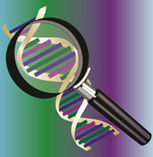
Sequence data analysis
Read depth ranged from 8× to 13×
Pipeline for short-read sequence data analysis included BWA (v. 0.7.10) and Samtools (v. 1.3)
Annotation with SNPeFF (v. 4.3)
Likely false positive variants and variants with small predicted functional effects removed

Slide 12
Ayrshire bulls sequenced
Bull ID | Name | Born | Carrier | Sequencing depth
AYCAN000008401621 | DES CHAMOIS POKER -ET | 2002 | Yes | 12.0
AYCAN000007407843 | JELYCA OBLIQUE | 2004 | No | 11.9
AYCAN000102326334 | CHALUKA KILOWATT | 2004 | No | 11.0
AYCAN000103036515 | KILDARE PERCY -ET | 2005 | No | 13.5
AYCAN000105252735 | DES FLEURS PERFECT -ET | 2008 | No | 12.5
AYCAN000105530027 | DUO STAR POKERSTARS | 2008 | Yes | 9.1
AYCAN000107377013 | DUO STAR ARMANI -ET | 2011 | No | 8.3
AYCAN000107380178 | KAMOURASKA LACTEO | 2011 | Yes | 13.8
Notes:
8 – 13 read depth
2002 – 2011 byr
3 carriers and 5 non carriers

Slide 13
Sequence variants identified
Location | Ref | Alt | Mutation | Priority | Gene name
51,250,267 | T | C | Synonymous_variant | Low | RPAP2
51,267,548 | T | C | Splice_acceptor_variant, intron_variant | High | RPAP2
51,551,840 | G | C | Missense_variant | Moderate | ENSBTAG00000003724
51,574,137 | T | C | Missense_variant | Moderate | BRDT
Notes:
4 variants in fine mapped AH2 region with 100% concordance with AH2 carrier status
4 variants in 3 genes

Slide 14
Most likely causal variant
Splice acceptor variant at 51,267,548 bp in the RNA Polymerase 2 Associated Protein (RPAP2)
RPAP2 is essential component of RNA polymerase 2 holoenzyme for transcription of snRNA species
Variant present in the 1000 Bull Genomes Project data (one Swedish Red bull)
Mouse knockout studies [Gerdin (2010)]
  Deficiency of homozygotes
  Suggests RPAP2 needed for embryonic development

Slide 15
Causal variants for recently discovered haplotypes
Haplotype |  | Breed | Chromosome | Location | Gene
AH1 |  | Ayrshire | 17 | 65,921,497 | UBE3B
AH2 |  | Ayrshire | 3 | 51,267,548 | RPAP2
BH1 |  | Brown Swiss | 7
BH2 |  | Brown Swiss | 19 | 11,063,520 | TUBD1
HH0 |  | Holstein | 21 | 21,184,869 – 21,188,198 | FANCI
HH1 |  | Holstein | 5 | 63,150,400 | APAF1
HH2 |  | Holstein | 1
HH3 |  | Holstein | 8 | 95,410,507 | SMC2
HH4 |  | Holstein | 1 | 1,277,227 | GART
HH5 |  | Holstein | 9 | 93,223,651 – 93,370,998 | TFB1M
HCD |  | Holstein | 11 | 77,958,995 | APOB
JH1 |  | Jersey | 15 | 15,707,169 | CWC15
JH2 |  | Jersey | 26
Notes:
Causal variant found in 10 of 13 haplotypes
BH1, HH2 and JH2 still left to find

Slide 16
Economic impact of AH2
Economic value of AH2 estimated using approach of Cole et al. (2016)
AH2 assumed to produce early embryonic losses because of fertility effect
AH2$ = Cost of early embryonic loss × (AH2 frequency)²
= $200 × 0.093²
= $2.96/animal ($55,905/US population)
Underestimated if losses occur later in gestation
Slightly higher value ($3.38/cow) for AH1 because of its higher haplotype frequency
Notes:
Cost of embryonic loss x the hap freq of AH2 squared

Slide 17
Conclusions
Function of RPAP2 (along with observed effect on sire conception rate) suggest AH2 is a newly discovered, embryonic lethal recessive in Ayrshires
AH2 carrier status should be reported to the industry given its current and increasing frequency
AH2 effects on fertility are being calculated for the Canadian Ayrshire population in collaboration with Filippo Miglior’s team at CDN

Slide 18
Acknowledgments
Council on Dairy Cattle Breeding provided data under USDA Nonfunded Cooperative Agreement 58-1245-3-228N
Semex supplied semen for sequencing
Research supported by USDA-ARS project 1265-31000-101, “Improving Genetic Predictions in Dairy Animals Using Phenotypic and Genomic Information”

Slide 19
Disclaimers
USDA is an equal opportunity provider and employer
Mention of trade names or commercial products in this presentation is solely for the purpose of providing specific information and does not imply recommendation or endorsement by USDA

Slide 20
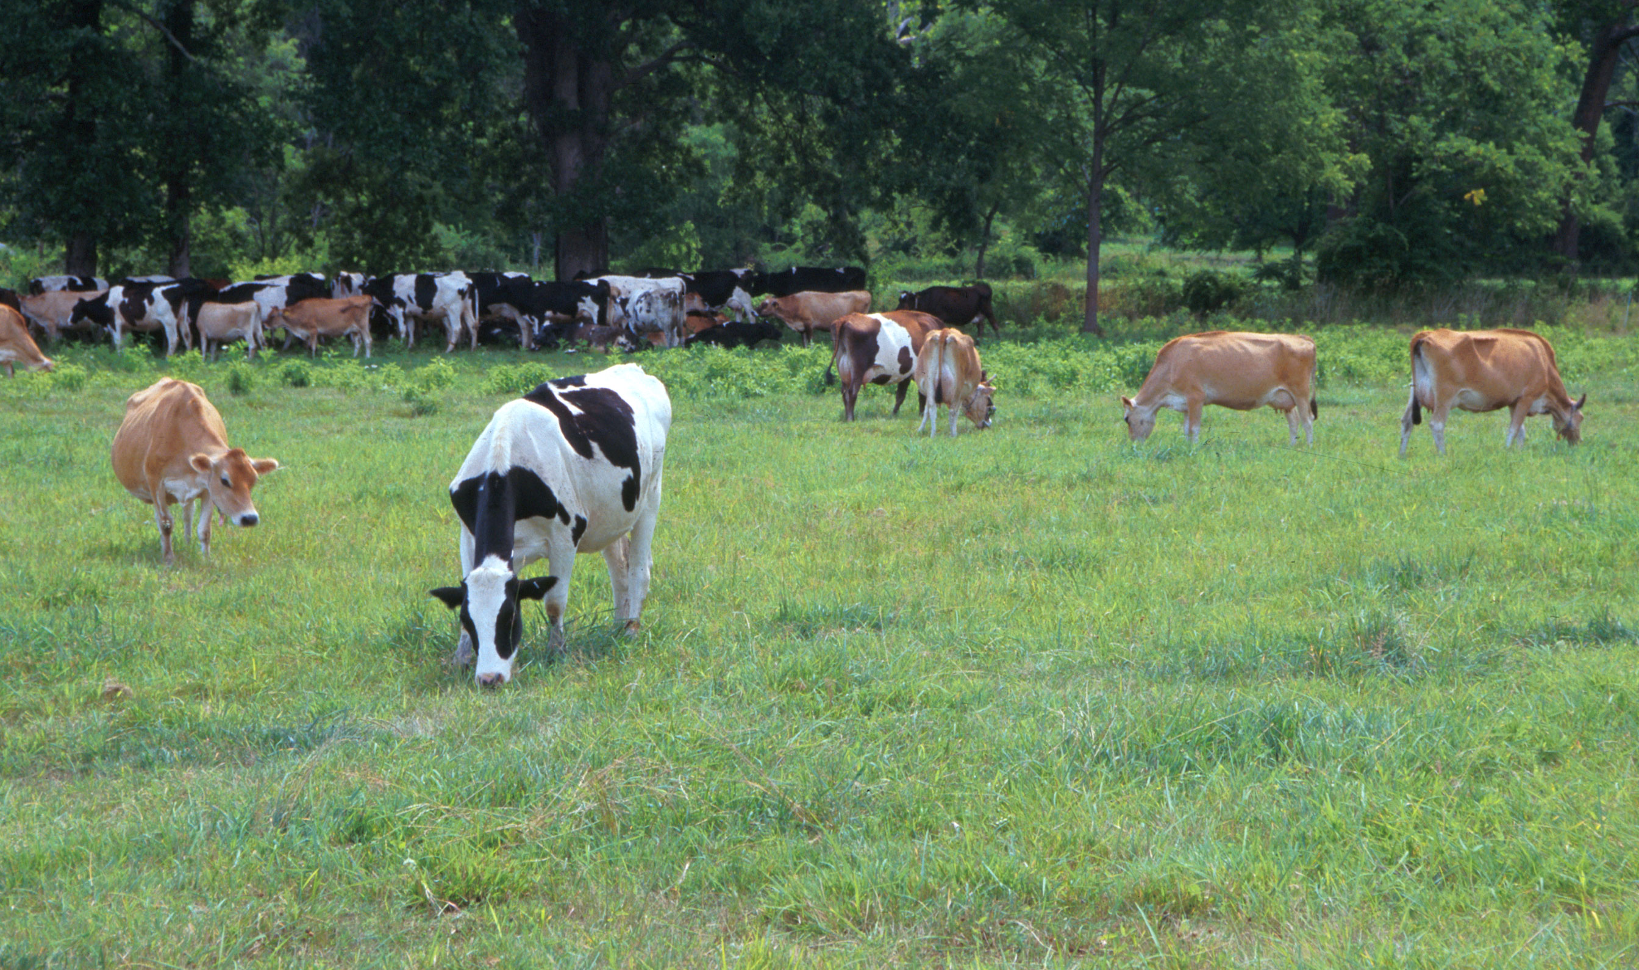
Questions?
AIP web site:
http://aipl.arsusda.gov
Holstein and Jersey crossbreds graze on American Farm Land Trust’s
Cove Mountain Farm in south-central Pennsylvania
Source: ARS Image Gallery, image #K8587-14; photo by Bob Nichols

