Slide 1
Identification of genomic regions associated with resistance to clinical mastitis in U.S. Holstein cattle (Abstract 58)
J.B. Cole^{1,*} K.L. Parker Gaddis², C. Willard¹, D.J. Null¹, C. Maltecca³, and J.S. Clay⁴
¹ Animal Genomics and Improvement Laboratory, ARS, USDA, Beltsville, MD, USA
² Council on Dairy Cattle Breeding, Bowie, MD, USA
³ Department of Animal Science, College of Agriculture and Life Sciences, North Carolina State University, Raleigh, NC, USA
⁴ Dairy Records Management Systems, Raleigh, NC, USA
john.cole@ars.usda.gov

Slide 2
Introduction
In April 2018, the US introduced genetic evaluations for 6 health traits in Holstein cattle, including clinical mastitis, using producer-reported data (Parker Gaddis et al., 2017).
Cows with clinical mastitis suffer yield depressions from which they don’t fully recover (e.g., Rajala-Schultz et al., 1999).
Cows with clinical mastitis have reduced fertility compared to health cows (e.g., Ahmadzadeh et al., 2009).

Slide 3
Objectives
Many loci associated with
clinical mastitis have been
identified (CattleQTLdb).
It is unknown how
susceptibility to clinical
mastitis is influenced by
common sets of genes.
The objective of this study
was to identify genes,
genomic regions, and gene
networks associated with
clinical mastitis.

Slide 4
Phenotypic and genomic data
Dec. 2016 genomic PTA for clinical mastitis (MAST) as described in Parker Gaddis et al. (2014, 2017).
Genotypes included 60,671 SNP from routine U.S. evaluations.
The predictor population included 34,818 bulls with reliabilities of PTA for lifetime net merit > parent average reliability.

Slide 5
Genomewide association studies (GWAS)
Single-trait GWAS were fit in GEMMA v. 0.94 (Zhou and Stevens, 2014) using the model:
y = μ + xβ^{T} + u + e
where:
y is an n × 1 vector of deregressed MAST GPTA for n individuals
μ is the intercept
x is an n × 1 vector of marker genotypes
β is an n × 1 vector of marker effect sizes for MAST
u is an n × 1 vector of random effects
and e is an n × 1 vector of random residual errors

Slide 6
SNP annotation
Autosomal markers were assigned to the closest gene within 25 kbp using BEDTools v. 2.21.0 (Quinlan and Hall, 2010).
Gene information was taken from the Bovine UMD3.1.1 genome assembly (Zimin et al., 2009).
36,435 markers remained after merging with annotation data.
SNP from the GWAS with P-values from a Wald test ≤0.10 were selected for further analysis.
Gene function was determined by a review of the literature.

Slide 7
Enrichment analyses
Gene ontology (GO; Ashburner et al., 2000) and medical subject heading (MeSH; Morota et al., 2015) enrichment analyses were used to compare all SNP with P-values ≤0.10 against a background of all annotated genes in the bovine genome.
GO and MeSH term analyses were carried out in R v. 3.4.0 using the “GOSTATS” v. 1.5.3 and “meshr” v. 1.12.0 packages as distributed in Bioconductor v. 3.5.

Slide 8
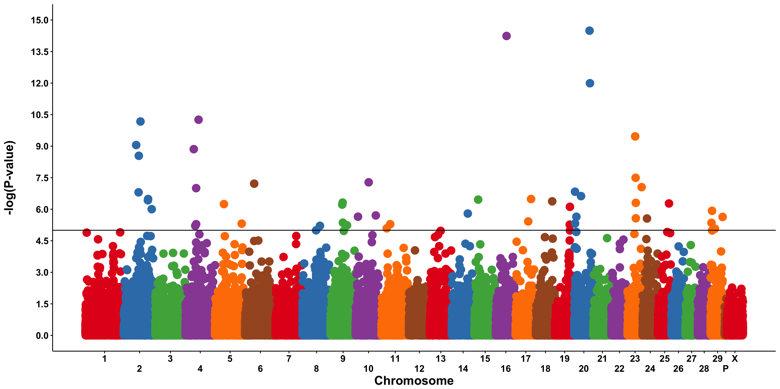
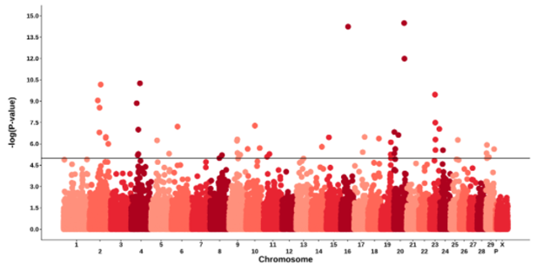
Manhattan plot for MAST [-log₁₀(P-values)]

Slide 9
GWAS results (most significant SNP)
SNP | Chrome¹ | Location | Gene | Function | Nearby QTL
ARS-BFGL-NGS-13826 | 20 | 59,299,807 | DNAH5 | Force-generating dynein protein with ATPase activity | Sodeland et al. (2011)
ARS-BFGL-NGS-22157 | 2 | 71,906,695 | TMEM177 | Promotes assembly of COX2 in the mitochondrion | Sodeland et al. (2011)
Hapmap44774-BTA-55887 | 23 | 28,307,706 | NA | Neuraminidase 1, immune response against viruses | Wojdak-Maksymiec et al. (2013)
BTB-01274050 | 2 | 53,161,676 | ARHGAP15 | GTPase activator for the Rho-type GTPases | --
Hapmap55409-rs29022997 | 4 | 33,236,485 | CROT | Regulates the breakdown of very long chain fatty acids | --
ARS-BFGL-NGS-100585 | 23 | 30,292,135 | NA | Neuraminidase 1, immune response against viruses | Wojdak-Maksymiec et al. (2013)
BTA-69288-no-rs | 10 | 52,933,550 | CGNL1 | Tight cell junction assembly and maintenance | --
Hapmap24324-BTC-062449 | 6 | 37,631,640 | HERC3 | Associated with colorectal and gastric carcinomas | Sahana et al. (2013)
ARS-BFGL-NGS-137 | 23 | 49,945,187 | FAM217A | Not known, localized to testis | --
BTB-01721944 | 4 | 44,694,369 | NAPEPLD | Lipid metabolism in animal tissues | --

Slide 10
Confirmation of other genes associated with MAST
CARD14 at 80.16 Mbp on BTA17 (Abdel-Shafy et al., 2014)
  Interacts with BCL10, a positive regulator of cell apoptosis and NF-κB activation
RPTOR at 52.30 Mbp on BTA19 (Sahana et al., 2013, 2014)
  Encodes part of a signaling pathway regulating cell growth which responds to nutrient and insulin levels

Slide 11
MAST effects were small
Mean = -1.500e-07
SD = 0.0037
Min = -1.630e-01
Max = 1.454e-01
Mean = 0.0013
SD = 0.0019
Min = 0.0000
Max = 0.1152

Slide 12
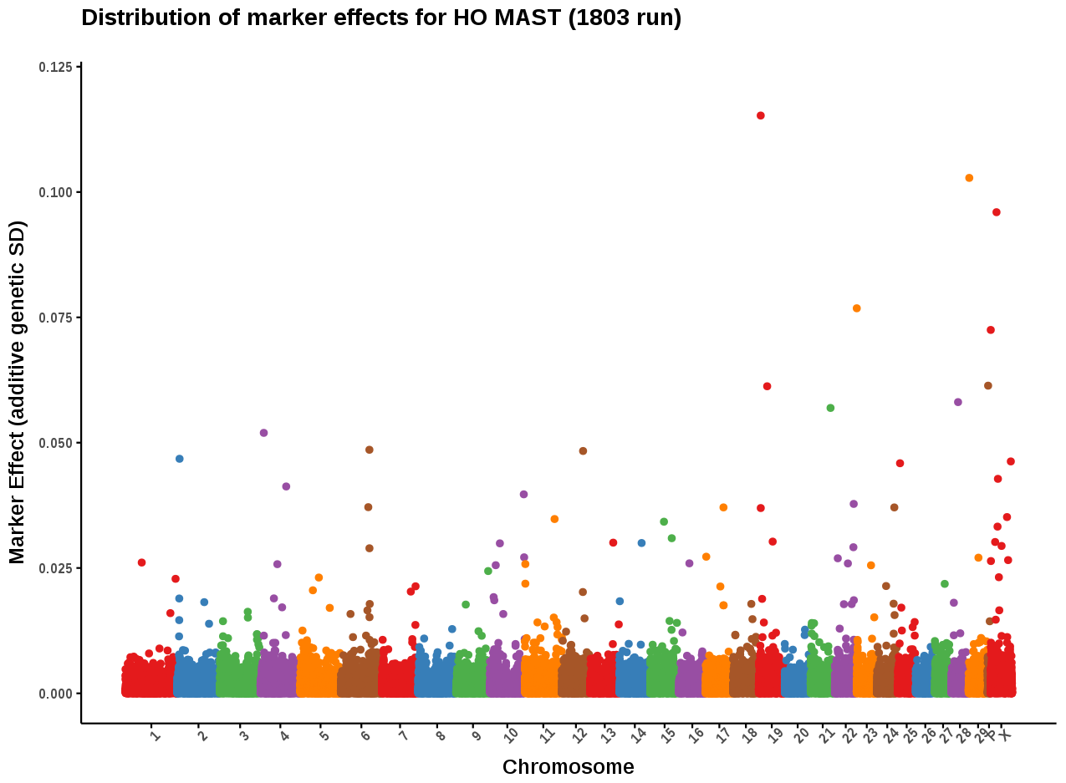
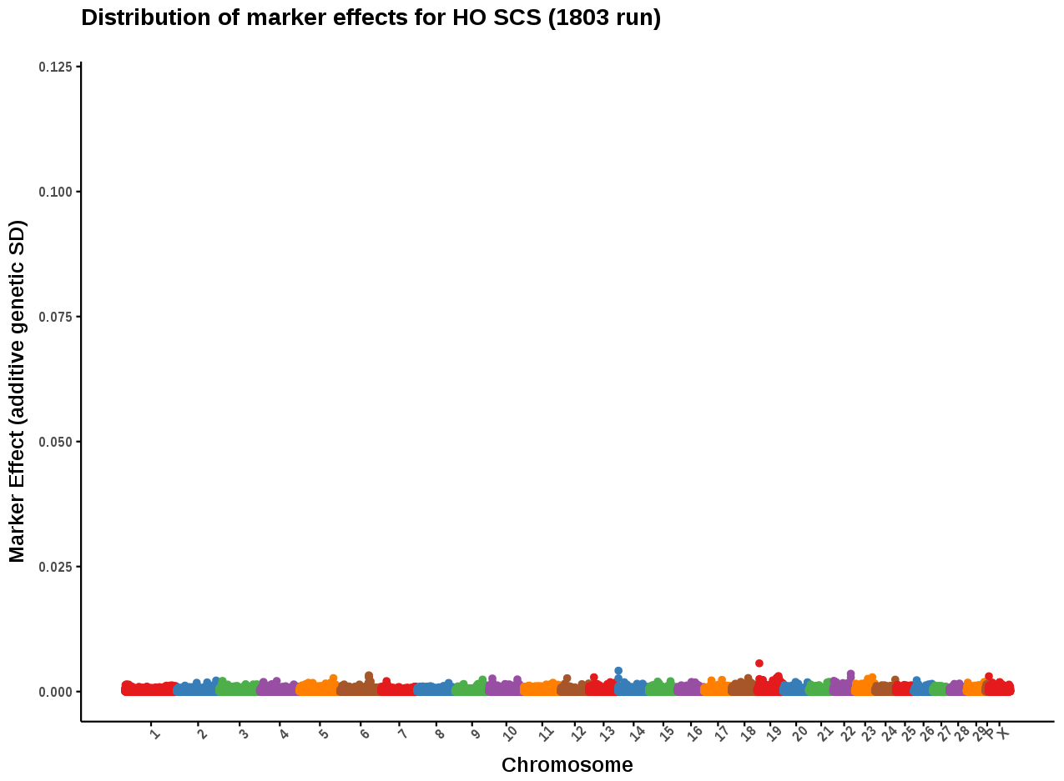
MAST compared with SCS
Results from April 2018 US genomic evaluations
No top 10 SNP we shared in common between clinical mastitis or SCS
Allele substitution effects had low correlations across traits(r_{P} = 0.5, r_{S} = -0.2)

Slide 13
Results of GO and MeSH term enrichment analysis
No enriched GO paths were identified
  Biological processes
  Molecular function
  Cellular component
No enriched MeSH terms were identified
  Diseases
  Anatomy
  Phenomena & processes
Results were confirmed with DAVID and PANTHER
This suggests that the observed QTL are distributed across many different biological processes
Consistent with infinitesimal alleles model

Slide 14
Conclusions
This analysis identified individual SNP associated with clinical mastitis, including some loci identified in previous studies by other authors.
These genes may be involved in the development and defense of the mammary gland, and possibly associated with changes in milk composition in response to infections of the udder.
However, results represent only statistical associations, and functional validation is needed to determine if these effects are causal, or simply represent correlations with other processes that may represent true causal mechanisms.

Slide 15
Acknowledgments and disclaimers
Dairy Records Management Systems (Raleigh, NC) provided the health data. The Council on Dairy Cattle Breeding (Bowie, MD) provided fertility evaluations. The Cooperative Dairy DNA Repository (Madison, WI) provided genotypes.
USDA-ARS project ARS 8042-31000-002-00, “Improving dairy animals by increasing accuracy of genomic prediction, evaluating new traits, and redefining selection goals”
Mention of trade names or commercial products in this presentation is solely for the purpose of providing specific information and does not imply recommendation or endorsement by USDA

Slide 16
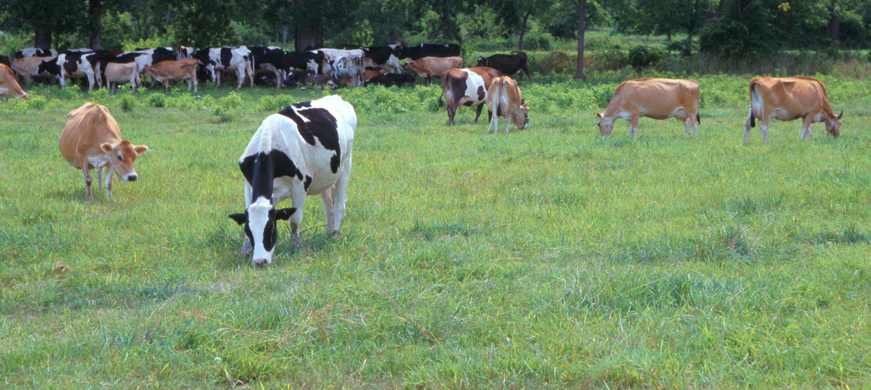
Questions?
AIP web site:
http://aipl.arsusda.gov/
Holstein and Jersey crossbreds graze on American Farm Land Trust’s
Cove Mountain Farm in south-central Pennsylvania
Source: ARS Image Gallery, image #K8587-14; photo by Bob Nichols

Slide 17
References
Ashburner M., C.A. Ball, J.A. Blake, D. Botstein, H. Butler, et al., 2000. Gene Ontology: tool for the unification of biology. Nature Genet. 25(1):25–29.
Fourichon, C., H. Seegers, & X. Malher, 2000. Effect of disease on reproduction in the dairy cow: a meta-analysis. Theriogenol. 53:1729–1759.
Fortes…
Han Y., & F. Peñagaricano, 2016. Unravelling the genomic architecture of bull fertility in Holstein cattle. BMC Genetics 17(1):143.
Morota, G., F. Peñagaricano, J.L. Petersen, D.C. Ciobanu, K. Tsuyuzaki, et al., 2015. An application of MeSH enrichment analysis in livestock. Anim. Genet. 46(4):381–387.
Parker Gaddis, K.L., D.J. Null, and J.B. Cole, 2016. Explorations in genome-wide association studies and network analyses with dairy cattle fertility traits. J. Dairy Sci. 99(8):6420–6435.
Parker Gaddis, K.L., J.B. Cole, J.S. Clay, & C. Maltecca, 2014. Genomic selection for producer-recorded health event data in US dairy cattle. J. Dairy Sci. 97(5): 3190–3199.
Parker Gaddis, K.L., M.E. Tooker, J.R. Wright, J.H. Megonigal, J.S. Clay, et al., 2017. Development of genomic evaluations for direct measures of health in U.S. Holsteins and their correlations with fitness traits. J. Dairy. Sci. 100(Suppl. 2):378(abstr. 377).
Quinlan, A.R., & I.M. Hall, 2010. BEDTools: a flexible suite of utilities for comparing genomic features. Bioinformatics 26(6):841–842.
Shannon, P., A. Markiel, O. Ozier, N.S. Baliga, J.T. Wang, D. Ramage, N. Amin, B. Schwikowski, & T. Ideker, 2003. Cytoscape: A software environment for integrated models of biomolecular interaction networks. Genome Res. 13:2498–2504.
Zhou, X., & M. Stephens, 2014. Efficient multivariate linear mixed model algorithms for genome-wide association studies. Nat. Methods 11(4):407–409.
Zimin, A.V., A. L. Delcher, L. Florea, D.R. Kelley, M.C. Schatz, et al., 2009. A whole-genome assembly of the domestic cow, Bos taurus. Genome Biol. 10:R42.

