Slide 1


Modeling uncertain paternity to address differential pedigree accuracy
Heather Bradford,
Yutaka Masuda, John Cole,
Ignacy Misztal, Paul VanRaden

Slide 2
Selective Daughter Genotyping

Slide 3
Pedigree Accuracy
Parent confirmed
  82% sire
  33% dam
Parent conflict
  8% sire
  1% dam
Parent not genotyped
  2% sire
  48% dam
No pedigree
  8% sire
  18% dam
2.2 million genotypes
  97% sire validated
  39% dam validated
Pedigree discovery accuracy
  100% sire
  97% MGS
  92% MGGS
VanRaden et al., 2013; Wiggans et al., 2018

Slide 4
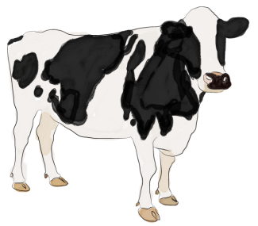
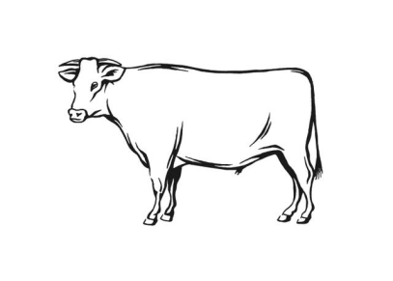
Original Idea
Certain
Multiple Sires
0.25
0.5
0.5
0.5
0.25
Henderson, 1988

Slide 5
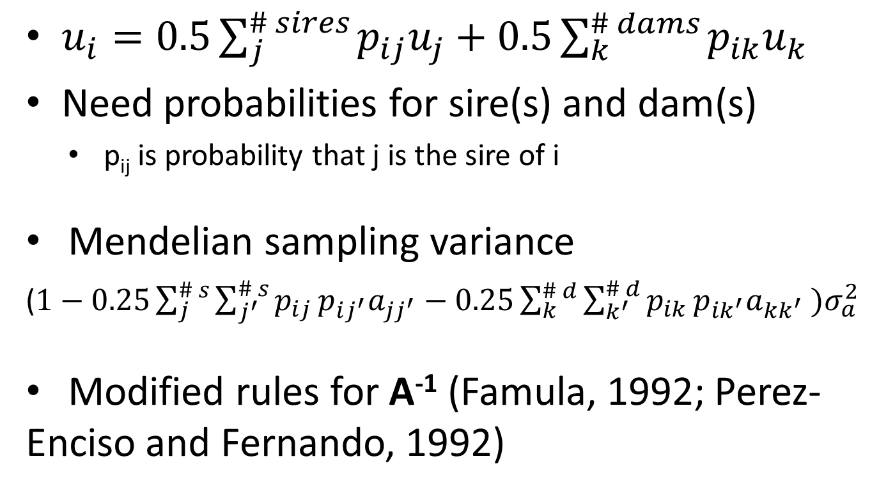
Modeling Uncertain Pedigree
$u_{i}=0.5\sum_{j}^{\# sires}{p_{ij}u_{j}}+0.5\sum_{k}^{\# dams}{p_{ik}u_{k}}$
Need probabilities for sire(s) and dam(s)
    p_{ij} is probability that j is the sire of i
Mendelian sampling variance
($1−0.25\sum_{j}^{\# s}{\sum_{j^{′}}^{\# s}{p_{ij}}p_{ij^{′}}a_{jj^{′}}}−0.25\sum_{k}^{\# d}{\sum_{k^{′}}^{\# d}{p_{ik}}p_{ik^{′}}a_{kk^{′}} )σ_{a}^{2}}$
Modified rules for A⁻¹ (Famula, 1992; Perez-Enciso and Fernando, 1992)

Slide 6
Assumptions
Accurate pedigree
Uncertain pedigree
Animal and parent both genotyped
AI sires and parents
All probabilities = 1
Animal or sire not genotyped
  Probability of sire = 0.90
  Probability of sire UPG = 0.10
Animal or dam not genotyped
  Probability of dam = 0.95
  Probability of dam UPG = 0.05

Slide 7
Uncertain Pedigree
0.45
Dam group
0.475
Sire group
0.05
0.025

Slide 8
A⁻¹ with Uncertain Pedigree
Animal Sire 1 Sire UPG 2 Dam 3 Dam UPG 4
1 | -0.5 p_{i1} | -0.5 p_{i2} | -0.5 p_{i3} | -0.5 p_{i4}
 | 0.25 p_{i1} p_{i1} | 0.25 p_{i1} p_{i2} | 0.25 p_{i1} p_{i3} | 0.25 p_{i1} p_{i4}
 |  | 0.25 p_{i2} p_{i2} | 0.25 p_{i2} p_{i3} | 0.25 p_{i2} p_{i4}
 |  |  | 0.25 p_{i3} p_{i3} | 0.25 p_{i3} p_{i4}
 |  |  |  | 0.25 p_{i4} p_{i4}
All multiplied by the inverse of Mendelian sampling

Slide 9
A⁻¹ with Uncertain Pedigree
Animal Sire 1 Sire UPG 2 Dam 3 Dam UPG 4
1 | -0.45 | -0.05 | -0.475 | -0.025
 | 0.2025 | 0.0225 | 0.21375 | 0.01125
 |  | 0.0025 | 0.02375 | 0.00125
 |  |  | 0.225625 | 0.011875
 |  |  |  | 0.000625
All multiplied by the inverse of Mendelian sampling

Slide 10

Data
Phenotypes from 2000 to 2017
  34 million
  Milk, fat, and protein
3-generation pedigree, 21 million animals
674k genotypes for 61k SNP
  Bulls
  Phenotyped cows

Slide 11
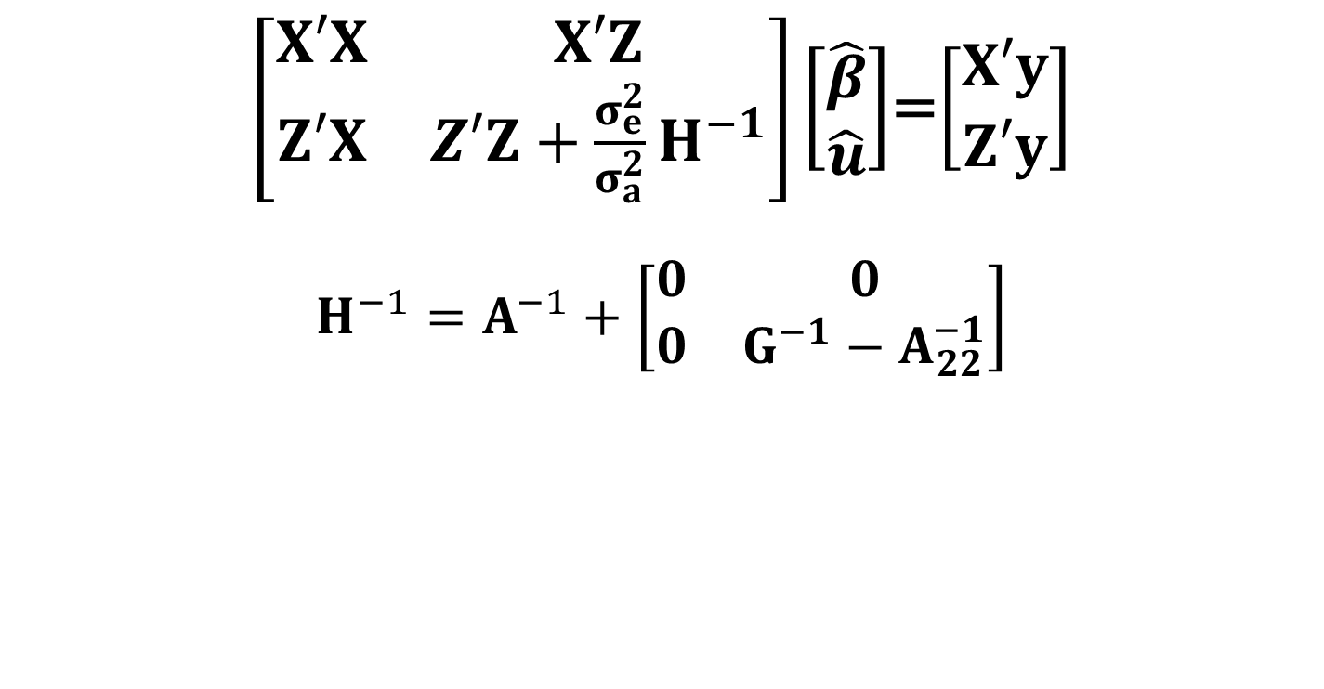
Model
$\left[\begin{matrix}X′X & X′Z \\ Z′X & Z′Z+{\frac{σ_{e}^{2}}{σ_{a}^{2}}H}^{−1}\end{matrix}\right]\left[\begin{matrix}\hat{β} \\ \hat{u}\end{matrix}\right]$=$\left[\begin{matrix}X′y \\ Z′y\end{matrix}\right]$
$$H^{−1}=A^{−1}+\left[\begin{matrix}0 & 0 \\ 0 & G^{−1}−A_{22}^{−1}\end{matrix}\right]$$
Modified for uncertain pedigree

Slide 12
Uncertain Pedigree Statistics
Pedigree relationship(s) | All (%) | Genotyped (%)
Sire uncertain | 0.01 | 0.2
Dam uncertain | 1.5 | 46.6
Sire and dam uncertain | 96.7 | 1.4
Neither uncertain | 1.8 | 51.7

Slide 13
Rank Correlations
Group | n | Milk | Fat | Protein
AI bulls | 581 | 0.98 | 0.99 | 0.97
Top 100 | 100 | 0.97 | 0.98 | 0.96
Genomic bulls | 2,215 | 0.99 | 0.99 | 0.99

Slide 14
PTA Differences
Traditional – uncertain pedigree
Trait (kg) | Min | Mean | Max | SD increase
All animals, n=20,917,044
Milk | -273 | 25 | 179 | 0.5
Fat | -10 | -1 | 6 | 0.00
Protein | -11 | -1 | 5 | 0.03
AI bulls, n=581
Milk | -149 | -66 | 35 | 4.8
Fat | -6 | -3 | 0 | 0.10
Protein | -4 | -2 | 0 | 0.10

Slide 15
Pedigree Discovery
2 million Holstein genotypes
  205,200 virtual dams
  194,429 virtual granddams
78% of cases with no maternal information
GGS
GS
GGD
Sire
GGS
GD
GGD
Animal
GGS
Discovered GS
GGD
Virtual Dam
Discovered GGS
Virtual GD

Slide 16
Conclusions
Pedigree errors reduce PTA dispersion
Differences in pedigree accuracy have minimal impact on bull rankings
Research needed to add discovered paternal lineage for maternal pedigree

