Slide 1
Genomic prediction and marker selection using high-density genotypes from 5 dairy breeds (Abstract #78904)
P.M. VanRaden¹, D.J. Null¹, J.R. O'Connell², J.B. Cole¹, and B. Li¹
¹ Animal Genomics and Improvement Laboratory, ARS, USDA, Beltsville, MD, USA
²University of Maryland School of Medicine, Baltimore, MD, USA
paul.vanraden@ars.usda.gov

Slide 2
Topics
Background of current official genomic prediction
High-density (HD) genotype imputation for 5 breeds
Effects of HD vs official 80k SNPs on 37 traits
Selection of SNPs for future chips and for routine use
Correlations of genomic predictions from HD vs 80k

Slide 3
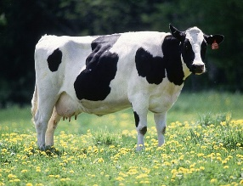
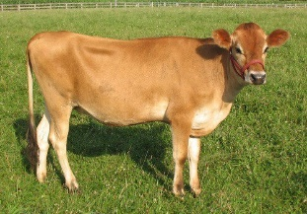
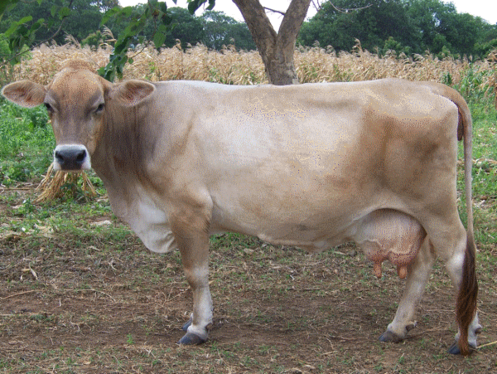
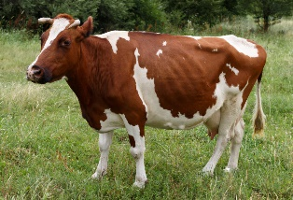
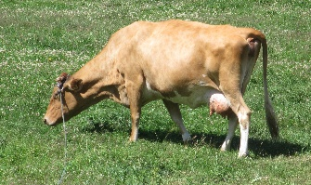
Current official genomic prediction
Official genomic prediction includes 79,294 (80k) SNPs and 5 breeds Holstein (HO), Jersey (JE), Brown Swiss (BS), Ayrshire (AY), Guernsey (GU)
The 80k markers include large-effect HD and sequence SNPs found previously in Holsteins
Large-effect HD SNP for non-Holstein breeds were rarely studied in the US because too few animals were HD genotyped in these breeds
HO
JE
BS
AY
GU

Slide 4
Current official genomic prediction
Recently, increased number of HD genotypes in non-Holstein breeds makes imputation possible
Imputed HD genotypes → to select large-effect SNP from HD chip
Adding newly-selected HD markers could improve genomic predictions for non-Holstein breeds and crossbred evaluation

Slide 5
Objectives of study
For each of the 5 breeds:
Estimate SNP effects using imputed HD genotypes
Select large-effect SNPs from HD SNPs
Compare predictions between HD & 80k

Slide 6
Genotypes available before and after imputation¹
Genotyped animals | HO² | JE | BS | AY | GU
High density | 4,012 | 407 | 181 | 527 | 147
Medium density (30k-150k) | 166,440 | 60,395 | 28,061 | 3,027 | 1,544
Low density (<30k) | 181,009 | 286,768 | 14,104 | 5,810 | 2,908
Total | 351,461 | 347,570 | 42,346 | 9,364 | 4,599
Available before (%) | 6.8 | 3.5 | 6.2 | 10.4 | 8.6
Available after (%) | 98.9 | 96.8 | 93.3 | 95.2 | 95.8
¹Missing genotypes were imputed with Findhap (version 3)
²Holstein genotypes included all bulls, their ancestors, plus HD females

Slide 7
Overview of imputed HD marker list
643,059 variants include:
SNPs of original HD chip
All 80k SNPs
Gene tests used in routine evaluations
Chromosome locations used the ARS-UCD1 map
The variants were not pruned for high LD as in previous HD studies for Holstein

Slide 8
Estimation of SNP effects: Data
For 5 breeds, 26 to 39 traits per breed (total 146 traits x breeds)
No. of animals in reference populations¹
Counts | HO | JE | BS | AY | GU
Proven bulls | 43,140 | 6,157 | 7,112 | 766 | 447
Cows with records | 40,835² | 110,130 | 3,252 | 550 | 1,238
Total reference | 83,975 | 116,287 | 10,364 | 1,316 | 1,685
Traits | 39 | 26 | 29 | 26 | 26
¹Reference counts are for milk yield, other traits may have fewer records
²Holstein imputed genotypes included all bulls, their ancestors, plus HD females

Slide 9
Estimation of SNP effects: Methods
Imputed HD genotypes (643,059 SNPs)
An approximate BayesA method
y = u + Zg + a + e
- y is de-regressed PTA; u is global mean
- Z is marker genotype; g is marker effect with var(g)=$σ_{BV}^{2}$*0.90
- a is polygenic effect with var(a)= A$σ_{BV}^{2}$*0.10
- e is the random residual with var(e)=R$σ_{e}^{2}$
SNP effects estimated for each marker for each breed and trait

Slide 10
SNP selection strategy
Window-based selection to select SNP across genome
Steps:
10-Mb window were built
For each window, breed-specific selection:
HO: |effect| > 8 or genSD > 5; Max. 5 SNP per window
JE: |effect| > 10 or genSD > 7; Max. 3 SNP per window
BS,AY,GU |effect| > 15 or genSD > 10; Max. 2 SNP per window
Pooling selected SNP from all windows, traits, breeds together

Slide 11
Results: Selected large-effect SNPs
A total of 11,045 SNP (8,922 unique) were selected
Category | Available |  | Selected |  | Selected/Available
 | N | % | N | % | % / %
80K | 79,254 | 12.3 | 3,127 | 35.0 | 2.8
- 50K | 46,290 | 7.2 | 1,298 | 14.5 | 2.0
- Sequence | 750 | 0.12 | 86 | 0.96 | 8.0
- QTLs | 82 | 0.013 | 8 | 0.09 | 6.9
Original HD chip | 554,014 | 86.2 | 5,539 | 62.1 | 0.7
Total | 643,059 | 100 | 8,922 | 100

Slide 12
SNPs selected for breed and trait
For 5 breeds
For TOP 5 traits
Breed | No. of SNP | % of Total
HO | 6,162 | 55.8
JE | 1,423 | 12.9
BS | 1,145 | 10.4
AY | 1,304 | 11.8
GU | 1,011 | 9.2
Total | 11,045 | 100
Trait | No. of SNP | % of Total
Heifer_Conc_Rate | 426 | 3.9
Mastitis | 412 | 3.7
Net merit | 409 | 3.7
Metritis | 394 | 3.6
Rear_ud_height | 366 | 3.3

Slide 13
Example of HD vs. 80k SNPs
HD SNPs effect > 80K SNP effect on BTA19 in GU for productive life
HD→Green
80k →Red
HD→Green
80k →Red

Slide 14
Correlations of HD with 80K predictions
Correlations of HD with 80K genomic predictions for young animals
The correlations tended to be higher in milk production traits than type traits and fertility traits
 | HO | JE | BS | AY | GU
Corr(HD, 80k) | 0.983 | 0.988 | 0.970 | 0.991 | 0.921

Slide 15
Conclusions
Previous studies selected and included large-effect markers from Holstein traits
Numbers of HD genotypes were now sufficient to impute other breeds
Newly selected large-effect HD markers should improve JE, AY, BS, GU, and crossbred genomic predictions
Diverse methods for SNP selection
SNPs selected for future chips and for routine use

Slide 16
Acknowledgments and disclaimers
The Council on Dairy Cattle Breeding (Bowie, MD) provided the evaluation data.
Genotyping labs provided data for gene tests and additional selected SNPs
USDA-ARS project ARS 8042-31000-002-00, “Improving dairy animals by increasing accuracy of genomic prediction, evaluating new traits, and redefining selection goals”
Mention of trade names or commercial products in this presentation is solely for the purpose of providing specific information and does not imply recommendation or endorsement by USDA

Slide 17
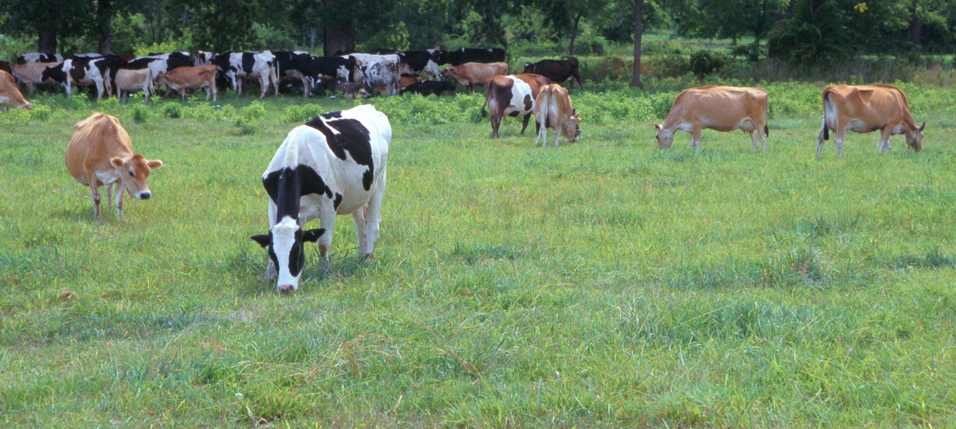
Questions?
AIP web site:
http://aipl.arsusda.gov/
Holstein and Jersey crossbreds graze on American Farm Land Trust’s
Cove Mountain Farm in south-central Pennsylvania
Source: ARS Image Gallery, image #K8587-14; photo by Bob Nichols

Slide 18
Computation
Imputation with 24 processors took < 2 days for each breed
Missing genotypes were imputed with Findhap version 3
Before imputation, 90-97% of genotypes in each breed were unknown
After imputation, 1-7% of alleles remained unknown
Estimation of allele effects took 4-8 processor days per trait
Each breed had from 26 to 39 traits (total 146 traits x breeds)
Convergence required up to 800 iterations

Slide 19
Selected large-effect SNPs
A total of 11,045 SNP (8,922 unique) were selected
Category | Available |  | Selected |  | Selected/Available
 | N | % | N | % | % / %
80K | 79,254 | 12.3 | 4,043 | 36.6 | 3.0
- 50K | 46,290 | 7.2 | 1,708 | 15.5 | 2.2
- Sequence | 782 | 0.12 | 177 | 1.6 | 13.3
- QTLs | 82 | 0.013 | 32 | 0.29 | 22.3
HD (not in 80k) | 554,014 | 86.2 | 6,567 | 59.5 | 0.69
Total | 643,059 | 100 | 11,045 | 100 | 1.0

Slide 20
Example of Jersey HD vs. 80k SNPs
Some HD effects were > twice as large as the largest 80K SNP
BTA 11 at 104 Mb, HD SNPs had the largest effects for fore udder attachment, front teat placement, rump width, and rump angle. For udder cleft and teat length, HD SNPs had higher effects than the highest SNP already in the 80K list
Large new effects were also discovered from HD for daughter pregnancy rate and cow conception rate
Surprisingly for protein, the Β-Lactoglobulin gene test had smaller effects than three nearby HD SNPs

Slide 21
Official predictions include 79,294 (80k) SNPs
Official genomic predictions include 79,294 (80k) SNPs
Large effect HD and sequence SNPs from 2 previous studies
Wiggans et al., 2016 J. Dairy Sci. 99:4504-4511 [HD SNPs]
VanRaden et al., 2017 Genet. Sel. Evol. 49:32 [sequence]
Gene tests that were added to recent chips
Causal alleles within lethal haplotypes
Removed previous SNPs with high parent-progeny conflict rates, missing genotypes, Hardy-Weinberg within breeds, etc.
Set SNPs to missing on individual chips with poor properties

Slide 22
QTLs with big effects on 80k SNPs
Gene test | Breeds | Traits
DGAT1 | JE | Fat%, Prot%, Milk, NM$, Fore udder, teat length
BGHR | HO, JE, BS, AY | Fat%, Prot%, Milk
ABCG2 | HO | Fat%, Pro%
β-casein | HO | Pro%
β-lactoglobulin | HO, JE, BS | Fat, Protein, Fat%
MITF | AY | Foot Angle

