Slide 1
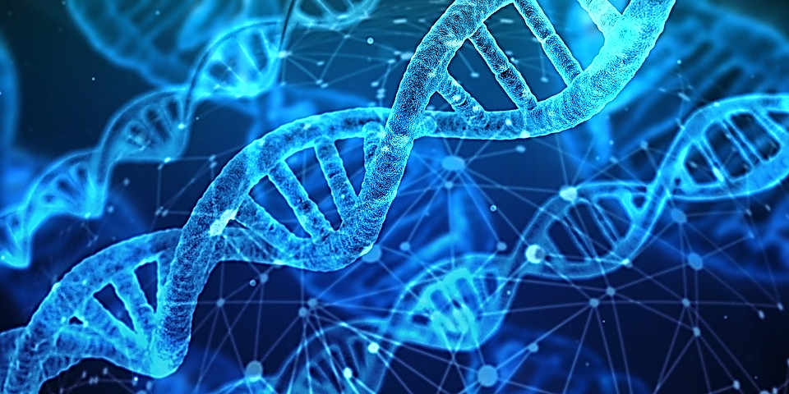
How to implement genomic selection
abstract #66
Paul VanRaden
USDA, Agricultural Research Service, Animal Genomics and Improvement Laboratory, Beltsville, MD
Email: paul.vanraden@ars.usda.gov
Project web site: https://aipl.arsusda.gov/

Slide 2
Genomic selection requires:
DNA from many animals
Genotypes for many variants per animal
Phenotypes from many animals
Quality control of the data
Statistical methods to convert data into predictions
Breeders convinced that the predictions will work
Investment to continue collecting data

Slide 3
Progress over the last decade
Progress in stability and reliability of predictions
Expansion in number of variants tested
Additional traits tested and new uses for genotyping
Growth in numbers genotyped worldwide and in other species
Genetic progress

Slide 4
Sources of DNA for selected years
Source | 2008 | 2010 | 2018 | 2008 | 2010 | 2018
 | % | % | % | N | N | N
Tissue (ear) | 0 | <1 | 81 | 0 | 100 | 579,255
Hair | 0 | 82 | 14 | 0 | 22,550 | 102,229
Blood | 10 | 5 | 2 | 623 | 1,375 | 14,656
Embryos | 0 | 0 | 1 | 0 | 0 | 6,188
Nasal swab | 0 | 12 | <1 | 0 | 3,300 | 656
Semen | 90 | <1 | <1 | 5,285 | 200 | 319
Unknown | 0 | 0 | 2 | 0 | 0 | 17,048

Slide 5
Potential for embryo genotyping
15,000 embryos already genotyped
Genomic predictions sent only to breeder via nominator
Change selection strategies if technology improves and costs decline
  Genotype before instead of after pregnancy
  Demand for embryo genotyping could be more than for calves
  Could genotype 20 million embryos/year instead of 4 million calves
May be difficult to automate … requires switching to ET instead of AI

Slide 6
Worldwide dairy genotyping (January 2009)
Countries | Animals
United States and Canada | 22,344
France | 8,500
Netherlands and New Zealand* | 6,000
New Zealand and Ireland | 4,500
Germany | 3,000
Australia | 2,000
Denmark, Finland, and Sweden | 2,000
Source:
“Dairy Cattle Breeders Have Adopted Genomic Selection” (Gordon Conference on Quantitative Genetics and Genomics, February 2009)
*Used customized Illumina 50K chip
(different markers)

Slide 7
Worldwide livestock genotyping (January 2019)
Species | Countries/Companies | Animals
Dairy | United States and Canada | 3,020,000
 | France | 550,000
 | Netherlands | 465,000
 | New Zealand | 140,000
 | Germany | 785,000
Beef (Angus) | United States | 550,000
Beef and dairy | Ireland | 1,500,000
Poultry | Aviagen | 1,000,000/year?

Slide 8
CDCB usable genotype counts/year by animal sex
*Through December 13

Slide 9

Formal international genotype exchanges
Country exchanges with U.S. | Breed | Sex | Year
Canada | All | All | 2008
United Kingdom, Italy | Holstein | Bulls | 2011
All Europe via Interbull | Brown Swiss | Bulls | 2012
Denmark (Viking) | Jersey | Bulls | 2014
Japan, Switzerland, Germany | Holstein | Bulls | 2016
United Kingdom | All | All | 2017

Slide 10
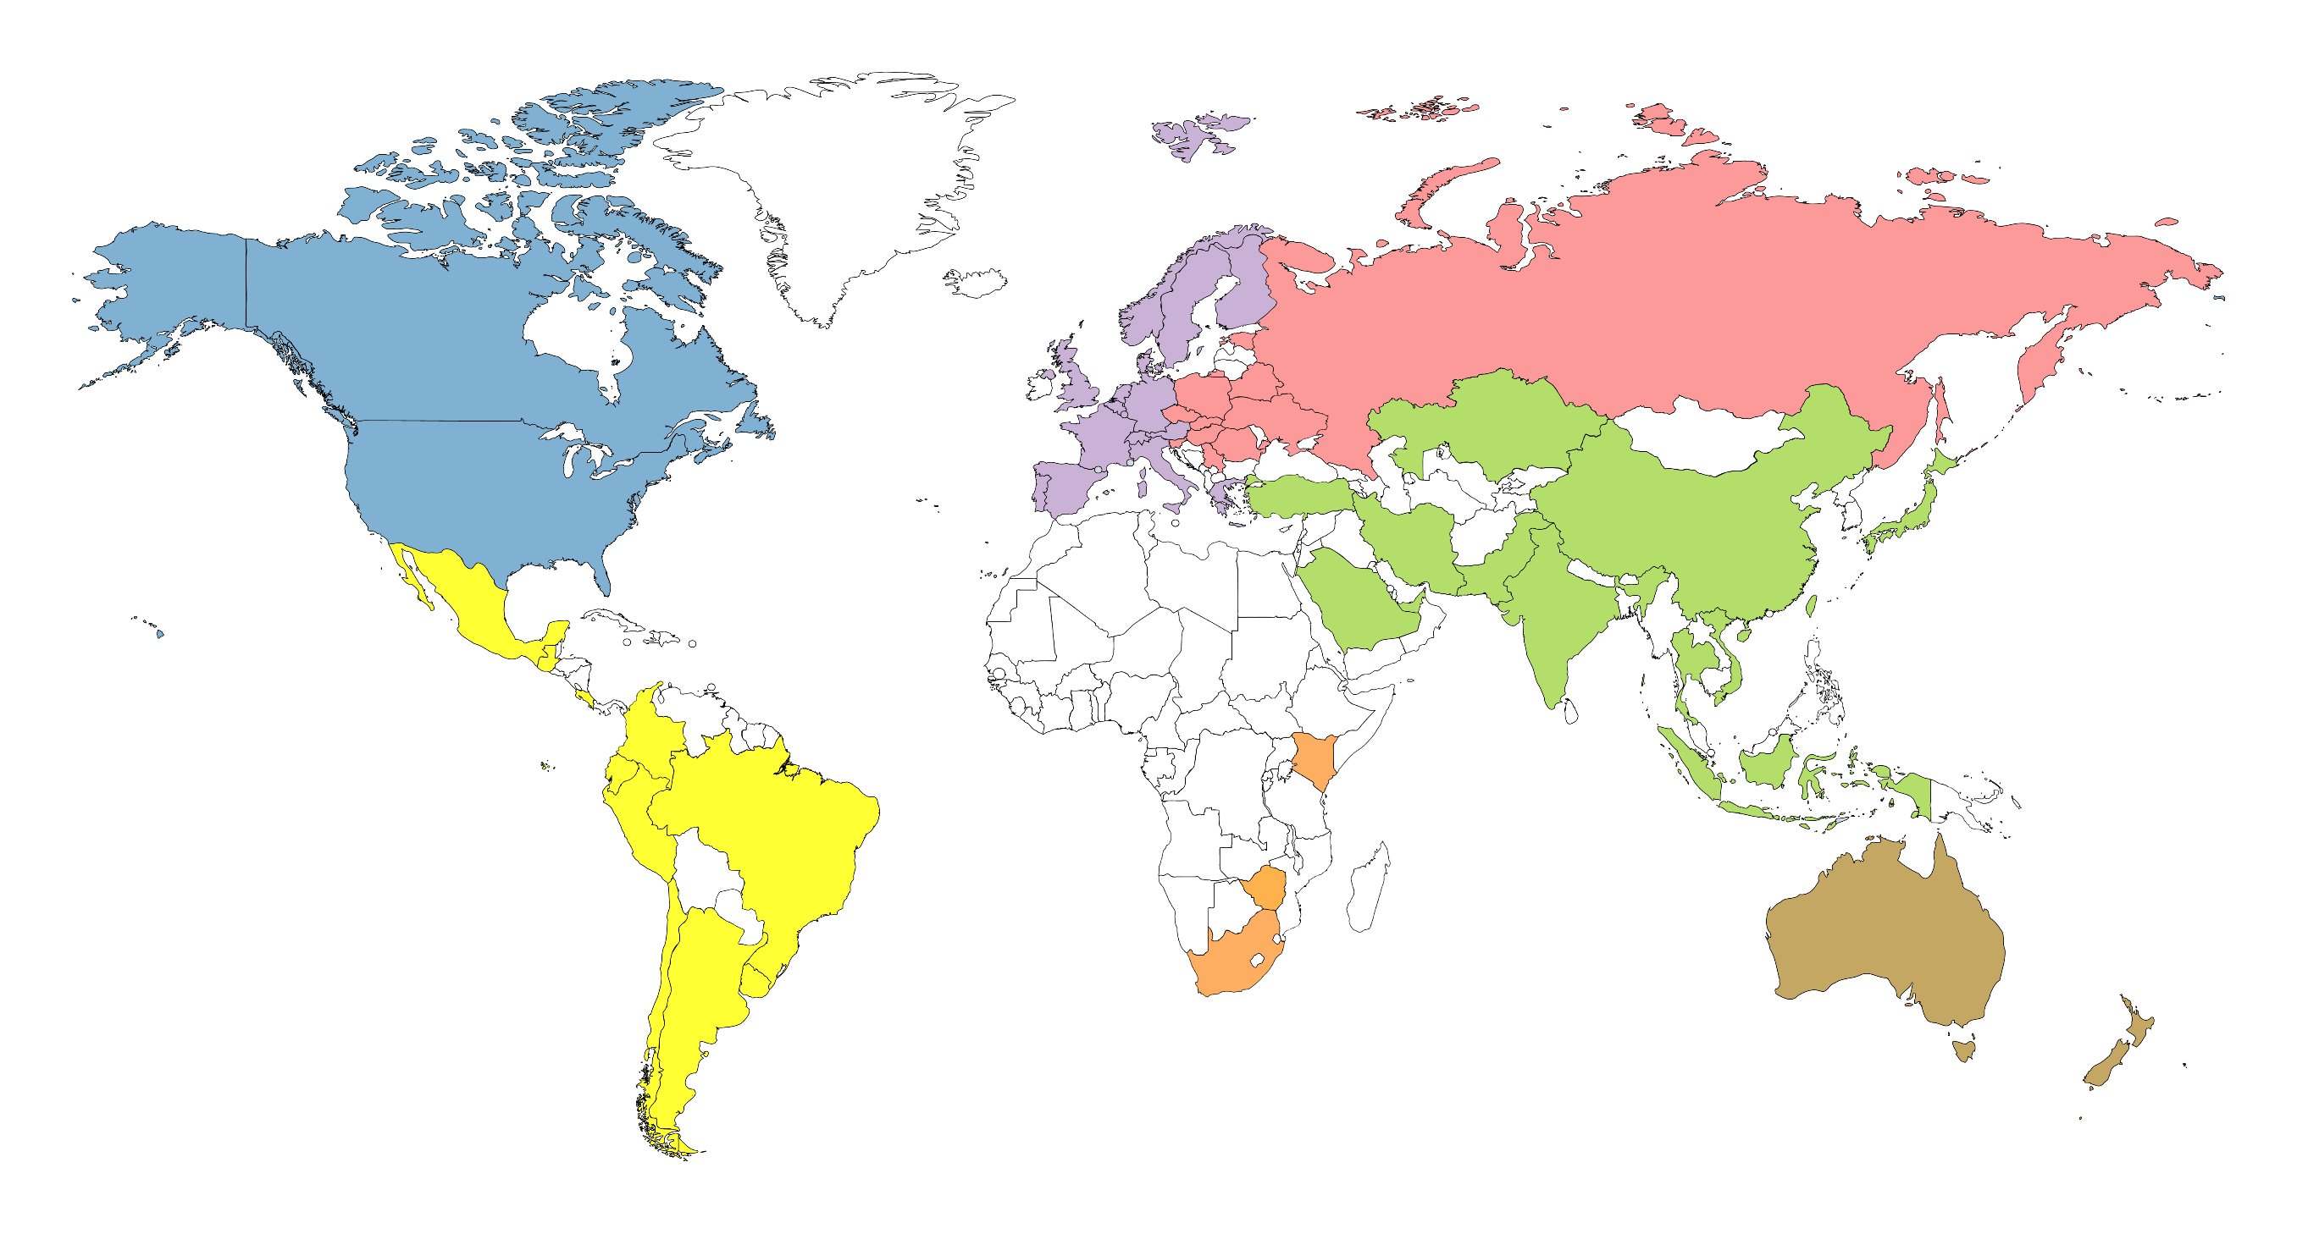
Genotyped animals in database by region (2019)
7,749
2,585,255
200,002
23,408
27,356
1,943
18,513

Slide 11
Top 10 NM$ genotyped Holsteins by country
Country | NM$ | Country | NM$ | Country | NM$ | Country | NM$
USA | 1114 | JPN | 854 | CHE | 763 | NZL | 595
CAN | 1040 | HUN | 850 | ZAF | 724 | RUS | 555
GBR | 1006 | ESP | 837 | ROU | 698 | NOR | 532
NLD | 996 | ARG | 823 | SWE | 696 | SVN | 508
DEU | 973 | POL | 799 | FIN | 684 | URY | 492
ITA | 930 | DNK | 789 | TUR | 672 | GRC | 443
CZE | 908 | LUX | 780 | TWN | 656 | PKS | 443
FRA | 904 | VNM | 780 | BRA | 652 | UKR | 384
CHN | 879 | CHL | 776 | BLR | 615 | IDN | 333
AUS | 864 | IRL | 765 | SAU | 615
BEL | 858 | MEX | 763 | PRT | 614

Slide 12
Numbers of variants tested in cattle
Year | Variants | Data source
<1995 | 0 | Only pedigrees and phenotypes
2003 | 367 | RFLP markers, not implemented
2008 | 50,000 | 50K SNP chip
2010 | 777,000 | High-density chip
2015 2019 | 39,700,000 63,000,000 | Whole genome sequencing (1000 Bull Genomes Project)
Future | New mutations (e.g., HCD) | Sequence each new AI bull
Future | Epigenetic | External control of gene function

Slide 13
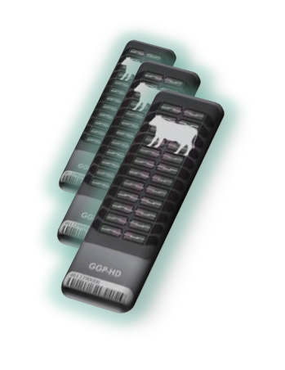
Chip history (37 chips + sequence)

Slide 14
Human genotyping and sequencing (January 2019)
Technology | Database | People genotyped | Variants genotyped
High-density (HD) SNP chip | Ancestry.com | >10 million | 700,000
 | 23andMe | Millions | 700,000
 | UK Biobank | 483,000 | 826,000
Whole genome sequence | TopMed (U. Michigan) | 135,000 | 500 million
 | Illumina | 600,000 | 500 million
HD imputed to sequence | U. Michigan | >25 million | 500 million
Total raw data = 600,000 people × 40× coverage × 2.7 billion genome length) = 65 million GB

Slide 15
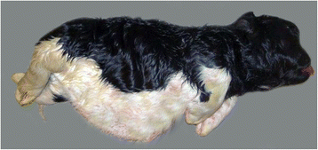
Detect new mutations by sequencing new AI bulls?
Normal DNA in both parents, but progeny has new mutation
New dominant mutation examples
  NZL: Half of Halcyon daughters had thick hair and gave no milk
  CAN: Rosabel had new dominant mutation for red hair color
  Europe: Bulldog calves from Igale Masc (1%), Captivo (12%), Energy (20%)
New recessive mutation examples
  CAN: Maughlin Storm with HCD mutation causing calf death
  USA: 118 animals with large new chromosome deletions; 252 with XXY

Slide 16
Statistical methods
Many models to choose from and several currently in use
17 countries filled out Interbull Form GENO:
  10 use multi-step GBLUP linear model
  4 use multi-step Bayesian model (non-normal SNP effect distributions)
  2 use single-step GBLUP linear model
  1 uses linear haplotype model after choosing subset by Bayesian model
  9 of the 17 countries include a polygenic term (non-SNP genetic variance)
Where did these methods come from?

Slide 17

Linear model using genomic relationships
Nejati-Javaremi, Smith, Gibson (1997) derived GBLUP methods
Compared G matrix to A matrix
  Used individual SNP genotypes (not haplotypes)
  Simulated 1,000 phenotypes with 30% heritability
  Selected directly on 100 QTLs (not markers, no polygenic effect)
  Obtained 71% REL with G matrix vs. 42% REL with A matrix
Research was from U. Guelph, Canada, but was not cited by Schaeffer (2006)
First author is a professor at U. Tehran, Iran

Slide 18
Bayesian haplotype models using Gibbs sampling
Meuwissen, Hayes, Goddard (2001) compared Bayesian to linear models
  Used haplotypes (not individual SNP effects) from 1,000 markers
  Simulated 2,200 phenotypes with 50% heritability and 100 QTLs with some very large effects
  Obtained REL = 20% pedigree, 54% GBLUP, 64% BayesA, 72% BayesB
  Did not cite Nejati-Javaremi et al (1997 JAS) in their 2001 or later papers
Calus et al (2008) showed that individual SNP effects are better than haplotypes at higher SNP densities; polygenic effects should be included
BayesA and BayesB had much smaller gains in later studies of real traits

Slide 19
Steps taken to reduce upward bias of young bulls
Highest parent averages and elite cows had been inflated for decades
  Animal model rewarded cow families within herds
Early genomic PTAs had similar biases, later corrected by:
  Including a polygenic effect in the model (2010)
  Adjusting the Mendelian sampling of top cows downward (2010)
  Using pedigree index instead of parent average (mainly in Europe)
  Reducing the weight on direct genomic value (2011)
  Using lower heritability estimates for yield traits (2014)

Slide 20
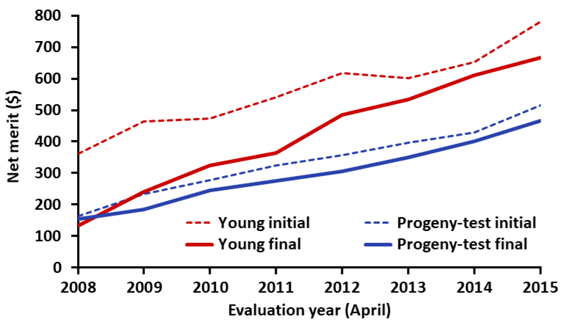
Proven vs. young bull merit and bias across time
Initial and final (Apr 2019) PTA averages of the top 100 NM$ USA AI Holsteins.
Young: bulls with no milking daughters. Proven: bulls with ≥ 100 daughters.
NM$ adjusted to current base.

Slide 21
Generation interval – Holstein

Slide 22

Genetic progress (Holstein)

Slide 23
Predict 50 years of genetic progress (Cole, 2018)
Trait | 50-year progress | 2017 mean | 2067 mean
Milk (pounds) | +9,329 | 27,055 | 36,384
Fat (pounds) | +531 | 1,008 | 1,539
Protein (pounds) | +342 | 825 | 1,167
Productive life (months) | +65 | 26 | 91
Body size (pounds) | –230 | 1,500 | 1,230
Udder composite | +2.65 | 0 | 2.65
Daughter pregnancy rate (%) | +26 | 29 | 55
Cow conception rate (%) | +42 | 35 | 77
Heifer conception rate (%) | +21 | 57 | 78

Slide 24
Selection for more traits
26 traits had US genomic PTAs in 2009
10 new traits added in 2010-2019, mostly with low h²
  Heifer and cow conception rates, cow livability, gestation length, mastitis, metritis, retained placenta, DA, ketosis, milk fever, and early first calving
Several more future traits expected soon:
  Feed intake, calf livability, heat tolerance
High genomic reliability requires:
  Large reference populations, historical databases, or high h²

Slide 25
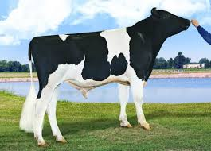

Genomic mating programs
Reduce inbreeding using genomic instead of pedigree relationships
  Genomic relationship of each live female to each marketed bull
  File contains 1 million females × 5,000 males
Genomic mating increases heifer calf value by
  +$33 compared with pedigree mating (1.3% lower inbreeding)
  +$78 compared with random mating (3.1% lower inbreeding)
Also improves conception rates by avoiding recessive carrier matings
Also reduces inbreeding of bull calves, promoting faster growth

Slide 26
Ancestor discovery
Accurate discovery if true ancestor is genotyped
Accurate detection if reported pedigree is wrong
Accuracy slightly reduced with lower density chips
Methods published and used since 2013 (VanRaden et al.)
Ancestor | Correctly discovered
Sire | ~100%
MGS | 97%
MGGS | 92%

Slide 27
Discovering pedigrees (parents, grandparents, etc.)
 |  |  | Sire
Calf
 |  |  |  |  |  | Maternal grandsire (MGS)
 |  |  | Dam |  |  |  |  |  | Maternal great-grandsire (MGGS)
 |  |  |  |  |  | Maternal granddam (MGD)
Notes:
We are all familiar with a traditional pedigree chart. Animal is expected to be an average of his parents.

Slide 28
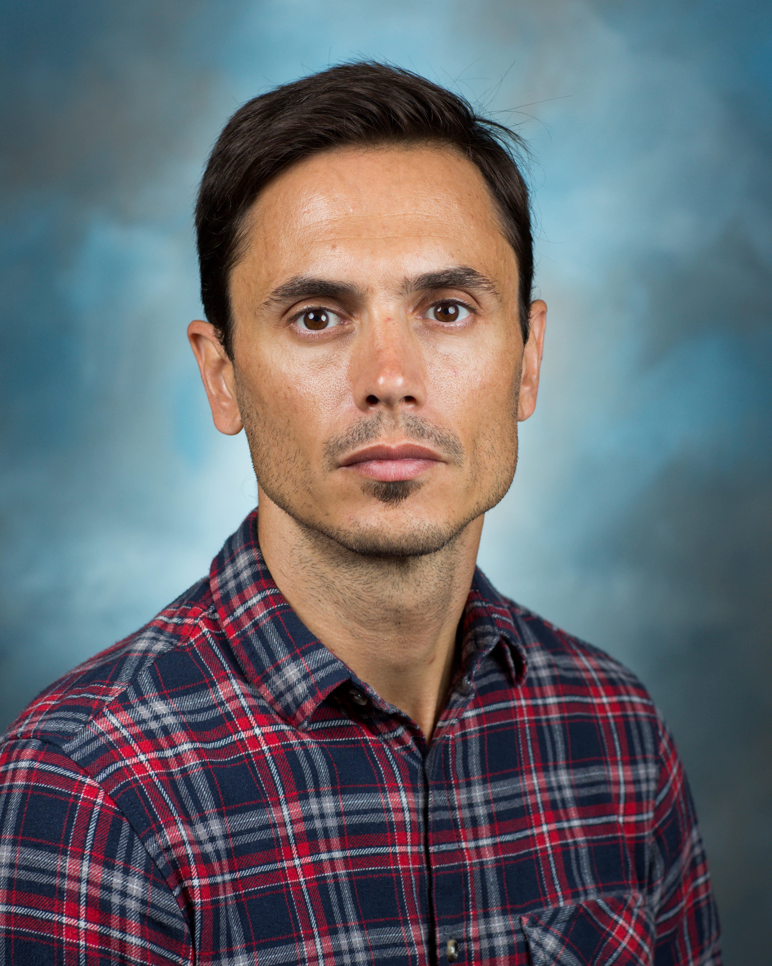
Filling in pedigrees
291,131 discovered MGS not yet used because no dam ID available
153,909 discovered MGGS not yet used because no MGD ID available
Procedures developed to fill missing dam IDs to link to ancestors
  HOUSADAM000000001, for example
  Should predictions use and public see the discovered pedigrees?
First check if true dam can be discovered in same herd (33,810 found)
  Match birth and fresh dates (only 1 dam’s pedigree matches calf’s)
Postdoc Juan Nani is documenting benefits from pedigree discovery

Slide 29
Genetic and genomic milestones
Year | Researchers | Discovery/Development
1865 | Mendel | Inherited traits of peas
1900 | Bateson and others | Rediscovery of Mendel’s laws
1905 | Spillman (USDA) | Horned/polled (Mendelian trait in cattle)
1922 | Wright (USDA) | Pedigree relationship matrix
1953 | Watson, Crick | Structure of DNA
1974 | Norman (USDA), Henderson (1976) | Use of pedigree relationships in PTAs
2001 | Lander | Sequence of human genome
2007 | Illumina, USDA, and others | Development of SNP chip for cattle
2009 | Elsik (NIH and USDA funding) | Sequence of cattle genome
2009 | USDA and many others | Genomic methods, official predictions

Slide 30
Genomic selection in other species: Example in peas
Genomic methods from dairy cattle are now used for many species
Example: Roorkiwal et al. (2016) Front. Plant Sci. 7:1666
  3,000 markers for 315 elite lines of chickpeas in India
  Tested G-BLUP, Bayes B, Bayes Cπ, Bayesian LASSO, and Random Forest
  “… models did not show any significant difference for estimating prediction accuracy within traits”
  “… study establishes the necessary resources for deployment of genomic selection in chickpea breeding”

Slide 31
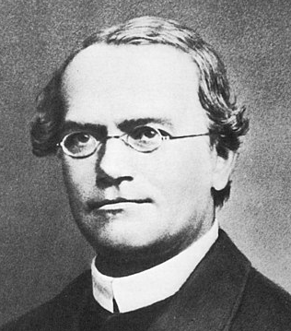
Summary
The DNA predictions implemented 10 years ago have improved rapidly
  Adjustments were needed to remove biases, give breeders confidence
  Accuracy improved as datasets expanded, more traits were included
  Many new uses such as pedigree discovery and genomic mating
Future predictions will use more gene tests discovered from sequence data and more international genotypes
Methods developed for dairy cattle are now used for beef, swine, poultry, humans, corn, alfalfa, soybeans, and even peas
Mendel would be pleased

Slide 32
Acknowledgments and Disclaimers
Council on Dairy Cattle Breeding (CDCB) and its industry suppliers for data
Taxpayers for funding USDA-ARS-AGIL project 8042-31000-002-00, “Improving dairy animals by increasing accuracy of genomic prediction, evaluating new traits, and redefining selection goals”
AGIL staff for doing this research
Mention of trade names or commercial products in this presentation is solely for the purpose of providing specific information and does not imply recommendation or endorsement by USDA; USDA is an equal opportunity provider and employer

