Slide 1
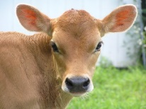

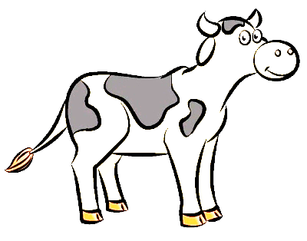
Genomic Evaluation of Dairy Heifer Livability
M. Neupane, J.L. Hutchison, C.P. Van Tassell, and P.M. VanRaden
Genomic evaluation system for heifer livability was developed
Traditional and genomic predicted transmitting abilities for heifer livability and its genetic correlation with other traits included in net merit dollars was estimated
USDA, Agricultural Research Service, Animal Genomics and Improvement Laboratory, Beltsville, MD, USA

Slide 2
Background
Heifer livability is important from economic, genetic, and animal welfare perspectives ¹⁻⁴
Preweaned (6.4%) and weaned (1.9%) heifer loss: digestive and respiratory diseases ³
Differences among breeds and sires suggest genetic component of heifer livability ⁵
¹Gulliksen et al., 2009; ²Chamberlain, 2012
³NAHMS 2014; ⁴Gonzalez-Peña et al.
⁵2019 Koch et al., 1994

Slide 3
Heifer livability
Low level of heritability (0.001 – 0.06) associated with heifer mortality ¹⁻⁶
US genetic evaluation in dairy cattle includes still birth (loss within 48 hours of birth) and cow livability
Gap of knowledge in heifer survival from 48 hours to start of productive life
¹Hansen et al., 2003; ²Fuerst-Waltl and Sørensen, 2010
³Henderson et al., 2011; ⁴Pritchard et al., 2013
⁵VanRaden et al., 2016; ⁶Mahmoud et al., 2017

Slide 4
Objectives
To develop a genomic evaluation system for heifer livability
To estimate traditional and genomic PTAs with reliabilities
To estimate genetic correlation between PTA of heifer livability and other traits already included in US dairy genetic evaluation system

Slide 5
Methodology: Data
Extracted data from CDCB database (birth years 2009–16)
  3,362,499 dairy heifer data records
  Herds with death loss of 1–25%
  Heifers <2 days old not evaluated (used in stillbirth)
  Heifers up to 18 months old used
  Total number of deaths = 134,753 (4.01%)
Livability scored as 100 (alive) or 0 (dead)
Heritability estimate of 0.4% by sire model REML (VanRaden et al., 2016)
Holstein, 89.2%
Cross Breed, 4.7%
Jersey, 4.9%

Slide 6
Covariates
Parity of dam ^{1,2}
  First parity dam was further divided into three groups;
    < 22 mo, between 22-25 mo, and > 25 mo
  Embryo transferred heifers were recorded as separate group
Herd-year-season of birth (HYS)
¹Hansen et al., 2003
²Hutchison et al., 2017

Slide 7
Predicted transmitting abilities (PTA)
PTAs were calculated using the animal model:
HLIV = HYS + PG + a + e
2,922,969 genotyped Holstein and 371,275 genotyped Jersey heifers
All animals genotyped on various platforms were imputed to 79,294 markers using Findhap version 3 ^{1,2}
¹VanRaden et al., 2011; ²Wiggans et al., 2019

Slide 8
Results: heifer mortality
Total deaths = 4.01%, less than average loss of 8.3% (NAHMS, 2014)

Slide 9
PTA
 | Genomic |  |  | Pedigree-based
Breed | Mean ± SD | REL |  | Mean ± SD | REL
HO | 1.6 ± 0.5 | 46 |  | 1.2 ± 0.8 | 16
JE | 0.5 ± 0.2 | 30 |  | 0.3 ± 0.4 | 12
Calves from older than 2-year-old dams perform better than youngest dams

Slide 10
Results: Genetic correlation with other traits in HO
Traits | Correlation
Productive life | 0.44
Milk | 0.34
Fat | 0.33
Protein | 0.36
Cow livability | 0.21
Daughter pregnancy rate | 0.08
Heifer conception rate | 0.17
Cow conception rate | 0.19
Early first calving | 0.36
Gestation length | -0.31
Somatic cell score | -0.18

Slide 11
Economics
Decreased cost of replacement heifer and improved genetic gain
Strong genetic correlation (0.55) between genomic heifer livability PTA with NM$
Average cost of heifer loss of $500 (200-1400)
Based on NM calculation¹ : 1% of emphasis on net merit index and economic progress of $0.05 million per year
¹ https://aipl.arsusda.gov/reference/nmcalc-2018.htm

Slide 12
Conclusions
Heifer livability is positively correlated with NM$, productive life, and fertility traits
More precise and detailed recordings on calf mortality: increased reliabilities
Routine genetic evaluation of heifer livability: increased profitability and improved animal health and welfare
Heifer livability: new trait in CDCB genomic evaluation in December 2020

Slide 13
Acknowledgments & disclaimers
USDA-ARS project 8042-31000-002-00, “Improving Dairy Animals by Increasing Accuracy of Genomic Prediction, Evaluating New Traits, and Redefining Selection Goals”
CDCB and its industry suppliers for data
USDA is an equal opportunity provider and employer
Mention of trade names or commercial products in this presentation is solely for the purpose of providing specific information and does not imply recommendation or endorsement by USDA

