Slide 1

New traits and economic updates for the net merit index
Paul VanRaden,*¹ John Cole,¹ Mike VandeHaar,² Mahesh Neupane,¹ and Jana Hutchison¹
¹USDA, Agricultural Research Service, Animal Genomics and Improvement Laboratory, Beltsville, MD, USA
²Michigan State University, East Lansing, MI, USA
paul.vanraden@usda.gov
Topics:
Genomic predictions likely for more traits in 2020
Net merit revision likely in April 2021
Faster genetic progress if all traits are in selection goal with correct weight

Slide 2
Relative weighting in 2018 net merit (NM$)
UC Udder composite
BWC Body weight composite
FLC Feet-legs composite
DPR Daughter pregnancy rate
CCR Cow conception rate
HCR Heifer conception rate
CA$ Calving ability (calving ease & stillbirth rate)
PL Productive life
LIV Livability
SCS Somatic cell score
MAST Mastitis
METR Metritis
DA Displaced abomasum
RETP Retained placenta
KETO Ketosis
MFEV Milk fever

Slide 3

Proposed NM$ revisions
August 2020
  Revise calving trait (CT) scale and emphasis
April 2021
  Include heifer livability (HLIV) and early first calving (EFC)
  Include residual feed intake (RFI) of cows
  Revise maintenance cost of body weight composite (BWC)
  Revise opportunity and maturity costs in productive life (PL)
  Adjust price forecasts and other economic assumptions

Slide 4
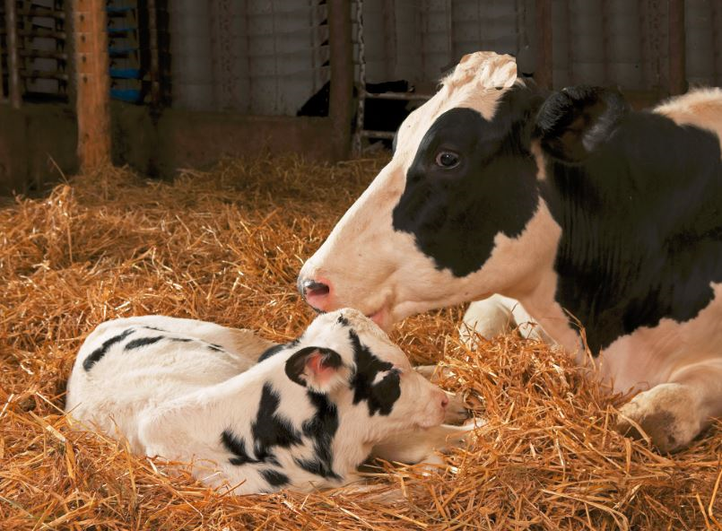
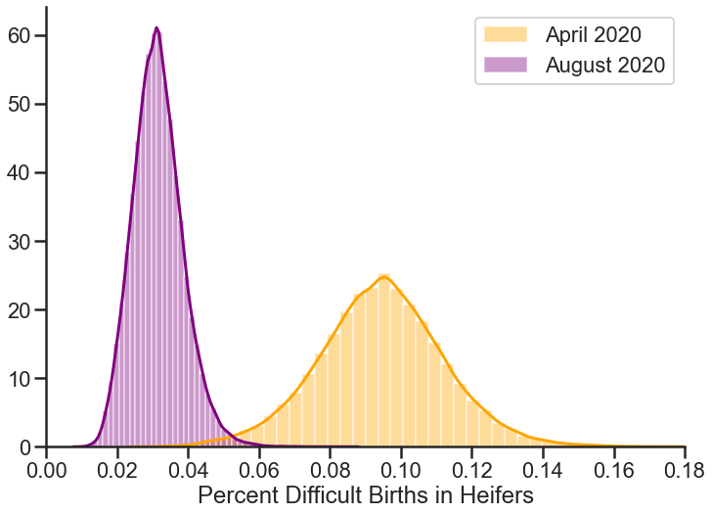
Reduced genetic SD for calving traits
PTA included phenotypic means for Holstein calvings of 8%
Incidence now only 2–4% from genetic progress and changes in management
PTA SD and means will be reduced 33–64% when converting from underlying to observed scale
Emphasis in NM$ will be reduced proportionally (about half)

Slide 5
Genomic PTAs for type traits and milking speed (BS)
Trait | Trait name | Breeds | Data since | Reason
RUW | Rear udder width | All | 1976 | Not an Interbull trait
BDP | Body depth | AY, GU | 1985 | Not scored by JE
FLS | Feet/leg score (mobility) | BS | 2012 | Recent data
MSP | Milking speed | BS | 2006 | Recent data
RTR | Rear teat (rear view) | JE | 2008 | Recent data
RTS | Rear teat (side view) | JE | 2008 | Recent data
Reliabilities (REL) of 51–73% for genomic predictions of new traits for August 2020
Several traits already included in breed association indexes or added in April 2020

Slide 6
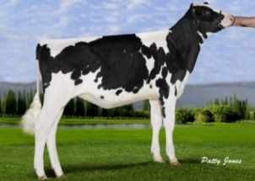
Economic values for EFC and HLIV
EFC has value of $2.50 per day (SD of 2.5 days)
  Relative emphasis on EFC could be ∼3% of NM$
  Emphasis on HCR would decline from 2.1% to ∼1.5%
  Evaluation and derivation in Hutchison et al. (2017 JDS)
HLIV has value of <$5.00 per 1% (SD of 0.5%)
  Relative emphasis on HLIV could be <1% of NM$
  Contributions to NM$ will be small (less than $5)
  Evaluation developed by postdoc Mahesh Neupane

Slide 7
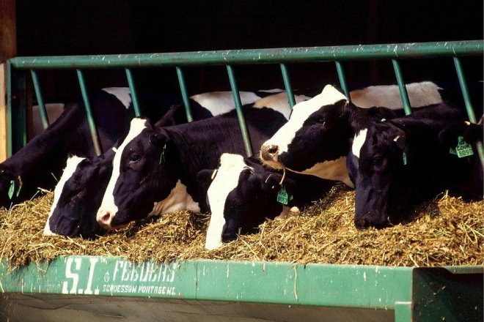
Economic value for RFI
RFI measures intake uncorrelated with yield and body weight and could get 16% of emphasis in NM$ but has low REL
Economic values for yield traits and BWC already account for correlated feed intake
Feed saved combines reduced feed intake estimated from RFI and from BWC of smaller cows
Use of RFI in NM$ requires continuing data collection; international cooperation seems likely
Since last year, a new 5-year FFAR-CDCB project has added ∼1,800 US lactations to previous 4,800-lactation USDA study

Slide 8
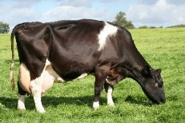
Economic value of Productive Life
NM$ previously assumed equal profit for each additional lactation but should account for differing profit in younger vs.
older cows
Faster genetic gain makes young replacements cows more valuable; higher mature yields make older cows more profitable
Current PL value of 12% – 6% for genetic progress + 12% for maturity
Economic research by Michael Schmitt and Albert De Vries (University of Florida)
  Ranking sires using genetic selection indices based on financial investment methods versus lifetime net merit. J. Dairy Sci. 102:9060–9075. 2019. https://doi.org/10.3168/jds.2018-16081

Slide 9
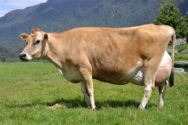
Economic value of BWC in NM$
BW pounds = 40 × BWC (Manzanilla-Pech et al., 2016)
BWC$ = BW × [cull price × (1 – cow death loss) – heifer growth cost – cow maintenance cost × 2.8 lactations – cow growth cost]
Maintenance = 3.28 pounds feed / pound BW / lactation (NRC values)
Now about twice as high as previously used in NM$
  $ value was constant using lower feed costs from 1990s
  Modern cows require more energy for maintenance (NRC)
BWC$ contribution to FeedSaved and NM$ should double

Slide 10
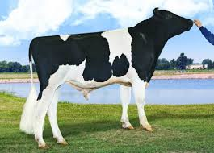
Extra progress from each proposed revision
Index revisions | Old emphasis | New emphasis | Progress (% of NM$ gain) | Value/year (million $)
Add RFI | … | 15% | 0.85 | 4.25
Add EFC | … | 3% | 0.04 | 0.20
Add HLIV | … | <1% | 0.01 | 0.05
Revise SD of CT | 5% | 2.5% | 0.10 | 0.50
Revise maintenance costs (BWC) | ‒5% | ‒10% | 0.62 | 3.10
Revise lactation profits (PL) | 12% | 18% | 0.56 | 2.70
Total for all revisions | … | … | 2.18 | 10.90

Slide 11
Extra progress from adding more traits to NM$
Year | Traits (no.) | Traits included | Correlation with previous index | Extra progress
1977 | 3 | Milk, fat, protein | … | …
1994 | 5 | PL, SCS | 0.84 | 19%
2000 | 18 | Linear type | 0.94 | 6%
2003 | 21 | DPR, calving ease | 0.98 | 2%
2006 | 23 | Stillbirth | 0.975 | 3%
2014 | 25 | HCR, CCR | 0.965 | 4%
2017 | 26 | LIV | 0.989 | 1%
2018 | 32 | Health traits | 0.994 | 0.6%
2020 | 35 | RFI, EFC, HLIV, revisions | 0.981 | 2.2%

Slide 12
Conclusions
Genomic predictions likely for more traits in 2020
  HLIV, further type traits, and Brown Swiss milking speed (August)
  Revise scale and emphasis for CT (August)
  RFI for Holsteins (December)
Net merit revision likely in April 2021
  Include RFI, EFC, and HLIV
  Put more emphasis on smaller BWC and longer PL
  Revise other economic values
Progress is faster if all traits are in selection goal with correct weight

Slide 13
Acknowledgments & disclaimers
USDA-ARS project 8042-31000-002-00-D, “Improving Dairy Animals by Increasing Accuracy of Genomic Prediction, Evaluating New Traits, and Redefining Selection Goals” (AGIL funding)
CDCB and its industry suppliers for data
Agriculture and Food Research Initiative competitive grant #2011-68004-30340 from USDA National Institute of Food and Agriculture (feed intake funding)
USDA is an equal opportunity provider and employer
Mention of trade names or commercial products in this presentation is solely for the purpose of providing specific information and does not imply recommendation or endorsement by USDA

