Slide 1
Imputation and investigation of sequence genotypes for 6,735,530 variants of 39,048 Holsteins. “Abstract Tracking Number: 82959”
Al-Khudhair, A.¹, J.R. O’Connell², D.J. Null¹, and P.M. VanRaden¹.
¹USDA, Agricultural Research Service, Animal Genomics and Improvement Laboratory, Beltsville, MD, USA.
²University of Maryland. MD, USA.
ahmed.al-khudhair@usda.gov

Slide 2
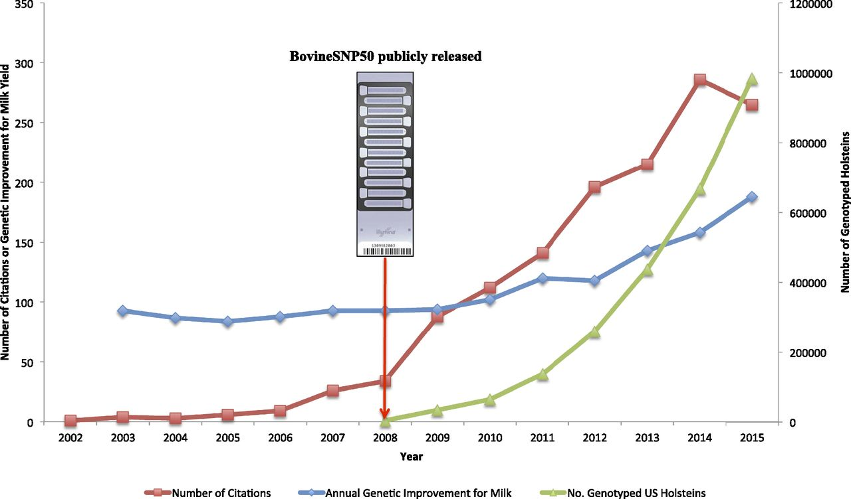
Annual numbers of citations of Meuwissen et al.
Jeremy F. Taylor et al. PNAS 2016;113:28:7690-7692
©2016 by National Academy of Sciences
Notes:
The paradigm shift in the dairy animal breeding happened around 2007 – 2008, where the rapid advancing in the sequencing technology allowed us to move from the phenotypic evaluation of the dairy into the genomic evaluation.
In this slide we see a study describing the rate of genetic improvement in milk production from García-Ruiz et al.
and the rapid increased numbers of Holstein cows chip-genotyped by December of each year. from the Council for Dairy Cattle Breeding database (https://www.cdcb.us/Genotype/cur_density.html).
And the Annual numbers of citations of Meuwissen et al. (1), who first described Alternative statistical models for Genomic Prediction in 2001

Slide 3
Background
Notes:
And the efforts came up as a invention and production of the DNA snp chips which increased in their marker densities by function of improved technology and research identifying new markers of interest in the genomic evaluation process.
This expansion in the number of markers available is improved mainly through two means.
Advancement of the sequencing technology.
Different SNP chips and then whole genome technology.

Slide 4
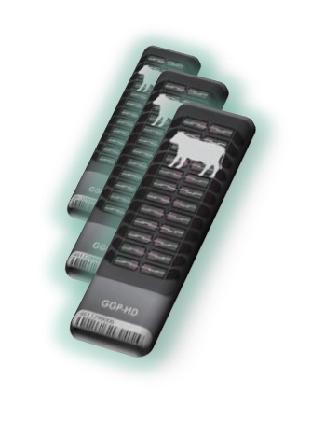
Chip history (37 chips + sequence)

Slide 5
Genotypes received/year by animal sex
*Through December 13

Slide 6
Sequence data source

Slide 7
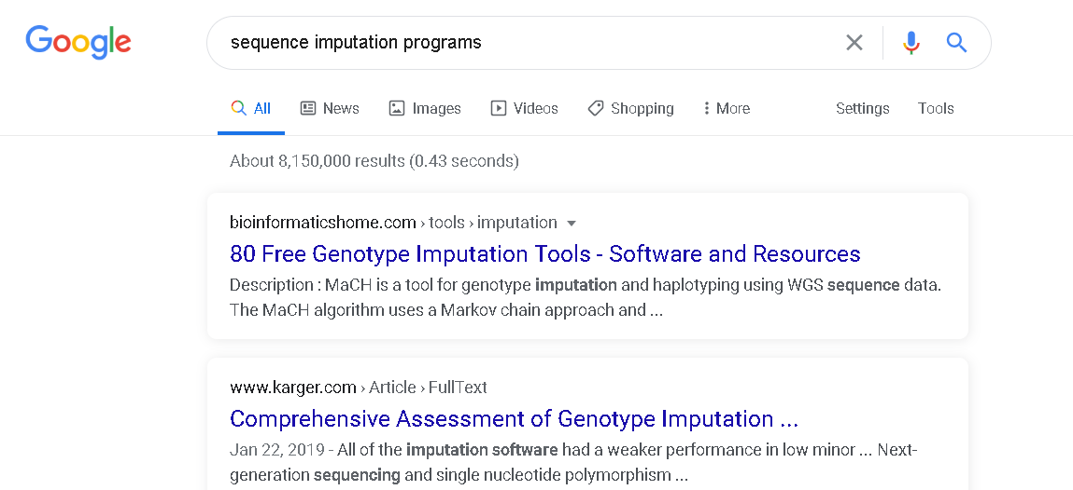
Imputation
Notes:
COMPUTATIONAL SOLUTIONS, Development of the imputation software.
Backed up and improved by the availability of the pedigree and phenotype data.

Slide 8
Design of study
Use 1000 Bull Genomes run7 sequence data to double number of variants examined
Edit data using new methods described by Dan Null’s abstract
Impute all proven bulls to sequence using their chip genotypes, doubling the reference population size from our previous study
Compare findhap version 3 to version 4 which imputes using raw counts of sequence read depth
Perform GWAS using MMAP software to find largest effects

Slide 9
Growth of sequence data by breed
Table. X Number of animals sequenced per breeds (1000 Bulls Genome Project)
Year | 2015 | 2017 | 2019 | 2020 | 2019
Seq Technology | Run5 | Run6 | Run7 | Run8 | HD
Breed
BSW | 123 | 142 | 175 | 352 | 181
GUE | 20 | 20 | 20 | 20 | 147
HOL | 444 | 524 | 928 | 1125 | 4012
JER | 66 | 87 | 105 | 196 | 407
RDC | 114 | 130 | 156 | 492 | 527
HOL | 444 | 524 | 928 | 1125 | 4012
JER | 66 | 87 | 105 | 196 | 407
RDC | 114 | 130 | 156 | 492 | 527
 |  | Run5 | Run7
Number of Holstein animals included
whole genome sequence (Ref) |  | 471 | 917
different density DNA chips |  | 17,300 | 38,131
Total number of markers used for the evaluation |  | 3,148,506 | 6,735,530
The last genomic prediction and Investigation of a large scale genomic data for HOL in the US was done using Run5 of the 1000 Bulls database.
This study is expanding the number of bulls by using Run7 (double the number of bulls with whole genome sequence), and including about two times the number of markers included in the analysis.

Slide 10
Results : Imputation of sequence for Holstein breed
Available SNP frequency from sequence run 7 and from low, medium and high density marker chips.
Category | Variants (n) | Percent %
1000 Bulls Project (917 animals) Sequence reference | 6,645,512 | 98.66
Council on Dairy Cattle Breeding (Bowie, MD) database (38,048 bulls)
50k chip | 47,231 | 0.7
80k used for PTAs | 79,254 | 1.18
Seq SNPs added | 767 | 0.01
Known QTLs added | 97 | 0
Total variants before edits | 6,772,861 | 100
Total variants after edits | 6,735,531 | 0.9945
Total variants omitted | 37,330 | 0.0055
*For run5 data, After eliminating redundant polymorphisms (consecutive polymorphisms with an identity of >0.95) and polymorphisms with low call rates, 3,148,506 polymorphic sites were retained (VanRaden et al., 2017).
*Fortran findhap.f90 imputation program (https:// aipl.arsusda.gov/software/findhap/; VanRaden et al., 2011) was used to determine the phase for each chromosomal segment.
Notes:
initial results from densemap using only 20 iterations which took 2 days and 75% of memory for 13 traits. Convergence with 7 million variants would take a long time

Slide 11
Results: Imputation of sequence for Holstein breed.
Imputation accuracy in Run5 vs Run 7 dataset
 |  | Mean | Std Dev
Run5 | Findhap3 | 0.967 | 0.0056
Run7 | Findhap3 | 0.944 | 0.0474
Run7 | Findhap4 | 0.949 | 0.0388
Other breed accuracies using Run7 and Findhap4 ranged from 0.866 for Guernsey to 0.922 for Brown Swiss
Notes:
Jeff
I first used plink to extract a set of variants using the ld prune option with r2 =0.5 and r2=0.8, leaving 305626 and 867293 variants respectively to construct the grm. The milk reml variance component estimation was not stable for either grm so computed the eigenvalues to investigate. The smallest eigenvalues were -17.5 and -9.7, for r2=0.5 and r2=0.8, respectively, which is a new record for me! Obviously inversion even with the whitening from the identity matrix from the residuals requires h2<0.05. So next I tried using just the 318832 variants in chromosome.data that were on HD AND in sequence, figuring, they had to be high quality if in both. Smallest eigenvalue -14! Surprised me. Next I computed the pedigree kinship. Smallest eigenvalue 0.0021. Positive so kinship invertible. Finally I decided to construct grm using the imputed genotypes from an old run. Smallest eigenvalue -0.167, which is a bit more negative than numerical noise, but inversion is well conditioned as long as h2<0.86
I am using this grm for the gwa. I could use pedigree kinship, but type I error will be inflated (I will run as a comparison when there is time).
I've run Fat using both the R matrix (captures reliability) and identity for comparison.
My gwa is N squared but BFMAP should scale linearly in N if you want to get some quicker results.
I would merge the plink1 files (bed,bim,fam) then convert to plink2 if needed
=================
paul
Dan and I agree that the quality is poor, but Z Z' is a positive semi-definite matrix regardless of input data. Adjusting G to match A often does introduce a negative eigenvalue, but if you did not adjust then the flaw is in the matrix multiplication. Perhaps even double precision has issues with very large matrices and high LD.
================
Jeff
Semi-definite bounds the eigenvalues to >=0, which is what the A matrix always gives. Negative eigenvalues are not uncommon with genetic due to numerical precision, allele frequencies, etc, but they tend to be small and only a few. The -17 is not the outlier, the smallest 80 eigenvalues are < -2. Even in TOPMed and UK Biobank I've never had issues fitting the variance components with the grm. Since using the higher quality chip data grm on the same animals solves the issue, the source has to be genotype quality of the imputation, which was impacted by the quality of the imputation panel.
My guess is that bad calls are causing extreme departures from HWE.
Jeff
Full milk and fat GWA results are available in /seq1/jeff/1KB_run7/gwa
I ran two models for each. One with homoscedastic residuals (I matrix) and the other with the degregressed reliabilities (R matrix)
The null model likelihood with mean + polygenic +error fit with R is better than with I, but variance component fit doesn't always translate to SNP regression. See attached
The fact that observed data has greater power than imputed data at a true QTL makes interpretation of the 1KB results with regard to QTL localization challenging.

Slide 12
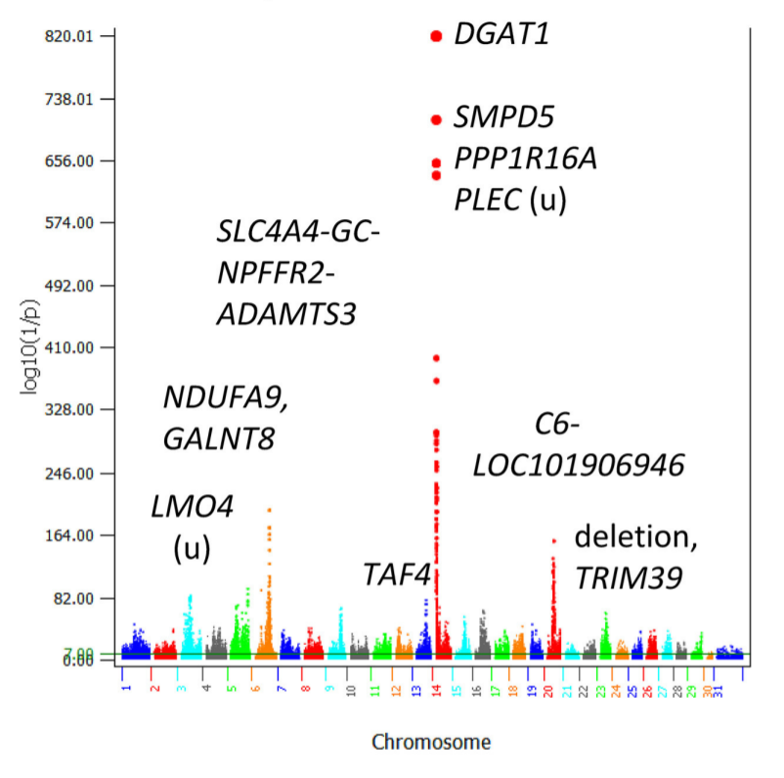
Results : Statistical significance of SNP effects for Milk yield trait

Slide 13
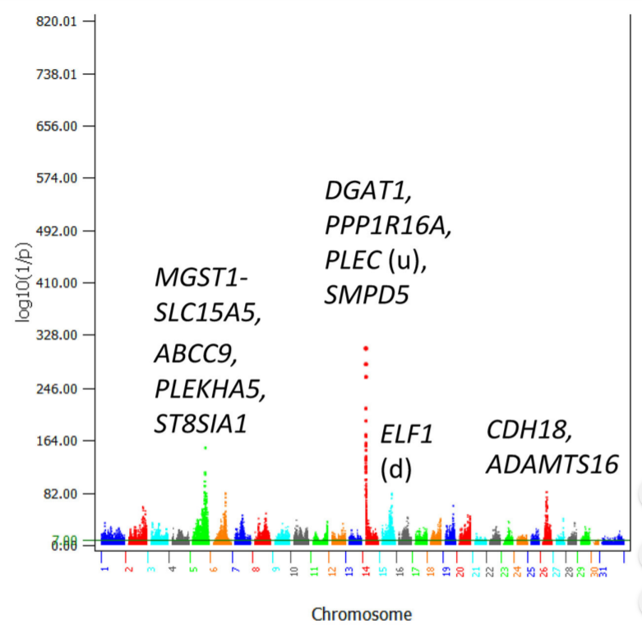
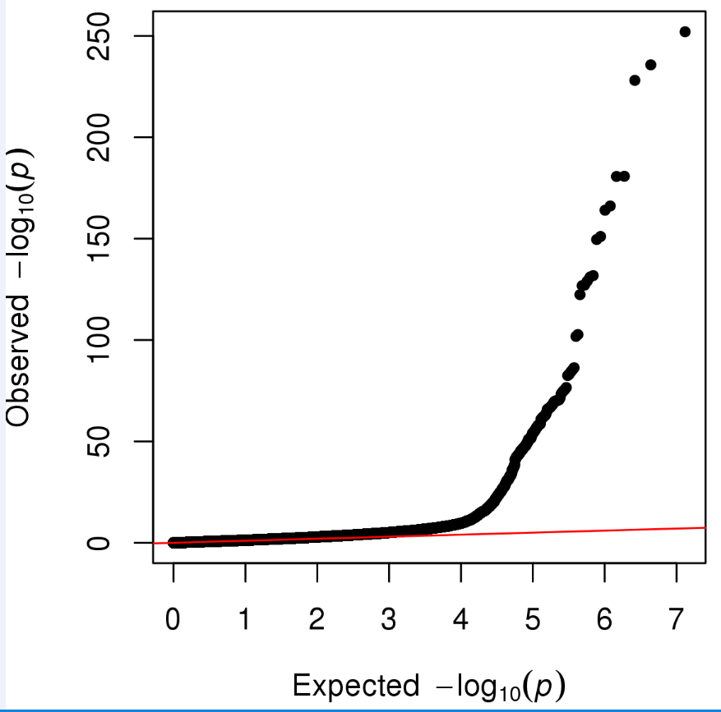
Results : Statistical significance of SNP effects for Fat yield trait
Notes:
Top hits with p <1.0e-10 for milk and fat.
Notice that DGAT is nowhere near the best signal in the chr14 region. Due to the missing start of the chromosome but most likely another metric of overall data quality.

Slide 14
Results : Comparative association “Milk, Fat” 60K vs HD vs Whole Genome
 | 60K Imputed (Jiang J, Ma L, Prakapenka D, VanRaden PM, Cole JB, Da Y. A Large-Scale Genome-Wide Association Study in U.S. Holstein Cattle. Front Genet. 2019 May 14;10:412. doi: 10.3389/fgene.2019.00412. PMID: 31139206; PMCID: PMC6527781). |  |  |  |  |  | /res1/paul/HD/1905/HO/yld/ (Weller JI, Bickhart DM, Wiggans GR, et al. Determination of quantitative trait nucleotides by concordance analysis between quantitative trait loci and marker genotypes of US Holsteins. J Dairy Sci. 2018;101(10):9089‐9107. doi:10.3168/jds.2018-14816) |  |  |  |  | run7raw_top_snps_mmap (Current Study)
 | SNP | Chr | POS | Candidate gene | p-value | Rank | name | Chr | POS | genSD | Rank | SNPNAME | Chr | POS | SNP_TSCORE_PVAL | Rank
MILK YIELD | rs109421300 | 14 | 1,801,116 | DGAT1 | 1.0E-820a | 1 | ARS-BFGL-NGS-4939 | 14 | 609,870 | 6.72663 | 1 | Chr14_1757935 | 14 | 572120 | 7.1113E-156 | 1
 | rs135549651 | 14 | 1,967,325 | SMPD5 | 9.5E-710a | 2 | BovineHD1400000216 | 14 | 550,784 | 6.60927 | 2 | ARS-BFGL-NGS-4939 | 14 | 609870 | 1.8447E-142 | 2
 | rs109146371 | 14 | 1,651,311 | PPP1R16A | 7.4E-653a | 3 | Chr14_1757935 | 14 | 572,120 | 6.24364 | 3 | BovineHD1400000216 | 14 | 550784 | 2.2077E-133 | 3
 | rs109350371 | 14 | 2,054,457 | PLEC (u) | 7.2E-637a | 4 | BovineHD1400000206 | 14 | 494,621 | 6.10587 | 4 | Chr14_1699016 | 14 | 513203 | 7.6697E-118 | 4
 | rs109558046 | 14 | 2,909,929 | ARC-ADGRB1 | 1.0E-396a | 5 | ARS-BFGL-NGS-57820 | 14 | 465,742 | 6.0733 | 5 | ARS-BFGL-NGS-57820 | 14 | 465742 | 7.689E-100 | 5
 | rs109752439 | 14 | 1,489,496 | ZNF34 (u) | 1.0E-347a | 6 | BovineHD1400000275 | 14 | 827,586 | 6.06224 | 6 | Chr14_1653693 | 14 | 468124 | 2.3644E-96 | 6
FAT YIELD | rs109421300 | 14 | 1,801,116 | DGAT1 | 9.0E-374a | 1 | ARS-BFGL-NGS-4939 | 14 | 609870 | 0.29109 | 1 | ARS-BFGL-NGS-4939 | 14 | 609870 | 8.7334E-253 | 1
 | rs109146371 | 14 | 1,651,311 | PPP1R16A | 4.80E-308 | 2 | BovineHD1400000216 | 14 | 550784 | 0.28515 | 2 | BovineHD1400000216 | 14 | 550784 | 1.7581E-236 | 2
 | rs109350371 | 14 | 2,054,457 | PLEC (u) | 5.00E-283 | 3 | BovineHD1400000206 | 14 | 494621 | 0.26968 | 3 | Chr14_1757935 | 14 | 572120 | 8.3559E-229 | 3
 | rs135549651 | 14 | 1,967,325 | SMPD5 | 3.70E-263 | 4 | BovineHD1400000204 | 14 | 487527 | 0.26882 | 4 | BovineHD1400000204 | 14 | 487527 | 1.6588E-181 | 4
 | rs109350371 | 14 | 2,084,067 | LOC786966 | 9.80E-214 | 5 | Chr14_1757935 | 14 | 572120 | 0.26872 | 5 | BovineHD1400000206 | 14 | 494621 | 1.9958E-181 | 5
 | rs109558046 | 14 | 2,909,929 | ARC-ADGRB1 | 3.10E-194 | 6 | ARS-BFGL-NGS-57820 | 14 | 465742 | 0.26461 | 6 | Chr14_1653693 | 14 | 468124 | 7.5177E-167 | 6
*
Notes:
approximate generalized least squares (AGLS) analysis, and a
Bayesian linear mixed model implemented by the BOLT-LMM

Slide 15
Results : Phenotypic effects estimated by multiple regression
Trait | SNP name | chr# | location | genSD | Trait | SNP name | chr# | location | genSD | Trait | SNP name | chr# | location | genSD | Trait | SNP name | chr# | location | genSD
Net_Merit | 14_955774 | 14 | 955774 | 0.022 | Heifer_Conc_Rate | AX-27827657 | 9 | 41006848 | 5E-05 | SCS | 6_86944964 | 6 | 86944964 | 9E-06 | Livability | 6_87190744 | 6 | 87190744 | 8E-05
 | BovineHD1400000324 | 14 | 1063078 | 0.021 |  | 29_47177522 | 29 | 47177522 | 5E-05 |  | 6_87162227 | 6 | 87162227 | 9E-06 |  | 6_87191196 | 6 | 87191196 | 8E-05
 | 14_1137961 | 14 | 1137961 | 0.021 |  | 29_47177529 | 29 | 47177529 | 5E-05 |  | 6_87179497 | 6 | 87179497 | 9E-06 |  | 6_87193497 | 6 | 87193497 | 8E-05
 | 14_1443297 | 14 | 1443297 | 0.021 |  | 31_125555828 | 31 | 1.26E+08 | 5E-05 |  | 6_87198844 | 6 | 87198844 | 9E-06 |  | 6_87189062 | 6 | 87189062 | 8E-05
 | 14_1794927 | 14 | 1794927 | 0.02 |  | 18_51377844 | 18 | 51377844 | 5E-05 |  | 6_87189311 | 6 | 87189311 | 8E-06 |  | 6_87186454 | 6 | 87186454 | 8E-05
 | 14_1851461 | 14 | 1851461 | 0.02 |  | BovineHD2900014411 | 29 | 48065768 | 5E-05 |  | BovineHD0600024354 | 6 | 87178508 | 8E-06 |  | 6_87298167 | 6 | 87298167 | 8E-05
 | 14_1017714 | 14 | 1017714 | 0.02 |  | BovineHD0200037244 | 2 | 1.28E+08 | 5E-05 |  | 6_87167309 | 6 | 87167309 | 8E-06 |  | 6_87197176 | 6 | 87197176 | 8E-05
 | 14_1713879 | 14 | 1713879 | 0.019 |  | 9_46316407 | 9 | 46316407 | 4E-05 |  | 6_87119296 | 6 | 87119296 | 8E-06 |  | 6_87197195 | 6 | 87197195 | 8E-05
 | 14_1710285 | 14 | 1710285 | 0.019 |  | 2_127647704 | 2 | 1.28E+08 | 4E-05 |  | 6_87127383 | 6 | 87127383 | 8E-06 |  | 6_87165832 | 6 | 87165832 | 8E-05
 | 14_1786923 | 14 | 1786923 | 0.019 |  | ARS-BFGL-NGS-55920 | 2 | 1.28E+08 | 4E-05 |  | 6_87189321 | 6 | 87189321 | 8E-06 |  | 6_87190723 | 6 | 87190723 | 8E-05
Trait | SNP name | chr# | location | genSD | Trait | SNP name | chr# | location | genSD | Trait | SNP name | chr# | location | genSD | Trait | SNP name | chr# | location | genSD
Prod_Life | 6_86965175 | 6 | 86965175 | 7E-05 | Cow_Conc_Rate | 18_41444396 | 18 | 41444396 | 1E-04 | Dtr_Preg_Rate | BovineHD1800015117 | 18 | 51368430 | 9E-05 | Early_calving | 31_60990615 | 31 | 60990615 | 9E-05
 | 6_86989333 | 6 | 86989333 | 7E-05 |  | 18_41457732 | 18 | 41457732 | 1E-04 |  | 6_86944964 | 6 | 86944964 | 9E-05 |  | 31_55535233 | 31 | 55535233 | 8E-05
 | 6_86940863 | 6 | 86940863 | 7E-05 |  | 18_43515067 | 18 | 43515067 | 9E-05 |  | 18_43515095 | 18 | 43515095 | 8E-05 |  | 31_55521421 | 31 | 55521421 | 8E-05
 | 6_86995369 | 6 | 86995369 | 7E-05 |  | 18_43515054 | 18 | 43515054 | 9E-05 |  | 18_43515067 | 18 | 43515067 | 8E-05 |  | BTA-30189-no-rs | 31 | 55511224 | 8E-05
 | 6_87189311 | 6 | 87189311 | 7E-05 |  | 18_43515095 | 18 | 43515095 | 9E-05 |  | 18_43515054 | 18 | 43515054 | 8E-05 |  | 31_55514965 | 31 | 55514965 | 8E-05
 | 6_87189321 | 6 | 87189321 | 7E-05 |  | 18_43515186 | 18 | 43515186 | 9E-05 |  | 6_87189302 | 6 | 87189302 | 8E-05 |  | 31_55525099 | 31 | 55525099 | 8E-05
 | 6_86956804 | 6 | 86956804 | 7E-05 |  | BovineHD1800015117 | 18 | 51368430 | 9E-05 |  | 6_86995369 | 6 | 86995369 | 8E-05 |  | 31_54113729 | 31 | 54113729 | 8E-05
 | 6_87189302 | 6 | 87189302 | 7E-05 |  | 18_43515228 | 18 | 43515228 | 9E-05 |  | 18_43515228 | 18 | 43515228 | 8E-05 |  | 31_55550993 | 31 | 55550993 | 8E-05
 | 6_87178828 | 6 | 87178828 | 7E-05 |  | 18_42608175 | 18 | 42608175 | 9E-05 |  | 6_87167564 | 6 | 87167564 | 8E-05 |  | BovineHD3000015510 | 31 | 54250662 | 8E-05
 | 6_87009744 | 6 | 87009744 | 7E-05 |  | 18_41446899 | 18 | 41446899 | 8E-05 |  | 6_87119296 | 6 | 87119296 | 8E-05 |  | 31_55497378 | 31 | 55497378 | 7E-05
* only 20 iterations which took 2 days and 75% of memory for 13 traits. Convergence with 7 million variants would take a long time
Notes:
initial results from densemap using only 20 iterations which took 2 days and 75% of memory for 13 traits. Convergence with 7 million variants would take a long time

Slide 16
Conclusions
Analysis of Run7 sequence data doubled the numbers of sequence variants and proven bulls compared to Run5 study
GWAS included all variants that passed edits whereas our previous studied excluded intronic and intergenic variants
Imputation accuracy was reduced when more variants were included, but Findhap4 gave better accuracy than Findhap3
Future studies will include additional breeds, but their imputation accuracy is less than Holstein due to smaller reference populations for sequence and HD data

Slide 17
Acknowledgments & disclaimers
USDA-ARS project 8042-31000-002-00-D, “Improving Dairy Animals by Increasing Accuracy of Genomic Prediction, Evaluating New Traits, and Redefining Selection Goals” (AGIL funding)
CDCB and its industry suppliers for data
1000 Bull Genomes Project for sequence data

