Slide 1
Inheritance of a mutation causing Jersey neuropathy with splayed forelimbs. “Abstract Tracking Number: 199”
A. Al-Khudhair¹, D.J. Null¹, J.B. Cole¹, C.W. Wolfe², and P.M. VanRaden¹
¹USDA, Agricultural Research Service, Animal Genomics and Improvement Laboratory, Beltsville, MD, USA.
²American Jersey Cattle Association. OH, USA.
ahmed.al-khudhair@usda.gov

Slide 2
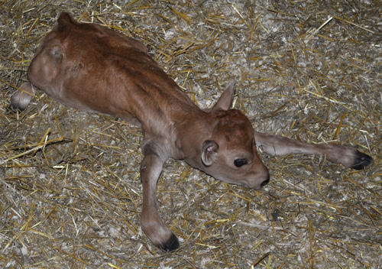
About: Jersey neuropathy with splayed forelimbs (JNS)
Phenotype of the affected calves born with JNS
Alert at birth.
Unable to stand.
Splayed forelimbs that exhibit extensor rigidity and excessive lateral abduction at birth
Spasticity of head and neck and convulsive behavior.
*A recessive genetic etiology was proposed for the
JNS disorder as the calves' parent sires and dams all had a normal appearance.
*Genetic abnormality in dairy cattle takes a toll on the health, performance and the over all $$.
Photograph courtesy of the American Jersey Cattle Association (Reynoldsburg, OH).
A Jersey calf affected with neuropathy with splayed forelimbs
*JNS = Jersey Neuropathy with Splayed forelimbs

Slide 3
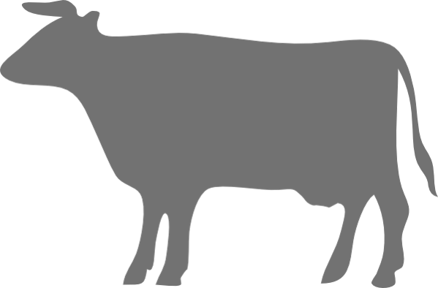
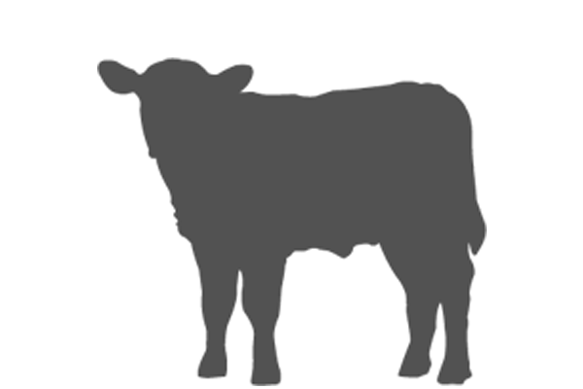
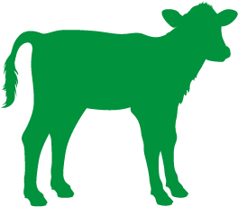
JNS is an autosomal recessive inheritance disease
*JNS = Jersey Neuropathy with Splayed forelimbs

Slide 4
Estimation of the $$ economic loss
The economic loss of each affected Jersey heifer due to JNS is estimated to be $225.
The 360,000 Jersey cows with records used in the national genetic evaluations (Norman et al., 2020) are 14% of the cows enrolled in the national milk recording system.
If the breed makes up the same proportion of the 9.4 million cow national herd, then there are ~1.3 million Jersey cows in the U.S.
The JNS allele frequency of 0.03 is half the carrier frequency of 0.06 and would be expected to result in 1,170 affected calves annually (1.3 million * 0.032) with random mating.
If half are bull calves, the national loss would be ~ $130,000 annually.

Slide 5
The study objective:
To describe the new genetic condition (JNS) in newborn calves reported to the American Jersey Cattle Association by Jersey breeders.
*JNS = Jersey Neuropathy with Splayed forelimbs

Slide 6
Materials and methods
16 JNS affected calves the time frame of July 2008 to October 2020.
1 additional calf born April 2021 was examined in greater detail at the University of Nebraska – Lincoln.
Array genotypes and pedigrees:
Genotypes for 303,087 Jerseys (30,422 males and 272,665 females). *(CDCB)
All Genotypes were imputed to the 80K.
The pedigree file for this genotyped population included a total of 983,234 animals.
Whole Genome Sequence :
16 affected calves.
9 close relatives (3 sires, 4 dams, and 2 unaffected siblings).
477 other Ayrshires, Brown Swiss, Guernseys, Holsteins, Jerseys. *(Animal Genomics and Improvement Laboratory (Beltsville, MD) and the Collaborative Dairy DNA Repository (Madison, WI)).
*CDCB = Council on Dairy Cattle Breeding (Bowie, MD).

Slide 7
Materials and methods
Pedigree:
Affected animals and their carrier ancestors were visualized using PyPedal version 2.0.4 *(Cole, 2007; https://github.com/wintermind/pypedal)
Genomic analysis:
The imputation process divided the genome into haplotype segments of maximum length 100 SNP.
A target region to search for the causal mutation was obtained by visually inspecting the regions of shared homozygosity for the imputed genotypes of the affected calves.
Causal mutation consequence were predicted using SIFT (Sorting Intolerance From Tolerance) software.

Slide 8
Trend of the JNS carriers increase per year
*JNS = Jersey Neuropathy with Splayed forelimbs

Slide 9
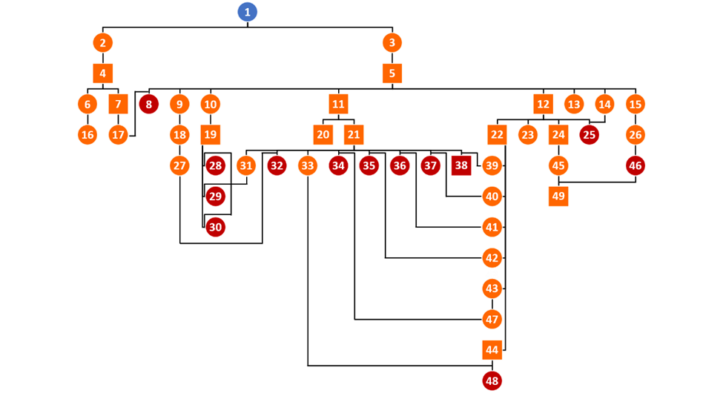
JNS calves had common ancestry of a cow born in 1995
1995
Animal # Registration # Name
1 JEUSA000003906889 WOODSTOCK BERRETTA LESLIE
2 JEUSA000003980701 WOODSTOCK ALF LESLIE
3 JEUSA000111360167 WOODSTOCK LEMVIG LINDY
4 JEUSA000111389227 WOODSTOCK LLV LIEUTENANT-ET
5 JEUSA000061929249 TOLLENAARS IMPULS LEGAL 233 ET
6 JEUSA000067001904 HEINS LIEUTENANT RAQUEL {2}
7 JEUSA000115330908 LACAMAS OFFICER-ET
8 JEUSA000118092164 GIESEKE LEGAL G700
9 JEUSA000117676567 CLOVER PATCH LEGAL LILAC
10 JEUSA000069042853 AHLEM LEGAL WYN 35647
11 JEUSA000117217618 SCHULTZ LEGAL CRITIC-P ET
12 JEUSA000117222740 ALL LYNNS LEGAL VISIONARY-ET E
13 JEUSA000067138634 SHAN-MAR LEGAL CHARISMA
14 JEUSA000119437018 CRF LEGAL 2791
15 JEUSA000117511598 LUCKY HILL LEGAL PRETZEL
16 JEUSA000116169172 HEINS UNREGISTERED B16
17 JEUSA000067301641 GIESEKES OFFICER RITZY
18 JEUSA000119903120 CLOVER PATCH BANCROFT LEEANN
19 JEUSA000074067487 AHLEM TEXAS WILDCAT 22702-ET
20 JEUSA000071199770 AHLEM NIKON-P
21 JE840003012423929 RIVER VALLEY CECE CHROME ET
22 JEUSA000118201001 ROWLEYS 11 VISIONARY CHILI-ET
23 JEUSA000118769686 DODAN CARNATION DADS DREAM
24 JEUSA000118440510 BLUE MIST VISIONARY METHOD
25 JEUSA000119437027 CRF VISIONARY 5150
26 JE840003125319168 LUCKY HILL PLUS PRINGLE {6}
27 JEUSA000173408977 CLOVER PATCH VICEROY LEONA
28 JEUSA000067340303 UR CALF 000303 23060118-ET
29 JEUSA000067340304 UR CALF 000304 23060118-ET
30 JEUSA000067340307 UR CALF 000307 23060118-ET
31 JE840003126479214 RIVER VALLEY CHROME REJOYCE
32 JEUSA000174009528 CLOVER PATCH CHROME LEXILOU
33 JEUSA000067359358 WETUMPKA CHROME NABISCO
34 JEUSA000174074942 PHILLIPS CHROME PUMPKIN
35 JEUSA000174001904 CLOVER PATCH CHROME DIVA
36 JEUSA000174009537 CLOVER PATCH CHROME MONTY
37 JEUSA000173985162 CLOVER PATCH CHROME CURRY
38 JEUSA000174009519 CLOVER PATCH CHROME PRIVATE
39 JEUSA000119791431 CLOVER PATCH CHILI PENELOPE
40 JEUSA000173002395 CLOVER PATCH CHILI CRYSTAL
41 JEUSA000173002564 CLOVER PATCH CHILI MONET
42 JEUSA000173002612 CLOVER PATCH CHILI DARLING
43 JEUSA000119588107 PHILLIPS CHILLI PAPRIKA
44 JEUSA000067333440 HILLVIEW LISTOWEL-P
45 JEUSA000119777938 CINNAMON RIDGE METHOD BULGARIA
46 JE840003219717380 LUCKY HILL BUBBA PHLOP
47 JE840003145661780 PHILLIPS BARNABAS PUMPKIN
48 JEUSA000067457393 WETUMPKA LISTOWEL NIBLET
49 JEUSA000067771710 PINE-TREE DISCO BUBBA-ET
2008
2020
Earliest known carrier (Blue)
Carrier ancestors (Orange)
Affected calves (brown)
*visualized using PyPedal version 2.0.4
*Animal identification key is available (https://www.ars.usda.gov/arsuserfiles/80420530/publications/scientific/journals/JDS_JNS_SupplTableS1.pdf).

Slide 10
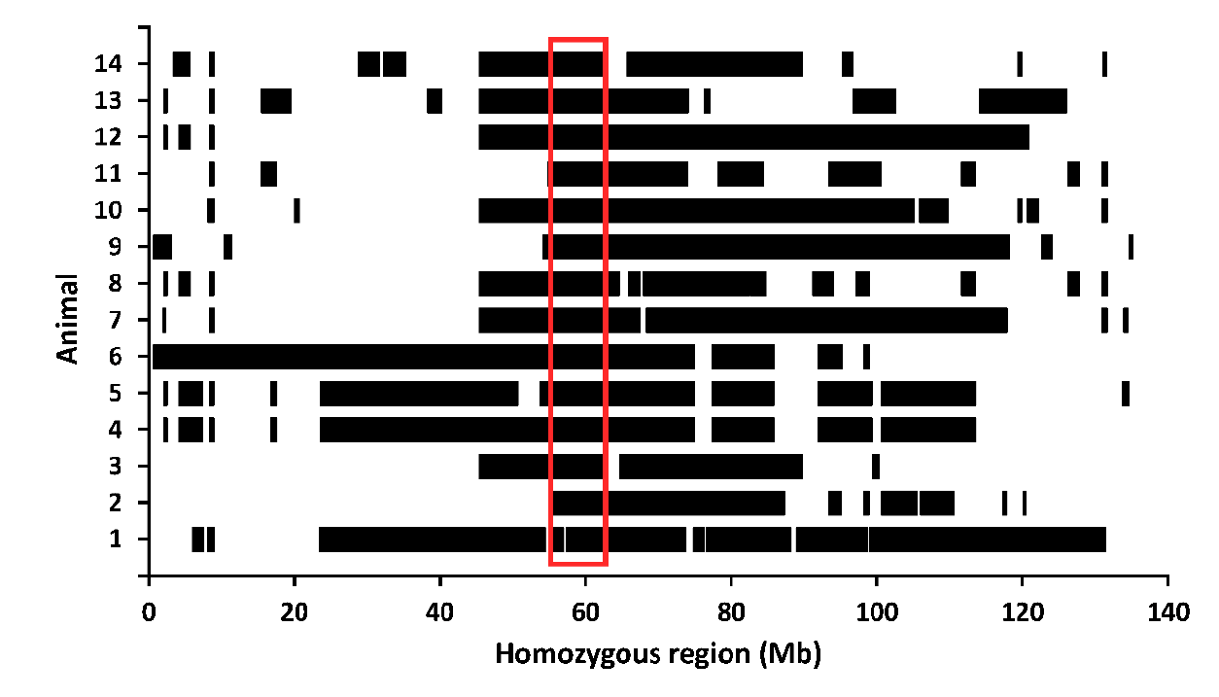
14 JNS calves shared homozygosity on region from 55.1 to 62.8 Mb of BTA 6 on the ARS-UCD1.2 reference map
*JNS = Jersey Neuropathy with Splayed forelimbs
* ARS-UCD1.2 reference map (Rosen et al, 2019)

Slide 11
rs1116058914 (G / A) located in the coding region of the last exon of the Ubiquitin C-terminal Hydrolase L1 (UCHL1) gene

Slide 12
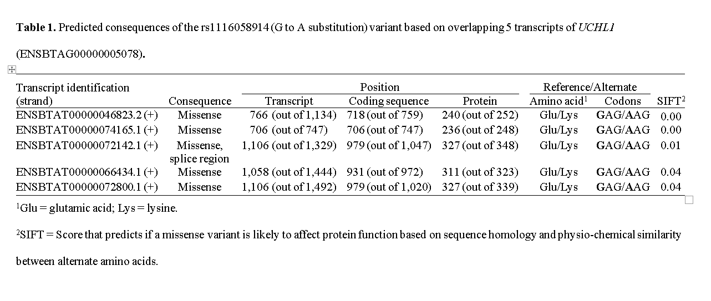
rs1116058914 variant is predicted to have a missense consequence in all 5 transcripts of the UCHL1 gene
*SIFT =

Slide 13
Conclusion:
Jersey neuropathy with splayed forelimbs is a recessive genetic condition that results in an affected calf that is unable to stand when the recessive allele is inherited from both parents.
Genetic abnormality in dairy cattle takes a toll on the health, performance and over all the $$.
Inheritance of the defect began to be tracked and reported in December 2020 by the Council on Dairy Cattle Breeding (Bowie, MD) using a haplotype test. However, direct genotype tests of the UCHL1 missense variant at 60,158,901 bp on BTA6 is expected soon.
Jersey owners should select against JNS and limit carrier‐to‐carrier matings to manage the impact on potential calf loss.

Slide 14
Acknowledgments and disclaimers
Jersey breeders and the Cooperative Dairy DNA Repository for providing genetic material.
The Council on Dairy Cattle Breeding (Bowie, MD) for access to its database.
Combined efforts and support of veterinarians and pathologists in several states and geneticists at the Animal Genomics and Improvement Laboratory.
Funds; appropriated project 8042-31000-002-00-D, “Improving Dairy Animals by Increasing Accuracy of Genomic Prediction, Evaluating New Traits, and Redefining Selection Goals,” of the USDA Agricultural Research Service.

Slide 15
Thank you

