Slide 1

Phenotypic and genotypic impact of milk components and body weight composite on dry matter intake
Sajjad Toghiani *¹, Paul VanRaden¹ , Mike VandeHaar ², and Robert Tempelman²
¹ USDA-ARS, Animal Genomics and Improvement Laboratory, Beltsville, MD, USA
² Department of Animal Science, Michigan State University, East Lansing, MI, USA
* sajjad.toghiani@usda.gov

Slide 2

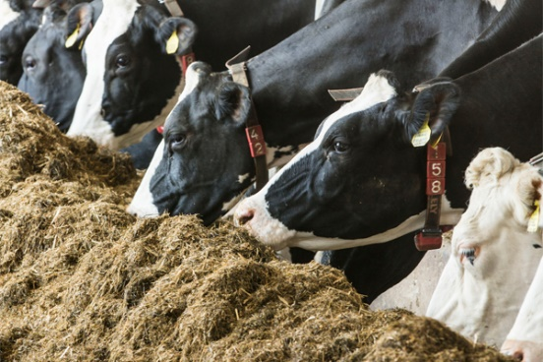
Backgrounds
Improvement in feed efficiency in dairy industry matters
  Farm profitability
  Environmental management
Dry matter intake (DMI)
  Key factor to Measure feed efficiency
  Main quantity in dairy nutrition research
  Develop breeding objectives for breeding programs
    Feed efficiency, methane emissions

Slide 3
Why feed efficiency is important?
Feed costs represent the largest operating cost in dairy production
Since 1990, feed efficiency was intended to initiate as breeding objective
Collecting feed intake data was and still is expensive and difficult
  Exclusively recorded in research herds
Larger datasets required for accurate estimation of genetic parameters
    Using information from multiple data source

Slide 4
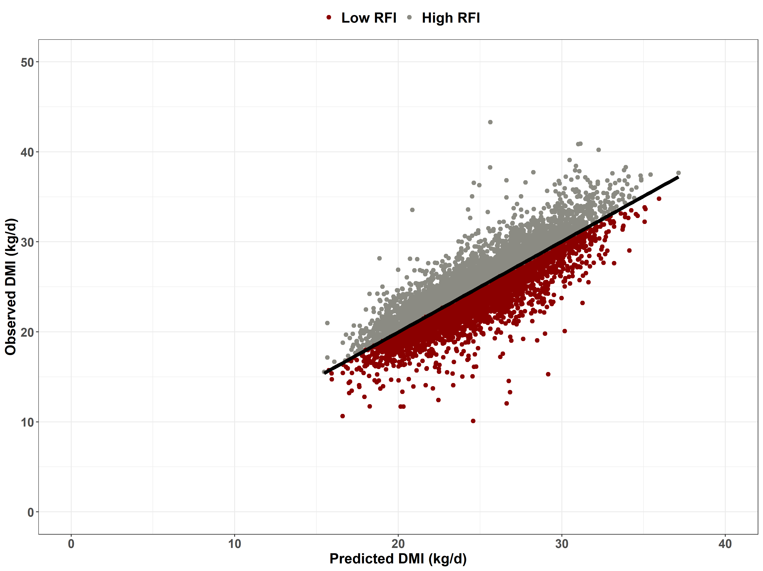
Factors affecting Feed Efficiency
Residual feed intake (RFI)
  Difference between actual and predicted dry matter intake
    Independent of variation in BW and level of production
    Low or Negative RFI → More efficient cows
    High or Positive RFI → Less efficient cows
  RFI is a useful tool for selecting efficient dairy cows
    Reducing feed cost at the herd level
Body weight (BW)/Body size
  Plays a major role for cow’s maintenance requirement
  Improving feed efficiency by selecting cows with smaller BW
    Leading to a decrease in maintenance cost

Slide 5
Objectives
Use feed intake data from U.S. Holstein dairy research herds
  To develop prediction models for DMI and BW from phenotypic and genomic regression of key energy sink traits
  To estimate the maintenance cost and feed cost of milk components associated with DMI for each given model

Slide 6
U.S. Feed efficiency database
Feed efficiency Project
  USDA-NIFA grant $5M (2010-2015)
  CDCB-FFAR grant $2M (2019-2024)
Main U.S. research herds
  Univ. of Wisconsin (WI)
  Univ. of Florida (FL)
  Michigan State Univ. (MI)
  Iowa State Univ. (IA)
  USDA-AGIL (MD)
Data collection
  Mid-lactation (50-200 days in milks)
    Recording period of 28 and 42-days
  Dry matter intake (DMI)
  Milk yield and components
  Body weight and BCS
Data processing
  Quality Data checked
    CDCB and contributing institutions
  Data joint with cooperator database
    Pedigree, Birth date, Calving dates, Parity, etc.

Slide 7
Mixed Models for DMI
DMI records used from 6,338 lactations of 5,094 U.S. Holstein cows
  Implementing mixed models through SAS PROC MIXED
Common fixed effects
  Overall mean
  Days in milk
  Age-Parity
  Body weight change
Common random effects
  Herd-year
  Experimental trial
  Residual effect
Phenotypic Model
Phenotypic regression (Kg)
  Milk yield
  Fat yield
  Protein yield
  Metabolic body weight
Genomic Model
Genomic regression (GEBV)
  Milk yield
  Fat yield
  Protein yield
  BWC
Sire’s genomic Model
Sire’s genomic regression (GEBV)
  Milk yield
  Fat yield
  Protein yield
  BWC
Extended genomic Model
Genomic regression (GEBV)
  Milk yield
  Fat yield
  Protein yield
  Stature
  Strength
  Body depth
  Dairy form
  Rump width

Slide 8
Feed cost for yield components
Method | Marginal feed cost ($)/ 100 kg standardized milk | DMI (kg) required per unit of component output
 |  | Milk | Milk S.E. | Fat | Fat S.E. | Protein | Protein S.E.
Phenotypic regression | 6.47 | 0.007 | ±0.008 | 2.82 | ±0.13 | 5.32 | ±0.31
Genomic regression | 16.77 | 0.076 | ±0.03 | 10.82 | ±0.60 | 7.88 | ±1.34
Sire Genomic regression × 2 | 11.37 | 0.043 | ±0.05 | 6.43 | ±1.14 | 6.66 | ±2.35
NM$ 2018 | 16.95 | 0.225 | -- | 5.42 | -- | 7.50 | --
NM$ 2021 | 11.52 | 0.120 | -- | 5.00 | -- | 6.00 | --
Theoretical (Dado et al. 1994) | 12.43 | 0.112 | -- | 4.42 | -- | 8.17 | --
ECM (National Research Council, 2001) | 9.14 | 0.122 | -- | 4.82 | -- | 2.85 | --
Each method gave differing feed cost for milk component, especially for fat yield.
Phenotypic regression indicates much more feed requires to produce protein than Fat.
Genomic regression shows the opposite result which producing fat requires more feed than protein.
New data indicates that milk fluid and protein may require less feed than previously assumed in NM$ 2018.

Slide 9
Maintenance cost per year
Methods | Maintenance (pounds DMI/pound BW) | Standard error
NM$ 2018 value | 1.7 | …
NRC 2001 value | 2.7 | …
NRC 2021 value | 3.4 | …
Phenotypic regression | 5.8 | ±0.18
Genomic regression | 6.3 | ±0.42
Sire genomic regression | 5.9 | ±0.72
NM$ 2021 value | 4.5 | …
Estimates from CDCB data give much higher maintenance cost compared to NRC values
  When regressing DMI on phenotypic, genomic and sire’s genomic body size predictors
Direct emphasis assigned against BWC in NM$ 2021 (- 9.4%) vs. NM$ 2018 (-5.3%)

Slide 10
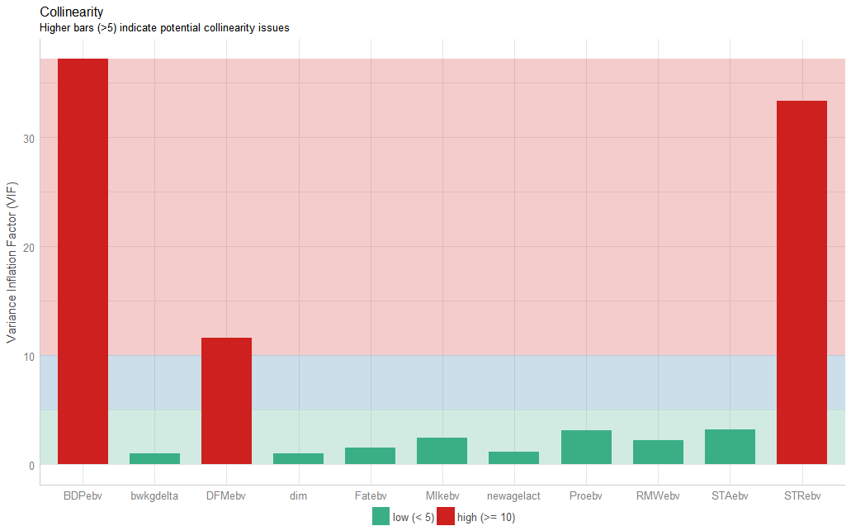
DMI prediction using 5 type traits forming BWC
Including genomic BWC is significant for predicting DMI, Directly associated with maintenance cost
Replacing BWC predictor with 5 type traits forming this index is valuable to test for predicting DMI
Multicollinearity Diagnostic checked because of possible high correlation between type trait predictors
Body depth has the largest VIF score, leading to unstable estimate and high S.E.
DMI (kg/day) required per unit of component output
Type traits | estimates (S.E.)
Stature | 0.04 (±0.07)
Strength | 0.75 (±0.24)
Body depth | -0.17 (±0.26)
Dairy form | 0.02 (±0.12)
Rump width | 0.03 (±0.06)

Slide 11
DMI prediction using 4 type traits forming BWC
Body depth removed from the set of 5 type traits due to highly VIF score.
Strength was the most significant predictor associated with DMI, agreeing with the current BWC formula
Although including only BWC in the mixed model was statistically significant, dissecting BWC to its 4 type trait components shows smaller AIC indicating the best fitted model.
DMI (kg/day) required per unit of each type trait
Type traits | Multicollinearity Diagnostic
 | Before | After
 | Estimates (S.E.)
Stature | 0.04 (±0.07) | 0.04 (±0.07)
Strength | 0.75 (±0.24) | 0.60 (±0.07)
Body depth | -0.17 (±0.26) | --
Dairy form | 0.02 (±0.12) | -0.05 (±0.05)
Rump width | 0.03 (±0.06) | 0.04 (±0.06)

Slide 12
BW prediction using type traits forming BWC
All 5 type traits included in BW model as predictors shown statistically significant.
Body depth predictor removed from the model after detecting with highly VIF score (> 30).
Strength and dairy form were the most important trait associated with BW, after removing body depth.
The importance and direction of coefficients used for strength and dairy form traits in BWC formula for HOL breed, supported by the estimates of both traits and their relationship with BW.
BW (kg) required per unit of each type trait
Type traits | Multicollinearity Diagnostic
 | Before | After
 | Estimates (S.E.)
Stature | 7.96 (±1.12) | 7.82 (±1.12)
Strength | 46.91 (±3.79) | 29.30 (±1.19)
Body depth | -20.52 (±4.19) | --
Dairy form | -4.16 (±1.86) | -12.34 (±0.82)
Rump width | 2.05 (± 1.01) | 3.40 (±0.98)
Weights (%) from BWC formula
Type traits | Holstein and other Breeds | Jersey and Brown Swiss
Stature | 23 | 28
Strength | 72 | 28
Body depth | 8 | --
Dairy form | -47 | -35
Rump width | 17 | 9

Slide 13
Conclusions
Phenotypic regressions of DMI on yield components were much less than corresponding genomic regressions.
For 100 kg of standardized milk with 3.5% fat and 3.0% protein,
  Estimated feed costs of genomic regression was 2.6 times more than phenotypic regression
The average of annual maintenance cost from estimates using phenotypic, genomic, and sire genomic regressions
  2X more than published NRC values in 2001 and 2021
  3.5X more than assumed NM$ 2018 value.
Selection for breeder should be more profitable
  Smaller cow size
  Eating less than expected (lower RFI)
  Produce more milk components
NM$ revision 2021 will be implemented in August by CDCB

Slide 14


Acknowledgments
USDA-ARS project 8042-31000-002-00, “Improving Dairy Animals by Increasing Accuracy of Genomic Prediction, Evaluating New Traits, and Redefining Selection Goals”
CDCB and its industry suppliers for data
Feed intake funding
  Agriculture and Food Research Initiative Competitive Grant #2011-68004-30340 from USDA National Institute of Food and Agriculture
  Foundation for Food and Agriculture Research (FFAR)

