Slide 1

Flexible testing and use of milk-only records
Paul VanRaden,*¹ Gary Fok,¹ Lillian Bacheller,² Gerald Jansen,² and Jose Carrillo²
¹USDA, Agricultural Research Service, Animal Genomics and Improvement Laboratory, Beltsville, MD, USA
²Council on Dairy Cattle Breeding, Bowie, MD, USA
paul.vanraden@usda.gov
Topics:
Adding ~1 million milk-only records in April 2022 genetic evaluations
Adding records for many other traits from those herds
Phenotypic and genetic progress for milk components

Slide 2
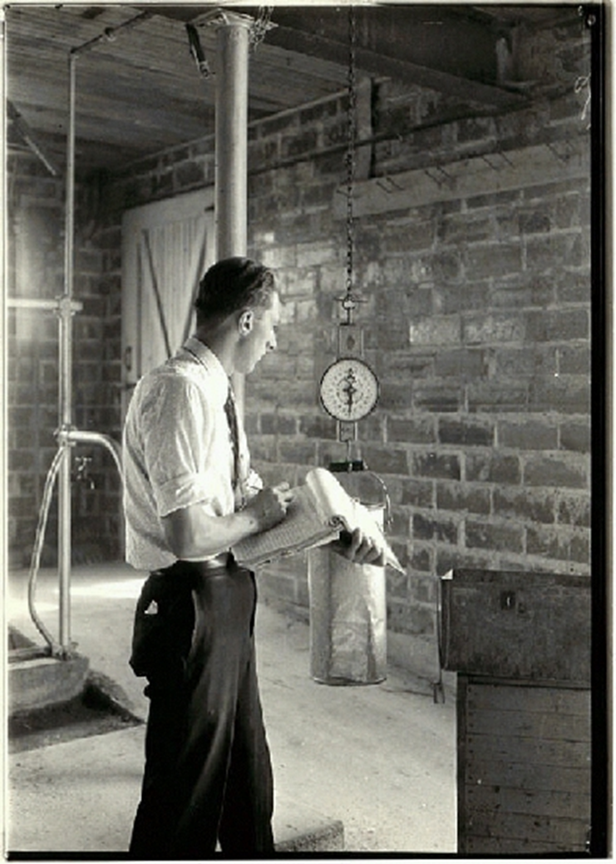
History of milk and component testing
Milk-only records
Churning butter from each cow’s milk (1854-1932)
Butterfat testing (Babcock, 1890)
Protein testing and MIR at central labs (1970s)
Somatic cell counts replaced California mastitis test (~1980)
In-line sensors, electrical conductivity to detect mastitis (1980s)
Cow sensors (internal or external) to estimate other important traits such as illness or estrus (recent)

Slide 3
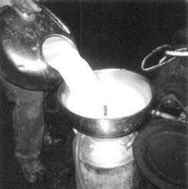
Growth of DHI milk and component testing

Slide 4
Milk record quantity, quality, and edits
Previous edits required at least 1 fat test / lactation
968,056 milk-only records were added in April 2022
Milk meters must be certified for all herds
% milk shipped and % valid ID edits for all unsupervised (owner sampler) herds
Trait | Total lactation records
Milk | 101,661,245
Fat | 100,693,189
Protein | 81,346,399
Somatic cell score | 65,440,082
Milk only | 968,056

Slide 5
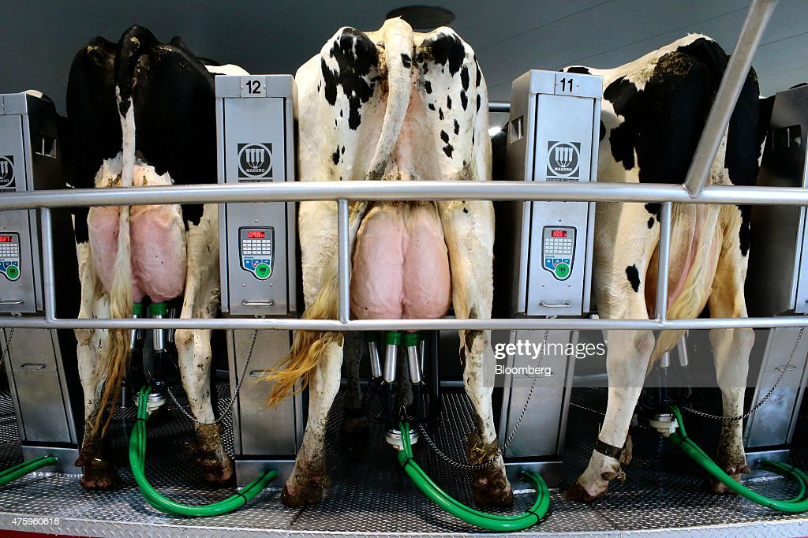
Trend in usable milk-only records

Slide 6
Genetic and phenotypic correlations
Genetic correlations above and phenotypic below diag.
Correlations are for 305-day lactation totals
Component testing adds more info for fat than protein due to lower correlation with milk, adds even more info for SCS
Multi-trait model since 2014, previously approximate MT
Correl-ations | Milk | Fat | Protein | SCS
Milk | 1 | 0.40 | 0.84 | 0.18
Fat | 0.62 | 1 | 0.59 | 0.12
Protein | 0.90 | 0.72 | 1 | 0.17
SCS | -0.16 | -0.17 | -0.15 | 1

Slide 7
Component prices and feed costs in MFP$ and NM$
Gross income was used in MFP$ until 1994

Slide 8
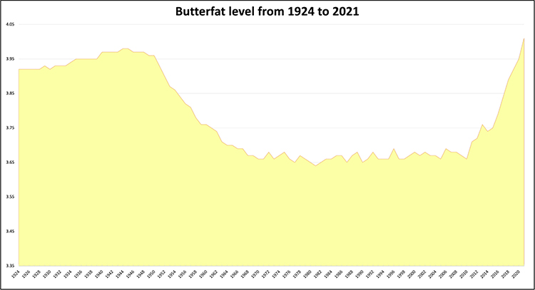
U.S. butterfat percentage has increased since 2015
4.0%
Data: USDA
Graphic:
Hoard’s
Dairyman
3.8%
3.6%
1924
1974
2021

Slide 9
Software and edit redesign
Programs were revised to include milk-only records, use trait-specific variance adjustments and weights, and remove much obsolete code
4 usability edits had all shared 1 bit in the LACT_MASK byte:
  Complete records must have ≥15 days in milk
  Records in progress must have ≥40 days in milk
  Lactation initiation codes must be 0, not 1 or 2 (abortions)
  Milk-only records were unusable

Slide 10
Herd variance and data collection ratings (DCR)
Herd variance adjustments had been estimated from 1 trait (milk yield since 1992 and then fat yield since 2007) but in 2022 all 3 traits (milk, fat, and protein) are adjusted separately.
Breed genetic variances now adjusted to common variance for each trait separately in the all-breed model.
Data collection ratings were introduced in 1998 but milk and fat had both received the same lactation weight calculated as an average of the DCR values for milk and components because of software limitations. In 2022 each trait is weighted separately.

Slide 11
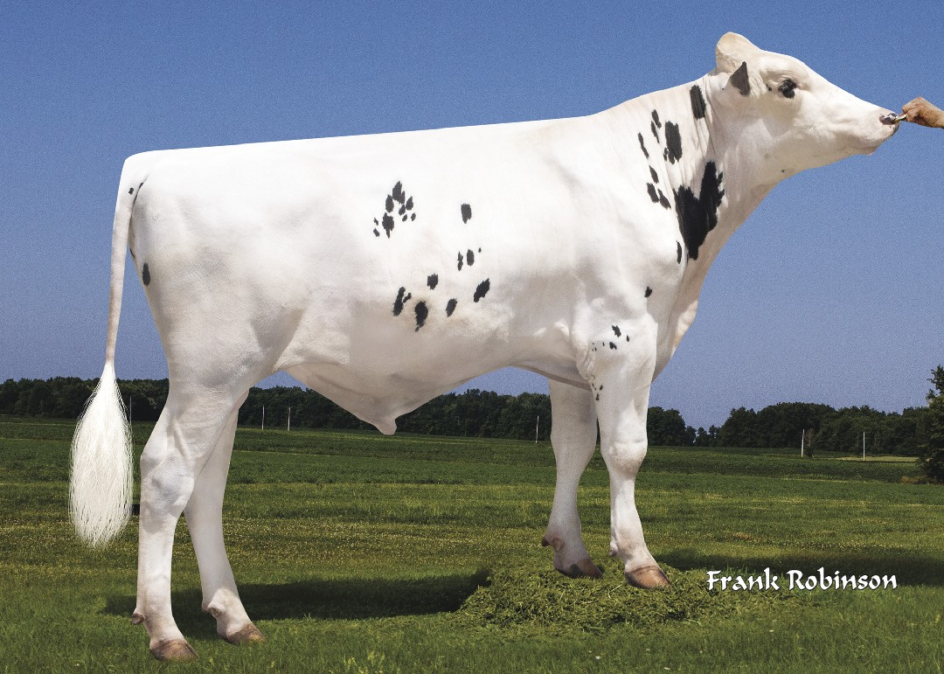
Predicted transmitting abilities
Correlations of new with previous PTA were:
  > 0.9995 across all bulls for milk, fat, and protein
  > 0.997 for bulls born since 2007 with > 50% reliability
SD of PTA increased slightly by 2.4% for milk, 0.1% for fat, and 0.4% for protein
Reliability also increased a little from the extra records
Example bull: Lionel (top proven HO for NM$)
  1320 daughters in 74 herds plus 9 milk-only daughters
Lionel

Slide 12
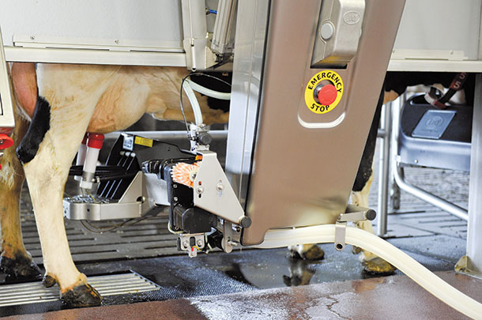
Other traits now used from milk-only herds
Many other traits require usable milk records:
  Daughter pregnancy rate, cow and heifer conception rates
  6 cow health traits
  Cow and heifer livability
  Calving ease, stillbirth, gestation length
  Early first calving
Productive life had already included cows culled early without usable milk records or in milk-only herds

Slide 13
Future possibilities
Automatic milk recording could allow more flexible herd testing and supply further traits such as
  Electrical conductivity
  Milking speed
New components have not been introduced since SCS in 1980s
  Spectral data could estimate several other properties:
  Metabolic health, individual milk proteins, non-protein nitrogen, etc., but requires industry standardization

Slide 14
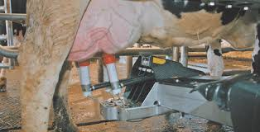
Conclusions
Fat testing was required for records used in U.S. genetic evaluations from 1926 to 2021.
About 1 million milk-only records added to April 2022 evaluations.
Many other traits (fertility, calving, health, etc.) are now used from milk-only herds even if component samples are not taken.
Component testing is still very valuable.

Slide 15
Acknowledgments & disclaimers
USDA-ARS project 8042-31000-002-00-D, “Improving Dairy Animals by Increasing Accuracy of Genomic Prediction, Evaluating New Traits, and Redefining Selection Goals” (AGIL funding).
CDCB and its industry suppliers for data
Mention of trade names or commercial products in this presentation is solely for the purpose of providing specific information and does not imply recommendation or endorsement by USDA.

