Slide 1
Use of new multi-trait, all-breed genetic evaluation software

Slide 2
Introduction
Animal model (Wiggans et al.,1988)
  Single-trait milk, fat, and protein
  PL, SCS added in 1994, DPR in 2003
  All-breed animal model – 2007
  Multiple-step genomic model - 2009
One step evaluations are difficult
  All breeds, traits, foreign data, and genotypes evaluated together?

Slide 3
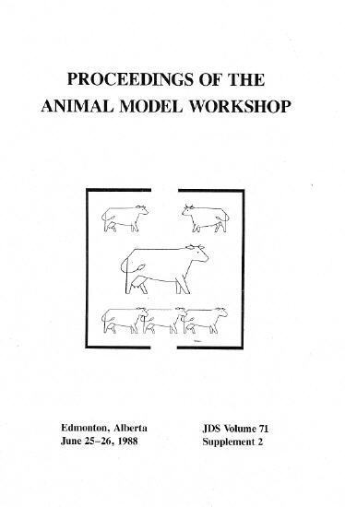

Slide 4
Software evaluation tests
Single (ST) or multi-trait (MT) national evaluations (new software)
  3 fertility traits: daughter pregnancy rate (DPR), heifer and cow conception rates (HCR, CCR), implemented December 2013
  6 more traits: milk, fat, protein, SCS, DPR, PL proposed for December 2014
  Exact MT productive life also tested

Slide 5
HCR Genetic Trends, All-Breed Scale

Slide 6
CCR Genetic Trends, All-Breed Scale

Slide 7
Plans for December 2014
New software for traditional PTAs
  Total rewrite began in 2010
  Ready for Sept 2014 Interbull test run
  Change input data for DPR
  Also test GPTAs obtained from PTAs
Base change for all traits
Net merit revision (John Cole’s talk)

Slide 8
Data (yield and health)
Animal model includes:
  76 million lactation phenotypes / trait
  63 million animals in pedigree
  30 million permanent environment
  7 million herd management groups
  11 million herd by sire interactions
  Traits: M, F, P, SCS, PL, DPR
Genotypes processed separately

Slide 9
Previous Features Retained
Official animal model
  Data edits and adjustments
  Separate weight for each observation
  All breeds and crossbreds included
  Inbreeding and heterosis correction
  Herd by sire interaction
  Convert PTAs to within-breed base
Heritability of yield decreased
  Mimic effect of cow adjustments

Slide 10
New Features Added
Model options now include:
  Multi-trait models
  Multiple class and regress variables
  Suppress some factors / each trait
  Random regressions
  Foreign data
  Parallel processing
Compute reliability, YD, DYD, and renumber factors in same program
Notes:
Renumber factors in same program

Slide 11
Traditional, ST, and MT Evaluation
Domestic bulls (≥ 10 USA daughters)
 | Correlations within breed
Trait | Trad, ST | Trad, MT | ST, MT
Milk | .986 | .986 | .999
Fat | .985 | .985 | .999
Protein | .986 | .988 | .999
SCS | .998 | .994 | .995
PL | .975 | .945 | .972
DPR | .987 | .958 | .970

Slide 12
Computation Required
CPU for all-breed model (7 traits)
  ST: 4 min / round with 7 processors and ~1000 rounds
  MT: 15 min / round and ~1000 rounds
  ~200 rounds for updates using priors
  Little extra cost to include foreign
Memory required
  ST or MT: 32 Gbytes (512 available)

Slide 13
Redefine Pregnancy Rate
Derived from days open using
  Non-linear: 21 / (DO – VWP + 11)
  Linear approx: (233 – DO) / 4
Weight by number of opportunities
  Now more similar to conception rate
  Previously equal weights for DPR
  Weights = n / [1 + (n – 1) repeat]
  Heritability = 1.4% / 21 days
    (was 4.0% / lactation)

Slide 14
Pregnancy Rate vs Days Open
100
90
80
70
60
Pregnancy Rate
50
40
30
20
10
1
2
3
4
5
6
7
8
9
0
60
81
102
123
144
165
186
207
228
249
Number of Chances
Days Open

Slide 15
Theoretical Distribution of
Days Open

Slide 16
Actual Distribution of Days Open
Holstein Calvings 1990 - 2001
Cows culled for reproductive reasons
≤ 50
≥ 250

Slide 17
Properties of DPR change
Genetic SD 35% larger (2.3 vs. 1.7)
Cows open at 250 DIM no longer assumed pregnant
DPR requires weighted average of PR rather than simple average
Faster testing using new software

Slide 18
Conclusions
Multi-trait all-breed model developed
  Replace software used since 1989
  Correlations ~.99 with traditional AM
  Tested with 7 yield and health traits
  Implement with smaller groups of traits
  Many new features added
  Much easier to use, modify, maintain
Including genotypes in single-step not yet possible with >500,000 Holsteins

Slide 19
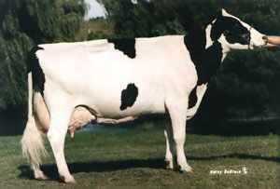
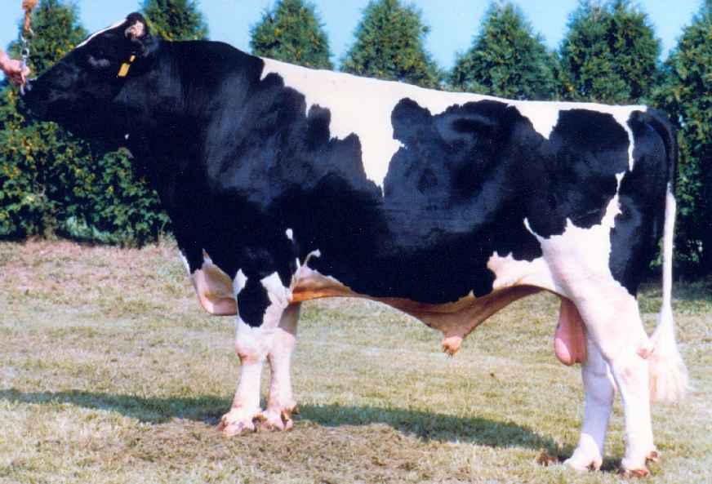
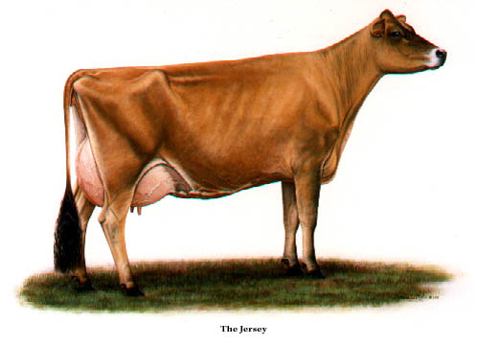
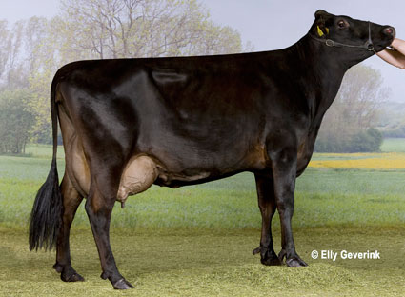
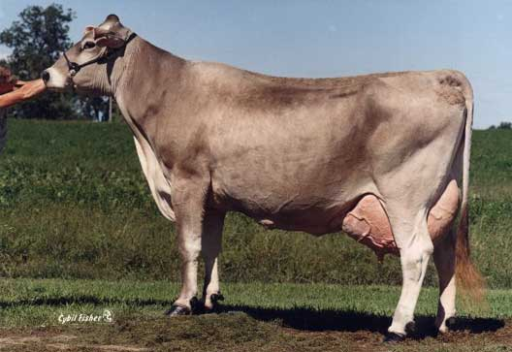
Acknowledgments
Members of the Council on Dairy Cattle Breeding provided data
George Wiggans, Ignacy Misztal, and Shogo Tsuruta provided advice on algorithms and modeling

