Slide 1
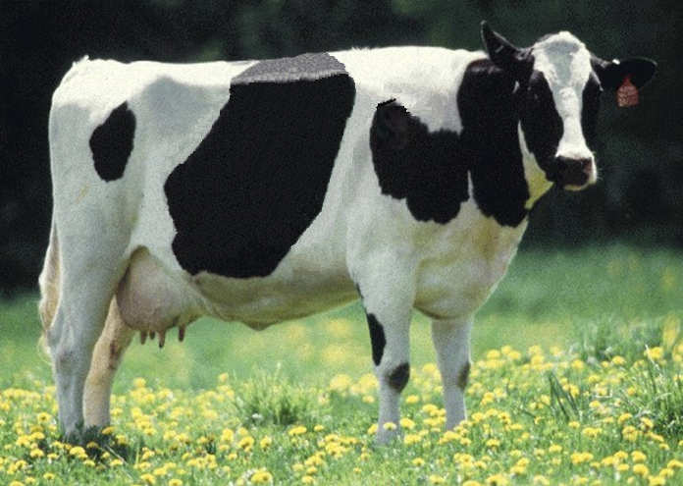
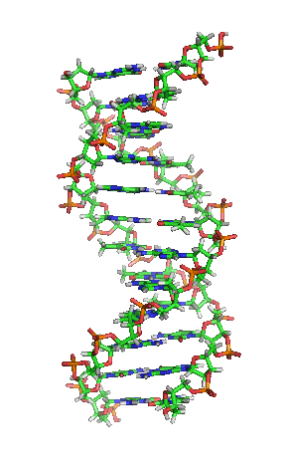
Analysis of Genomic Predictor Population

Slide 2
Objectives
Evaluate the accuracy of cow and bull traditional information in the genomic evaluation system for Holstein
How useful are cows?
Would more old bulls increase accuracy?
What is the contribution of additional predictor animals?

Slide 3
Introduction
The number of females genotyped monthly has increased from approximately 1,800 per month in 2010 to 12,650 per month in 2013.
Only a few countries other than the US include cows in the reference population. Ex: Ireland, Australia and Czeck Republic
For bulls, efforts have been made to increase collaborations with many other organizations.

Slide 4
Number of Genotypes Added Monthly

Slide 5
Cut off study (Bulls vs. Cows)
Predictor Bulls – 21,883
Predictor Cows – 30,852
Traditional evaluation by August 2012 to predict animals that gained a traditional evaluation between August 2012 and December 2013
Only females who were genotyped before they were two years old where included in the validation set to avoid selection bias

Slide 6
Bulls and/or Cows Predicting Bulls
 |  |  | Gain Gen Rel
Trait | Validation Bulls (no.) | Parent Average | Cows Only | Bulls Only | Both
Milk | 1486 | 40.5 | 26.2 | 34.9 | 35.8
Fat | 1486 | 40.5 | 21.9 | 33.9 | 33.3
Protein | 1486 | 40.5 | 16.8 | 25.8 | 26.0
PL | 1484 | 35.3 | 21.4 | 54.9 | 55.2
SCS | 1484 | 37.5 | 16.9 | 30.3 | 31.1
DPR | 1287 | 34.9 | −5.0 | 23.3 | 22.6
HCR | 1377 | 28.2 | −3.2 | 28.3 | 25.1
CCR | 1063 | 28.6 | 19.5 | 56.9 | 57.4
Final score | 934 | 36.3 | 17.7 | 27.0 | 26.0
Average* |  |  | 20.4 | 31.7 | 32.1
Highest Gen Rel Gain *Excluding $NM

Slide 7
Bulls and/or Cows Predicting Cows
 |  |  | Gain Gen Rel
Trait | Validation Bulls (no.) | Parent Average | Cows Only | Bulls Only | Both
Milk | 26559 | 26.1 | 23.9 | 30.2 | 31.8
Fat | 26562 | 26.1 | 20.2 | 26.4 | 27.5
Protein | 26558 | 26.1 | 14.1 | 18.8 | 20.1
PL | 357 | 19 | −6.4 | 8.5 | 14.6
SCS | 24879 | 24.8 | 15.5 | 25.1 | 26.0
DPR | 9064 | 24.6 | −1.1 | −0.8 | −0.6
HCR | 12618 | 24.5 | 1.6 | 9.3 | 13.1
CCR | 7156 | 24.4 | 25.4 | 8.6 | 15.2
Final score | 10759 | 21.9 | 19.5 | 8.3 | 29.8
Average* |  |  | 20.6 | 23.0 | 25.5
Highest Gen Rel Gain *Excluding $NM

Slide 8
Number predictor bulls by birth year

Slide 9
Cut off study (Age)
Predictor Bulls
    All – 21,883
    Bulls born before 1996 removed – 17,047
    Bulls born before 2001 removed – 11,507
    Bulls born before 2005 removed – 6,623
Traditional evaluation by August 2012 to predict animals that gained a traditional evaluation between August 2012 and December 2013

Slide 10
Bulls only excluded by birth year
 |  |  | Gain Gen Rel
Trait | Validation Bulls (no.) | Parent Average | All | Birth years included
 |  |  |  | ≥1996 | ≥2001 | ≥2005
Milk | 1486 | 40.5 | 34.9 | 34.7 | 33.5 | 30.2
Fat | 1486 | 40.5 | 33.9 | 34.1 | 32.7 | 28.7
Protein | 1486 | 40.5 | 25.8 | 26.3 | 25.3 | 21.9
PL | 1486 | 35.3 | 54.9 | 53.0 | 48.9 | 36.6
SCS | 1484 | 37.5 | 30.3 | 29.3 | 26.6 | 23.3
DPR | 1287 | 34.9 | 23.3 | 21.9 | 19.5 | 3.7
HCR | 1377 | 28.2 | 28.3 | 24.0 | 23.5 | 10.8
CCR | 1063 | 28.6 | 56.9 | 35.1 | 30.0 | 5.5
Final score | 934 | 36.3 | 27.0 | 25.6 | 22.8 | 15.9
Average* |  |  | 31.7 | 29.9 | 27.4 | 19.7
Highest Gen Rel Gain *Excluding $NM

Slide 11
Random vs. birth year exclusion (Milk)
Gain in genomic rel (Milk)

Slide 12
Conclusions
How useful are cows?
    Cows contribute a small amount to genomic accuracy due to low reliabilities in the US. However, if bull genotypes are limited, they become more valuable.
Would more old bulls increase accuracy?
    Historic bulls contribute a small amount to genomic accuracy due to linkage decay. Bulls closer in age to the young bulls offer more predictive ability.
What is the contribution of additional predictor animals?
    We have not yet reached a plateau of gains in genomic reliability.

Slide 13
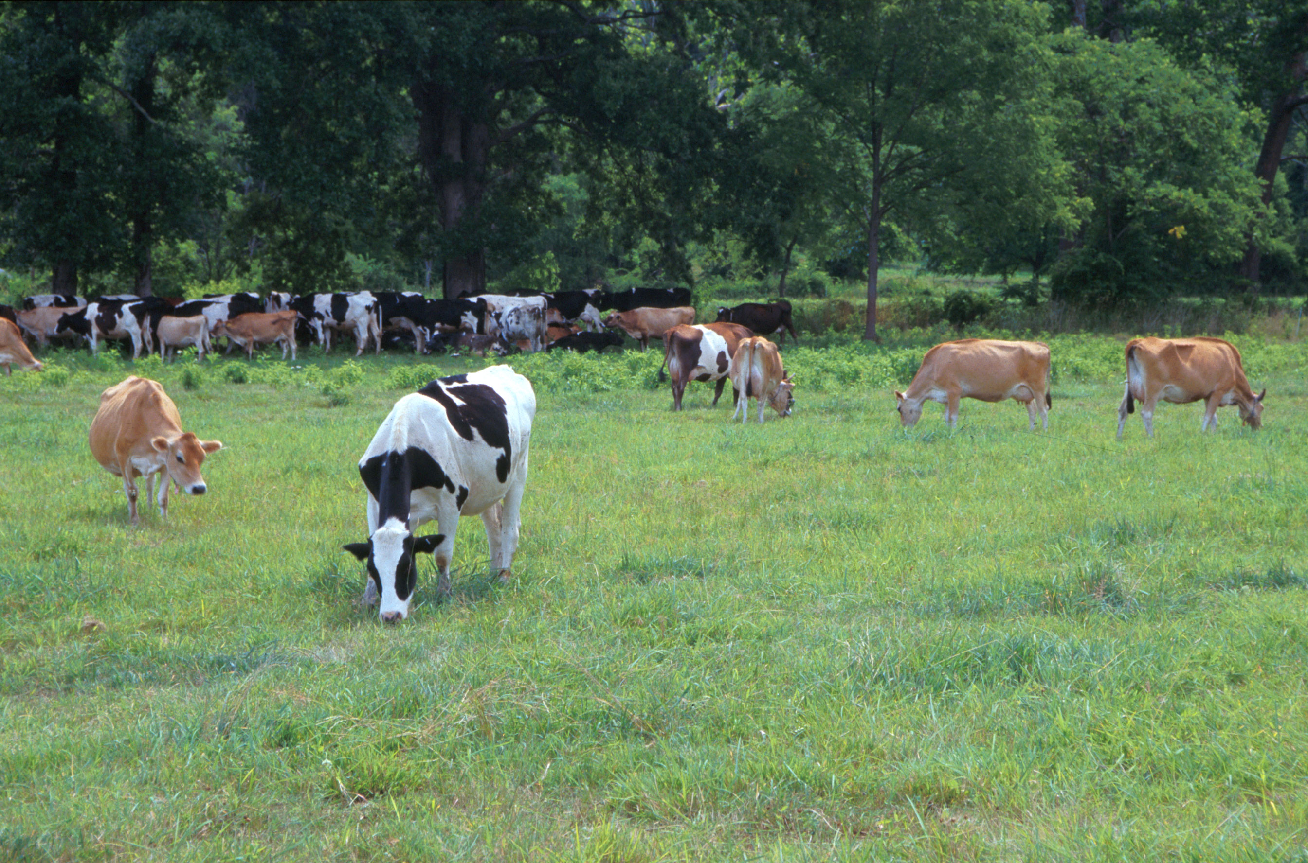
Questions?
AIP web site:
http://aipl.arsusda.gov
Holstein and Jersey crossbreds graze on American Farm Land Trust’s
Cove Mountain Farm in south-central Pennsylvania
Source: ARS Image Gallery, image #K8587-14; photo by Bob Nichols

