Slide 1
Immediate evaluations and new chips

Slide 2
Immediate evaluation proposal
Proposal to be presented to Board of Council on Dairy Cattle Breeding
Input solicited from Research Advisory Working Group and Nominators

Slide 3
Efforts in other countries
Weekly evaluations in the Netherlands
Daily evaluations in Germany of animals with 50K genotypes (No imputation required)

Slide 4
Immediate evaluation details
Released to nominator at 8 am on the Tuesday after genotype is loaded or becomes usable
Contains pedigree, genomic evaluation, parent average, and imputed recessive codes
Approximations for additional fields possible

Slide 5
Genotypes submitted (June 2014)
Sun | Mon | Tue | Wed | Thu | Fri | Sat
1 | 2 | 3 | 4 85 | 5 756 | 6 | 7
8 | 9 973 | 10 361 | 11 1417 | 12 449 | 13 1091 | 14 524
15 | 16 4212 | 17 1706 | 18 5419 | 19 1228 | 20 | 21 92
22 | 23 | 24 | 25 | 26 101 | 27 29 | 28
29 6 | 30 36

Slide 6
Characteristics
Quick access to evaluations for early decision on which calves to raise
Quick turnaround possible because no reliability calculated
Selection-index combination step approximated with fixed weights

Slide 7
Comparison with official evaluation
High correlation (.995) with following month’s official evaluation
Reasons for differences
Approximate selection index combination
New estimates of SNP effects
Changes in imputed genotypes
Pedigree changes (e.g., adding maternal grandsire)

Slide 8
Immediate-evaluation summary
Quick turnaround
Highly accurate prediction of official monthly evaluation
Distribution to nominator, DRPC, and Breed association
Enables early decisions on which calves to raise
Recommended by RAWG, Awaits board action

Slide 9
Genotype chips
Chip Name | No. of SNP |  | Chip Name | No. of SNP
50K | 54,001 |  | GHD | 77,068
50K V2 | 54,609 |  | GP2 | 19,809
3K | 2,900 |  | ZLD | 11,410
HD | 777,962 |  | ZMD | 56,955
Affy | 648,875 |  | ELD | 9,072
LD | 6,909 |  | LD2 | 6,912
GGP | 8,762 |  | GP3 | 26,151

Slide 10
Revised low-density chip (July 2014)
GeneSeek Genomic Profiler, version 3 (GP3)
26,151 SNPs (19,808 for GP2)
13,218 SNPs used for evaluation (8,422 for GP2)
Improved imputation accuracy especially when:
Missing pedigree
Nongenotyped ancestors
Chip 14 in formats 38 and 105 (August 2014)

Slide 11
Low-cost chip (in development)
~5,000 SNPs
Built-in validation
Single-gene tests
Lower imputation accuracy if neither parent genotyped
Imputation accuracy within 1% of LD chip if at least 1 parent genotyped

Slide 12
New GHD version (in development)
120–150K SNPs
Include 16,248 among the 60,671 SNPs currently used that are not on the GHD
Research underway to determine if adding SNPs with a low to moderate minor allele frequency (MAF) improves accuracy of genomic evaluations

Slide 13
Chip summary
New versions of chips frequently released
Allows adding SNP for newly discovered causative genetic variants
Improved accuracy from better SNP
New chips Improve value
Lower cost, or
More SNP, same cost

Slide 14
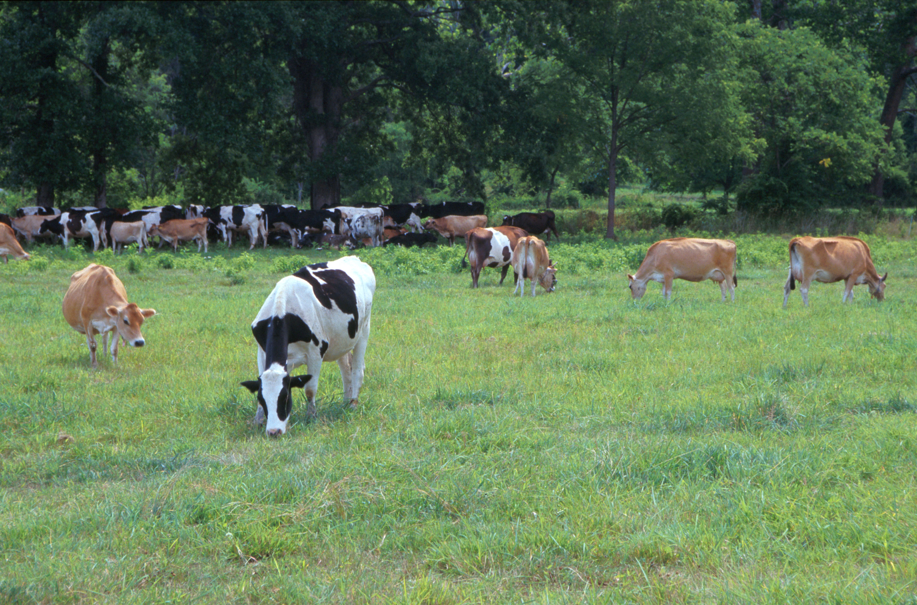
Questions?
AIP web site:
http://aipl.arsusda.gov
Holstein and Jersey crossbreds graze on American Farm Land Trust’s
Cove Mountain Farm in south-central Pennsylvania
Source: ARS Image Gallery, image #K8587-14; photo by Bob Nichols

