Slide 1

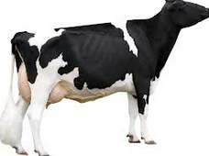

Genomic Relationships for Mating Programs
Chuanyu Sun and Paul VanRaden
National Association of Animal Breeders (NAAB)
Animal Genomics and Improvement Laboratory (AGIL)

Slide 2
Introduction
Computerized mating programs have helped breeders reduce pedigree inbreeding by identifying matings between animals with fewer ancestors in common than average
In genomic era, dense single nucleotide polymorphism (SNP) markers across the whole genome have been widely used for genomic selection
Pedigree relationship
Genomic relationship

Slide 3
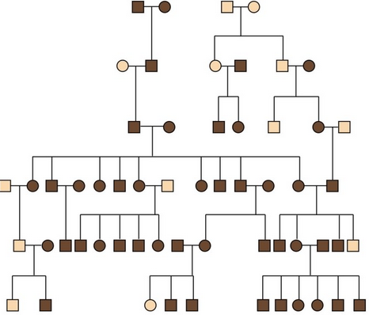
Introduction
Pedigree relationship
The expected relationship
Genomic relationship
40925026 00000021111120022002111011111201110101111001
52110921 2000200101001120220021100201200012212001120
54304711 2100002021102002200200002202020220022200200
The realized relationship

Slide 4
Introduction
Inbreeding should be controlled on the same basis as used to estimate breeding values (Sonesson et al. 2012)
Pedigree-based inbreeding control with traditional pedigree-based method estimated breeding values
Genome-based inbreeding control with genome-based estimated breeding values
New programs to minimize genomic inbreeding by comparing genotypes of potential mates should be developed and implemented by breed associations, AI organizations, and on-farm software providers

Slide 5
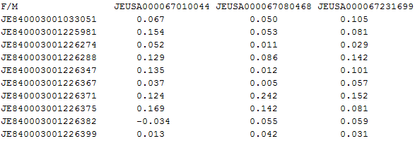
Genomic relationship
The Genomic relationship file given bulls and cows ID is ready to create routinely by CDCB since Aug, 2014
This file includes all the genotyped females and a list of bulls

Slide 6
Genomic relationship
Which bulls were included ?
HO: The 3,300 potential sires are:
800 A - Active bulls
500 I – Inactive bulls that breeders are still using
1000 G - Genomic young sire – semen being marketed.
1000 C - High Ranking Elite sires – Collected but not yet made available
Within each category, bulls would be sorted by NM$ with the highest ones taken first
Extra criteria: the top 500 Inactive bulls would also need to have a minimum production and type reliability of at least 95%. This way is to ensure that we are selecting the popular Inactive bulls.
Other breeds limit reliability >90%

Slide 7
Genomic relationship
Each approved CDCB member organization would receive their own copy of the file
One breed one file
The CDCB would create the large file 3 times per year. Then at each monthly genomic update, providing a monthly update file for new females with the Previously identified bulls

Slide 8
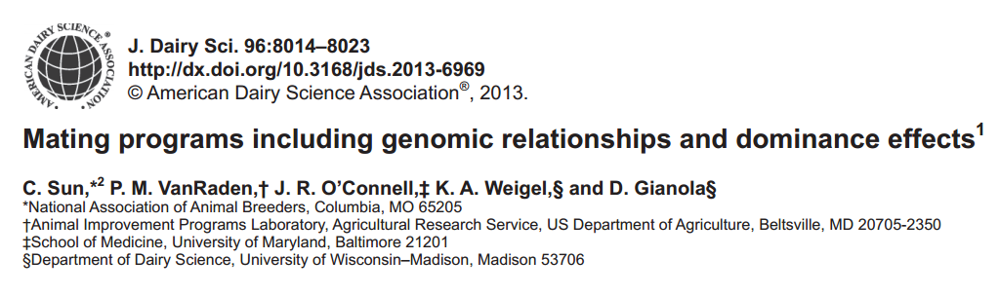
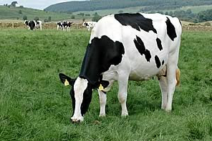
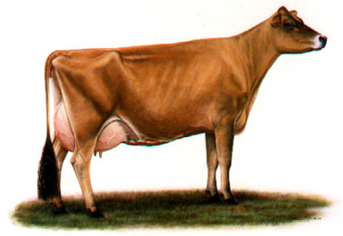
How to earn benefit
Mating strategies

Slide 9
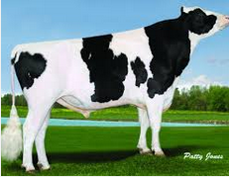
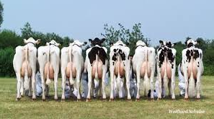
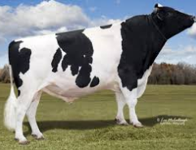
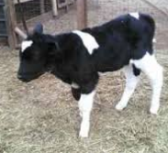
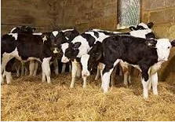
How to earn benefit
Mean expect progeny values (EPV)
GLNM is Genomic lifetime net merit
B_{LNM} is defined as the loss of LNM per 1% inbreeding, B_{LNM}=$23.11
EFI is expected future inbreeding,
G_{sire,dam} is the genomic relationship between sire and dam

Slide 10
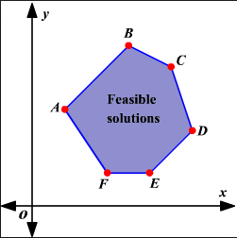
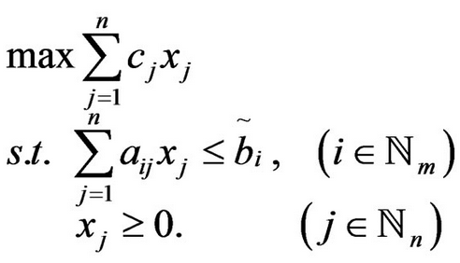
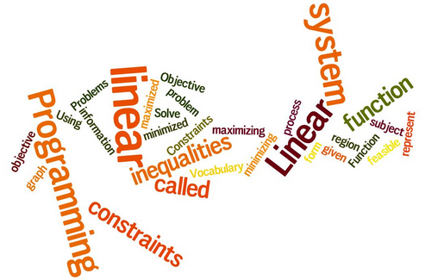
How to earn benefit
Mating strategies
bulls
females
 |  |  |  | EPV_{ij}
Random mating (RD)
Sequential selection of least-related mates (SM)
Linear programming (LP)

Slide 11
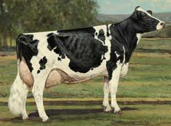
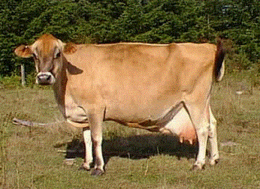
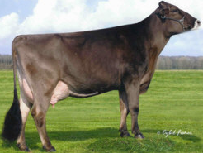
How to earn benefit
Example data
Mating programs | Brown Swiss | Jersey | Holstein
Males | 8 | 50 | 50
females | 79 | 500 | 500

Slide 12
How to earn benefit
Example data – increased Progeny values
Selected bulls | Mating method | Mate Inbreeding source | EPV² ($)
 |  |  | Brown Swiss | Holstein | Jersey
Top 50 for genomic LNM | Linear programming | Genomic | 205 | 494 | 358
 |  | Pedigree | 184 | 462 | 326
 | Sequential least-related³ | Genomic | 181 | 474 | 333
 |  | Pedigree | 175 | 450 | 312
 | Random |  | 138 | 422 | 255
Top 50 for traditional LNM | Linear programming | Genomic | 158 | 393 | 307
 |  | Pedigree | 136 | 363 | 274
 | Sequential least-related² | Genomic | 127 | 372 | 278
 |  | Pedigree | 124 | 350 | 263
 | Random |  | 107 | 314 | 214
Random 50 | Linear programming | Genomic | 64 | 70 | 78
 |  | Pedigree | 43 | 40 | 42
 |  | Genomic | 64 | 70 | 78
 |  | Pedigree | 45 | 40 | 41
 | Sequential least-related² | Genomic | 37 | 36 | 46
 |  | Pedigree | 27 | 21 | 29
 |  | Genomic | 32 | 39 | 46
 |  | Pedigree | 22 | 24 | 27
 | Random |  | 0 | 0 | 0
²Relative to randomly selected bulls that were randomly mated
³Pryce et al. (2012)

Slide 13
How to earn benefit
Example data – reducing progeny inbreeding
Selected bulls | Mating method | Mate Inbreeding source | Progeny inbreeding (%)
 |  |  | Brown Swiss | Holstein | Jersey
Top 50 for genomic LNM | Linear programming | Genomic | 6.94 | 5.17 | 3.72
 |  | Pedigree | 7.87 | 6.58 | 5.12
 | Sequential least-related | Genomic | 7.97 | 6.03 | 4.78
 |  | Pedigree | 8.27 | 7.09 | 5.70
 | Random |  | 9.83 | 8.31 | 8.17
Top 50 for traditional LNM | Linear programming | Genomic | 6.11 | 4.87 | 3.41
 |  | Pedigree | 7.07 | 6.15 | 4.82
 | Sequential least-related | Genomic | 7.45 | 5.79 | 4.66
 |  | Pedigree | 7.60 | 6.72 | 5.32
 | Random |  | 8.36 | 8.30 | 7.43
Random 50 | Linear programming | Genomic | 6.64 | 4.46 | 3.65
 |  | Pedigree | 7.56 | 5.77 | 5.22
 |  | Genomic | 6.64 | 4.46 | 3.65
 |  | Pedigree | 7.49 | 5.78 | 5.26
 | Sequential least-related | Genomic | 7.83 | 5.97 | 5.04
 |  | Pedigree | 8.26 | 6.58 | 5.76
 |  | Genomic | 8.05 | 5.84 | 5.05
 |  | Pedigree | 8.47 | 6.48 | 5.86
 | Random |  | 9.30 | 7.51 | 7.04

Slide 14
How to earn benefit
Example data – summaries
Expected progeny value was higher when genomic rather than pedigree relationship was used as the mate inbreeding source.
Expected progeny value was higher for linear programming than the sequential method, and both of those methods were better than random mating.
Expected progeny value was higher when top 50 mated bulls were selected based on genomic LNM rather than traditional LNM or random.
Mean genomic inbreeding of progeny was lowest when genomic relationship was used other than pedigree relationship
LP is better than SM and RD on control inbreeding of progeny

Slide 15
How to earn benefit
Total annual value (based on Oct, 2012 data):
Selected bulls | Mating method | Mate Inbreeding source | EPV ($)
 |  |  | Brown Swiss | Holstein | Jersey
Top 50 for genomic LNM | Linear programming | Genomic | 205 | 494 | 358
 |  | Pedigree | 184 | 462 | 326
 | Sequential least-related³ | Genomic | 181 | 474 | 333
 |  | Pedigree | 175 | 450 | 312
 | Random |  | 138 | 422 | 255
($494 - $462)(120989) = $3,871,648
Only by replacing Pedigree relationship using Genomic relationship

Slide 16
How to earn benefit
Economic benefits will continue to grow as more females are genotyped
($494 - $462)(249877 ) = $7,996,064

Slide 17
Software Implement
Genomic relationship
Linear programming
GLPK
http://www.gnu.org/software/glpk/
Rglpk
http://cran.r-project.org/web/packages/Rglpk/index.html
lpSolve
http://cran.r-project.org/web/packages/lpSolve/index.html
Rsymphony
http://cran.r-project.org/web/packages/Rsymphony/index.html

Slide 18
Software Implement
Available
The matingProgram package includes two executable files:
matingProgram_S1
matingProgram_S2
This package performs 3 functions:
  Create relationship files given bulls ID and female ID
  Create relationship and mating plans files given bulls ID and female ID
  Make mating plans given bulls ID, female ID and relationship file

Slide 19

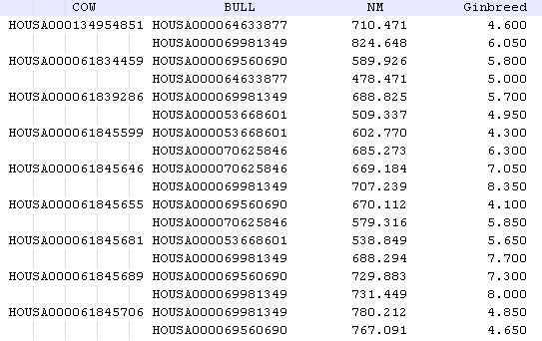
Software Implement
Inputs
HOUSA000069981349
HOUSA000069560690
HOUSA000070625846
HOUSA000064633877
HOUSA000053668601
Outputs
HOUSA000134954851
HOUSA000061834459
HOUSA000061839286
HOUSA000061845599
HOUSA000061845646
HOUSA000061845655
HOUSA000061845681
HOUSA000061845689
HOUSA000061845706
HOUSA000061845722
HOUSA00035SHE7944
HOUSA00035SHE7943
HOUSA00035SHE7948
HOUSA00035SHE7949

Slide 20

Discussions
Type trait
  Nonlinear merit function
  M=c + a G + bG² (b<0)
Intrabreed Mating Pair Selection Methods for Improvement of Nonlinear Merit from Additive Genetic Inheritance: A Review
F.R. Allaire Volume 76: 2308–2319, 1993
  Different approach to assign optimized mating pair
Including dominance effect in mating program to earn extra benefit

Slide 21
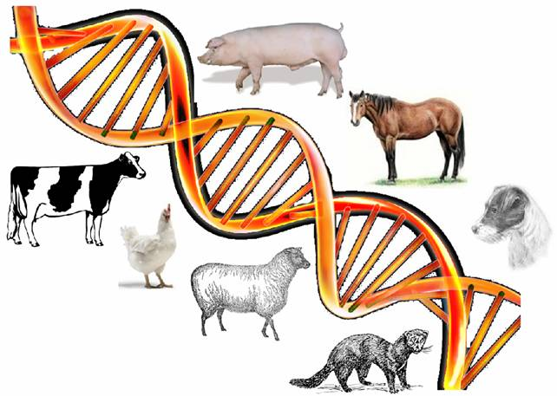
Thank you

