Slide 1
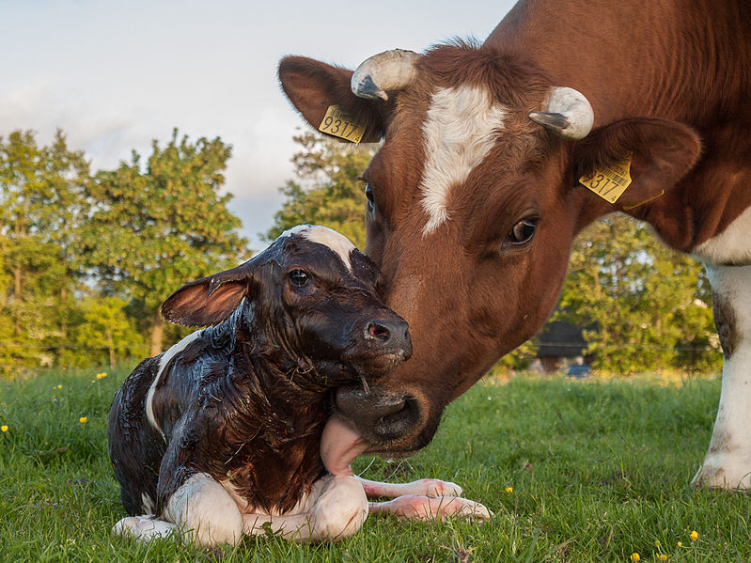
AGIL Technical Report

Slide 2
Topics
Evaluation changes (recent and future)
  Net Merit revisions for livability and body weight
  Type trait evaluations for JE, BS, AY, GU, MS
Potential new traits from existing data
  Gestation length, age at 1st calf
  Genetic rankings for heat stress
Checkup on stability of bull GPTAs
5-year research planning process (ARS and AGIL)
AGIL staffing

Slide 3
Evaluation changes since 2015 workshop
Change: | When:
Foreign Montbeliarde, Simmental, and Fleckvieh bulls converted by MACE to HO base | Dec 2015
Guernsey genomic evaluations | Apr 2016
Breed base representation (BBR) for crossbreds | Apr 2016
Reliability and inbreeding in weekly evaluations | Apr 2016
Cow livability (LIV) evaluation introduced | Aug 2016
Genotype exchanges (proven) with Japan, Switzerland | May 2016
Genotype exchanges (young bulls) with Germany | Aug 2016
6 new chips accepted (G7K, GP4, ZL4, AMD, BG1, GF1) | 2015-16
Known mutation locations used in HCD, HH5, and BH2 | 2016

Slide 4
Chips and markers available across time

Slide 5
Haplotypes affecting fertility
Name | BTA chromo- some | Location (Mbp) | Carrier frequency (%) | Earliest known ancestor
HH1 | 5 | 63.2* | 3.8 | Pawnee Farm Arlinda Chief
HH2 | 1 | 94.9–96.6 | 3.3 | Willowholme Mark Anthony
HH3 | 8 | 95.4* | 5.9 | Glendell Arlinda Chief, Gray View Skyliner
HH4 | 1 | 1.3* | 0.7 | Besne Buck
HH5 | 9 | 93.3* | 4.4 | Thornlea Texal Supreme
JH1 | 15 | 15.7* | 24.2 | Observer Chocolate Soldier
JH2 | 26 | 8.8–9.4 | 2.6 | Liberators Basilius
BH1 | 7 | 42.8–47.0 | 13.3 | West Lawn Stretch Improver
BH2 | 19 | 11.1* | 15.6 | Rancho Rustic My Design
AH1 | 17 | 65.9* | 26.0 | Selwood Betty’s Commander
*Causative mutations now known

Slide 6
Haplotypes for other conditions
Holstein
Recessive | Haplo-type | BTA chromo- some | Location (Mbp) | Carrier frequency (%)
BLAD | HHB | 1 | 145.1* | 0.5
Brachyspina | HH0 | 21 | 21.2* | 5.5
Cholesterol deficiency | HCD | 11 | 78.0* | 5.0
Coat color Red | HHR | 18 | 14.8* | 10.8
Black/red | HBR | 18 | 14.8 | 1.6
Dominant red | HDR | 3 | 9.5* | 0.1
CVM | HHC | 3 | 43.4* | 2.7
DUMPS | HHD | 1 | 69.8* | <0.1
Mule foot | HHM | 15 | 77.7 | 0.1
Polled | HHP | 1 | 1.7–2.0* | 1.4
*Causative mutations known

Slide 7
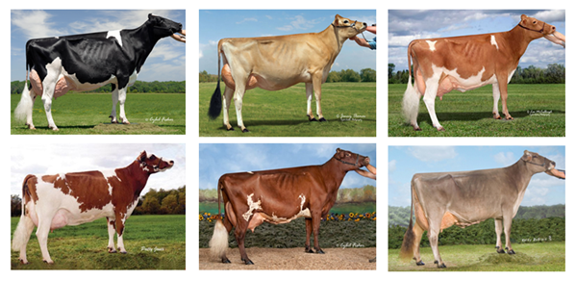
International genotype exchanges
Country exchanges with U.S. | Breed | Sex | Since
Canada | All | Both | 2009
United Kingdom, Italy | Holstein | Bulls | 2011
All Europe via Interbull | Brown Swiss | Bulls | 2012
Denmark | Jersey | Bulls | 2014
United Kingdom | Guernsey | Both | 2016
Japan, Switzerland, Germany | Holstein | Bulls | 2016

Slide 8
Potential changes for December 2016
Net merit update to include livability
Change evaluation software for non-HO type traits
New definition of body size composite (in Aug TPI)
  HO cow weight from feed efficiency project
  Less emphasis on stature, more on dairy form (neg)
  Larger regression on BSC (40 vs. 24 pounds)

Slide 9
Proposed net merit price revisions
Income or expense | 2014 | 2016
Cow LIV (beef $0.75 / pound) | (in PL) | $1200
Productive life (profit / lactation) | $290 | $220
Milk price ($ / 100 pounds) | $18.00 | $17.50
Fat price ($ / pound) | $1.95 | $2.00
Protein price ($ / pound) | $3.10 | $2.90
SCC premium ($ / 1000 cells) | -0.0008 | -0.0009
Replacements (1200 pound heifer) | $1700 | $1500
Body weight (pounds / composite) | SD = 24 | SD = 40

Slide 10
Proposal to include LIV in net merit
Trait | Relative emphasis in USDA index (%)
 | PD$ 1971 | MFP$ 1976 | NM$ 1994 | NM$ 2000 | NM$ 2003 | NM$ 2014 | NM$ 2016
Milk | 52 | 27 | 6 | 5 | 0 | –1 | –1
Fat | 48 | 46 | 25 | 21 | 22 | 22 | 24
Protein | … | 27 | 43 | 36 | 33 | 20 | 18
Longevity | … | … | 20 | 14 | 11 | 19 | 13
SCS | … | … | –6 | –9 | –9 | –7 | –7
Udder | … | … | … | 7 | 7 | 8 | 7
Feet/legs | … | … | … | 4 | 4 | 3 | 3
Body size | … | … | … | –4 | –3 | –5 | –6
Pregnancy rate | … | … | … | … | 7 | 7 | 7
Calving traits | … | … | … | … | 4 | 5 | 5
Conception rate | … | … | … | … | … | 3 | 3
Livability | … | … | … | … | … | … | 7
Notes:
10
10

Slide 11
Correlations of traits with net merit
Trait | Correlations
 | NM$ 2014 | NM$ 2016 | diff
Milk | .44 | .41 | -.03
Fat | .63 | .64 | .01
Protein | .61 | .59 | -.02
Productive life | .76 | .77 | .01
SCS | -.37 | -.34 | .03
Udder | .12 | .09 | -.03
Feet/legs | .06 | .04 | -.02
Body size | -.13 | -.20 | -.07
Pregnancy rate | .39 | .38 | -.01
Calving traits | .46 | .47 | .01
Conception rate | .52 | .51 | -.01
Livability | .40 | .48 | .08
Correlation (2014, 2016)
= 0.989
Notes:
11
11

Slide 12
Type trait PTAs: JE, BS, AY, GU, MS
New software to compute traditional PTAs
  AGIL programs also used for yield, health, fertility
  AGIL 2014 replace Gengler 1998 programs
Update heritabilities and genetic correlations (2003)
Jersey rear teat placement (rear and side view) added
All trait PTAs together (BS & MS milk speed, mobility)

Slide 13
Correlations of new, previous PTAs
 | JE | BS | AY | GU | MS
Final score | 0.993 | 0.974 | 0.988 | 0.982 | 0.929
Linear traits (average) | 0.985 | 0.969 | 0.966 | 0.985 | 0.892
Bulls born since 1985 with > 80% reliability for final score
Research on revising type traits done by Jan Wright

Slide 14
Changes to non-HO type trait heritabilities
 | AY | BS | GU | JE | MS
Final Score | 0.03 | -0.03 | 0.06 | 0.01 | -0.02
Stature | -0.03 | -0.09 | 0.02 | -0.05 | -0.11
Strength | -0.07 | -0.07 | 0.05 | -0.04 | -0.09
Dairy form | -0.03 | 0.00 | 0.05 | -0.04 | 0.02
Foot angle | -0.04 | -0.04 | -0.02 | -0.02 | -0.01
Rear leg (side) | -0.04 | -0.05 | -0.05 | 0.01 | -0.05
Body depth | -0.02 | -0.05 | 0.04 | *** | -0.06
Rump angle | 0.03 | -0.09 | -0.08 | -0.01 | -0.04
Rump width | -0.09 | -0.06 | 0.04 | -0.02 | -0.06
F. U. Attach. | 0.02 | -0.03 | -0.06 | -0.01 | -0.07
Notes:
14
14

Slide 15
Changes to non-HO type trait heritabilities (cont.)
 | AY | BS | GU | JE | MS
Rear udder height | 0.00 | -0.04 | -0.03 | -0.06 | 0.02
Rear udder width | 0.01 | -0.04 | -0.01 | -0.07 | 0.04
Udder depth | -0.04 | -0.08 | -0.02 | 0.03 | -0.03
Udder cleft | -0.05 | -0.10 | -0.03 | -0.05 | 0.00
Front teat place. | 0.01 | -0.05 | -0.05 | 0.00 | 0.00
Teat length | 0.00 | -0.05 | 0.05 | 0.03 | 0.05
Rear legs (rear) | *** | -0.07 | 0.00 | *** | 0.01
Mobility | *** | -0.14 | *** | *** | -0.04
Milking speed |  | 0.05 |  |  | -0.12
Notes:
15
15

Slide 16
Revised heritabilities of non-HO type traits
 | AY | BS | GU | JE | MS
Final Score | 0.30 | 0.26 | 0.27 | 0.20 | 0.26
Stature | 0.51 | 0.34 | 0.51 | 0.32 | 0.33
Strength | 0.24 | 0.13 | 0.28 | 0.17 | 0.14
Dairy form | 0.17 | 0.18 | 0.33 | 0.17 | 0.21
Foot angle | 0.11 | 0.09 | 0.08 | 0.09 | 0.08
Rear leg (side) | 0.12 | 0.13 | 0.11 | 0.08 | 0.06
Body depth | 0.27 | 0.20 | 0.36 |  | 0.22
Rump angle | 0.31 | 0.18 | 0.33 | 0.21 | 0.25
Rump width | 0.26 | 0.12 | 0.33 | 0.16 | 0.14
F. U. Attach. | 0.23 | 0.19 | 0.23 | 0.18 | 0.09
Notes:
16
16

Slide 17
Revised heritabilities of non-HO type traits (cont.)
 | AY | BS | GU | JE | MS
Rear udder height | 0.26 | 0.18 | 0.25 | 0.20 | 0.18
Rear udder width | 0.20 | 0.15 | 0.27 | 0.16 | 0.15
Udder depth | 0.28 | 0.26 | 0.38 | 0.29 | 0.23
Udder cleft | 0.18 | 0.12 | 0.18 | 0.12 | 0.08
Front teat place. | 0.25 | 0.22 | 0.26 | 0.20 | 0.20
Teat length | 0.30 | 0.29 | 0.39 | 0.21 | 0.33
Rear legs (rear) |  | 0.03 | 0.08 |  | 0.11
Mobility |  | 0.07 |  |  | 0.14
Milking speed |  | 0.24 |  |  | 0.10
Rear teat place. rear* |  |  |  | 0.21
Rear teat place. side* |  |  |  | 0.13
* New trait
Notes:
17
17

Slide 18
Monthly computation reduction
Monthly processing takes nearly 1 week
  All 1.5 million genotypes re-imputed monthly
  Genomic relationships all re-computed
Weekly processing of new animals takes a few hours
  Store imputed genotypes and G matrix in database
Reduce monthly to 1-2 days by extracting from database, also use more SNPs in prediction

Slide 19
Fertility trait evaluations
Trait | Code | By | Began
Service sire nonreturn rate | ERCR | DRMS | 1986
Service sire conception rate | SCR | USDA | 2006
Daughter pregnancy rate | DPR | USDA | 2003
Cow conception rate | CCR | USDA | 2010
Heifer conception rate | HCR | USDA | 2010
Calving to first insemination | CFI | To Interbull | 2012
Gestation length | GL | CDCB | soon
Age at first calving | AFC | CDCB | ?

Slide 20
Gestation length
Useful for maternity pen management (DHIA) or synchronized calving with grazing (NZL, AUS, IRL)
NAAB Dairy Sire Evaluation Com. requested Apr 2016
High heritability with small maternal effect
Service sire model preliminary PTAs computed
Animal model PTAs as trait of calf will be tested

Slide 21
Age at first calf
Reduce costs of raising replacements
Data available for all 33 million cows
Good genomic reliabilities for young animals
  REL = 66% for HO, 51% for JE, heritability = 2.7%
Favorable correlations with most traits (HO)
  -.45 HCR, -.27 CCR, -.45 yield, -.34 PL, -.54 NM$

Slide 22
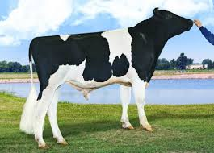
Top young bulls from Aug 2013
Now with > 1,000 daughters
 | NM$ |  |  |  | Progeny (2016)
Bull | 2016 | 2013 | PA 2013 |  | Daughters | AI sons
Supersire | 895 | 670 | 471 |  | 6,531 | 250
Cabriolet | 849 | 646 | 482 |  | 2,019 | 8
Uno | 541 | 613 | 303 |  | 6,584 | 216
Predestine | 491 | 613 | 406 |  | 1,525 | 51
AltaAntrim | 383 | 595 | 400 |  | 1,061 | 0
Jacey | 574 | 595 | 429 |  | 1,699 | 60
AltaJackman | 441 | 592 | 444 |  | 1,270 | 35
Maurice | 701 | 582 | 420 |  | 2,031 | 26
Mogul | 689 | 578 | 355 |  | 10,241 | 310
Tango | 648 | 562 | 395 |  | 1,428 | 96
Top 10 average | 621 | 604 | 410 |  | 3,434 | 105
(base adjusted values)

Slide 23
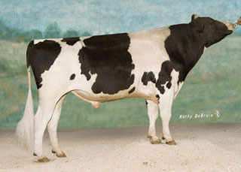
Top proven bulls from Aug 2013
Now with >1,000 daughters
 | NM$ |  |  |  | Progeny (2016)
Bull | 2016 | 2013 | PA 2013 |  | Daughters | AI sons
Robust | 791 | 550 | 328 |  | 1,948 | 104
Freddie | 460 | 532 | 290 |  | 24,139 | 176
Awesome | 481 | 518 | 353 |  | 6,308 | 0
Twist | 559 | 514 | 244 |  | 1,112 | 4
Massey | 525 | 490 | 249 |  | 11,922 | 81
O-Style | 406 | 477 | 366 |  | 10,536 | 63
Manifold | 604 | 462 | 259 |  | 44,315 | 4
Bookem | 550 | 459 | 272 |  | 7,585 | 114
Domingo | 399 | 454 | 224 |  | 8,848 | 4
Hill | 426 | 452 | 247 |  | 11,628 | 30
Top 10 average | 503 | 503 | 304 |  | 18,497 | 58
(base adjusted values)

Slide 24
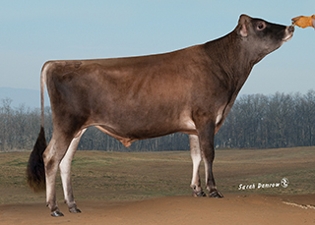
Top young JE bulls from Aug 2013
Now with > 100 daughters
 | NM$ |  |  |  | Progeny (2016)
Bull | 2016 | 2013 | PA 2013 |  | Daughters | AI sons
Pilgrim | 425 | 507 | 305 |  | 144 | 4
Machete | 491 | 467 | 325 |  | 1485 | 8
Dazzler | 406 | 465 | 310 |  | 403 | 4
Kindle | 320 | 463 | 411 |  | 113 | 0
Soprano | 507 | 453 | 436 |  | 639 | 8
Marvel | 356 | 451 | 273 |  | 4441 | 53
Award | 295 | 448 | 364 |  | 209 | 2
Harris | 610 | 446 | 313 |  | 100 | 26
Kona | 303 | 436 | 411 |  | 100 | 1
Frontrunner | 293 | 432 | 316 |  | 509 | 6
Top 10 average | 400 | 457 | 346 |  | 814 | 11
(base adjusted values)

Slide 25
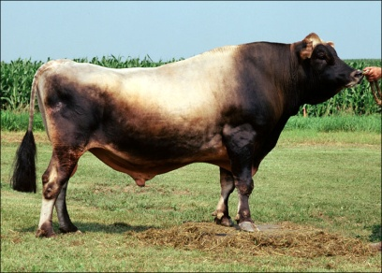
Top proven JE bulls from Aug 2013
With > 100 daughters
 | NM$ |  |  |  | Progeny (2016)
Bull | 2016 | 2013 | PA 2013 |  | Daughters | AI sons
Magnum | 518 | 525 | 208 |  | 3,611 | 9
Zuma | 331 | 446 | 142 |  | 17,504 | 21
Bold | 296 | 377 | 188 |  | 8,415 | 42
Lotto | 246 | 374 | 184 |  | 1,007 | 6
Rock | 288 | 365 | 260 |  | 373 | 0
Renegade | 353 | 365 | 226 |  | 7,459 | 64
Oliver | 294 | 341 | 301 |  | 250 | 0
Victory | 389 | 341 | 252 |  | 1,280 | 2
Herodot | 273 | 340 | 223 |  | 682 | 0
Mable | 244 | 335 | 177 |  | 468 | 0
Top 10 average | 326 | 395 | 217 |  | 4,356 | 14
(base adjusted values)

Slide 26
Guernsey major gene for many traits
On chromosome 19 near location 29 million bases
Largest positive effects of all SNPs for:
  Milk, protein, stature, strength, dairy form, rump width, rump angle, teat length, SCS (unfavorable)
Largest negative effects of all SNPs for:
  Fat%, Pro%, udder traits, PL, LIV, fertility
Negative overall effect on Guernsey NM$

Slide 27
GPTAs for crossbreds
Crossbreds = weighted average of purebred effects
Must do math on all-breed, not within-breed scale
  Convert foreign data (MACE, dams) to all-breed
  Then convert GPTAs to within-breed scale
  Would be simpler to publish all-breed scale
All-breed scale not available for type or calving traits

Slide 28
Heat stress research
Genetic by environmental (GxE) interactions in national genetic evaluation
Model included random regression on state average for temperature-humidity index in July
  Differences between northern and southern states
Tested ability of GxE predictions from domestic traits to predict foreign data from Interbull or future US data

Slide 29
Heat stress (HS) and foreign rankings†
Country | Bulls | Milk | Fat | Protein
CAN | 1,184 | Cold*** | Cold*** | Cold***
DFS | 531 | Cold*** | Cold*** | Cold***
DEU | 862 | Cold*** | Cold*** | Cold
NLD | 766 | Cold*** | Cold*** | Cold***
ITA | 868 | Cold*** | Cold | Cold***
AUS | 452 | Hot | Hot | Hot
ARG | 416 | Hot | Cold | Hot*
URY | 303 | Hot | Cold** | None
† Predicted using Interbull data and HS from U.S. data
Cold = Bulls ranked higher if daughters performed better in cooler U.S. states
Hot = Bulls ranked higher if daughters performed better in warmer U.S. states
*P < 0.05; **P < 0.01; ***P < 0.001

Slide 30
Protein PTAs for Florida vs. Wisconsin
 | Bull rank for PTA protein in
Bull | USA | WI | FL
Coyne | 1 | 1 | 2
Nobleland | 2 | 4 | 1
Listen | 3 | 2 | 7
Tyrone | 4 | 6 | 4
AltaGreatest | 5 | 7 | 3
Ruble | 6 | 3 | 12
AltaStone | 7 | 15 | 6
Lonzo | 8 | 33 | 11
Syrup | 9 | 11 | 20
Picardus | 10 | 8 | 95
2015 data

Slide 31
Heat stress conclusions (Wright et al, 2015)
Yield traits had some rank changes
  Corr (FL, U.S.) = 0.912
  Corr (WI, U.S.) = 0.986
Most trait predictions gained little
  R² = 0.1499 vs. 0.1501 with HS for PL
  R² = 0.1189 vs. 0.1190 with HS for DPR
  R² = 0.2083 vs. 0.2083 with HS for SCS
http://aipl.arsusda.gov/publish/presentations/ADSA15/ADSA15_jrw.ppt

Slide 32
ARS and AGIL 5-year plans 2016-2020
Stakeholder listening sessions April-June, 2016
ARS food animal 5-year plan published September, 2016
  https://www.ars.usda.gov/animal-production-and-protection/food-animal-production/docs/action-plan/
AGIL 5-year plans to be drafted by November, 2016
  1) Expand genomic data and use new variants
  2) Evaluate new traits to add value
  3) Improve computational algorithms and models

Slide 33
AGIL / AIP staffing changes
Tabatha Cooper – left AGIL January 8, 2016
George Wiggans – retired June 25, 2016
John Cole – replacing Erin Connor as Research Leader
Derek Bickhart – leaving Beltsville in Fall 2016
Replacement for Tad Sonstegard’s position as Computational Biologist nearly complete after 1.5 yr

Slide 34

Dr. George R. Wiggans
USDA Research Geneticist 1978-2016
Animal model PTA programs 1989-2015
Database design and edits 1993-current
Many industry, scientific, and government awards
  NAAB Research 1996, NDHIA Outstanding Service 2006, ADSA Fellow 2012, ADSA Most Cited 2014, Thompson-Reuters Highly Cited Scientists 2016

Slide 35
Conclusions
Several changes implemented since 2015 workshop
Many possible changes in 2016-2018 (type traits, LIV in NM$, gestation length, age first calf, persistency, crossbred GPTAs, health traits, heat stress)
5-year plans finalized by November 2016
Permission slow to replace staff

Slide 36
Acknowledgments
All AGIL staff contributed to this report:
  John Cole, Derek Bickhart, Suzanne Hubbard, Jan Wright, Mel Tooker, Jana Hutchison, Dan Null, Kim Fletcher, Lillian Bacheller, Gary Fok, Frank Ross
Research is conducted using data provided by CDCB

