Slide 1
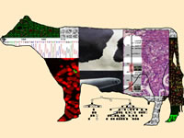
What farmers should expect from the use of full sequencing data
Derek M. Bickhart

Slide 2
Outline
Non-technical description of DNA sequencing
Applications of DNA sequencing to genomic selection
Future projects and technologies

Slide 3
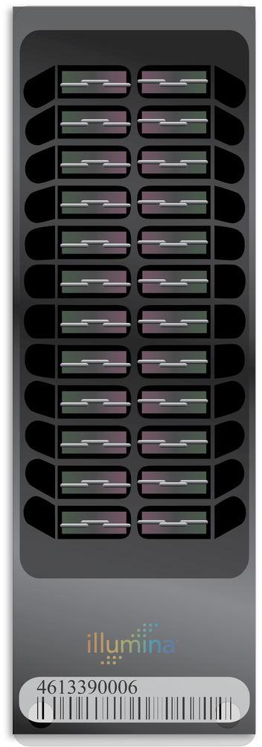
Spoilers: SNP arrays are still the most efficient means of genotyping
Mature technology
First SNP arrays in 1986
Benefit from automation
Combination of efficiency and accuracy unmatched, currently
Why bother with sequencing?

Slide 4
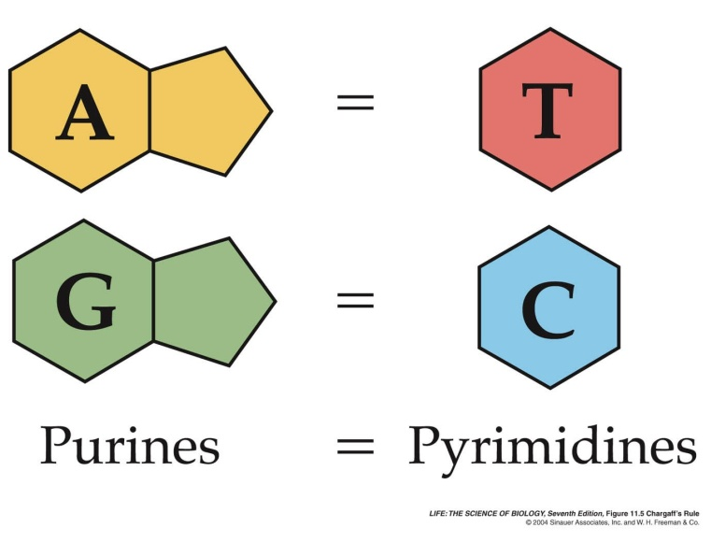
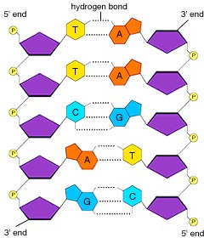
What is “DNA sequencing?”
Identifying the order of bases in a DNA molecule or Genome
Genome sizes vary
Bovine Polyomavirus: 4,679 bases
Cattle Genome: 2,800,000,000 bases
Started in the 1970’s
Was laborious until the early 2000’s
From McGraw-Hill
Notes:
Bovine polyomavirus is a benign parasitic virus of cattle origin. First discovered in bovine serum albumin-cultured rhesus macaque cells.

Slide 5
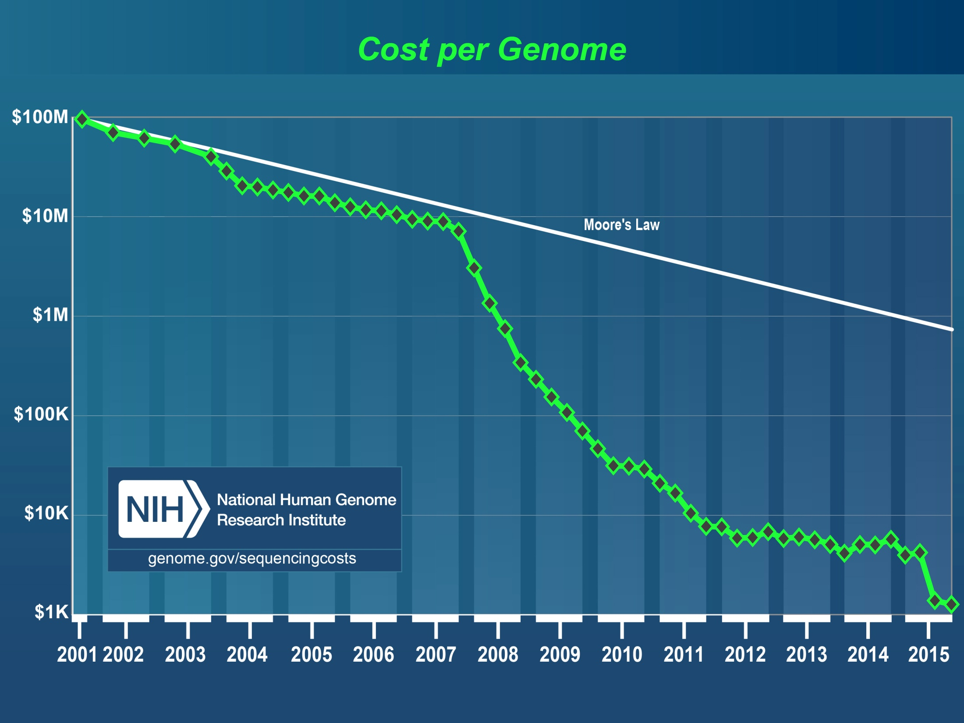
Human Genome
Project Draft
Completed
454 Technology
Released
Illumina GA II
Released
Illumina HiSeq X
Released

Slide 6
Types of sequencing technologies: long or short
Short read technologies (36 – 150 bases)
Long read technologies (500 – 150,000 bases)

Slide 7
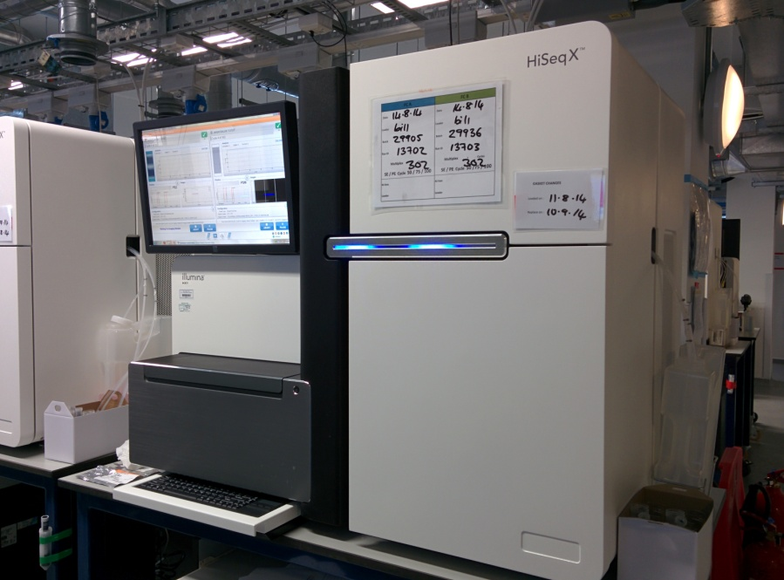
Short read technologies for routine genotyping and variant discovery
Illumina platform
Hiseq X
NextSeq
MiSeq
Generates efficient data
29 – 30 hours to generate data at 1% error
Hiseq X can generate “$1000 genome”
Niche: variant discovery and genotyping

Slide 8
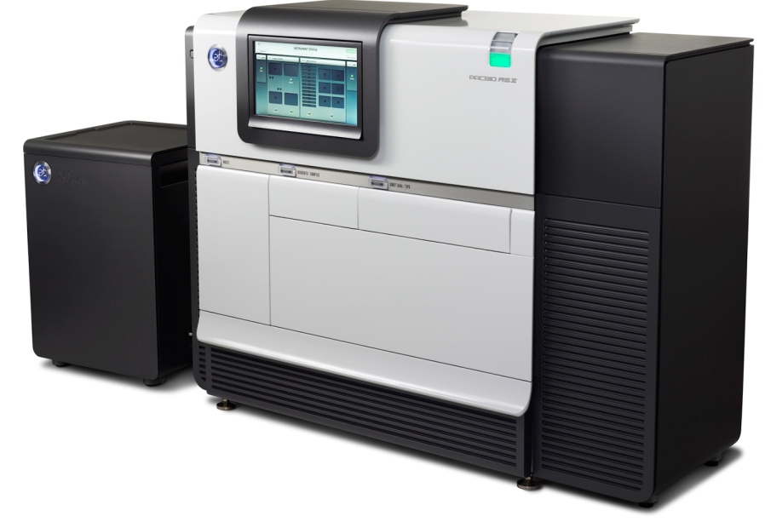
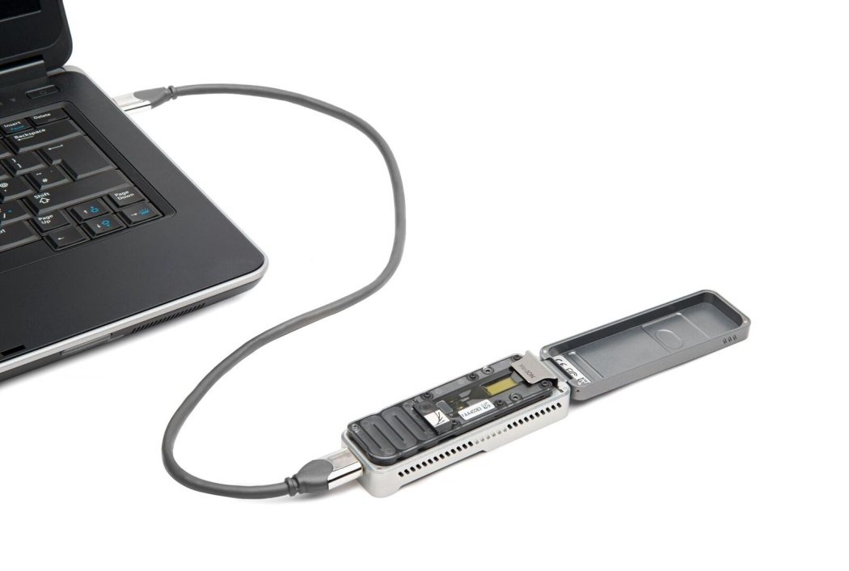
Long read technologies for genome assembly and improvement
Pacific Biosystems (PacBio)
Oxford Nanopore
Characteristics
Expensive
Very long reads (150,000!)
High error rate (17 – 20%)
Niche: genome projects

Slide 9
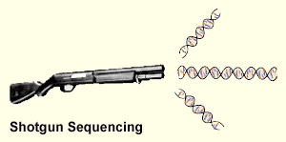
Sequencing strategies: targeted or whole genome shotgun
Cannot sequence whole genome in one shot
Solution: fragment the genome into pieces
Solution: develop “sticky” DNA molecules to capture specific segments

Slide 10
A single base deletion!
Potential
SNPs!

Slide 11
Nuc
Genetic variation – difference from
the reference genome
Classified as a function of size (variants per animal)
Single nucleotide variations – SNP (1 to 12 million)
INDELs – Insertions/Deletions (100,000+)
Mobile Elements – SINE, LINE Transposition (???)
Genomic structural variation
Large-scale Insertions/Deletions (Copy Number Variation; 600)
Chromosomal Inversions, Translocations, Fusions (???)
Chr
Notes:
Variation of genetic sequence between two individuals can encompass smaller sequence-based events or larger scale, cytogenetic events.
Starting on the small scale, SNPs comprise a significant variation of sequence between individuals. On the human side, dbSNP has over 60 million recorded SNPs.
Insertions and deletions that range in size from 1bp to 50bp are a larger form of variation, though these are less frequent than SNPs
SINE, LINE transpositions and duplications are larger events still, ranging in size from 300 bp to 6 kb
The largest genetic variants are called Structural variants due to their massive size. The intra-chromosome insertions and deletions that range in size from 1kb to 5 Mb are termed copy number variations. Duplications of sequential sequence are termed segmental duplications (SDs). Data from the 1000 genomes project pilot study suggests that CNVs and SDs are predicted to generate the largest size of variable DNA among individuals, even more so than SNPs. Currently, 60,000 CNVs have been identified in humans, with more unique and infrequent events to be discovered in the near future.
CNVs = younger, still segregating
SDs = ancient, fixed events
George’s
As a biologist, we really think about genome differences or variations in term of understanding the relationship between the genotype and phenotype. For last several decades, our perspectives at the global level have being one of the cytogenetics. Looking at the big things moving along the genome. Such as the most common type of Robertsonian translocation in cattle is the t(1;29), which is a fusion of chr1 with 29. With the human, cow or other genome available, we have an opportunity now to look at the other direction: from the sequence up.
One of the important things to remember is that not all differences are single nucleotide variations or SNP. There are a lot of other types of mutation that occurred in the genome over the evolutionary time. Here are some of them which is larger than SNP in size: small insertion/deletion events, movement of mobile repetitive elements and many large-scale events.
We term those large-scale events as genomic structural variations (ranging from 1 kb to 5Mb). By structural, we do not mean the 2-d or 3d structure, but instead a 1-D segment of DNA sequences. They include larger-scale insertion/deletion (CNV), segmental duplication of sequences, inversion and translocation and so on. We defined: The copy number of a piece of DNA segment is the number of times this piece occurs in the genome.
Human studies have discovered ~66,000 CNV and majority of them are innocent. They are associated with 17% of phenotypic changes in gene expression and a subset of them contributed to individual health and disease. We are the first to report the existence, frequency and impact of such CNV in cattle (1%).
SegDup: Segmental duplications exist in many species and are defined as stretches of DNA sequence >=1-5 kb in length with >= 90% sequence conservation that are present in more than one location in a genome. These sequences make up 5.5%, 2.9%, 1.2% and 0.6% of the human, rat, mouse and dog genomes, respectively. The extent of segmental duplication in the bovine genome is 3%.
*Human studies: 66,741 CNVs, 18% phenotype, health & disease-related

Slide 12
Application of Whole Genome Sequencing Data to Genomic Selection

Slide 13
Sequencing technologies are the best methods to find new genetic markers
Bovine SNP50 and BovineHD
Types of genetic variants discovered
SNPs
Small insertions and deletions
Deletions and duplications
Complex abnormalities
All of these can
be tracked on
current genotyping
platforms!
Notes:
50k was developed from three pools: 15 Holstein, 35 angus and 2 bulls from each of the popular remaining beef breeds.

Slide 14
Challenges we still face: analysis isn’t trivial
Computer algorithms to analyze data
Written by Human researchers
Not always scaleable
Many artifacts
Task | Program | Memory | Threads | Mins
Align 10× reads and call known variants | Findmap | 46 gb | 10 | 20
Align 10× reads | BWA | 46 gb | 10 | 629
Identify and call variants | SAMtools |  | 10 | 66 (201)
Table adapted from VanRaden et al. in prep.

Slide 15
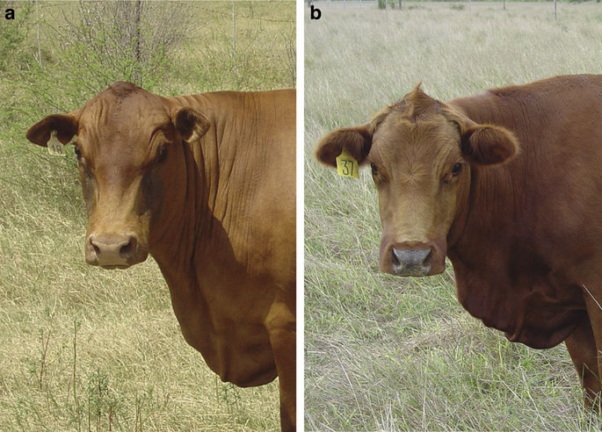
Sequencing assists in identifying causal variants
Figures from Littlejohn et al. 2014. Nature Biotech
There are two other mutations
In other breeds, in the same gene,
that cause this phenotype!

Slide 16
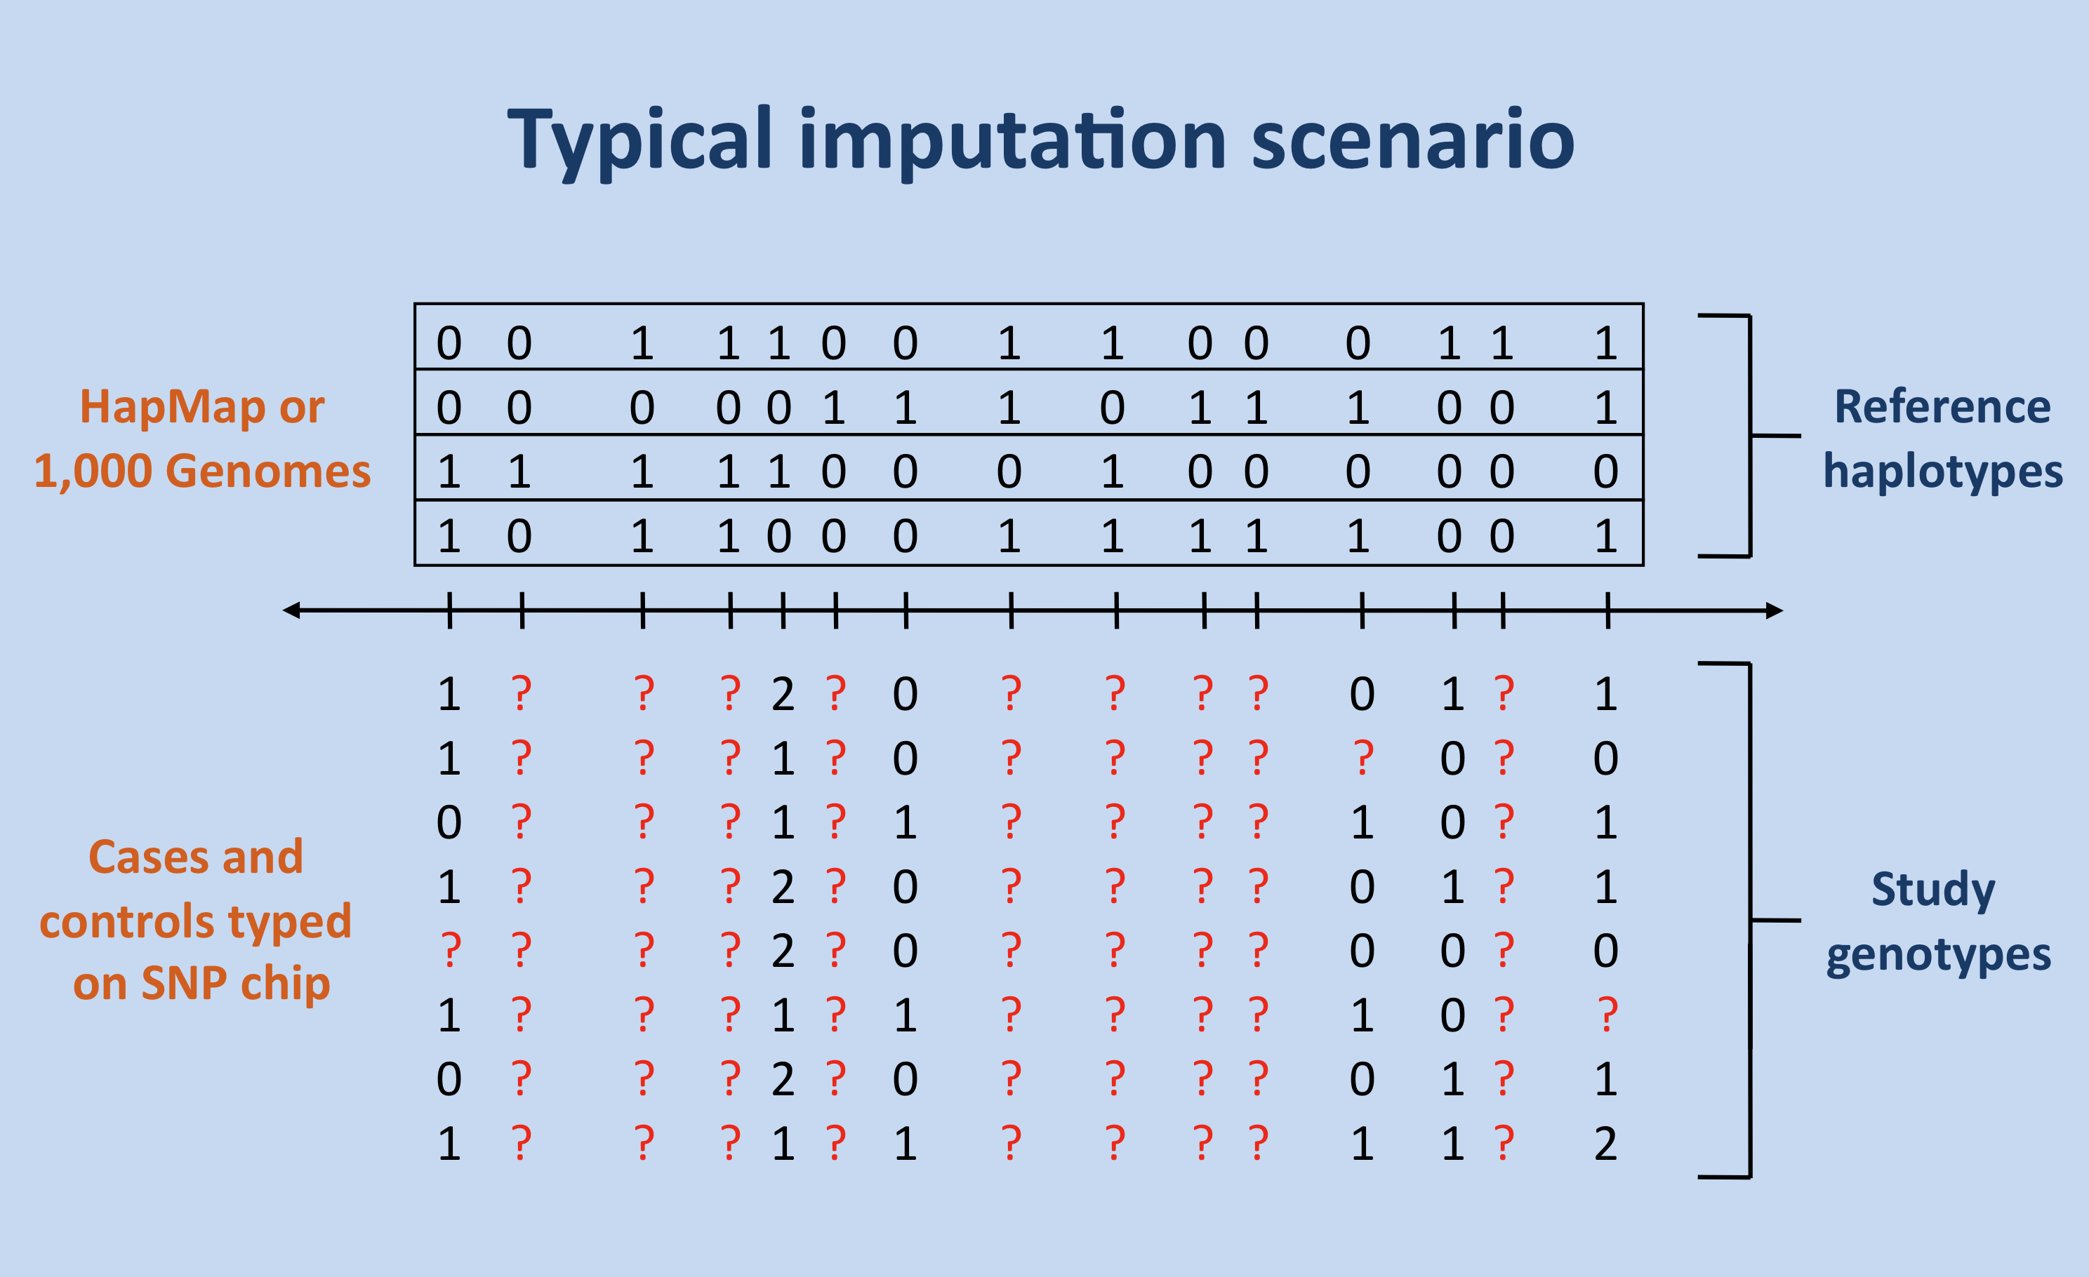
Imputation
Haplotypes
Reference
Population
0
0
1
0
0
1
0
1
1
0
0
1
0
0
1
1
Slide from: https://mathgen.stats.ox.ac.uk/impute/impute_v2.html

Slide 17
High frequency sequence variants can be imputed with high accuracy
From VanRaden et al. GSE. submitted
Notes:
Sequence data imputed onto 40 Holstein with sequence data

Slide 18
Gains in reliability from adding imputed sequence variants
Trait | 60K + selected (reliability %)
 | 60K only | 60K + 17K | Improvement
PL | 35.6 | 38.2 | 2.6
SCS | 35.1 | 37.0 | 1.9
DPR | 29.0 | 33.0 | 4.0
CCR | 28.9 | 31.8 | 2.9
HCR | 20.5 | 21.5 | 1.0
Average trait reliability improvement: 2.7%
Slide adapted from a presentation by Mel Tooker at ADSA, Salt Lake City, UT. 2016

Slide 19
Advancements in the pipeline: low frequency haplotype sequencing
Haplotypes from SNP Genotypes
Select Animals with homozygous, rare haplotypes
Sequence animals and select variants in haplotypes
Funded by the CDDR
Advantages
Easy to filter variants
Trivial to impute in CDCB database
Benefits
Will improve sequence variant calling
Gives a first-look at rare variants
Algorithm described in: Bickhart et al. 2016. Journal of Dairy Science

Slide 20
The potential to use sequencing for routine genotyping
Targeted probe genotyping (example: Eureka Genomics)

Slide 21
Future technology: sequencing in the field?

Slide 22
Conclusions
Whole genome sequencing is only going to improve
SNP chips remain the most efficient means of genotyping, for now…
Research efforts will continue
Improvements to accuracy
New markers/chips

Slide 23
Acknowledgements
USDA – ARS
John Cole
Paul VanRaden
George Wiggans
Present and former AGIL lab members
The Cattle Genome Assembly consortium
The CDCB and board of directors
The CDDR and board of directors
This presentation was supported by USDA CRIS project number 8042-31000-101-00-D.
The USDA does not support or endorse any commercial services. Any data presented is for information purposes only.

Slide 24
Advancements in the pipeline: a better cattle reference genome
Joint leadership of UC Davis (Juan Medrano) and USDA (Tim Smith and Ben Rosen)
Draft version is 60 times more contiguous than current version
Remapped BovineHD markers
Old Assembly
130,000 missing bases!
Data from:
John B. Cole
New Assembly

