Slide 1
Applications of haplotypes in dairy farm management

Slide 2
Introduction
Genomic selection increases selection response by reducing generation interval
Bulls were genotyped first due to cost
Now we have genotypes for many cows
What can we do with those data that we couldn’t do before?

Slide 3
O-Style Haplotypes Chromosome 15

Slide 4
Genetic merit of Jersey bulls
Net Merit ($)
Breeding Year

Slide 5
Many cows have been genotyped
Genotypes
Evaluation Date (YYMM)
Notes:
5

Slide 6
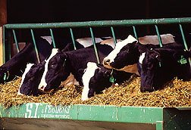
Haplotypes for farm management
Many uses other than
genetic evaluation
  Culling decisions
  Mating strategies
  Identification of new recessive defects
  Phenotypic prediction
ARS Image Number K7964-1

Slide 7
Input costs are rising quickly
Milk:Feed Price Ratio
July 2012 Grain Costs
Soybeans: $15.60/bu (€0.46/kg)
Corn: $ 7.36/bu (€0.23/kg)
Month
M:FP = price of 1 kg of milk /
price of 1 kg of a 16%
protein ration

Slide 8
Optimal culling decisions
Low density genotypes on females can be used to guide early culling decisions
  165,526 genotyped cows in August 2012
Sexed semen increases heifer population from which to select
What animals should be retained and what animals culled?

Slide 9
Testing and selecting heifer calves
Calves selected | EBV selected calves (pre-ranked, 35% rel.) | Optimal fraction calves tested with genomic test (65% rel.) | EBV selected calves (after genomic testing) | Cost of genomic testing per selected calf | NPV of selected calves
100% | €0 | - | - | €0 | €0
90% | €31 | 70-100 | €46 | €13 | €52
80% | €64 | 60-90 | €78 | €14 | €94
70% | €87 | 50-90 | €113 | €22 | €136
60% | €112 | 40-80 | €145 | €25 | €176
50% | €139 | 30-70 | €179 | €30 | €218
EBV = estimated breeding value, NPV = net present value

Slide 10
Bottom line economics
 | No sexed | 2x sexed | No sexed | 2x sexed
Pre-ranking calf reliability | 0% | 0% | 35% | 35%
Genomic testing policy¹ | 20-100 | 0-100 | 70-90 | 50-90
Statistics (€/cow/year):
Profit without heifer calf value | 381 | 378 | 381 | 378
Heifer calves sold | 14 | 31 | 14 | 31
NPV calves before pre-ranking | 99 | 101 | 99 | 101
NPV calves due to pre-ranking | 0 | 0 | 30 | 51
Added NPV from genomic testing | 38 | 71 | 7 | 16
Cost of genomic testing | 7 | 23 | 4 | 9
Heifer calf value | 146 | 180 | 148 | 191
Profit with heifer calf value | 527 | 558 | 529 | 569
¹7K test (€36.50, 65% reliability)

Slide 11
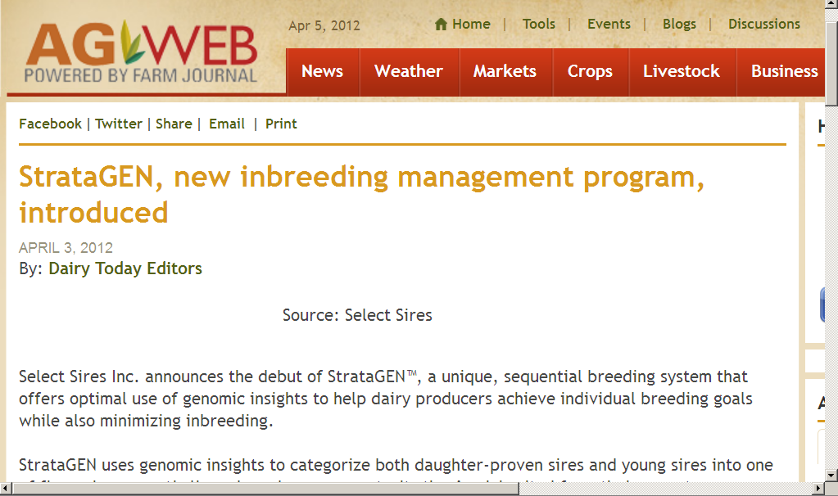
Farmers want new genomic tools

Slide 12
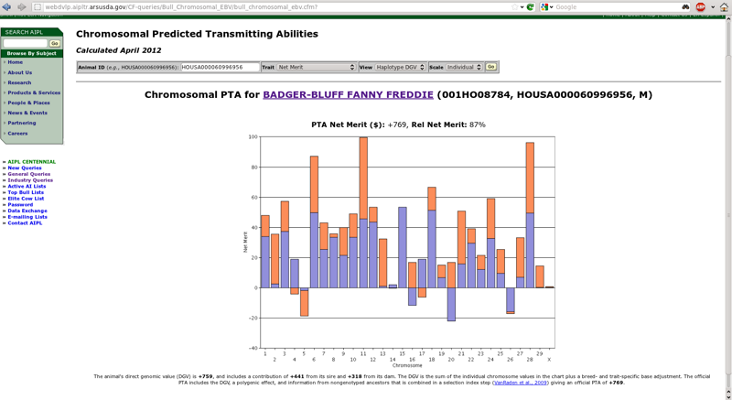
New haplotype query
Cole, J.B., and Null, D.J. 2012. AIPL Research Report GENOMIC2: Use of chromosomal predicted transmitting abilities. Available: http://aipl.arsusda.gov/reference/chromosomal_pta_query.html.

Slide 13
Simulated matings
Mated all genotyped Jersey bulls and cows in a fully cross-classified design
  5,877 bulls and 15,553 cows
    91,404,981 matings
  Crossovers, independent assortment
  100 replicates per mate pair
Mean, variance, skewness, and kurtosis

Slide 14
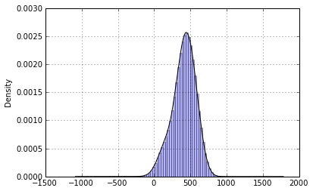
Distribution of progeny DGV
Distribution of 6,000,000 randomly sampled simulated matings.

Slide 15
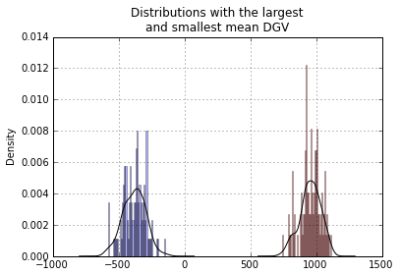
Most extreme groups for progeny DGV

Slide 16
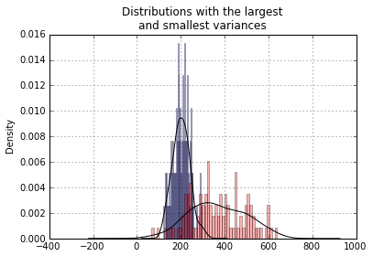
Most extreme groups for DGV variance

Slide 17
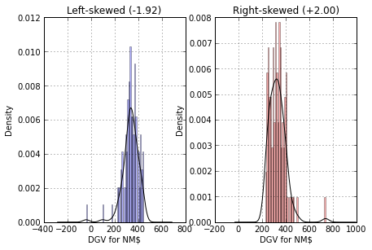
Most- and least-skewed progeny groups

Slide 18
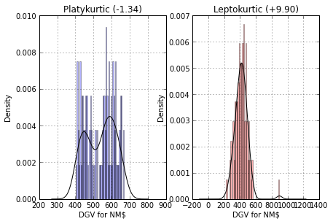
Most- and least-kurtotic progeny groups

Slide 19
Within-herd analysis
Selected 3 Jersey herds
  Ranked by number of genotyped animals and percentage of 50K genotypes
Compared actual with possible matings
Could the herd manager have selected better mate pairs?

Slide 20
Comparison to actual matings
Simulated matings were compared to 220 actual matings from 142 mate pairs
Three strategies tested in simulation
  Mating plans using traditional and genomic PTA as in Pryce et al. (2012)
  Selection of mate pairs with greatest mean DGV
  Bulls limited to 10 matings

Slide 21
Sire portfolios
Cows in herd
Simulated calves
Consider each bull as a mate for each cow using different strategies.
Bulls used in herd
Genotyped calves
Actual calves born to these parents.

Slide 22
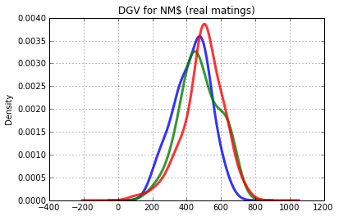
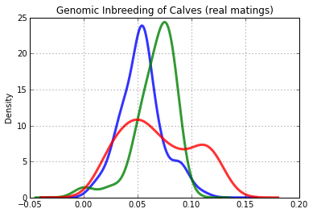
Actual DGV and inbreeding
Similar distribution of DGV
Different distribution of relation-
ships – different sire portfolios

Slide 23
Herd 1 results
 | Actual¹ | Best PTA² | Best gPTA² | Best DGV²
Genetic value | 416 | 308 | 446 | 452
Difference | − | -108 | +28 | +36
SE(Genetic) | 12 | 7 | 11 | 12
Inbreeding | 0.053 | 0.075 | 0.083 | 0.070
Min | 0.010 | 0.005 | 0.027 | <0.001
Max | 0.110 | 0.274 | 0.145 | 0.112
Correlation | − | 0.443 | 0.218 | 0.247
¹Results from 94 genotyped offspring of 62 cows.
²Simulated matings of 62 cows to a portfolio of 54 bulls (n=3348 combinations).

Slide 24
Herd 2 results
 | Actual¹ | Best PTA² | Best gPTA² | Best DGV²
Genetic value | 468 | 396 | 534 | 538
Difference | − | -72 | 66 | 70
SE(Genetic) | 23 | 14 | 13 | 13
Inbreeding | 0.068 | 0.051 | 0.077 | 0.077
Min | 0.025 | 0.001 | 0.021 | 0.021
Max | 0.090 | 0.120 | 0.124 | 0.106
Correlation | − | 0.577 | 0.735 | 0.745
¹Results from 31 genotyped offspring of 19 cows.
²Simulated matings of 19 cows to a portfolio of 31 bulls (n=589 combinations).

Slide 25
Herd 3 results
 | Actual¹ | Best PTA² | Best gPTA² | Best DGV²
Genetic value | 480 | 342 | 505 | 501
Difference | − | -138 | 25 | 21
SE(Genetic) | 19 | 8 | 12 | 10
Inbreeding | 0.068 | 0.076 | 0.093 | 0.068
Min | 0.015 | 0.000 | 0.045 | 0.015
Max | 0.125 | 0.183 | 0.178 | 0.106
Correlation | − | 0.665 | 0.682 | 0.495
¹Results from 95 genotyped offspring of 38 cows.
²Simulated matings of 38 cows to a portfolio of 25 bulls (n=950 combinations).

Slide 26
Specific combining ability
Quantitative model
  Must solve equation for each mate pair
Genomic model
  Compute dominance for each locus
  Haplotype the population
  Simulate matings and compute average dominance

Slide 27
Inbreeding effects
Are inbreeding effects distributed uniformly across the genome?
  Where are the recessives and the over- and under-dominant loci?
Inbreeding changes transcription levels and gene expression profiles in D. melanogaster (Kristensen et al., 2005)

Slide 28
Precision inbreeding
Runs of homozygosity may indicate genomic regions where inbreeding is acceptable
Can we target those regions by selecting among haplotypes?
Dominance
Under-dominance
Recessives

Slide 29
Phenotypic prediction
Can haplotypes be used to improve phenotypic predictions?
  Models with GxE are better predictors (Bryant et al., 2005)
  Models with A+D better than records from relatives (Lee et al., 2008)
  Disease risk can be predicted even if mechanisms unknown (Wray et al., 2005)

Slide 30
Unknown phenotypes
Susceptibility to disease
  e.g., Johne’s is difficult to diagnose
Differential response to management
  e.g., Feed conversion efficiency
Can simulate more plausible outcomes with haplotypes than genotypes
  Chromosome transmitted, not means

Slide 31
Loss-of-function mutations
At least 100 LoF per human genome surveyed (MacArthur et al., 2010)
  Of those genes ~20 are completely inactivated
  Uncharacterized LoF variants likely to have phenotypic effects
How can mating programs deal with this?

Slide 32
Novel haplotypes affecting fertility
Name | Chrom-osome | Loca-tion | Carrier Freq | Earliest Known Ancestors
HH1 | 5 | 62-68 | 4.5 | Pawnee Farm Arlinda Chief
HH2 | 1 | 93-98 | 4.6 | Willowholme Mark Anthony
HH3 | 8 | 92-97 | 4.7 | Glendell Arlinda Chief, Gray View Skyliner
JH1 | 15 | 11-16 | 23.4 | Observer Chocolate Soldier
BH1 | 7 | 42-47 | 14.0 | West Lawn Stretch Improver

Slide 33
Precision mating
Eliminate undesirable haplotypes
  Detection at low allele frequencies
Avoid carrier-to-carrier matings
  Easy with few recessives, difficult with many recessives
Include in selection indices
  Requires many inputs

Slide 34
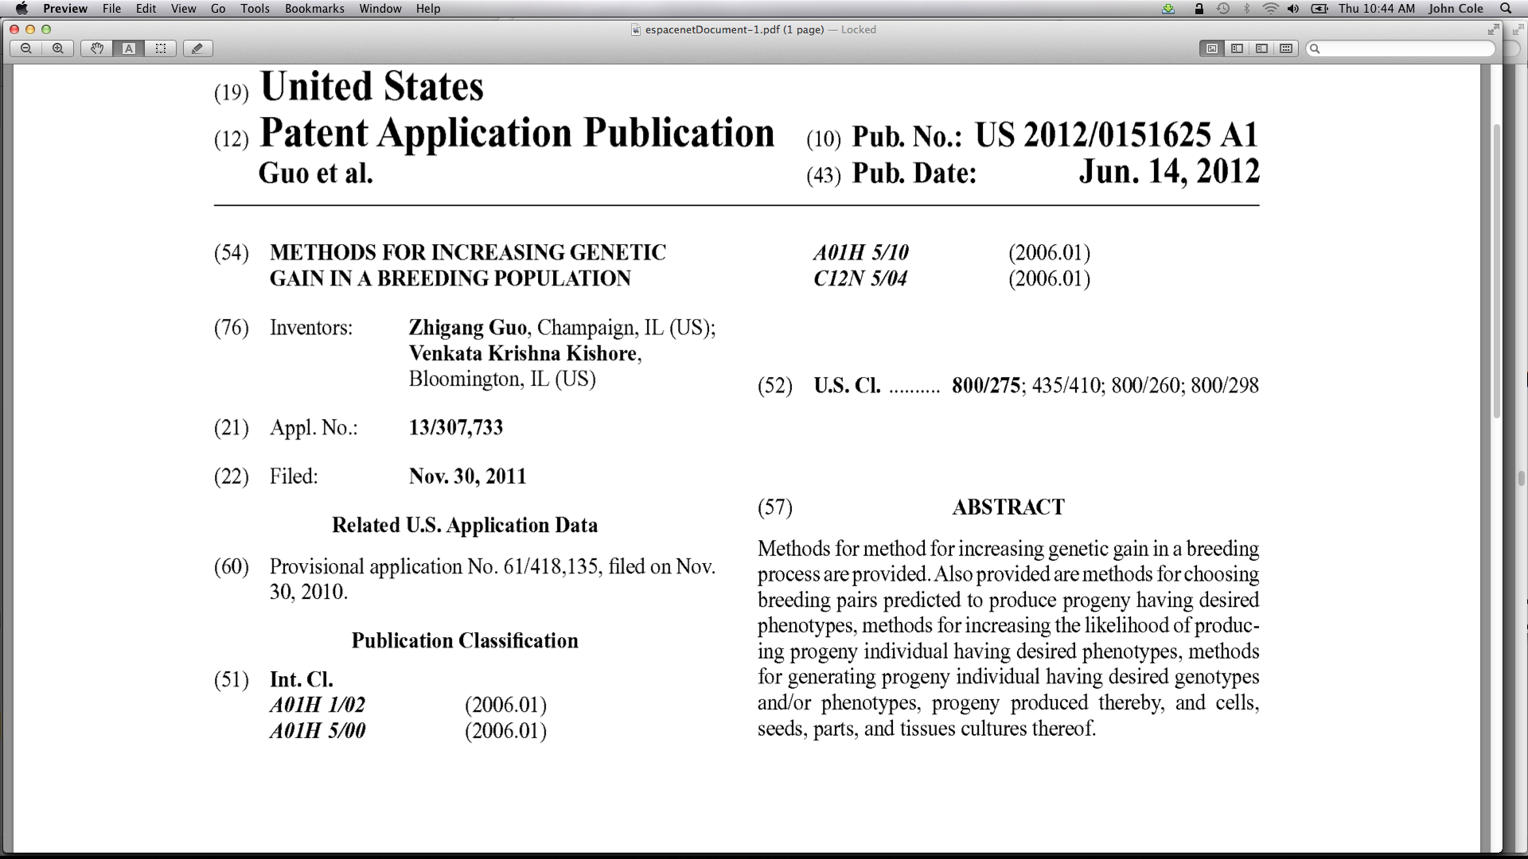
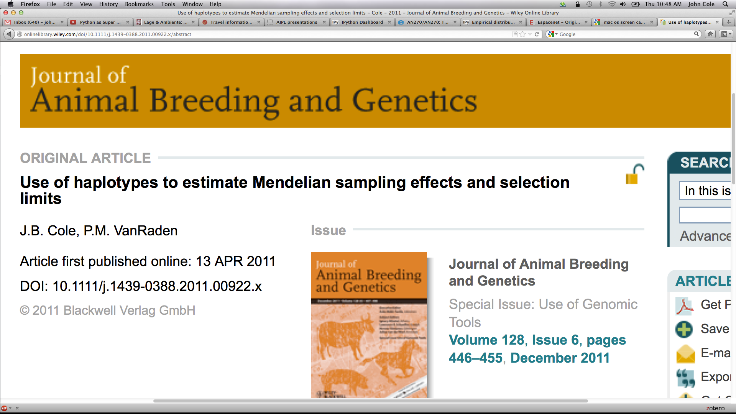
Threats to continued progress
Provisional US patent filed on
20 NOV 2010 after the
9WCGALP in Leipzig – no
disclosure at that time!
This MS with similar ideas was
submitted 22 SEP 2010 and
published on 12 APR 2011.
Why share?

Slide 35
Conclusions
Selecting calves based on genomic tests can increase farm profitability
Simple mate selection using haplotypes is as good or better than other strategies
We may be able to do interesting things with inbreeding and prediction
Tools for handling many new recessives in breeding programs are needed

Slide 36
Acknowledgments
Paul VanRaden, Dan Null, and Tabatha Cooper
Animal Improvement Programs Laboratory, ARS, USDA Beltsville, MD
Albert De Vries
Department of Animal Sciences
University of Florida, Gainesville, FL
David Galligan
School of Veterinary Medicine
University of Pennsylvania
Kennett Square, PA

