Slide 1
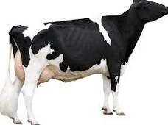
Increasing long term response by selecting for favorable minor alleles
Chuanyu Sun
Paul VanRaden
National Association of Animal breeders, USA
Animal Improvement Programs Laboratory, USA

Slide 2
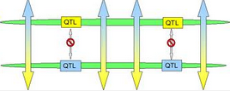
Introduction
Genomic selection has become a standard tool in dairy cattle breeding
Response to genomic selection can continue for many generations or decline rapidly, depending on the number of QTLs, their frequencies, linkage with markers, and effects on the trait or index selected, etc.

Slide 3
Introduction
Based on simulations (Muir, 2007) or deterministic predictions (Goddard 2009)
Long-term gains from genomic selection can be less than from phenotypic selection or from selection on pedigree and phenotypes
But long term response can be improved by modifying the selection pressure applied to a QTL as its allele frequency changes, as demonstrated
For 1 QTL in combination with phenotypic selection (Dekkers et al., 1998)
For multiple QTL using index selection (Jannink, 2010; Goddard 2009)

Slide 4
Introduction
The weight for each marker or QTL is adjusted according to its current frequency, giving markers where the favorable allele has low frequency more weight in the index.
Such methods can improve long term response and will be referred to as favorable minor allele (FMA) selection.

Slide 5
Introduction
Objective
Propose simple and improved formulas for
weighting favorable minor alleles
increasing the long term progress from genomic selection
with less reduction of short term progress.
These formulas are applied to both simulated and real data

Slide 6
Materials and Methods
With standard genomic selection, estimated breeding values were calculated using
With FMA selection

Slide 7
Materials and Methods
Two new formulas to implement FMA selection were derived
.
1. Nonlinear formula
Identical to formula of Jannink (2010) if δ = 1
2. Linear formula

Slide 8
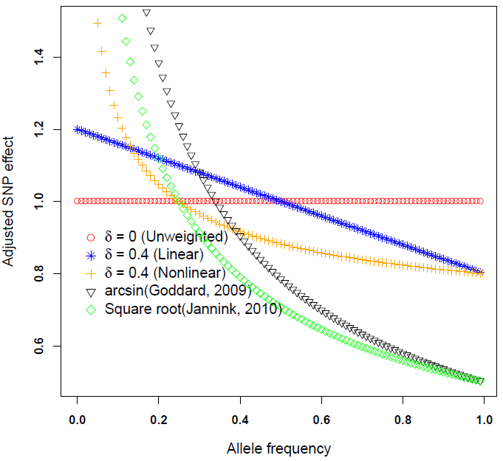
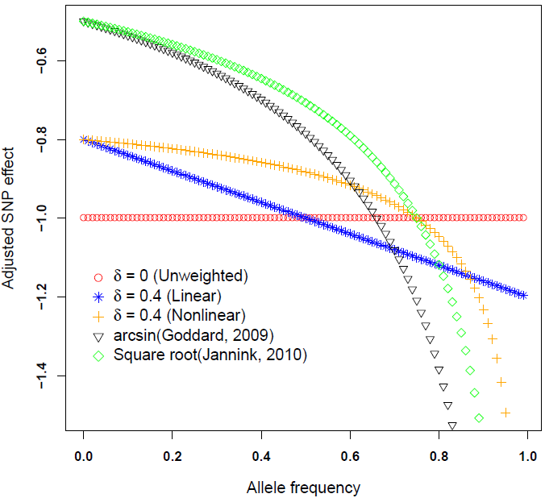
Materials and Methods
Both of them include parameter δ that can vary from 0 to 1 to balance long and short term progress.
For both the nonlinear and linear formulas, δ = 0 corresponds to official, unweighted genomic selection.

Slide 9
Materials and Methods
Simulation
20 generations
Genotypes and BV were simulated using real pedigree for first generation
In each subsequent generation, the top 100 males and top 1,000 females were selected and mated to produce 1,500 males and 1,500 females for the next generation
QTLs | QTL distribution | Number of replicates | Largest QTL variance¹
3000 | Normal | 100 | 0.599 (0.43 -1.1)
 | Heavy tail | 100 | 4.76 (1.89 – 24.14)

Slide 10
Materials and Methods
Selection acted directly on 3,000 QTL effects (100 per chromosome) instead of indirectly on estimated marker effects.
Responses to 20 generations of selection were tested using linear and nonlinear weighting formulas with δ parameters ranging from 0 to 1
QTL distribution | Number of replicates | Method | δ
Normal | 100 | Linear | 0 | 0.2 | 0.4 | 0.6 | -
 |  | Non linear | - | 0.2 | 0.4 | 0.6 | 1.0
Heavy tail | 100 | Linear | 0 | 0.2 | 0.4 | 0.6 | -
 |  | Non linear | - | 0.2 | 0.4 | 0.6 | 1.0
The best parameter value for δ were used to real data (HO, JE, BS)

Slide 11
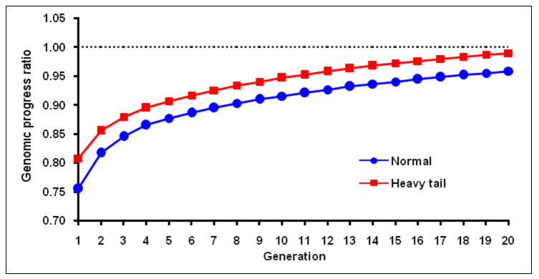
Results - response
The ratio of genetic progress based on adjusted genomic breeding values using Jannink (2010) formula over unadjusted genetic progress.
Large losses in early generations and did not recover these losses within 20 generations
Therefore the remaining results focused on optimizing δ to balance long term and short term progress

Slide 12
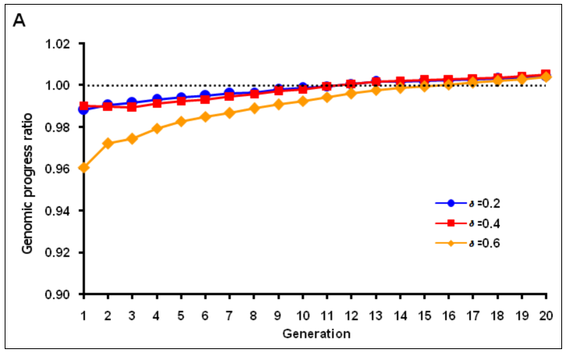
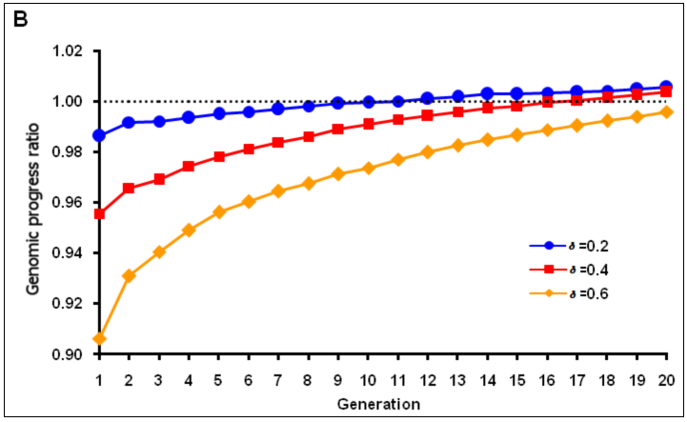
Results - response
Normal distribution
maximum response was achieved when δ = 0.2 (or 0.1) using FMA selection
losses were larger in the first few generations with non linear formula
Linear formula
Nonlinear formula

Slide 13
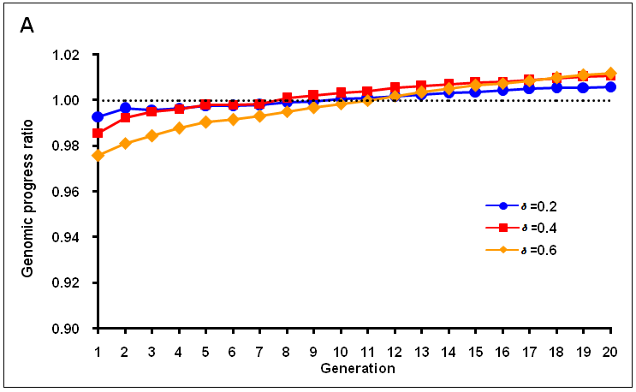
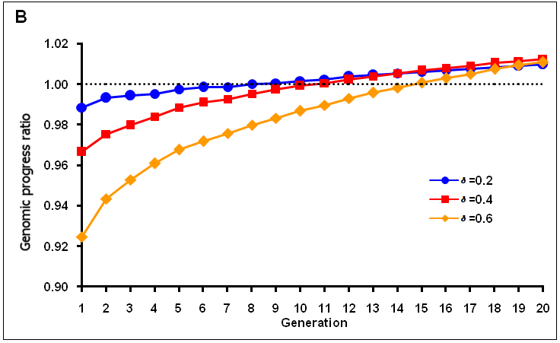
Results - response
Heavy tail distribution
maximum response by generation 20 was achieved with δ = 0.4 or δ = 0.6 using FMA selection
More losses in the first few generations with δ = 0.6
More losses in the first few generations with non linear formula
Linear formula
Nonlinear formula

Slide 14
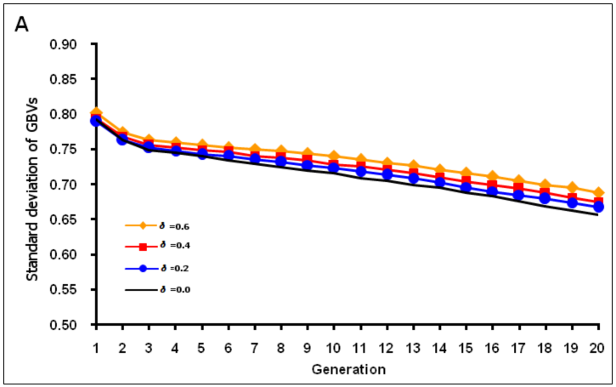
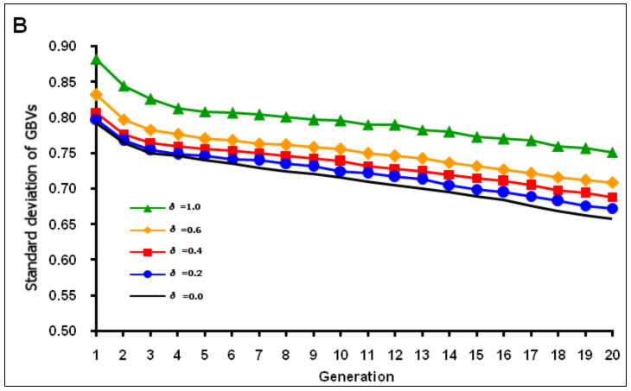
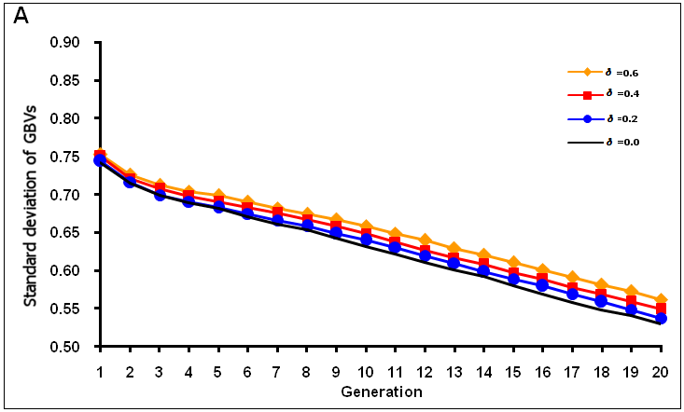
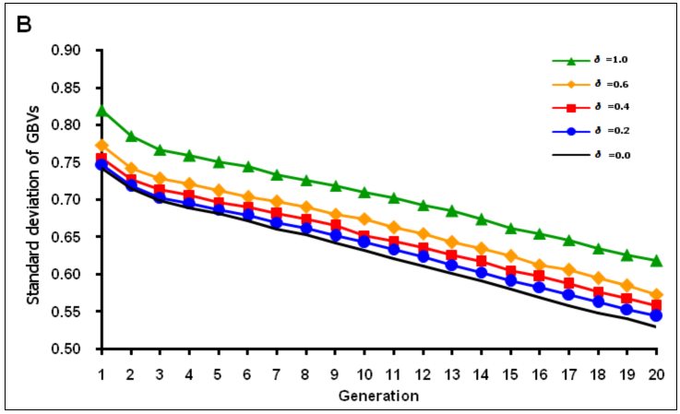
Results –variance
Linear formula
Normal distribution
Nonlinear formula
Normal distribution
Linear formula
Heavy tail distribution
Nonlinear formula
Heavy tail distribution

Slide 15
Results – inbreeding
Larger values of δ showed a little higher genomic inbreeding when true allele frequency was used but showed a little lower inbreeding when using 0.5 as the allele frequency for each locus or using pedigree inbreeding.
Genomic selection can increase genomic inbreeding rapidly
Method |  | Normal distribution |  |  | Heavy tail distribution
 |  | 0.500 | true | Ped | 0.500 | true | Ped
Linear | 0.0 | 0.457 | 0.261 | 0.095 | 0.456 | 0.256 | 0.093
 | 0.2 | 0.447 | 0.268 | 0.093 | 0.448 | 0.260 | 0.092
 | 0.4 | 0.437 | 0.272 | 0.091 | 0.441 | 0.264 | 0.091
 | 0.6 | 0.427 | 0.278 | 0.089 | 0.433 | 0.269 | 0.089
Curve | 0.2 | 0.443 | 0.265 | 0.092 | 0.445 | 0.258 | 0.092
 | 0.4 | 0.428 | 0.269 | 0.089 | 0.433 | 0.262 | 0.090
 | 0.6 | 0.413 | 0.273 | 0.087 | 0.422 | 0.266 | 0.088
 | 1.0 | 0.384 | 0.283 | 0.083 | 0.399 | 0.275 | 0.085

Slide 16
Results – real data
The linear and nonlinear formulas were both applied with the parameter value for δ set to 0.4 based on the optimum from simulated data
The correlation between official and FMA evaluation
Method | Holstein | Jersey | Brown Swiss
Linear formula | 0.994 | 0.994 | 0.989
Nonlinear formula | 0.991 | 0.986 | 0.978

Slide 17
Results
Expected future inbreeding (EFI)
Half the animal’s average pedigree relationship to its breed
Genomic future inbreeding (GFI)
Half the animal’s average genomic relationship to its breed
Correlation of the difference between FMA and official evaluation
with GFI and EFI, using linear weighting and δ = 0.4
Inbreeding measure | Holstein | Jersey | Brown Swiss
GFI | -0.85 | -0.94 | -0.85
EFI | -0.45 | -0.59 | -0.27

Slide 18
Conclusions
Short term and long term progress were balanced using new formulas for FMA selection.
Previous formulas put too much emphasis on rare favorable alleles and resulted in less progress than standard genomic selection over 20 simulated generations.
Optimum values of δ differed depending on QTL distribution, with lower values favored if QTL effects are small because allele frequencies will change more slowly with selection.
FMA selection using linear formula could increase long term response and less losses in the first few generations, and can be used for routine evaluation.
The differences between FMA and standard genomic selection were highly correlated to the animal’s GFI. Thus, strategies to reduce genomic inbreeding could achieve almost as much long term progress as FMA selection.

Slide 19
Thank you
for your attention
QUESTIONS?

