Slide 1
Measuring genomic pre-selection in theory and in practice

Slide 2
In Theory
Traditional mixed models do not account for genomic selection
Phenotypes only for animals with highest Mendelian sampling
GBV differ from EBV for progeny, mates, parents, or herdmates
Multi-step methods may be biased
Single-step methods reduce bias

Slide 3
1-Step Relationship Inverse Aguilar et al. (2010)
H⁻¹ = A¹¹ A¹²
A²¹ A²² + G⁻¹ - A₂₂⁻¹
1 = non-genotyped animals (60 million)
2 = genotyped animals (400,000)

Slide 4
Traditional and 1-Step Models
Animal model
EBV = w₁ PA + w₂ YD + w₃ PC
(parent average, yield deviation, progeny contribution)
1-step genomic info (GI) model
GBV = w₁PA_{g} + w₂YD_{g} + w₃PC_{g} + w₄GI
GI = ∑off-diagonal_{j} of G⁻¹–A₂₂⁻¹(GBV_{j}) divided by diagonal_{i} of G⁻¹–A₂₂⁻¹
Numerator of w₄ in denominator of w

Slide 5
Diagonals of G⁻¹–A₂₂⁻¹
Computed for 8,300 Brown Swiss
Diagonals of G and A₂₂ are similar
G: mean F_{G} = 3.98% and SD = 4.15%
A₂₂: mean F_{A} = 3.95% and SD = 2.97%
Diagonals of G⁻¹ larger than A₂₂⁻¹
Mean = 5.83 for G⁻¹, 2.18 for A₂₂⁻¹
G⁻¹, A₂₂⁻¹ and difference all highly correlated

Slide 6
Correlations of Diagonals Genotyped Brown Swiss
 | G | A | G⁻¹ | A⁻¹ | G⁻¹ - A⁻¹
G | 1.0 | .70 | .05 | .03 | .06
A |  | 1.0 | .02 | -.02 | .04
G⁻¹ |  |  | 1.0 | .98 | .99
A⁻¹ |  |  |  | 1.0 | .94
G⁻¹ - A⁻¹ |  |  |  |  | 1.0

Slide 7
Simulations of Pre-Selection Bias
Phenotyped only animals with good Mendelian sampling genotypes
Discrete or overlapping generations
Bias if discrete (Patry, Ducrocq 2011)
OK with overlap (Nielsen et al, 2012)
Large bias for dams (Liu et al, 2009)
Actual studies of pre-selection and genomic assortative mating needed

Slide 8
In Practice
Test actual selection and mating
Quantify genomic pre-selection in:
Mates of proven bulls (group 1)
Mates of young bulls (group 2)
Dams of young selected sons
Measure future bias because pre-selection has already occurred

Slide 9
Percentage of Genotyped Mates Group 2 bulls ranked by NM$
Garrold
Numero Uno
Supersire
Percentage of mates genotyped
Mogul
S S I Robust Topaz
Net Merit (Aug 2013)

Slide 10
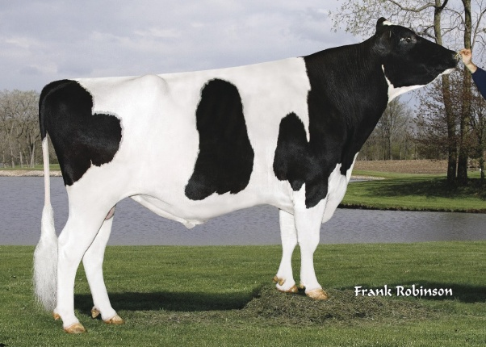
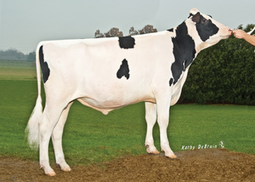
Mates of Group 1 and 2 Bulls
Group 1 (proven bulls)
Daughters with records
Top 50, no dtrs in April 2010
Were mates pre-selected?
Group 2 (young bulls)
Top 50, born 2009 and 2010
Study calves born in USA
Will pre-selected mates cause bias?

Slide 11
Group 1 Realized Mate Bias
Trait | Mean | SD | Min | Max
NM$ | 2 | 4 | -5 | 13
Protein | 0 | 0 | -1 | 1
Prod Life | .0 | .0 | .0 | .1
Dtr Preg Rate | .0 | .0 | .0 | .1
SCS | .00 | .00 | -.01 | .01
Final Score | .00 | .01 | -.04 | .02
Udder Depth | .00 | .01 | -.02 | .02

Slide 12
Group 2 Future Bias from Mates
Trait | Mean | SD | Min | Max
NM$ | 8 | 9 | 0 | 33
Protein | 0 | 0 | 0 | 1
Prod Life | .1 | .1 | .0 | .5
Dtr Preg Rate | .1 | .1 | .0 | .3
SCS | -.01 | .01 | -.03 | .00
Final Score | .02 | .03 | -.01 | .10
Udder Depth | .03 | .04 | -.01 | .13

Slide 13
Future Bias – Dams of Young Bulls
Dams with ≥ 1 sampled son born 2008 to 2012
Son selection differential = ∑(GPTA – PA) / # of sons sampled
Dam’s bias = 2 * sons’ selection differential * (DE from sampled sons) / (total conventional DE)
DE = daughter equivalents or EDC

Slide 14
Example Dam HOUSA000065597532
29 sons genotyped, 6 selected, each will provide 5.4 DE
Son selection differential for milk = ∑(GPTA – PA) / 6 = 583 pounds
30 daughters, each provide 1.5 DE
8.3 DE from PA, 7.8 from records
Dam’s future bias = 2 * 583 * 6 * 5.4 / [8.3 + 7.8 + 6 * 5.4 + 30 * 1.5] = 404

Slide 15
Expected Future Bias – Bull Dams
Trait | Mean | SD | Min | Max
NM$ | 29 | 33 | -124 | 156
Protein | 1 | 3 | -10 | 14
PL | .3 | .5 | -1.7 | 2.0
DPR | .1 | .2 | -.9 | .9
SCS | -.01 | .04 | -.22 | .14

Slide 16
Potential Biases
Also from preferential treatment
High-priced early daughters
Lack of random sampling
Deregression removes some bias
Example: dam gets credit only for own records and non-genotyped progeny, not genotyped sons
Use matrix instead of simple one at a time deregression

Slide 17
Conclusions
Evaluations should adjust for GBV instead of EBV of:
Progeny, mates, contemporaries, and parents
Biases from pre-selection:
Very small for recently proven bulls
Moderate from mates top young bulls
Will be large for dams of several highly selected sons, but deregression can remove some of the bias

Slide 18
Acknowledgments
Phenotypes, genotypes, and pedigrees were provided by the Council on Dairy Cattle Breeding

