Slide 1
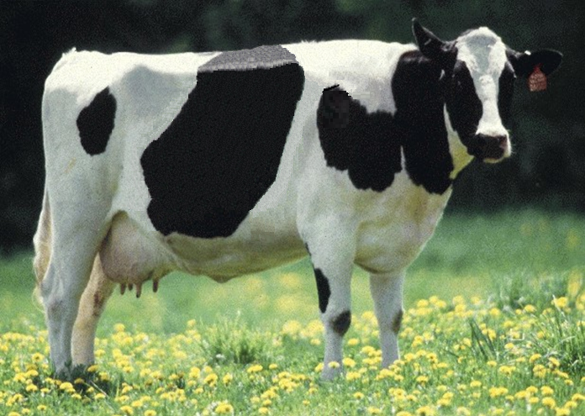
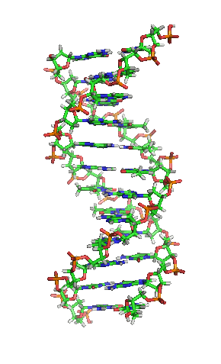
Selection changes in the United States due to genomics

Slide 2
Coauthors
Janice R. Wright¹
Jana L. Hutchison¹
Jay M. Mattison²
¹Animal Scientist, Animal Genomic and Improvement Laboratory, Beltsville, Maryland
²Chief Executive Officer, National Dairy Herd Information Association, Verona, Wisconsin

Slide 3
Introduction
Genomic testing of dairy cattle accelerated in the United States in early 2008.
Genomics is changing the way breeding programs are operating.
Genomics is changing information available & choice of parents producing replacements.
It is impacting genetic improvement. Some differences in programs will be described.

Slide 4
Objectives
Show number of genomic tests across time.
Show how age of bulls’ ancestors have changed.
Show genetic merit of bulls entering artificial insemination (AI) service across time.
Determine expected genetic merit of future animals derived from examining confirmed pregnancies.

Slide 5
Traits examined
Milk
Fat
Protein
Somatic cell score (SCS)
Productive life (Prod. Life)
Daughter Pregnancy Rate (Dau. Preg. Rate)
Net Merit Dollars

Slide 6
Number of US animals genotyped by year (Holstein)
Year | Females | Males
2007 | 77 | 2389
2008 | 2740 | 8810
2009 | 4445 | 7083
2010 | 14,212 | 6786
2011 | 37,091 | 9668
2012 | 81,382 | 11,699
2013 | 125,314 | 17,417

Slide 7
Number of US animals genotyped by year (Jersey)
Year | Females | Males
2008 | 90 | 1123
2009 | 532 | 1290
2010 | 3201 | 757
2011 | 7427 | 1287
2012 | 12,640 | 1598
2013 | 20,206 | 2829

Slide 8
Mean PTA* of Holstein bulls entering AI by year (yield traits)
Year | Milk | Fat | Protein | Number bulls
 | -------------------(kg)--------------------
2005 | 144 | 6 | 5 | 1818
2006 | 175 | 8 | 7 | 1755
2007 | 180 | 9 | 7 | 1910
2008 | 233 | 10 | 8 | 1797
2009 | 249 | 14 | 9 | 1766
2010 | 286 | 16 | 10 | 1613
2011 | 335 | 18 | 13 | 1731
2012 | 466 | 21 | 17 | 1811
2013 | 533 | 27 | 20 | 1593
*Based on April 2014 evaluations

Slide 9
Mean PTA* of Holstein bulls entering AI by year (other traits)
Year | SCS | Prod. Life | Dau. Preg. Rate | Net Merit
2005 | 2.99 | -0.2 | -0.4 | 73
2006 | 2.94 | 0.3 | -0.4 | 133
2007 | 2.91 | 0.4 | -0.2 | 161
2008 | 2.92 | 0.6 | -0.1 | 195
2009 | 2.88 | 1.6 | 0.2 | 281
2010 | 2.85 | 2.3 | 0.2 | 335
2011 | 2.81 | 2.9 | 0.5 | 426
2012 | 2.80 | 3.6 | 0.5 | 511
2013 | 2.75 | 4.2 | 0.8 | 618
*Based on April 2014 evaluations

Slide 10
Mean PTA* of Jersey bulls entering AI by year (yield traits)
Year | Milk | Fat | Protein | Number bulls
 | ------------------(kg)-----------------
2005 | 88 | 6 | 3 | 181
2006 | 94 | 8 | 4 | 183
2007 | 90 | 10 | 5 | 216
2008 | 138 | 13 | 7 | 204
2009 | 168 | 14 | 8 | 209
2010 | 240 | 16 | 10 | 209
2011 | 313 | 20 | 13 | 236
2012 | 400 | 24 | 16 | 236
2013 | 393 | 26 | 16 | 264
*Based on April 2014 evaluations

Slide 11
Mean PTA* of Jersey bulls entering AI by year (other traits)
Year | SCS | Prod. Life | Dau. Preg. Rate | Net Merit
2005 | 3.04 | 0.3 | -0.2 | 68
2006 | 3.05 | 0.4 | -0.1 | 96
2007 | 3.05 | 0.6 | 0.0 | 120
2008 | 3.04 | 0.9 | 0.0 | 158
2009 | 3.05 | 1.4 | 0.1 | 201
2010 | 3.02 | 1.9 | 0.1 | 243
2011 | 2.98 | 2.6 | 0.1 | 329
2012 | 2.96 | 2.7 | -0.1 | 376
2013 | 2.94 | 3.2 | 0.1 | 436
*Based on April 2014 evaluations

Slide 12
Age of sire and dam at bull’s birth (all breeds)

Slide 13
Age of Paternal and Maternal grandsire at bull’s birth

Slide 14
Age of Paternal and Maternal granddam at bull’s birth

Slide 15
Mean PTA protein of HO service sires used in matings

Slide 16
Mean PTA Daughter pregnancy rate of service sires used in matings

Slide 17
Mean PTA Productive life of HO service sires used in matings

Slide 18
Mean Net Merit of HO service sires used in matings

Slide 19
Conclusions
Amount of genomic testing has been increasing. Still, it seems risky predicting how the number of tests will change in the next few years.
Bulls age when entering AI has not changed, remaining at 16 mo. All ancestors’ ages when the bull entered AI service have declined.

Slide 20
Conclusions
Genetic change for bulls entering AI has been accelerating for most of the important traits. A few of the fitness traits have increased faster than the yield traits.
Confirmed pregnancy from breeding records illustrates rapid improvement due to genomics will continue.

Slide 21
Acknowledgments
Appreciation to all producers in the U.S. dairy industry and the industry support personnel who provided information to the Council on Dairy Cattle Breeding’s national database
Also, to personnel in the Animal Genomics and Improvement Laboratory who have assisted in the transition of operations to the Council on Dairy Cattle Breeding

