Slide 1
A scalable Bayesian mixed model approach for GWAS and genomic prediction
Jicai Jiang¹, Li Ma², Paul M. VanRaden³, Jeffrey R. O’Connell¹
¹University of Maryland School of Medicine, Baltimore, MD
²University of Maryland, College Park, MD
³AGIL-ARS-USDA, Beltsville, MD
2019 Interbull Meeting, Cincinnati, Ohio
June 22, 2019

Slide 2
Introduction

Slide 3
Big-data challenges
Biobank-scale samples
Big N>0.5 million
Sequence variants
Big M>10 million

Slide 4
Recent advances
Variance component estimation
BOLT-REML (MC-EM-REML)
RHE-reg (Randomized HE regression estimator)
GWAS
BOLT-LMM ($χ_{LMM}^{2}=c∙χ_{LM}^{2}$)
BOLT-LMM (χ_𝐿𝑀𝑀^2=𝑐∙χ_𝐿𝑀^2)
SAIGE (Like BOLT but better for binary traits)
GCTA-fastGWA (Sparsifying GRM)
Genomic prediction
ssGBLUP
BayesRv2 (One of the fastest MCMC-based)

Slide 5
Issues
$χ_{LMM}^{2}=c∙χ_{LM}^{2}$ in BOLT and SAIGE for GWAS
Correction factor c may have big variation.
Loss of accuracy in test statistics
Genomic prediction
Scalable and accurate Bayesian approaches are lacking.

Slide 6
Methods

Slide 7
SNP-set Genomic Prediction (SSGP)
SNP grouping
SNP weighting
Prior 1
No grouping
Bayes A
Prior 2
No grouping
Horseshoe

Slide 8
Mean field approximation
$$P\left(b,u_{∙},σ_{∙}^{2} | D\right)≈Q(b,u_{∙},σ_{∙}^{2})=q\left(b\right)\prod_{h=1}^{P}{q\left(u_{h}\right)}\prod_{h=1}^{P}{q\left(σ_{u_{h}}^{2}\right)}q(σ_{e}^{2})$$
Consider proximity-based SNP grouping of equal size …
SNP set size S=1: BayesA
S=M: GBLUP
$D_{KL}(Q||P)$ ↓ as S ↑
Prediction accuracy of P may ↑ as S ↓
We want smaller $D_{KL}(Q||P)$ and higher-accuracy P.
A small S may work well for genomic prediction.

Slide 9
Variational inference (VI)
When variance components are not known
Marker effect estimates are biased.
When variance components are known
VI is equivalent to block-wise Gauss-Seidel method.
Marker effect estimates are BLUP.

Slide 10
Association testing
$$\text{V}\text{=}\prod_{h=1}^{P}{K_{h}W{K_{h}^{′}σ}_{u_{h}}^{2}}+Rσ_{e}^{2}$$
$$χ_{LMM}^{2}=\frac{{(z^{′}V^{−1}\tilde{y})}^{2}}{z^{′}V^{−1}z}$$
Note $V^{−1}\tilde{y}=R^{−1}σ_{e}^{−2}\hat{e}$.
We compute $\hat{e}$ by block-wise Gauss-Seidel method.
We compute $V^{−1}z$ similarly.
$$V_{h}=K_{h}W{K_{h}^{′}σ}_{u_{h}}^{2} +Rσ_{e}^{2}$$
$χ_{h}^{2}=\frac{{(z^{′}V^{−1}\tilde{y})}^{2}}{z^{′}V_{h}^{−1}z}$ for z in group h.
$χ_{LMM}^{2}=c∙χ_{h}^{2}$
S ∈ [1000, 5000]
Fast and accurate approximation!

Slide 11
Time complexity
Scaling linearly in S, N, and M

Slide 12
Results

Slide 13
Dairy bull data for genomic prediction
20K old bulls as training
5K young bulls as validation
54K SNPs
S=10 and half-Cauchy prior used in SSGP
GCTA-GREML and BayesRv2 as benchmark

Slide 16
Time with single core on Intel Xeon E5-2680
~3 min. by SSGP
~80 min. by BayesRv2

Slide 17
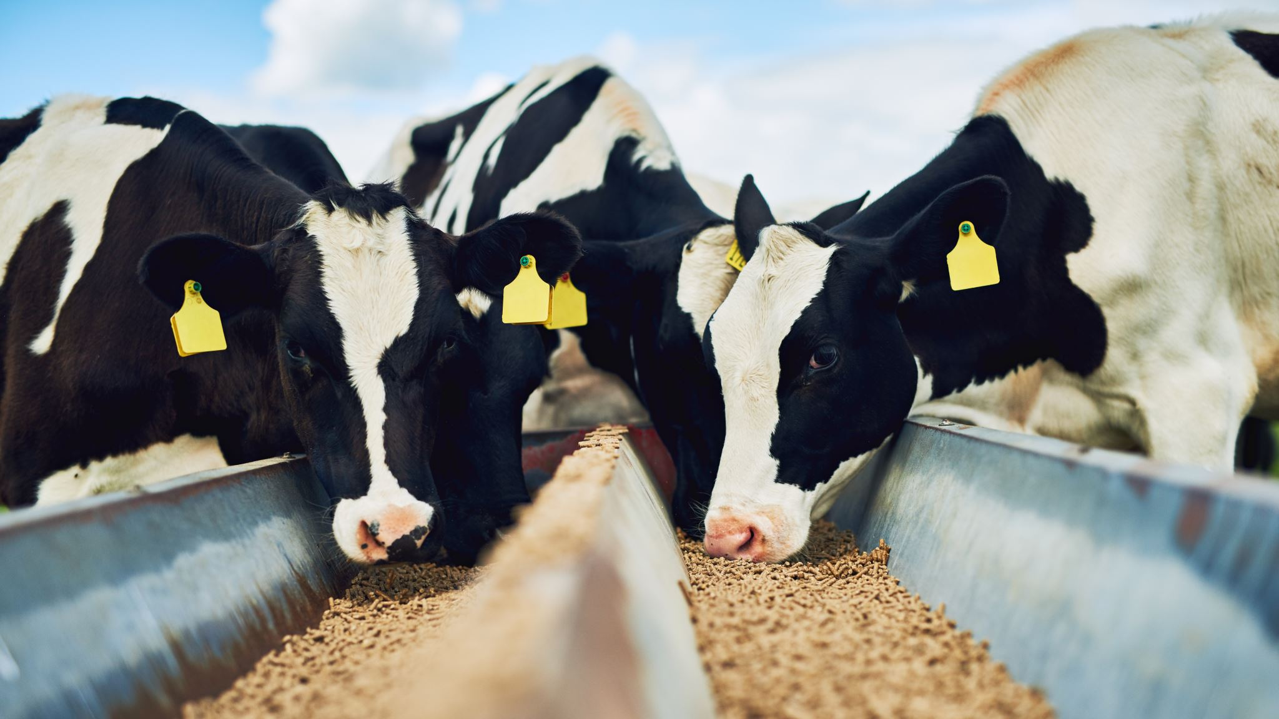
Cow data for GWAS
300K cows with yield deviations
60K SNPs
SAIGE as benchmark
10K cows randomly sampled from 300K
100 replicates
BFMAP (like EMMAX but 15X faster) as benchmark
Slope and R² of lm($χ_{SSGP}^{2}\sim χ_{BFMAP}^{2}−1$) for 60K SNPs

Slide 18
100 replicates

Slide 19
Red line: y=x
Red line: y=x

Slide 20
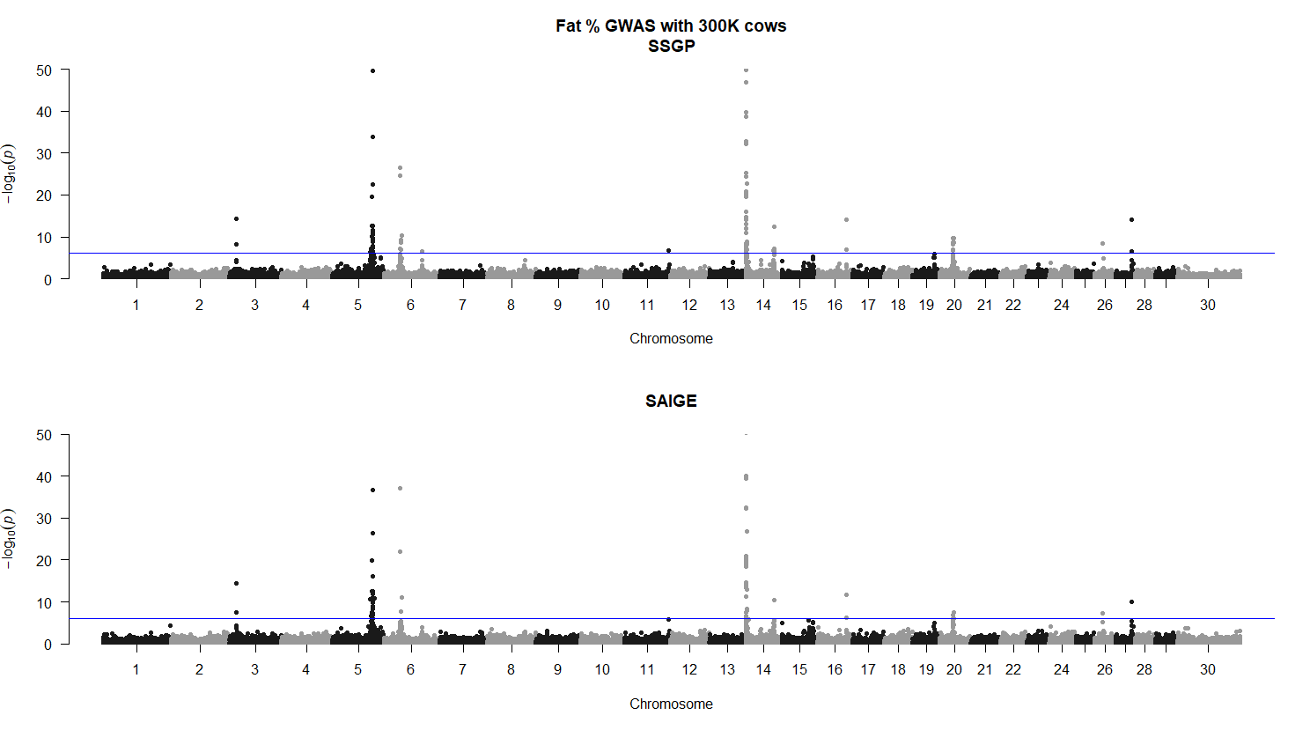
300K cows
Fat %
≈
PAEP
FASN
≈

Slide 21
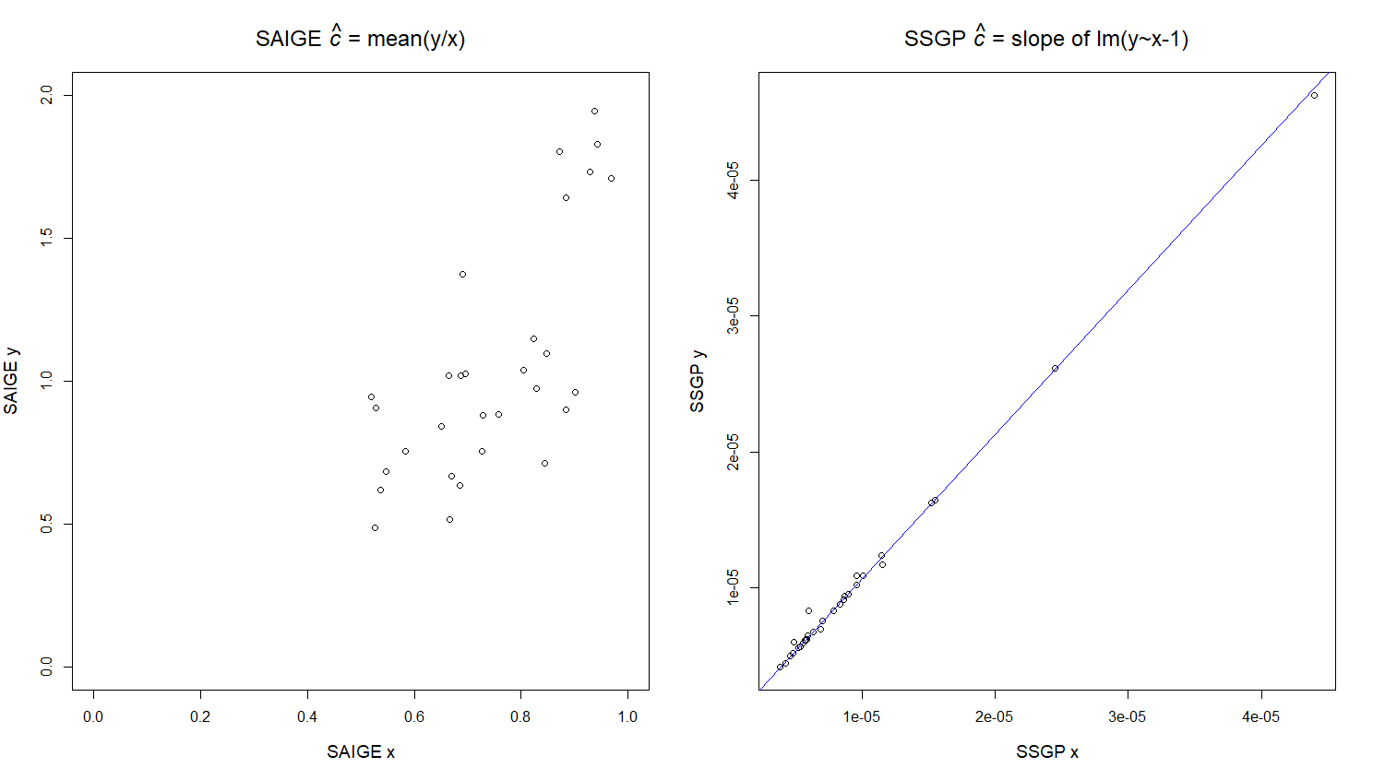
SAIGE
SSGP
30 markers
30 markers

Slide 22
Time on MacBook Pro (Intel i9) for 300K cows
~2.7 hours for GWAS by SSGP
>200 hours by SAIGE
Estimating the correction factor is time-consuming.

Slide 23
Summary
SSGP can be applied to various types of samples.
Mostly unrelated, like UK Biobank
Highly related, like dairy cattle
Admixed samples
SSGP is accurate for GWAS and for genomic prediction.
SSGP is fast.
1 million animals and 60K SNPs: <10 hours for GWAS and <5 hours for computing SNP effects on standard hardware.
SSGP can be applied to sequence GWA.
Reasonably more computational burden than linear regression.

Slide 24
Acknowledgements
Funding NHLBI U01 HL137181-01
Software
SSGP
https://sites.google.com/view/ssgp
BFMAP
https://jiang18.github.io/bfmap/
GWA is currently not available in the online version.
Contact
Jicai Jiang
jicai.jiang@gmail.com

