Slide 1
  Using the new ARS-UCD1 reference map in US genomic predictions
Dan Null¹*, Derek Bickhart², Paul VanRaden¹, John Cole¹, Jeff O’Connell³, and Ben Rosen¹
¹ Animal Genomics and Improvement Laboratory, ARS, USDA, Beltsville, MD, USA
² Cell Wall Biology and Utilization Research , ARS, USDA, Madison, WI, USA
³ University of Maryland School of Medicine, Baltimore, MD, USA
Email: daniel.null@ars.usda.gov
Web site: https://aipl.arsusda.gov/

Slide 2
Topics
Strategies to liftover SNP locations from one map to another
Compare previous UMD3 map to new ARS-UCD1 map
  Imputation results from 5 breeds (HOL, JER, BSW, RDC, GUE)
  Editing SNPs from potentially mismapped regions
  Inheritance and consistency of haplotypes across generations
US implementation of the ARS-UCD1 map
Further research with HD or sequence data

Slide 3
Liftover: Converting locations to a different map
Each chromosome may be longer or shorter than previous assembly
  Autosomes range from -4.3% shorter (chr12) to 0.6% longer (chr26)
  X chromosome 6.6% longer than UMD3, with more distinct PAR
Many insertions, deletions, inversions, translocations, SNPs vs. UMD3
  Official liftover tool developed by the UCSC Genome Browser (scaffolds)
  Use probe from manifest or flanking sequence, align to new map
  Simulate paired end reads from old map, align to new map (very fast)
  Use partial matches within a single chromosome

Slide 4
Liftover of SNP locations
Probes used for genotyping SNPs on arrays
  A 50-base sequence extended to the right or left of SNP, such as
  [C/T]AGTCAGCTCTGTGGCCTGGGCAGGTTCCCAGGATATTCCAGCCAGAC
  Where was this located on the old map?
  Where is this located on the new map?
File of new SNP locations provided by Bob Schnabel (U Missouri)
  https://www.animalgenome.org/repository/cattle/UMC_bovine_coordinates/
  Liftover of other SNPs not on manifests was done at AGIL
Notes:
Just shy 1 million SNP overlapped liftover
99.6% matched
4100 SNP did not match
We lifted over an additional 138,000 SNP

Slide 5
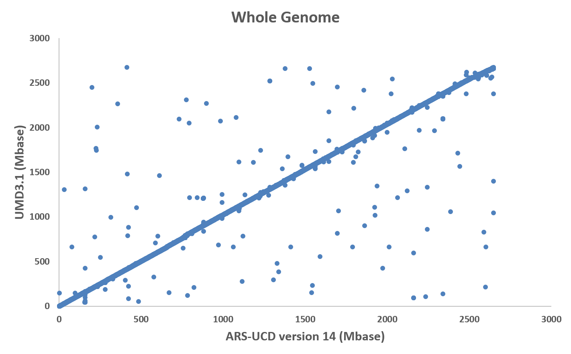
SNPs now located on different chromosomes
Notes:
142 SNP changed chromosome (.24%)

Slide 6
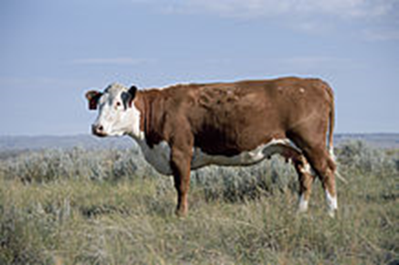
Switching from UMD3 to ARS-UCD1 map
Better assembly of Dominette DNA using longer reads
UMD3: Zimin et al. 2009 Genome Biology 10:R42
ARS-UCD1: Rosen et al. 2018 WCGALP, vol. Molecular Genetics 3, p. 802
  https://www.ncbi.nlm.nih.gov/assembly/GCA_002263795.2/
  Annotation (gene structure) released by NCBI in May 2018
  Also used for 1000 Bull Genomes Project Run7 in 2019
Edited versions used by AGIL after mis-mapped SNPs removed

Slide 7
PAR-X comparison
X
PAR
UMD3
X
ARS-UCD
PAR
Notes:
142 SNP changed chromosome (.24%)

Slide 8
Imputation tests
Locations for the 60,367 usable SNPs were converted to ARS-UCD1
Genotypes were imputed to 60K from 30 chips of differing density
Genotypes from 5 breeds were imputed separately:
  1,748,453 Holsteins (HO)
  215,800 Jerseys (JE)
  32,724 Brown Swiss (BS)
  4,834 Ayrshires (AY)
  3,517 Guernseys (GU)

Slide 9
60K Imputation results – 1: Inheritance rate
Haplotypes with parent-progeny noninheritance (%)
Breed | UMD3 | ARS-UCD1
 | edited | original | edited
HOL | 1.6 | 1.3 | 1.1
JER | 4.3 | 3.9 | 3.8
BSW | 1.5 | 1.3 | 1.2
RDC | 1.8 | 1.5 | 1.4
GUE | 1.6 | 1.4 | 1.3
Maximum non-inheritance within any haplotype (%)
Breed | UMD3 | ARS-UCD1
 | edited | original | edited
HOL | 13 | 31 | 12
JER | 25 | 35 | 18
BSW | 17 | 21 | 10
RDC | 16 | 27 | 10
GUE | 18 | 16 | 9
Notes:
Removed 12 potentially mismapped regions

Slide 10
60K Imputation results – 2: Maximum haplotypes
Maximum number of haplotypes per segment
Breed | UMD3 | ARS-UCD1
 | edited | original | edited
HOL | 47,987 | 81,316 | 36,690
JER | 39,628 | 33,034 | 29,732
BSW | 11,602 | 12,846 | 9,447
RDC | 2,030 | 2,512 | 1,606
GUE | 1,970 | 1,657 | 1,427
Haplotype counts and inheritance improved for all breeds
Much better on the X chromosome and its pseudoautosomal region
Further edits used HD data to identify smaller regions potentially mismapped

Slide 11
Imputation for published gene tests / haplotypes
The new map more cleanly separated truly lethal haplotypes from false candidate haplotypes.
Gene tests were added within previously published haplotypes:
  Added HH0, HH3, HH4, Red, Black/Red, Dominant Red, BH2, AH1, AH2.
  HH1, JH1, BLAD, CVM, DUMPs, Mulefoot, SDM, SMA, and Weaver were already included in previous 60K list. Some of these were progeny tests.
The added gene tests tended to identify more carrier animals.
For most haplotypes >99% of animals maintained the same status.
Notes:
Haplotype finemapping process was not able to identify all crossovers

Slide 12
Implementation steps
Converted UMD3 locations to ARS-UCD1 SNP locations
  Detected a few SNPs with different names, locations actually were same
  Detected a few SNPs with different locations, but names were the same
Increased usable SNP list from 60K to 80K (Wiggans ADSA talk)
Imputed genotypes for all breeds and crossbreds
Checked published haplotypes to ensure proper inheritance
Obtained prior allele effect estimates for all breeds, traits, and BBR
Implemented during the December 2018 full release
Notes:
On one chip SNP was called HH5 but was actually CVM

Slide 13
Published gene tests / haplotypes - HOL
Test | Same | Changed to: |  | Freq
 | (%) | Carrier | Non-C | (%)
HH0 | 99.8 | 0.17 | 0.05 | 3.2
HH1 | 99.7 | 0.24 | 0.05 | 2.6
HH2 | 99.3 | 0.71 | 0.02 | 2.6
HH3 | 99.5 | 0.46 | 0.03 | 4.6
HH4 | 99.9 | 0.02 | 0.01 | 0.5
HH5 | 98.2 | 1.69 | 0.15 | 6.2
HH6 | New |  |  | 0.5
Test | Same | Changed to: |  | Freq
 | (%) | Carrier | Non-C | (%)
BLAD | 99.9 | 0.03 | 0.05 | 0.2
CVM | 99.1 | 0.68 | 0.14 | 1.9
DUMPS | 100.0 | 0.00 | 0.00 | <0.1
MuleFt | 99.9 | 0.02 | 0.01 | 0.1
Polled | 99.2 | 0.57 | 0.18 | 3.8
Red | 97.1 | 1.33 | 1.53 | 9.4
Blk/Red | 99.7 | 0.21 | 0.08 | 1.2
DomRed | 99.9 | 0.03 | 0.00 | 0.2
HCD | 99.1 | 0.26 | 0.61 | 5.9

Slide 14
Published gene tests / haplotypes – Other breeds
Test | Same | Changed to: |  | Freq
 | (%) | Carrier | Non-C | (%)
BSW:
BH2 | 99.4 | 0.42 | 0.20 | 13.3
SDM | 98.7 | 0.92 | 0.37 | 3.0
SMA | 99.3 | 0.66 | 0.06 | 4.0
Polled | 99.6 | 0.07 | 0.31 | 2.5
Weaver | 99.9 | 0.07 | 0.06 | 1.2
Test | Same | Changed to: |  | Freq
 | (%) | Carrier | Non-C | (%)
JER:
JH1 | 98.4 | 1.27 | 0.29 | 18.4
JHP | 99.0 | 0.17 | 0.79 | 4.1
RDC:
AH1 | 98.2 | 1.55 | 0.23 | 22.2
AH2 | 99.0 | 0.69 | 0.35 | 21.0

Slide 15
HD Imputation results – 1: Inheritance rate
Haplotypes with parent-progeny noninheritance (%)
 | ARS-UCD1
Breed | 60K edits | HD edits
HOL | 3.0 | 2.9
JER | 3.9 | 4.9
BSW | 2.3 | 2.2
RDC | 2.4 | 2.4
GUE | 1.5 | 1.4
Maximum non-inheritance within any haplotype (%)
 | ARS-UCD1
Breed | 60K edits | HD edits
HOL | 48 | 18
JER | 47 | 22
BSW | 30 | 17
RDC | 37 | 18
GUE | 27 | 13
Notes:
17 new regions
9 expanded regions

Slide 16
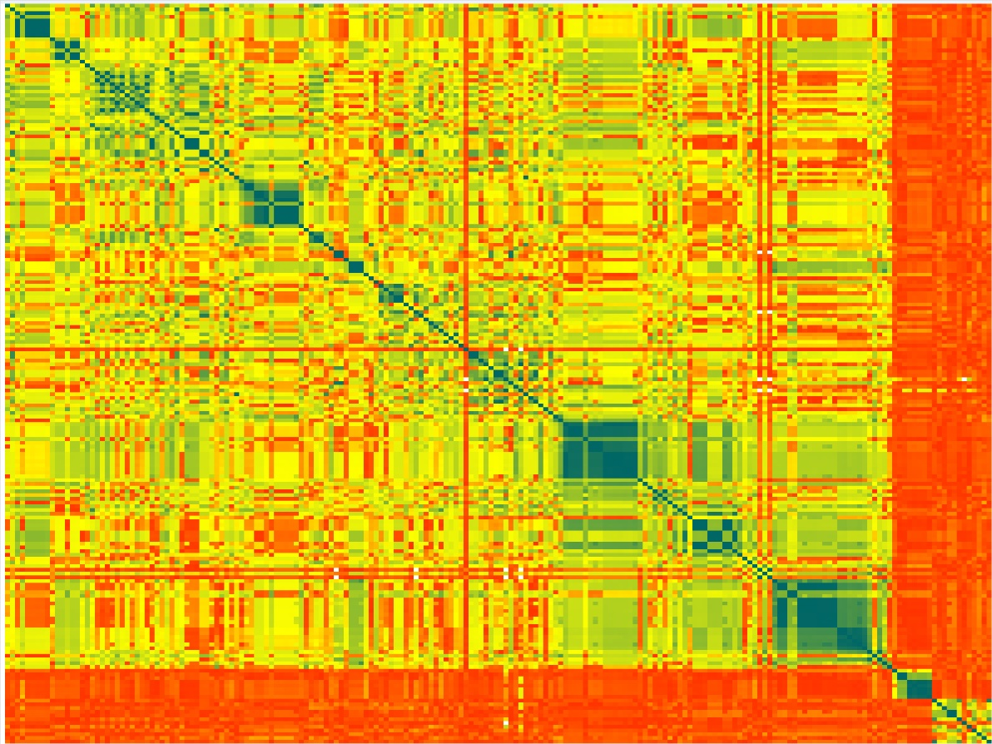
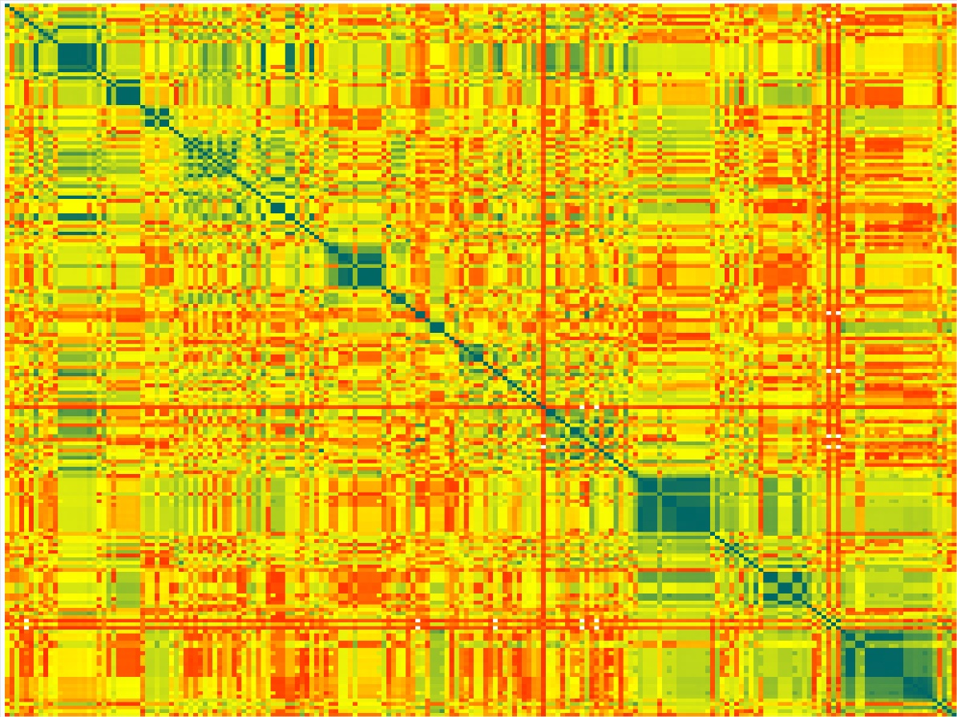
Check SNP correlation problems using heat maps
End of chromosome 29
Before HD edits
After HD edits
37% Non-inheritance
4% Non-inheritance

Slide 17
Potentially mismapped sections edited
Notes:
Largest region 2 mb on chr 15

Slide 18
Potentially mismapped sections edited
 | Mismapped Region |  |  |  |  | Mismapped Region |  |  |  |  | Mismapped Region
 | Starting | Ending |  |  |  | Starting | Ending |  |  |  | Starting | Ending
Chromosome | Location | Location | Size (Mb) |  | Chromosome | Location | Location | Size (Mb) |  | Chromosome | Location | Location | Size (Mb)
1 | 88,288,254 | 88,589,699 | 0.30 |  | 10 | 23,703,142 | 25,059,514 | 1.36 |  | 21 | 58,940,778 | 59,023,509 | 0.08
1 | 157,525,745 | 159,000,000 | 1.47 |  | 10 | 42,156,286 | 42,292,668 | 0.14 |  | 23 | 21,510,406 | 21,737,841 | 0.23
2 | 121,316,059 | 121,751,997 | 0.44 |  | 11 | 26,412,888 | 26,626,298 | 0.21 |  | 24 | 62,162,854 | 63,000,000 | 0.84
3 | 119,378,630 | 119,559,889 | 0.18 |  | 11 | 82,836,074 | 83,006,400 | 0.17 |  | 25 | 13,347,316 | 13,376,441 | 0.03
4 | 1,336,110 | 1,417,557 | 0.08 |  | 12 | 70,762,931 | 71,197,493 | 0.43 |  | 26 | 14,965,770 | 14,988,648 | 0.02
6 | 35,300,301 | 35,344,991 | 0.04 |  | 14 | 1 | 146,714 | 0.15 |  | 26 | 15,079,004 | 15,241,107 | 0.16
6 | 112,109,597 | 112,324,326 | 0.21 |  | 14 | 82,285,783 | 82,366,657 | 0.08 |  | 26 | 25,236,723 | 25,297,707 | 0.06
7 | 8,433,502 | 9,956,060 | 1.52 |  | 15 | 10,979,970 | 11,040,240 | 0.06 |  | 26 | 25,495,761 | 25,798,796 | 0.30
7 | 41,323,000 | 41,434,573 | 0.11 |  | 15 | 83,996,174 | 86,000,000 | 2.00 |  | 27 | 1 | 139,701 | 0.14
7 | 68,528,026 | 68,619,931 | 0.09 |  | 17 | 68,078,456 | 68,217,960 | 0.14 |  | 28 | 45,859,111 | 46,000,000 | 0.14
8 | 1 | 234,625 | 0.23 |  | 18 | 63,017,258 | 63,135,541 | 0.12 |  | 29 | 50,977,673 | 52,000,000 | 1.02
8 | 113,096,592 | 113,273,051 | 0.18 |  | 20 | 71,850,046 | 72,000,000 | 0.15 |  | 31 | 86,996,907 | 87,035,672 | 0.04
9 | 104,172,188 | 104,634,958 | 0.46 |  | 21 | 1 | 454,527 | 0.45
Notes:
Highlighted regions are from the HD analysis

Slide 19
Conclusions
The ARS-UCD map fixes many defects in the UMD3 map
Mis-mapped regions of UMD3 are now usable on ARS-UCD
The new map has several better properties than previous:
  Marker locations, genotype imputation, haplotype inheritance, sequence alignment, and gene annotation
ARS-UCD1 map used in U.S. genomic evaluations since Dec 2018
ARS-UCD1 map used in 1000 Bull Genomes run7 sequence data files delivered in 2019

Slide 20
Acknowledgments
USDA-ARS project 1265-31000-101-00, “Improving Genetic Predictions in Dairy Animals Using Phenotypic and Genomic Information” (AGIL funding)
Council on Dairy Cattle Breeding (CDCB) and its industry suppliers for data

