Slide 1



Macroeconomics of using high quality genetics

Slide 2
China-U.S. agriculture comparison
Item | China | United States
Population (2007, millions) | 1,321 | 304
Cropland (acres, millions) | 301 | 406
Cropland/agricultural worker (acres) | 1 | 194
Agricultural gross domestic product (GDP, 2007, US$, billions) | 370 | 161
Agricultural GDP/agricultural worker (US$/person) | 1,230 | 43,650
Source: USDA Economic Research Service

Slide 3
Why is dairy important to China?
Source of highly nutritious food
Rising income  greater demand
Domestic production can reduce imports

Slide 4
Effect of rising income
Some increase in calories consumed
General increase in diet quality
  More animal protein
Substantial increase in resources required
Rapid economic growth in China  huge increase in animal products

Slide 5
Why improve efficiency?
Meet needs of growing population at reduced cost
Reduce demand
  Land
  Water
  Labor
Reduce pollution (carbon footprint)
  Methane
  Runoff

Slide 6
How to improve efficiency
Increase production per cow
Improve cow’s efficiency of feed conversion
Improve longevity  reduces number of heifers required
Improve nutritional management
Reduce disease

Slide 7
China-U.S. dairy comparison
Item | China | United States
Cows (millions) | 12.8 | 9.1
Milk yield (kg) | 2,881 | 9,593
Source: UN Food and Agriculture Organization, 2010

Slide 8
US Carbon footprint
Per cow
  Doubled
Source:
Capper et al.,
J. Anim. Sci.,
2009
Per unit of milk
  Reduced 2/3
U.S. dairy industry reduced total footprint by 41%
Notes:
Ref #1700
Increased production per cow requires the cow to consume more feed, therefore her individual footprint to increase, just like the footprint of the bus is larger than the compact automobile.
8

Slide 9
Why US carbon footprint was reduced
Milk productivity has quadrupled
60% more milk with 75% fewer cows
Source: National Agricultural Statistics Service, USDA

Slide 10
Efficiency and “dilution of maintenance”
1.8 Mcal/kg
Energy efficiency
2.0 Mcal/kg
75%
65%
Dilution of maintenance
35%
25%
Based on dietary needs for 680-kg Holstein, 3.8% fat, 3.1% protein
Source: J. Capper, Washington State University, & R. Cady, Elanco, 2010

Slide 11
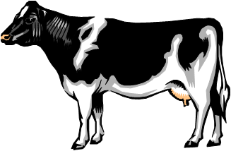

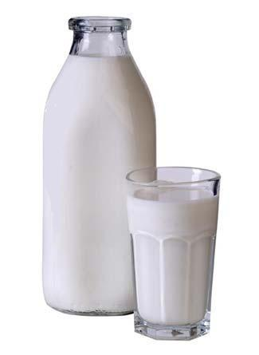
Practical application
Increasing productivity reduces environmental impact
1944
2007
60 lb
24 kg
Source: Capper et al., J. Anim. Sci., 2009
Notes:
Ref #1700
11

Slide 12


Per cow Background requirements
Maintenance feed
Water
  Intake
  Sanitation
Greenhouse gases
(carbon footprint)
  CO₂ – Carbon dioxide
  CH₄ – Methane
  N₂O – Nitrous oxide
Land
Manure
Fuel
Electricity
Herbicides, pesticides
+
⅛ of dry cow
+
97% of heifer
increases
Notes:
Virtually every paper prior to this paper has ignored the fact that more milking cows requires more dry cows (to be milking when other cows are dry) and more heifers to replace the milking cows when they die or are culled. These are critical infrastructure costs that must be accounted for.
12

Slide 13
Life-cycle assessment
Physical plant (machine) | Animal corollary
Off | Deceased
Idle | At rest (maintenance)
Performing | Production (growth, lactation, reproduction)
Physical plant (machine) | Animal corollary
Off | Deceased
Idle | At rest (maintenance)
Performing | Production (growth, lactation, reproduction)
Physical plant (machine)
Off
Idle
Performing
Source: J. Capper, Washington State University

Slide 14
Milk productivity trends
Euro-6 represents 2/3 of cow’s milk produced in European Union in 2010
Source: UN Food and Agriculture Organization, 2010
Notes:
Ref# 2100
Euro-6 is a weighted average of FR, UK, Ger, Pol, IT, and ND
14
Kansas Dietetic Association, April 17, 2009

Slide 15
Animals needed to produce 45 million kg of milk
1.4
2.4
1.1
1.0
Includes lactating and dry cows, heifer replacements, and breeding bulls in 2007
Values inside bars are relative ratio to most efficient country
Euro-6 represents 2/3 of cow’s milk produced in European Union in 2007
Source: J. Capper, Washington State University; adapted from FAO statistics
Notes:
Ref# 2100
Euro-6 is a weighted average of FR, UK, Ger, Pol, IT, and ND
15
Kansas Dietetic Association, April 17, 2009

Slide 16
Genetic improvement
Increases genetic ability
Considers traits of economic importance
Requires an environment that allows genetic potential to be expressed
Leads to permanent change in cow population

Slide 17
Method for genetic improvement
Collect performance data
Calculate genetic evaluations
Use highest ranking animals as parents of next generation
Focus on bulls
  Can have many daughters
  High selection intensity

Slide 18
Role of imported semen
Widespread international trade in semen
Semen exporting countries have well established evaluation system
Selection intensity is very high
Benefit of many generations of selection is available

Slide 19
U.S. semen
U.S. evaluation system respected worldwide
Large population allows for detection of bulls superior for a wide range of traits
Early adoption of genomics promises increased rate of genetic gain

Slide 20
Summary
Chinese consumption of dairy products will increase
Increased efficiency necessary to meet demand from available land and water resources
Higher yield/cow dilutes maintenance
United States is source of semen with proven high production potential

