Slide 1
Genomic Selection in Dairy Cattle

Slide 2
Dairy Cattle
9 million cows in US
Attempt to have a calf born every year
Replaced after 2 or 3 years of milking
Bred via AI
Bull semen collected several times/week. Diluted and frozen
Popular bulls have 10,000+ progeny
Cows can have many progeny though super ovulation and embryo transfer
Notes:
2

Slide 3
Data Collection
Monthly recording
  Milk yields
  Fat and Protein percentages
  Somatic Cell Count (Mastitis indicator)
Visual appraisal for type traits
Breed Associations record pedigree
Calving difficulty and Stillbirth
Notes:
3

Slide 4
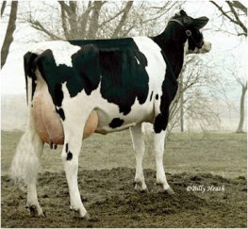
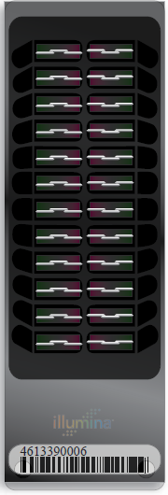
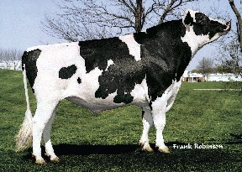
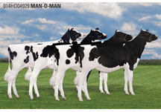
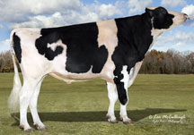
Lifecycle of bull
Parents Selected
Dam Inseminated
  Embryo Transferred to Recipient
  Bull Born
  Genomic Test
Semen collected (1yr)
Daughters Born (9 m later)
Bull Receives Progeny Test
(5 yrs)
Daughters have calves (2yr later)

Slide 5
Benefit of genomics
Determine value of bull at birth
  Increase accuracy of selection
  Reduce generation interval
  Increase selection intensity
  Increase rate of genetic gain
Notes:
5

Slide 6
History of genomic evaluations
Dec. 2007 BovineSNP50 BeadChip available
Apr. 2008 First unofficial evaluation released
Jan. 2009 Genomic evaluations official for
        Holstein and Jersey
Aug. 2009 Official for Brown Swiss
Sept. 2010 Unofficial evaluations from 3K chip
released
Dec. 2010 3K genomic evaluations to be official
Sept. 2011 Infinium BovineLD BeadChip available
Notes:
6

Slide 7
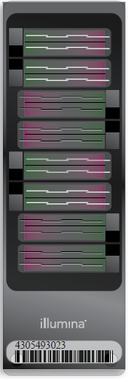

Chips
50KV2
BovineSNP50
  Version 1 54,001 SNP
  Version 2 54,609 SNP
  45,187 used in evaluations
HD
  777,962 SNP
  Only 50K SNP used,
  >1700 in database
LD
  6,909 SNP
  Replaced 3K
HD
LD
Notes:
7

Slide 8
Use of HD
Currently only 50K subset of SNP used
Some increase in accuracy from better tracking of QTL possible
Potential for across breed evaluations
Requires few new HD genotypes once adequate base for imputation developed

Slide 9
LD chip
6909 SNP mostly from SNP50 chip
  9 Y Chr SNP included for sex validation
  13 Mitochondrial DNA SNP
  Evenly spaced across 30 Chr (increased density at ends)
Developed to address performance issues with 3K while continuing to provide low cost genotyping
Provides over 98% accuracy imputing 50K genotypes
Included beginning with Nov genomic evaluation
Notes:
9

Slide 10
Genomic evaluation program steps
Identify animals to genotype
Sample to lab
Genotype sample
Genotype to USDA
Calculate genomic evaluation
Release monthly
Notes:
10

Slide 11
Steps to prepare genotypes
Nominate animal for genotyping
Collect blood, hair, semen, nasal swab, or ear punch
  Blood may not be suitable for twins
Extract DNA at laboratory
Prepare DNA and apply to BeadChip
Do amplification and hybridization, 3-day process
Read red/green intensities from chip and call genotypes from clusters
Notes:
11

Slide 12
What can go wrong
Sample does not provide adequate DNA quality or quantity
Genotype has many SNP that can not be determined (90% call rate required)
Parent-progeny conflicts
  Pedigree error
  Sample ID error (Switched samples)
  Laboratory error
  Parent-progeny relationship detected that is not in pedigree

Slide 13
Lab QC
Each SNP evaluated for
  Call Rate
  Portion Heterozygous
  Parent-progeny conflicts
Clustering investigated if SNP exceeds limits
Number of failing SNP is indicator of genotype quality
Target fewer than 10 SNP in each category

Slide 14
Parentage validation and discovery
Parent-progeny conflicts detected
  Animal checked against all other genotypes
  Reported to breeds and requesters
  Correct sire usually detected
Maternal Grandsire checking
  SNP at a time checking
  Haplotype checking more accurate
Breeds moving to accept SNP in place of microsatellites
Notes:
14

Slide 15
Imputation
Based on splitting the genotype into individual chromosomes (maternal & paternal contributions)
Missing SNP assigned by tracking inheritance from ancestors and descendents
Imputed dams increase predictor population
3K, LD, & 50K genotypes merged by imputing SNP not on LD or 3K

Slide 16
Recessive defect discovery
Check for homozygous haplotypes
  Most haplotype blocks ~5Mbp long
  7 – 90 expected, but 0 observed
  5 of top 11 haplotypes confirmed as lethal
  Investigation of 936 – 52,449 carrier sire × carrier MGS fertility records found 3.0 – 3.7% lower conception rates

Slide 17
Haplotypes impacting fertility
Breed | BTA chromo-some | Location, Mbases | Carrier frequency, %
Holstein | 5 | 62–68 | 4.5
 | 1 | 93–98 | 4.6
 | 8 | 92–97 | 4.7
Jersey | 15 | 11–16 | 23.4
Brown Swiss | 7 | 42–47 | 14.0

Slide 18
Data and evaluation flow
Requester
(Ex: AI, breeds)
samples
nominations
evaluations
Dairy
producers
Genomic Evaluation Lab
samples
samples
genotypes
DNA
laboratories

Slide 19
Collaboration
Full sharing of genotypes with Canada
  CDN calculates genomic evaluations on Canadian base
Trading of Brown Swiss genotypes with Switzerland, Germany, and Austria
  Interbull may facilitate sharing
Agreements with Italy and Great Britain provide genotypes for Holstein
  Negotiations underway with other countries
Notes:
19

Slide 20
Number of New Genotypes
09/10
11/10
01/11
03/11
05/11
07/11
09/11
11/11
50K and HD
3K and LD

Slide 21
Genotyped Holsteins
Date |  |  | Young animals** |  |  | All animals
 | Bulls* | Cows* | Bulls | Heifers
04-10 | 9,770 | 7,415 | 16,007 | 8,630 |  | 41,822
08-10 | 10,430 | 9,372 | 18,652 | 11,021 |  | 49,475
12-10 | 11,293 | 12,825 | 21,161 | 18,336 |  | 63,615
04-11 | 12,152 | 11,224 | 25,202 | 36,545 |  | 85,123
05-11 | 12,429 | 11,834 | 26,139 | 40,996 |  | 91,398
06-11 | 15,379 | 12,098 | 27,508 | 45,632 |  | 100,617
07-11 | 15,386 | 12,219 | 28,456 | 50,179 |  | 106,240
08-11 | 16,519 | 14,380 | 29,090 | 52,053 |  | 112,042
09-11 | 16,812 | 14,415 | 30,185 | 56,559 |  | 117,971
10-11 | 16,832 | 14,573 | 31,865 | 61,045 |  | 124,315
11-11 | 16,834 | 14,716 | 32,975 | 65,330 |  | 129,855
12-11 | 17,288 | 17,236 | 33,861 | 68,051 |  | 136,436
*Traditional evaluation
**No traditional evaluation

Slide 22
Sex Distribution
August 2010
November 2011
Females
Males
39%
38%
Males
Females
61%
62%
All genotypes

Slide 23
Calculation of genomic evaluations
Deregressed values derived from traditional evaluations of predictor animals
Allele substitutions random effects estimated for 45,187 SNP
Polygenic effect estimated for genetic variation not captured by SNP
Selection Index combination of genomic and traditional not included in genomic
Applied to yield, fitness, calving and type traits

Slide 24
Holstein prediction accuracy
Traitª | Bias^{b} | b | REL (%) | REL gain (%)
Milk (kg) | −64.3 | 0.92 | 67.1 | 28.6
Fat (kg) | −2.7 | 0.91 | 69.8 | 31.3
Protein (kg) | 0.7 | 0.85 | 61.5 | 23.0
Fat (%) | 0.0 | 1.00 | 86.5 | 48.0
Protein (%) | 0.0 | 0.90 | 79.0 | 40.4
PL (months) | −1.8 | 0.98 | 53.0 | 21.8
SCS | 0.0 | 0.88 | 61.2 | 27.0
DPR (%) | 0.0 | 0.92 | 51.2 | 21.7
Sire CE | 0.8 | 0.73 | 31.0 | 10.4
Daughter CE | −1.1 | 0.81 | 38.4 | 19.9
Sire SB | 1.5 | 0.92 | 21.8 | 3.7
Daughter SB | − 0.2 | 0.83 | 30.3 | 13.2
a PL=productive life, CE = calving ease and SB = stillbirth.
b 2011 deregressed value – 2007 genomic evaluation.

Slide 25
Reliabilities for young Holsteins*
9000
50K genotypes
8000
3K genotypes
7000
6000
5000
Number of animals
4000
3000
2000
1000
0
40
45
50
55
60
65
70
75
80
Reliability for PTA protein (%)
*Animals with no traditional PTA in April 2011

Slide 26
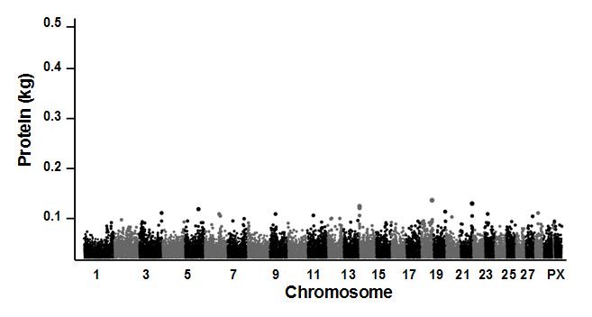
Holstein Protein SNP Effects

Slide 27
Use of genomic evaluations
Determine which young bulls to bring into AI service
Use to select mating sires
Pick bull dams
Market semen from 2-year-old bulls

Slide 28
Use of LD genomic evaluations
Sort heifers for breeding
  Flush
  Sexed semen
  Beef bull
Confirm parentage to avoid inbreeding
Predict inbreeding depression better
Precision mating considering genomics (future)

Slide 29
Application to more traits
Animal’s genotype is good for all traits
Traditional evaluations required for accurate estimates of SNP effects
Traditional evaluations not currently available for heat tolerance or feed efficiency
Research populations could provide data for traits that are expensive to measure
Will resulting evaluations work in target population?

Slide 30
Impact on producers
Young-bull evaluations with accuracy of early 1st­crop evaluations
AI organizations marketing genomically evaluated 2-year-olds
Genotype usually required for cow to be bull dam
Rate of genetic improvement likely to increase by up to 50%
Studs reducing progeny-test programs

Slide 31
Why Genomics works in Dairy
Extensive historical data available
Well developed genetic evaluation program
Widespread use of AI sires
Progeny test programs
High valued animals, worth the cost of genotyping
Long generation interval which can be reduced substantially by genomics
Notes:
31

Slide 32
Summary
Extraordinarily rapid implementation of genomic evaluations
Chips provide genotypes of high accuracy
Comprehensive checking insures quality of genotypes stored
Young-bull acquisition and marketing now based on genomic evaluations
Genotyping of many females because of lower cost low density chips

Slide 33


