Slide 1
New Tools for Genomic Selection of Livestock

Slide 2
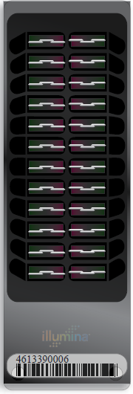
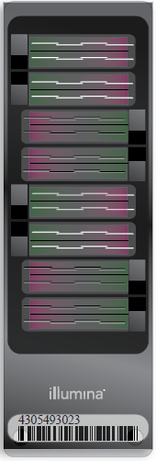
Illumina genotyping arrays
BovineSNP50
  54,001 SNPs (version 1)
  54,609 SNPs (version 2)
  45,187 SNPs used in evaluation
BovineHD
  777,962 SNPs
  Only BovineSNP50 SNPs used
  >1,700 SNPs in database
BovineLD
  6,909 SNPs
  Allows for additional SNPs
BovineSNP50 v2
BovineHD
BovineLD
Notes:
2

Slide 3
Genotyped Holsteins
Date | SNP Estimation* |  |  |  | Young animals** |  |  |  | All animals
 | Bulls |  | Cows |  | Bulls |  | Heifers
04-10 | 9,770 |  | 7,415 |  | 16,007 |  | 8,630 |  | 41,822
08-10 | 10,430 |  | 9,372 |  | 18,652 |  | 11,021 |  | 49,475
12-10 | 11,293 |  | 12,825 |  | 21,161 |  | 18,336 |  | 63,615
04-11 | 12,152 |  | 11,224 |  | 25,202 |  | 36,545 |  | 85,123
08-11 | 16,519 |  | 14,380 |  | 29,090 |  | 52,053 |  | 112,042
09-11 | 16,812 |  | 14,415 |  | 30,185 |  | 56,559 |  | 117,971
10-11 | 16,832 |  | 14,573 |  | 31,865 |  | 61,045 |  | 124,315
11-11 | 16,834 |  | 14,716 |  | 32,975 |  | 65,330 |  | 129,855
12-11 | 17,288 |  | 17,236 |  | 33,861 |  | 68,051 |  | 136,436
01-12 | 17,681 |  | 17,418 |  | 35,404 |  | 74,072 |  | 144,575
02-12 | 17,710 |  | 17,679 |  | 36,597 |  | 80,845 |  | 152,831
*Traditional evaluation **No traditional evaluation

Slide 4
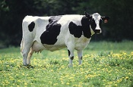
What’s a SNP genotype worth?
Pedigree is equivalent to information on about 7 daughters
For the protein yield (h²=0.30), the SNP genotype provides information equivalent to an additional 34 daughters
Notes:
4

Slide 5

What’s a SNP genotype worth?
And for daughter pregnancy rate (h²=0.04), SNP = 131 daughters
Notes:
5

Slide 6
Genotypes and haplotypes
Genotypes indicate how many copies of each allele were inherited
Haplotypes indicate which alleles are on which chromosome
Observed genotypes partitioned into the two unknown haplotypes
  Pedigree haplotyping uses relatives
  Population haplotyping finds matching allele patterns

Slide 7
Filling missing genotypes
Predict unknown SNP from known
  Measure 3,000, predict 43,000 SNP
  Measure 50,000, predict 500,000
  Measure each haplotype at highest density only a few times
Predict dam from progeny SNP
Increase reliabilities for less cost

Slide 8
Haplotyping program – findhap.f90
Begin with population haplotyping
  Divide chromosomes into segments, ~250 to 75 SNP / segment
  List haplotypes by genotype match
  Similar to fastPhase, IMPUTE
End with pedigree haplotyping
  Detect crossover, fix noninheritance
  Impute nongenotyped ancestors

Slide 9
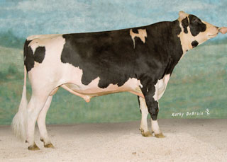
Example Bull: O-Style (USA137611441)
Read genotypes and pedigrees
Write haplotype segments found
  List paternal / maternal inheritance
  List crossover locations

Slide 10
O-Style Haplotypes Chromosome 15

Slide 11
Pedigree Haplotyping AB allele coding
Genotypes:
OMan BB,AA,AA,AB,AA,AB,AB,AA,AA,AB
OStyle BB,AA,AA,AB,AB,AA,AA,AA,AA,AB
Haplotypes:
OStyle (pat) B A A _ A A A A A _
OStyle (mat) B A A _ B A A A A _

Slide 12
Recessive defect discovery
Check for homozygous haplotypes
  7 to 90 expected but none observed
  5 of top 11 are potentially lethal
  936 to 52,449 carrier sire by carrier MGS fertility records
  3.1% to 3.7% lower conception rates
  Some slightly higher stillbirth rates
Confirmed Brachyspina same way

Slide 13
Potential recessive lethals
Name | Chrom-osome | Loca-tion | Carrier Freq | Source Ancestors
 | BTA | Mbase | %
HH1 | 5 | 58-66 | 4.5 | Pawnee Farm Arlinda Chief
HH2 | 1 | 92-97 | 4.6 | Willowholme Mark Anthony
HH3 | 8 | 90-95 | 4.7 | Glendell Arlinda Chief, Gray View Skyliner
JH1 | 15 | 13-18 | 23.4 | Observer Chocolate Soldier
BH1 | 7 | 41-47 | 14.0 | West Lawn Stretch Improver

Slide 14
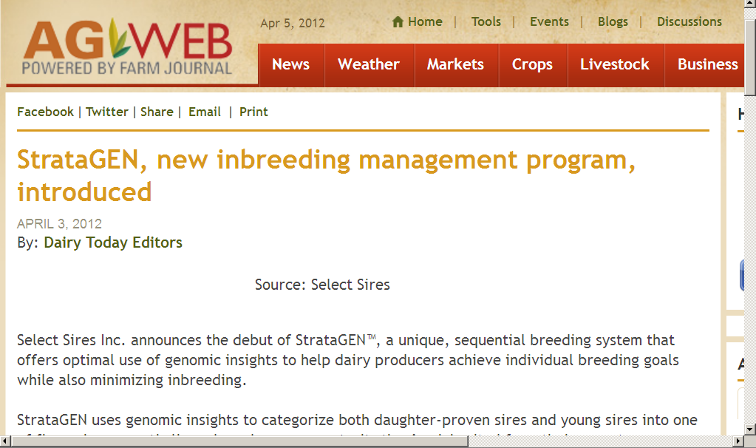
Our industry wants new genomic tools

Slide 15
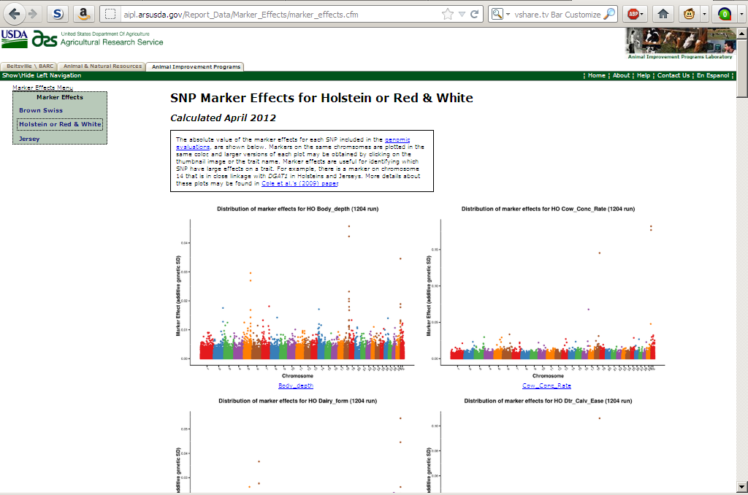
We already have some tools
http://aipl.arsusda.gov/Report_Data/Marker_Effects/marker_effects.cfm

Slide 16
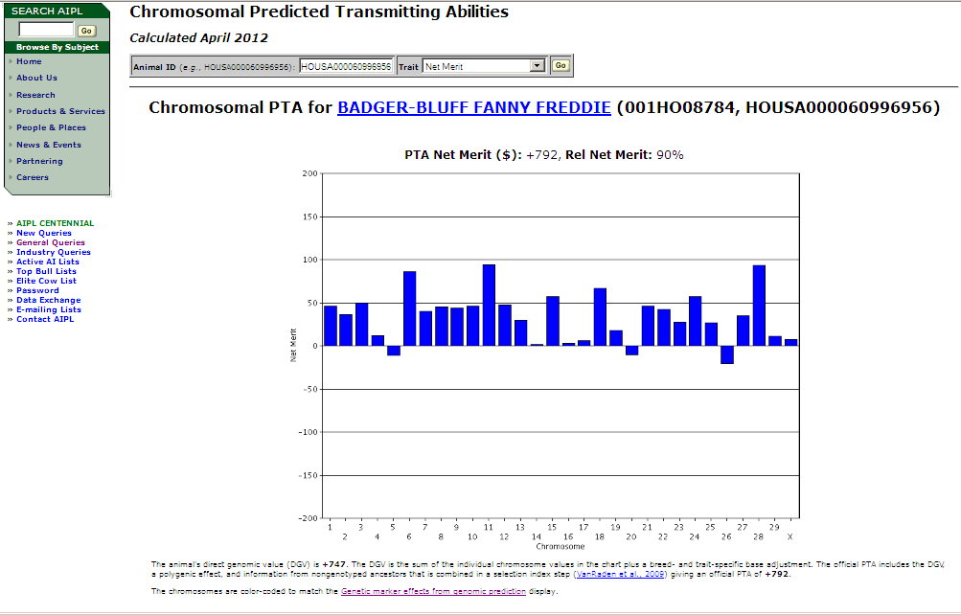
Chromosomal DGV query
http://aipl.arsusda.gov/CF-queries/Bull_Chromosomal_EBV/bull_chromosomal_ebv.cfm?

Slide 17
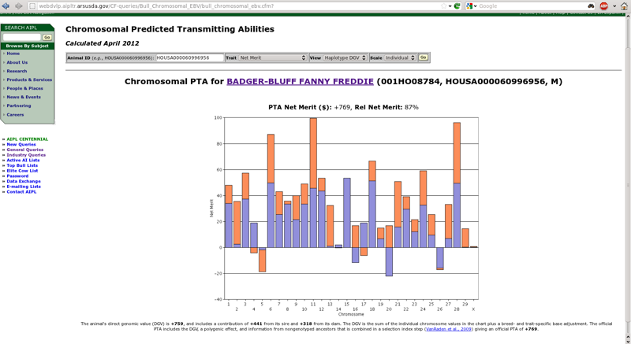
Now we have a new haplotype query

Slide 18
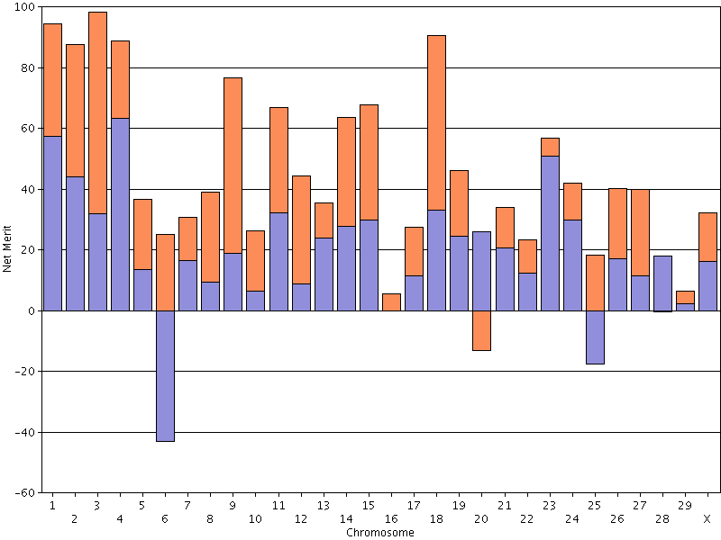
Top net merit bull April 2012
HOUSA000069981349, PTA NM$ +991

Slide 19
Paternal and maternal DGV
Shows the DGV for the paternal and maternal haplotyles
  Imputed from 50K using findhap.f90 v.2
Can we use them to make mating decisions?
  People are going to do it – we need to help them

Slide 20
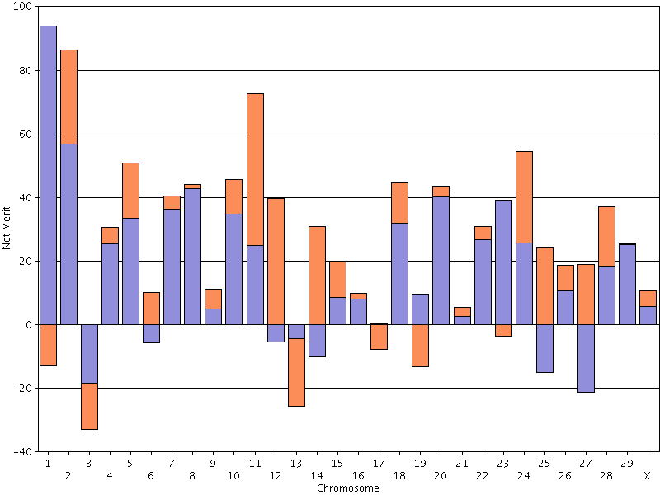
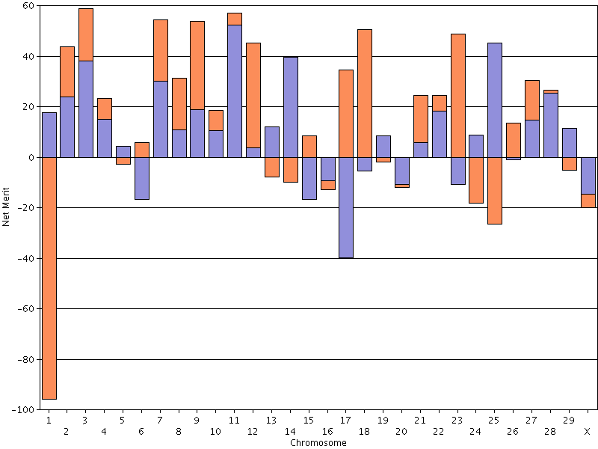
The good and the bad Chromosome 1

Slide 21
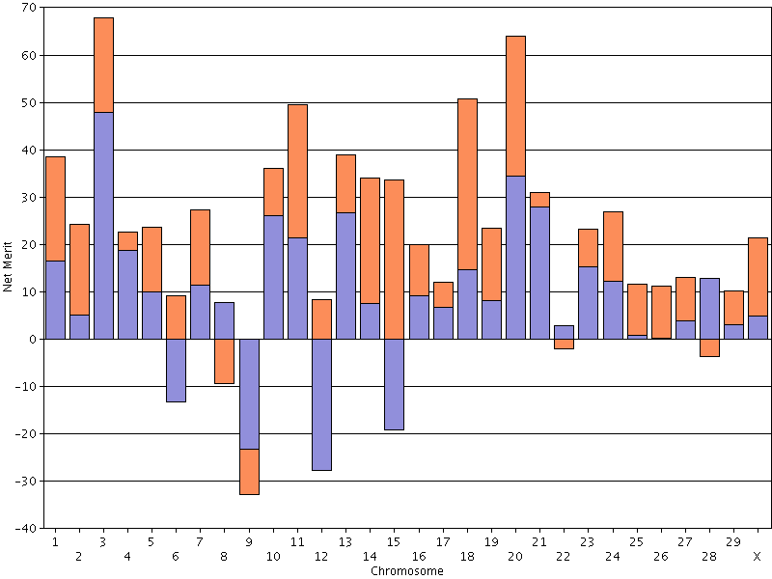
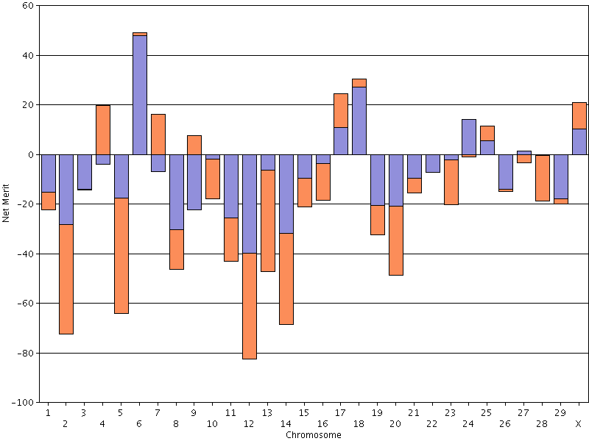
Pluses and minuses
23 positive chromosomes
19 negative chromosomes

Slide 22
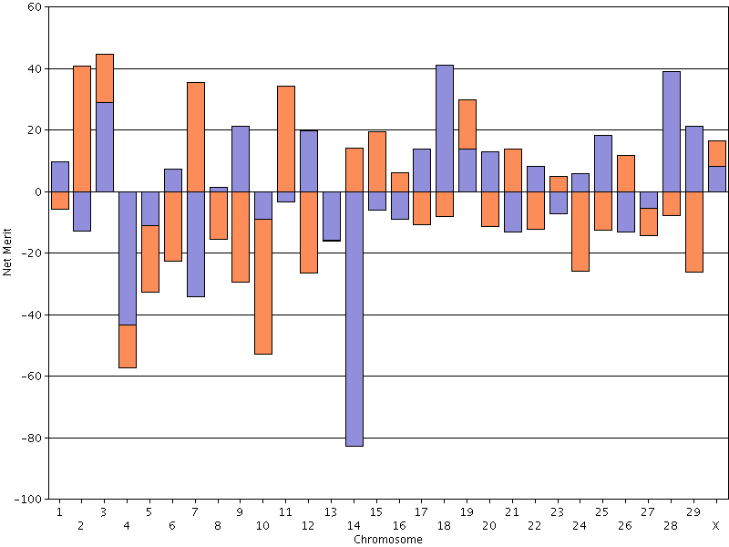
Breeders need MS variance

Slide 23
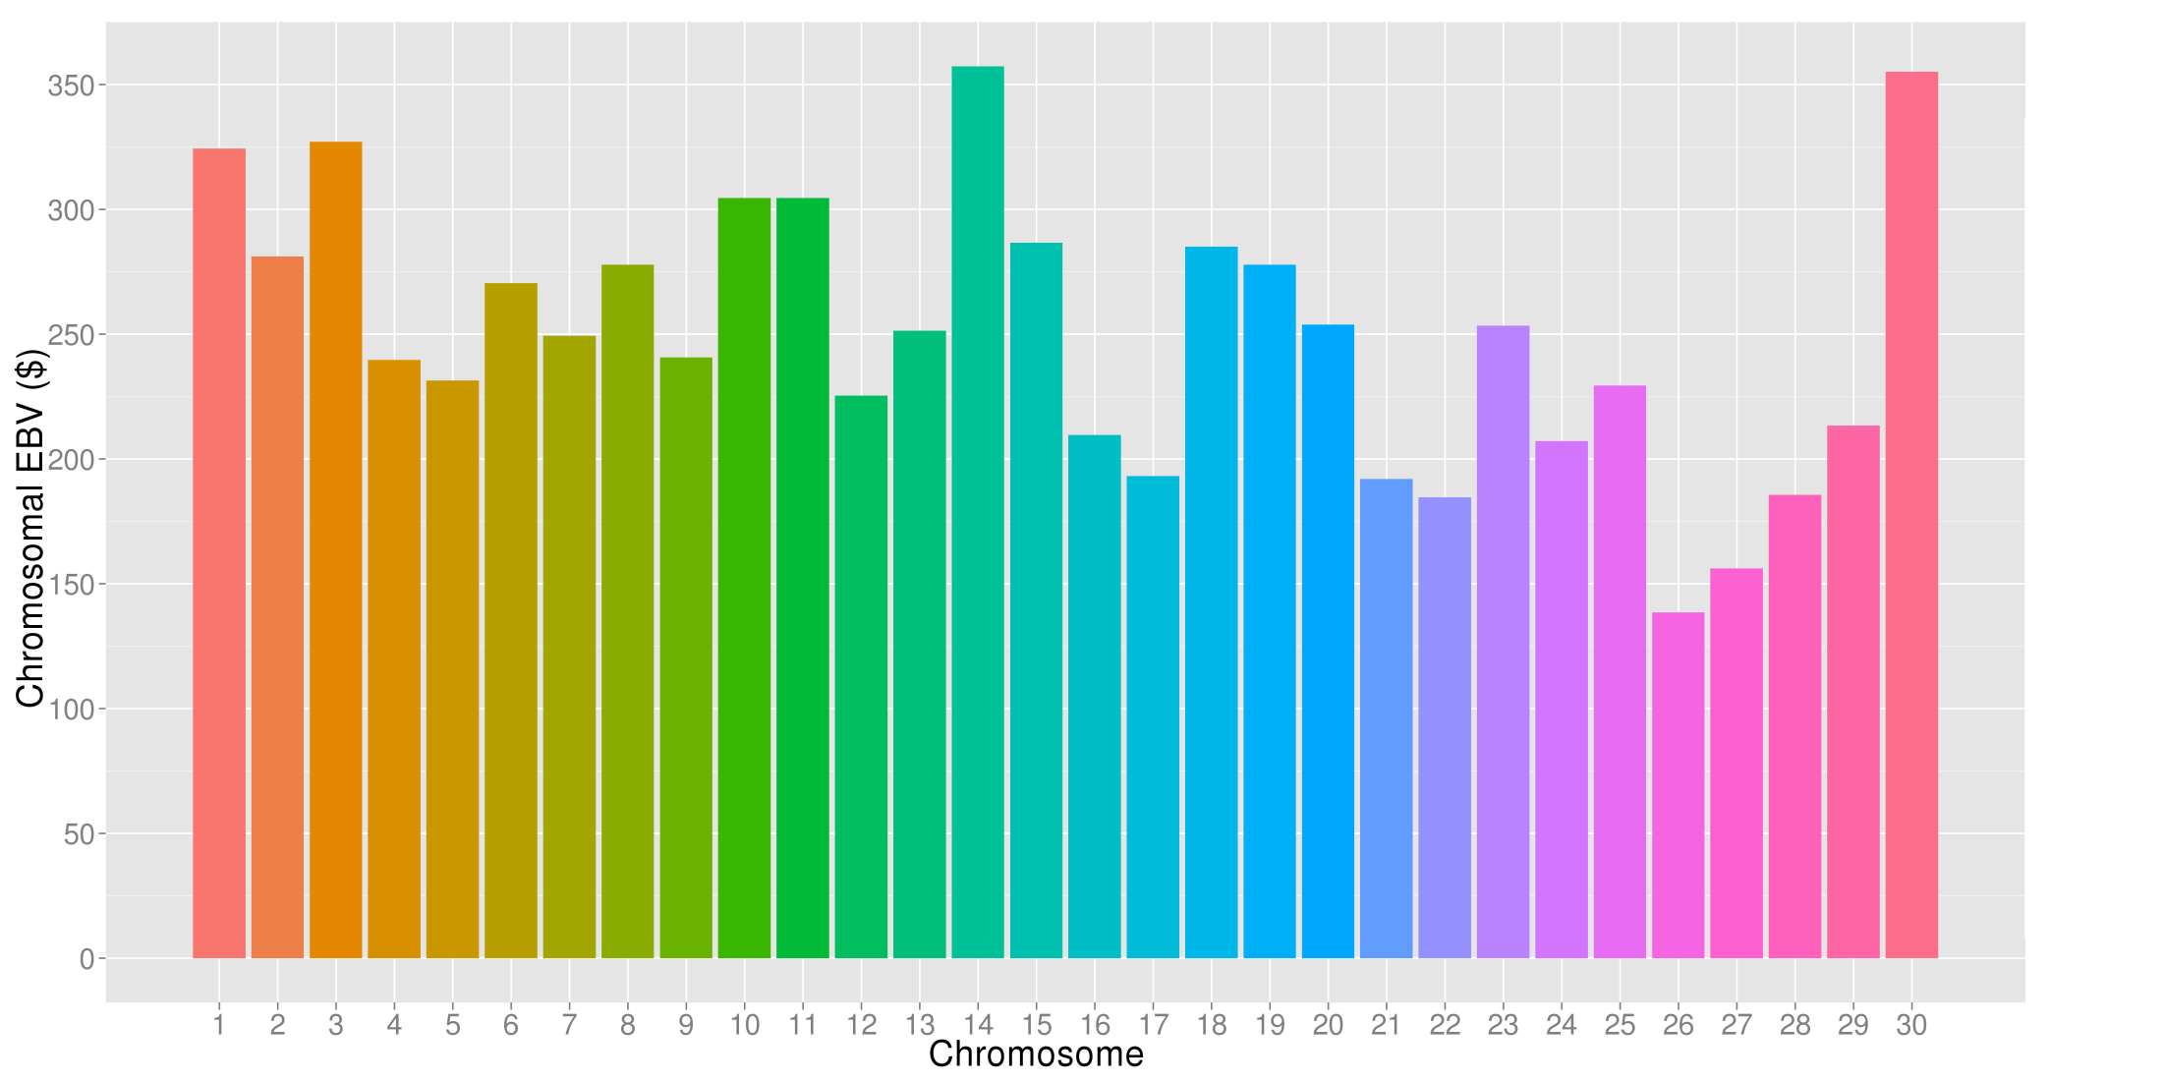
What’s the best cow we can make?
A “Supercow” constructed from the best haplotypes in the Holstein population would have an PTA(NM$) of $3,757

Slide 24
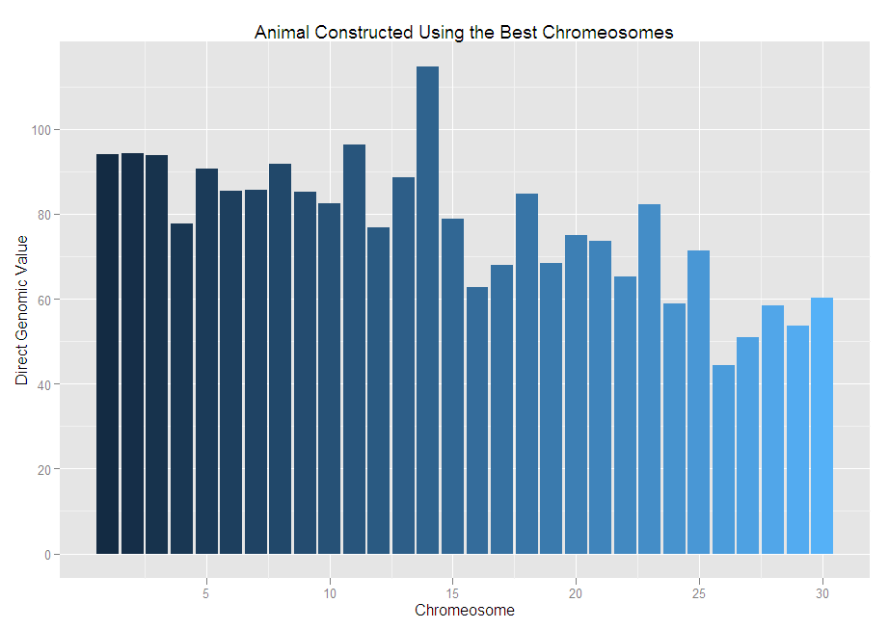
The best we can do DGV for NM$ = +2,314

Slide 25
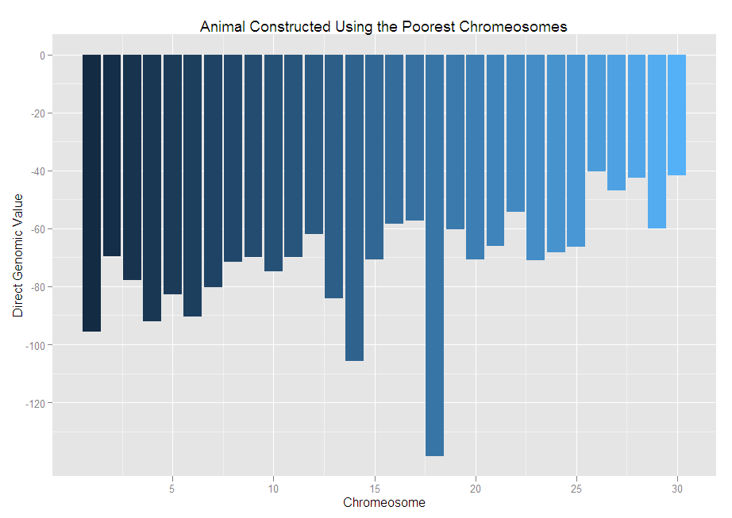
The worst we can do DGV for NM$ = -2,139

Slide 26
Index changes
Trait | Relative emphasis on traits in index (%)
 | PD$ 1971 | MFP$ 1976 | CY$ 1984 | NM$ 1994 | NM$ 2000 | NM$ 2003 | NM$ 2006 | NM$ 2010
Milk | 52 | 27 | –2 | 6 | 5 | 0 | 0 | 0
Fat | 48 | 46 | 45 | 25 | 21 | 22 | 23 | 19
Protein | … | 27 | 53 | 43 | 36 | 33 | 23 | 16
PL | … | … | … | 20 | 14 | 11 | 17 | 22
SCS | … | … | … | –6 | –9 | –9 | –9 | –10
UDC | … | … | … | … | 7 | 7 | 6 | 7
FLC | … | … | … | … | 4 | 4 | 3 | 4
BDC | … | … | … | … | –4 | –3 | –4 | –6
DPR | … | … | … | … | … | 7 | 9 | 11
SCE | … | … | … | … | … | –2 | … | …
DCE | … | … | … | … | … | –2 | … | …
CA$ | … | … | … | … | … | … | 6 | 5

Slide 27
Genetic-economic indexes 2010 revision
Trait | Relative value (%)
 | Net merit | Cheese merit | Fluid merit
Milk (lb) | 0 | –15 | 19
Fat (lb) | 19 | 13 | 20
Protein (lb) | 16 | 25 | 0
Productive life (PL, mo) | 22 | 15 | 22
Somatic cell score (SCS, log₂) | –10 | –9 | –5
Udder composite (UC) | 7 | 5 | 7
Feet/legs composite (FLC) | 4 | 3 | 4
Body size composite (BSC) | –6 | –4 | –6
Daughter pregnancy rate (DPR, %) | 11 | 8 | 12
Calving ability (CA$, $) | 5 | 3 | 5

Slide 28
What does it mean to be the worst?
Large body size
  Eats a lot
Average fertility
Begin first lactation with dystocia
  Bull calf
  Metritis
Adequate production

Slide 29
Dissecting genetic correlations
Compute DGV for 75-SNP segments
Calculate correlations of DGV for traits of interest for each segment
Is there interesting biology associated with favorable correlations?

Slide 30
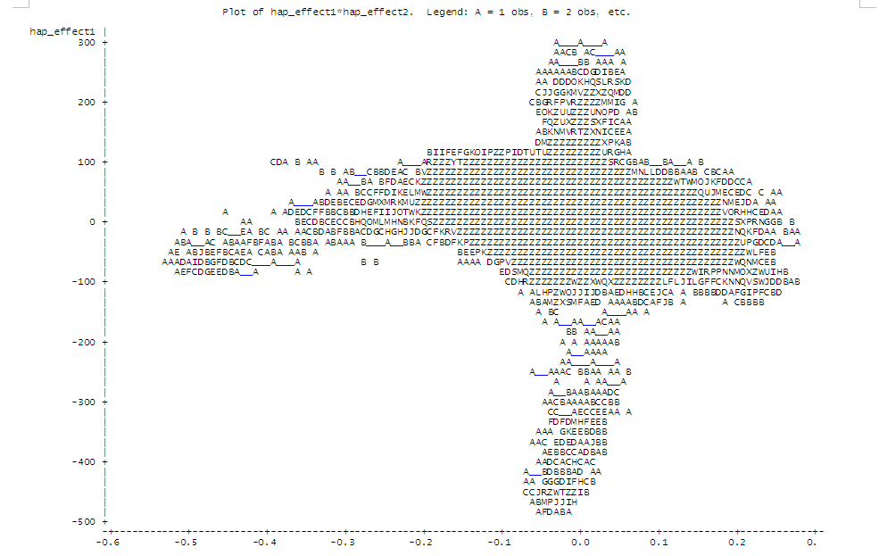
SNP segment correlations Milk with DPR
Unfavorable associations
Favorable associations
Favorable associations
Unfavorable associations

Slide 31
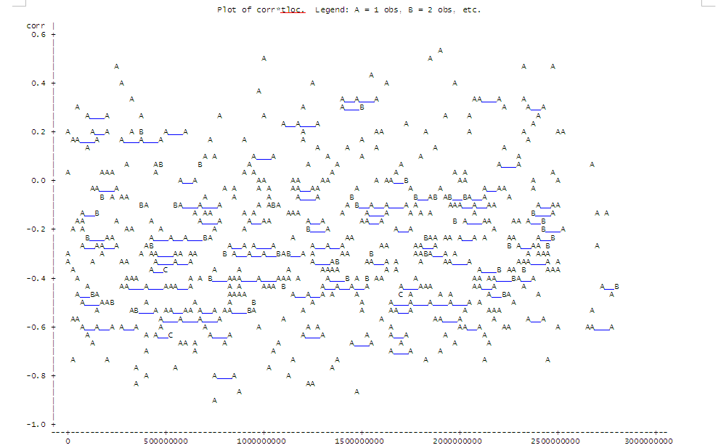
SNP segment correlations Dist’n over genome

Slide 32
Highest correlations for milk and DPR
Obs chrome seg tloc corr
1 18 449 1890311910 0.53090
2 18 438 1845503211 0.51036
3 8 233 990810677 0.49199
4 26 557 2331662169 0.47173
5 2 60 239796003 0.46507
6 29 596 2483178230 0.45252
7 14 366 1544999648 0.43817
8 2 65 269016505 0.41022
9 11 298 1255667282 0.39734
10 20 469 1971347760 0.3919

Slide 33
What can we learn from this?
We are not going to find big QTL
We may identify gene networks affecting complex phenotypes
We’re going to learn how much we don’t know about functional genomics in the cow

Slide 34

Gene set enrichment analysis-SNP
GWAS results
Gene pathways (G)
SNP ranked by significance (L)
Includes all SNP, S, that are included in L
SNP in pathway genes (S)
Score increases for each L_{i} in S
The more SNP in S that appear near the top of L, the higher the Enrichment Score
Score increase is proportional to SNP test statistic
Permutation test and FDR
Nominal p-value corrected for multiple testing
Pathways with moderate effects
Holden et al., 2008 (Bioinformatics 89:1669-1683. doi:10.2527/jas.2010-3681)

Slide 35
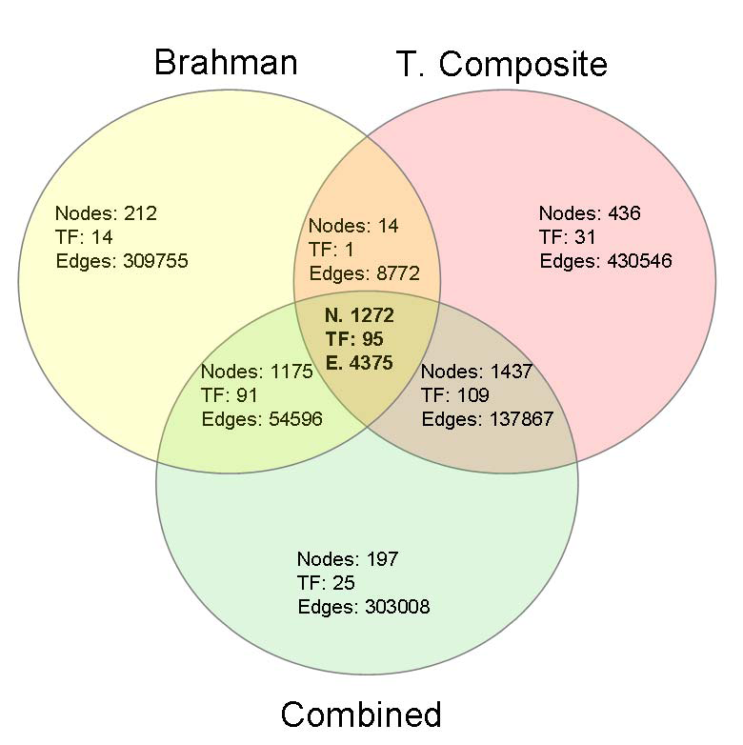
We hope to identify regulatory networks
Candidate genes and pathways that affect age at puberty common to both breeds
Fortes et al., 2011 (J. Animal Sci. 89:1669-1683. doi:10.2527/jas.2010-3681)

Slide 36
Where do we go from here?
Non-additive effects redux?
High-density genotyping versus sequencing
Annotation – will we ever know for sure that all of these genes do?
Gene pathways – we’re all systems biologists now

Slide 37
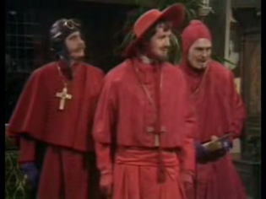
Questions?

