Slide 1
Challenges and successes in dairy cattle genomics

Slide 2
History

Slide 3
Why genomics works in dairy
Extensive historical data available
Well-developed genetic evaluation program
Widespread use of AI sires
Progeny test programs
High valued animals, worth the cost of genotyping
Long generation interval which can be reduced substantially by genomics
Notes:
3

Slide 4
History of genomic evaluations
Dec. 2007 BovineSNP50 BeadChip available
Apr. 2008 First unofficial evaluation released
Jan. 2009 Genomic evaluations official for
        Holstein and Jersey
Aug. 2009 Official for Brown Swiss
Sept. 2010 Unofficial evaluations from 3K chip
released
Dec. 2010 3K genomic evaluations to be official
Sept. 2011 Infinium BovineLD BeadChip available
Notes:
4

Slide 5
Current sources of data
PDCA
NAAB
DHI
AIPL
CDCB
Universities
AIPL Animal Improvement Programs Lab., USDA
CDCB Council on Dairy Cattle Breeding
DHI Dairy Herd Improvement (milk recording organizations)
NAAB National Association of Animal Breeders (AI)
PDCA Purebred Dairy Cattle Association (breed registries)

Slide 6
Sources of genomic data
Requester
(Ex: AI, breeds)
samples
nominations
evaluations
Dairy
producers
Genomic Evaluation Lab
samples
samples
genotypes
DNA
laboratories

Slide 7
Successes

Slide 8
Many animals have been genotyped
Genotypes
Evaluation Date (YYMM)
Notes:
8

Slide 9
Calculation of genomic evaluations
Deregressed values derived from traditional evaluations of predictor animals
Allele substitutions random effects estimated for 45,187 SNP
Polygenic effect estimated for genetic variation not captured by SNP
Selection Index combination of genomic and traditional not included in genomic
Applied to yield, fitness, calving, and type traits

Slide 10
Genetic merit of Jersey bulls
Net Merit ($)
Breeding Year

Slide 11
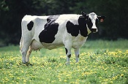
What is a SNP genotype worth?
Pedigree is equivalent to information on about 7 daughters
For the protein yield (h²=0.30), the SNP genotype provides information equivalent to an additional 34 daughters
Notes:
11

Slide 12

What is a SNP genotype worth?
And for daughter pregnancy rate (h²=0.04), SNP = 131 daughters
Notes:
12

Slide 13
Holstein prediction accuracy
Traitª | Bias^{b} | b | REL (%) | REL gain (%)
Milk (kg) | −64.3 | 0.92 | 67.1 | 28.6
Fat (kg) | −2.7 | 0.91 | 69.8 | 31.3
Protein (kg) | 0.7 | 0.85 | 61.5 | 23.0
Fat (%) | 0.0 | 1.00 | 86.5 | 48.0
Protein (%) | 0.0 | 0.90 | 79.0 | 40.4
PL (months) | −1.8 | 0.98 | 53.0 | 21.8
SCS | 0.0 | 0.88 | 61.2 | 27.0
DPR (%) | 0.0 | 0.92 | 51.2 | 21.7
Sire CE | 0.8 | 0.73 | 31.0 | 10.4
Daughter CE | −1.1 | 0.81 | 38.4 | 19.9
Sire SB | 1.5 | 0.92 | 21.8 | 3.7
Daughter SB | − 0.2 | 0.83 | 30.3 | 13.2
a PL=productive life, CE = calving ease and SB = stillbirth.
b 2011 deregressed value – 2007 genomic evaluation.

Slide 14
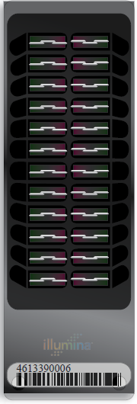
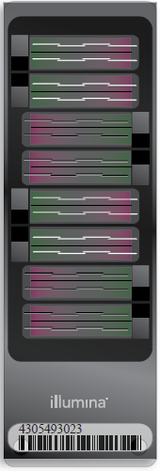

Many chips are available
50KV2
BovineSNP50
  Version 1 54,001 SNP
  Version 2 54,609 SNP
  45,187 used in evaluations
HD
  777,962 SNP
  Only 50K SNP used,
  >1700 in database
LD
  6,909 SNP
  Replaced 3K
HD
LD
Notes:
14

Slide 15
Genotypes and haplotypes
Genotypes indicate how many copies of each allele were inherited
Haplotypes indicate which alleles are on which chromosome
Observed genotypes partitioned into the two unknown haplotypes
  Pedigree haplotyping uses relatives
  Population haplotyping finds matching allele patterns

Slide 16
O-Style Haplotypes Chromosome 15

Slide 17
Haplotyping program – findhap.f90
Begin with population haplotyping
  Divide chromosomes into segments, ~250 to 75 SNP / segment
  List haplotypes by genotype match
  Similar to fastPhase, IMPUTE
End with pedigree haplotyping
  Detect crossover, fix noninheritance
  Impute nongenotyped ancestors

Slide 18
Recessive defect discovery
Check for homozygous haplotypes
  7 to 90 expected but none observed
  5 of top 11 are potentially lethal
  936 to 52,449 carrier sire-by-carrier MGS fertility records
  3.1% to 3.7% lower conception rates
  Some slightly higher stillbirth rates
Confirmed Brachyspina same way

Slide 19
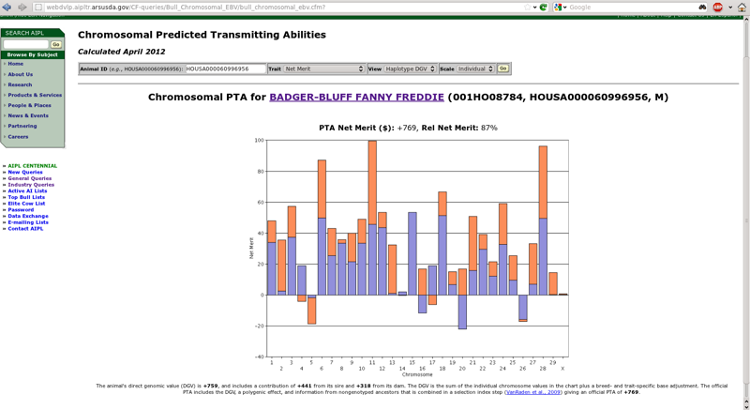
We’re working on new tools
Cole, J.B., and Null, D.J. 2012. AIPL Research Report GENOMIC2: Use of chromosomal predicted transmitting abilities. Available: http://aipl.arsusda.gov/reference/chromosomal_pta_query.html.

Slide 20
Impact on producers
Young-bull evaluations with accuracy of early 1st­crop evaluations
AI organizations marketing genomically evaluated 2-year-olds
Genotype usually required for cow to be bull dam
Rate of genetic improvement likely to increase by up to 50%
Studs reducing progeny-test programs

Slide 21
Challenges

Slide 22
Input costs are rising quickly
Milk:Feed Price Ratio
July 2012 Grain Costs
Soybeans: $15.60/bu (€0.46/kg)
Corn: $ 7.36/bu (€0.23/kg)
Month
M:FP = price of a kg of milk /
price of a kg of a 16%
protein ration

Slide 23
Bias from Pre-Selection
Expected value of Mendelian sampling no longer equal to 0
Key assumption of animal models
References:
  Patry, Ducrocq 2011 GSE 43:30
  Vitezica et al 2011 Genet Res (Camb) pp. 1–10.

Slide 24
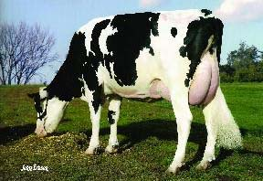
Pre-Selection Bias Now Beginning
Bulls born in 2008, progeny tested in 2009, with daughter records in 2012, were pre-selected:
  3,434 genotyped vs. 1,096 sampled
  Now >10 genotyped per 1 marketed
Potential for bias:
  178 genotyped progeny
  32 sons progeny tested

Slide 25
Methods to Reduce Bias
1-Step to incorporate genotypes
  Flexible models, many recent studies
  Foreign data not yet included
Multi-step GEBV, then insert in AM
  Same trait (Ducrocq and Liu, 2009)
  Or correlated trait (Mantysaari and Stranden, 2010; Stoop et al, 2011)
  Foreign genotyped bulls included

Slide 26
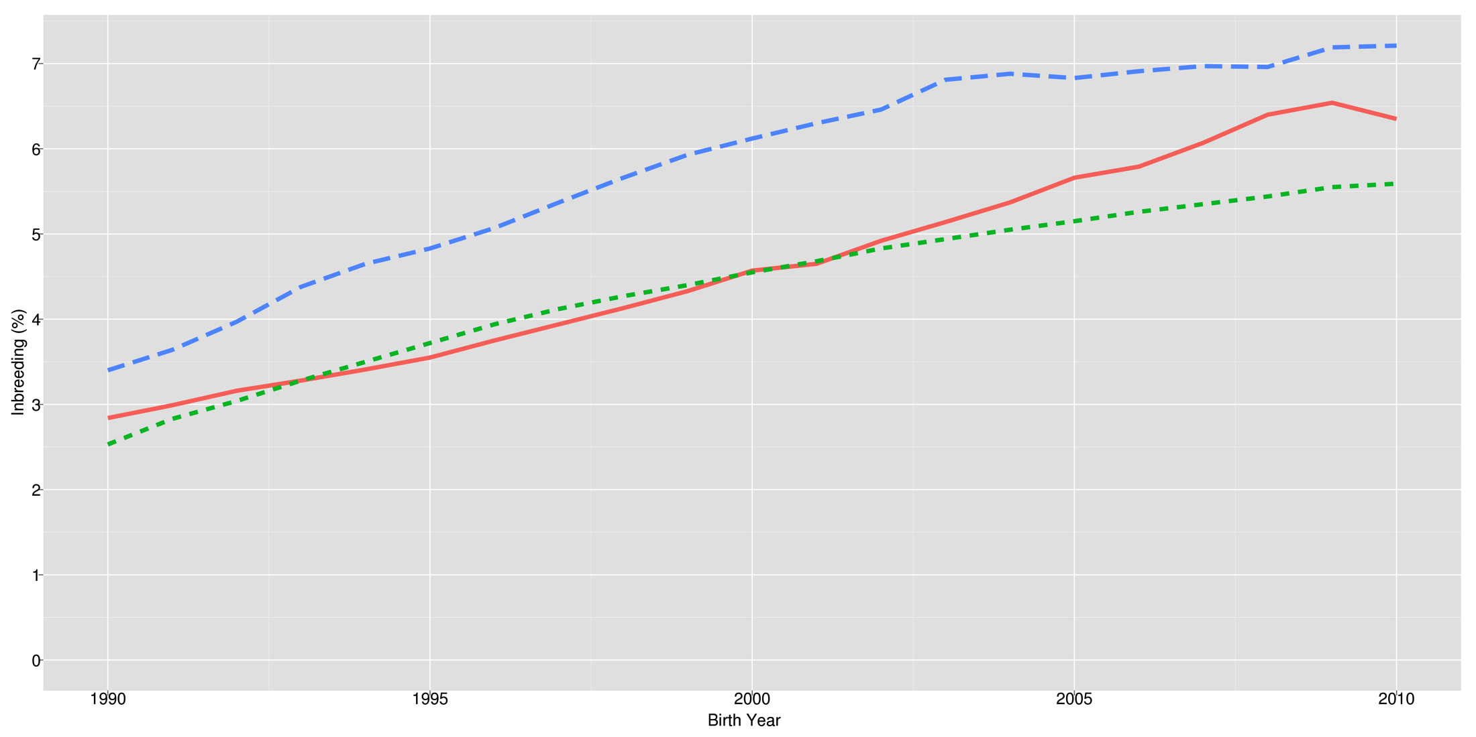
Inbreeding continues to increase
Cole, J.B., and P.M. VanRaden. 2011. Use of haplotyes to estimate Mendelian sampling effects and selection limits. J. Anim. Breed. Genet. 128(6):448-455.

Slide 27
Genomic vs. Pedigree Inbreeding
Bull | Pedigree F |  | Genomic F
O Man | 4.5 |  | 15.8
Ramos | 2.3 |  | 11.5
Shottle | 5.6 |  | 11.9
Planet | 6.7 |  | 18.8
Earnit | 6.2 |  | 12.8
Nifty | 3.1 |  | 11.7
Correlation = .68

Slide 28
Loss-of-function mutations
At least 100 LoF per human genome surveyed (MacArthur et al., 2010)
  Of those genes ~20 are completely inactivated
  Previously uncharacterized LoF variants likely to have phenotypic effects
How can mating programs deal with this?

Slide 29
Unknown phenotypes
Susceptibility to disease
  e.g., Johne’s is difficult to diagnose,
Differential response to management
  Conversion efficiency of different rations
  Response to superovulation
  Resistance to heat stress

Slide 30
Across-breed evaluations
Method 1 estimated SNP effects within breed then applied those effects to the other breeds
Method 2 (across-breed) used a common set of SNP effects from the combined breed genotypes and phenotypes
Method 3 (multi-breed) used a correlated SNP effects using a multi-trait method

Slide 31
Across-breed evaluations - conclusions
Using another breeds SNP estimates did not help
Across-breed method increased the predictive ability, however the traditional GPTA accounted for more variation than the across-breed GPTA
Multi-breed increased the predictive ability and the multi-breed GPTA accounted for more variation than the traditional GPTA

Slide 32
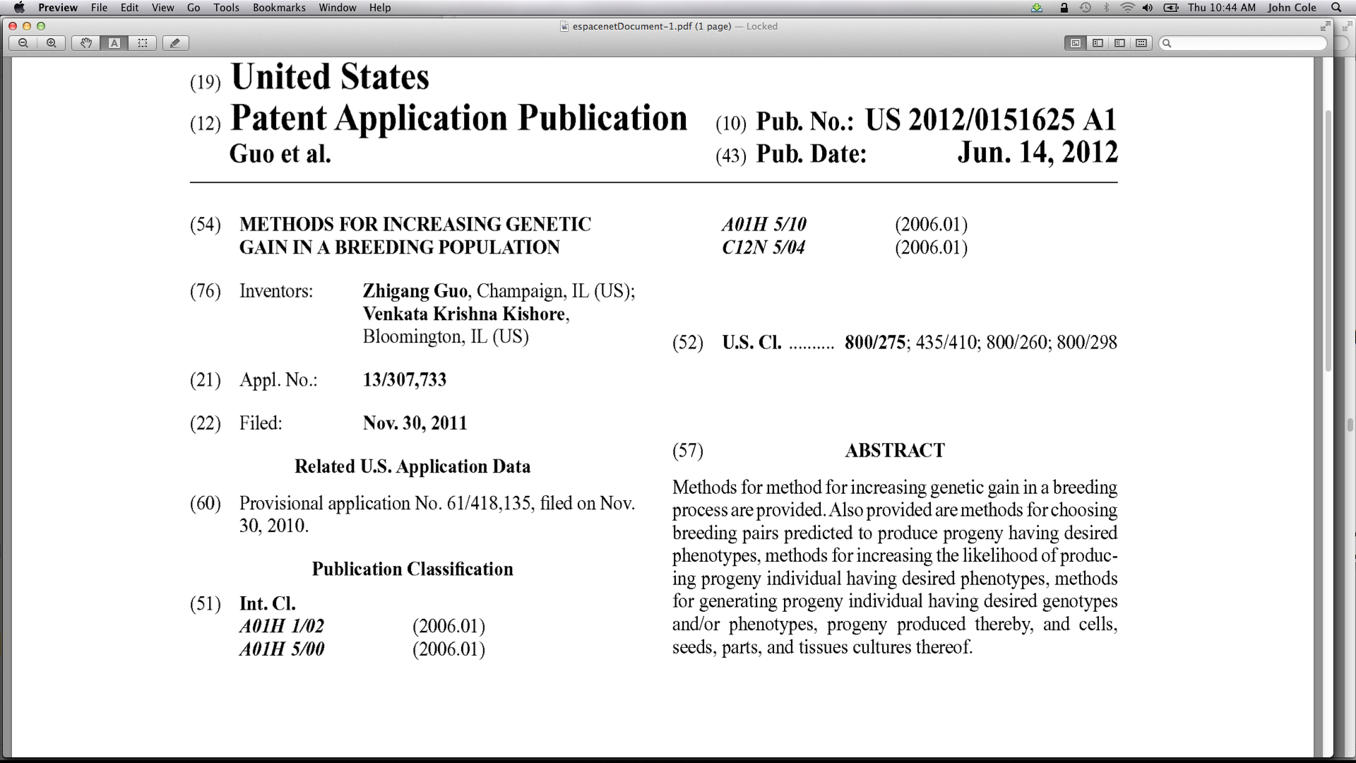
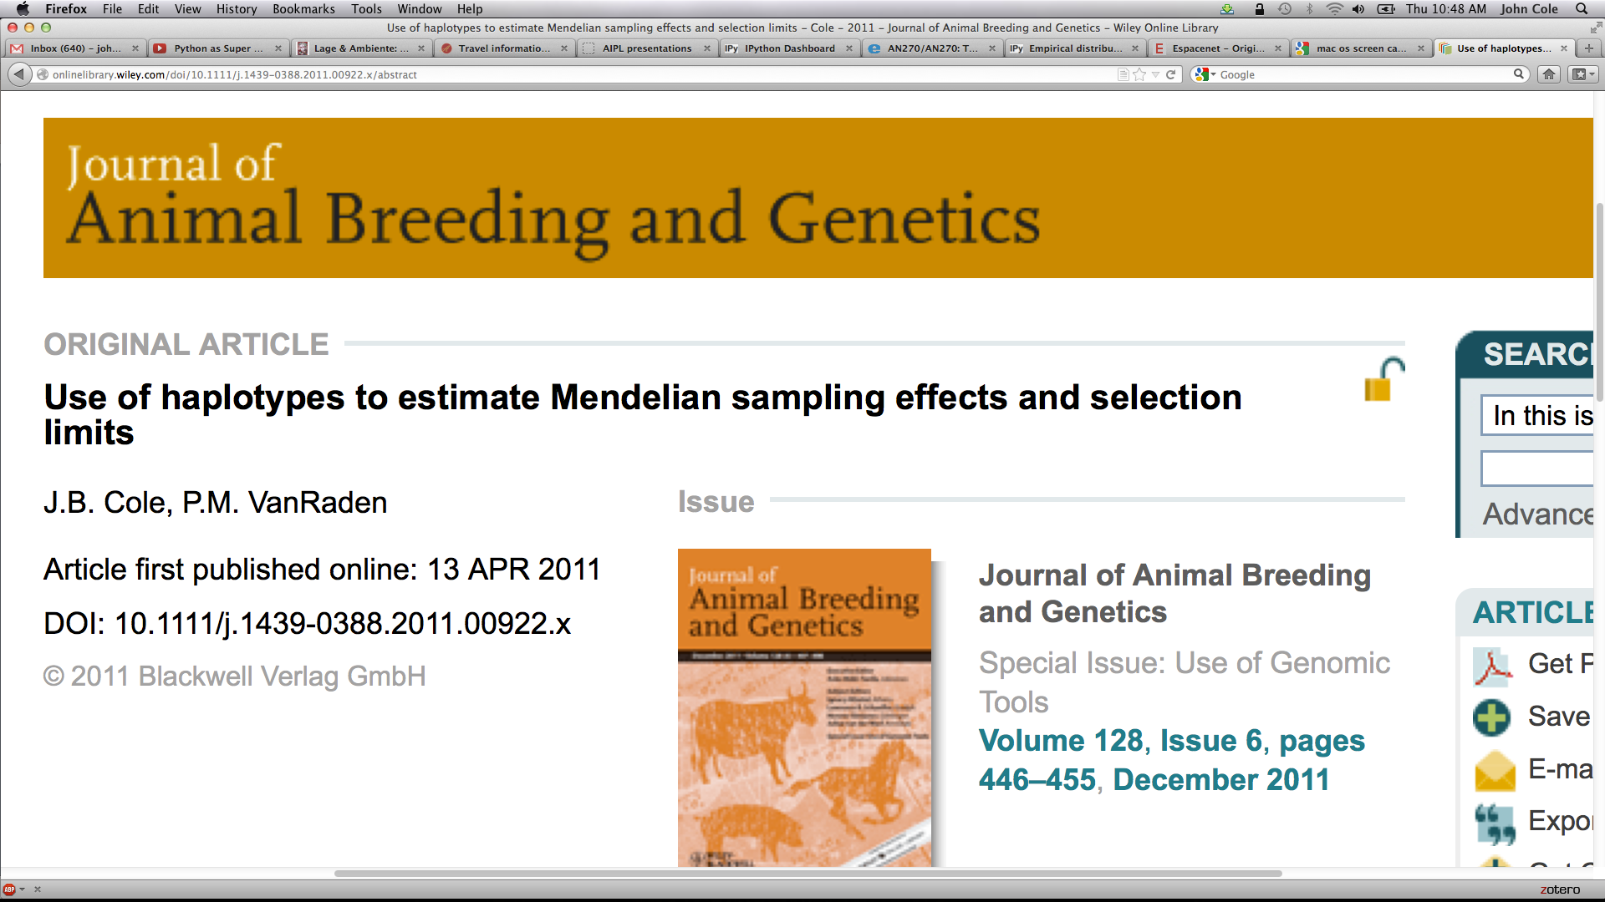
The IP land grab
Provisional US patent filed on
20 NOV 2010 after the
9WCGALP in Leipzig – no
disclosure at that time!
This MS with similar ideas was
submitted 22 SEP 2010 and
published on 12 APR 2011.
Why share?

Slide 33
Conclusions
Genomic selection has been very successful in the dairy industry.
The technology is widely used, and is increasing the rate of genetic progress.
Several challenges remain, particularly pre-selection bias and across-breed genomics.

Slide 34
Acknowledgments
Genotyping and DNA extraction:
  USDA Bovine Functional Genomics Lab, U. Missouri, U. Alberta, GeneSeek, Genetics & IVF Institute, Genetic Visions, and Illumina
Computing:
  AIPL staff (Mel Tooker, Leigh Walton)
Funding:
  National Research Initiative grants
    2006-35205-16888, 2006-35205-16701
  Agriculture Research Service
  Holstein and Jersey breed associations
  Contributors to Cooperative Dairy DNA Repository (CDDR)

Slide 35
CDDR Contributors
National Association of Animal Breeders (NAAB, Columbia, MO)
  ABS Global (DeForest, WI)
  Accelerated Genetics (Baraboo, WI)
  Alta (Balzac, AB, Canada)
  Genex (Shawano, WI)
  New Generation Genetics (Fort Atkinson, WI)
  Select Sires (Plain City, OH)
  Semex Alliance (Guelph, ON, Canada)
  Taurus-Service (Mehoopany, PA)

Slide 36

Questions?

