Slide 1
New Tools for Genomic Selection of Livestock

Slide 2
What else can we with genomic data?
Breeding values are a solved problem
Quantitative Genetics
  Validate theoretical predictions
  Understand genetic variation
Functional Biology
  Fine-map recessives
  Relate phenotypes to genotypes
  Identify important genes in complex systems

Slide 3
Genotyped Holsteins
Date | SNP Estimation* |  |  |  | Young animals** |  |  |  | All animals
 | Bulls |  | Cows |  | Bulls |  | Heifers
04-10 | 9,770 |  | 7,415 |  | 16,007 |  | 8,630 |  | 41,822
08-10 | 10,430 |  | 9,372 |  | 18,652 |  | 11,021 |  | 49,475
12-10 | 11,293 |  | 12,825 |  | 21,161 |  | 18,336 |  | 63,615
04-11 | 12,152 |  | 11,224 |  | 25,202 |  | 36,545 |  | 85,123
08-11 | 16,519 |  | 14,380 |  | 29,090 |  | 52,053 |  | 112,042
09-11 | 16,812 |  | 14,415 |  | 30,185 |  | 56,559 |  | 117,971
10-11 | 16,832 |  | 14,573 |  | 31,865 |  | 61,045 |  | 124,315
11-11 | 16,834 |  | 14,716 |  | 32,975 |  | 65,330 |  | 129,855
12-11 | 17,288 |  | 17,236 |  | 33,861 |  | 68,051 |  | 136,436
01-12 | 17,681 |  | 17,418 |  | 35,404 |  | 74,072 |  | 144,575
02-12 | 17,710 |  | 17,679 |  | 36,597 |  | 80,845 |  | 152,831
*Traditional evaluation **No traditional evaluation

Slide 4
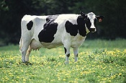
What is a SNP genotype worth?
Pedigree is equivalent to information on about 7 daughters
For the protein yield (h²=0.30), the SNP genotype provides information equivalent to an additional 34 daughters
Notes:
4

Slide 5

What is a SNP genotype worth?
And for daughter pregnancy rate (h²=0.04), SNP = 131 daughters
Notes:
5

Slide 6
Genotypes and haplotypes
Genotypes indicate how many copies of each allele were inherited
Haplotypes indicate which alleles are on which chromosome
Observed genotypes partitioned into the two unknown haplotypes
  Pedigree haplotyping uses relatives
  Population haplotyping finds matching allele patterns

Slide 7
Filling missing genotypes
Predict unknown SNP from known
  Measure 3,000, predict 43,000 SNP
  Measure 50,000, predict 500,000
  Measure each haplotype at highest density only a few times
Predict dam from progeny SNP
Increase reliabilities for less cost

Slide 8
Imputation
Identify haplotypes in population using many markers
Track haplotypes with fewer markers
e.g., use 5 SNP to track 25 SNP
  5 SNP: 22020
  25 SNP: 2022020002002002000202200

Slide 9
Haplotyping program – findhap.f90
Begin with population haplotyping
  Divide chromosomes into segments, ~250 to 75 SNP / segment
  List haplotypes by genotype match
  Similar to fastPhase, IMPUTE
End with pedigree haplotyping
  Detect crossover, fix noninheritance
  Impute nongenotyped ancestors

Slide 10
O-Style Haplotypes Chromosome 15

Slide 11
Recessive defect discovery
Check for homozygous haplotypes
  7 to 90 expected but none observed
  5 of top 11 are potentially lethal
  936 to 52,449 carrier sire by carrier MGS fertility records
  3.1% to 3.7% lower conception rates
  Some slightly higher stillbirth rates
Confirmed Brachyspina same way

Slide 12
Potential recessive lethals
Name | Chrom-osome | Loca-tion | Carrier Freq | Source Ancestors
 | BTA | Mbase | %
HH1 | 5 | 58-66 | 4.5 | Pawnee Farm Arlinda Chief
HH2 | 1 | 92-97 | 4.6 | Willowholme Mark Anthony
HH3 | 8 | 90-95 | 4.7 | Glendell Arlinda Chief, Gray View Skyliner
JH1 | 15 | 13-18 | 23.4 | Observer Chocolate Soldier
BH1 | 7 | 41-47 | 14.0 | West Lawn Stretch Improver

Slide 13
Predicted Mendelian sampling variance
Trait | Breed | Lower | Expected | Upper
DPR | BS | 0.09 | 1.45 | 1.57
 | HO | 0.57 | 1.45 | 4.02
 | JE | 0.09 | 0.98 | 1.27
Milk | BS | 35,335 | 215,168 | 507,076
 | HO | 228,011 | 261,364 | 1,069,741
 | JE | 150,076 | 205,440 | 601,979
NM$ | BS | 2,539 | 19,602 | 40,458
 | HO | 16,601 | 19,602 | 87,449
 | JE | 3,978 | 19,602 | 44,552

Slide 14
Predicted selection limits
Trait | Breed | Lower | Upper | Largest DGV
DPR | BS | 20 | 53 | 8
 | HO | 40 | 139 | 8
 | JE | 19 | 53 | 5
Milk | BS | 14,193 | 34,023 | 4,544
 | HO | 24,883 | 77,923 | 7,996
 | JE | 16,133 | 40,249 | 5,620
NM$ | BS | 3,857 | 9,140 | 1,102
 | HO | 7,515 | 23,588 | 2,528
 | JE | 4,678 | 11,517 | 1,556

Slide 15
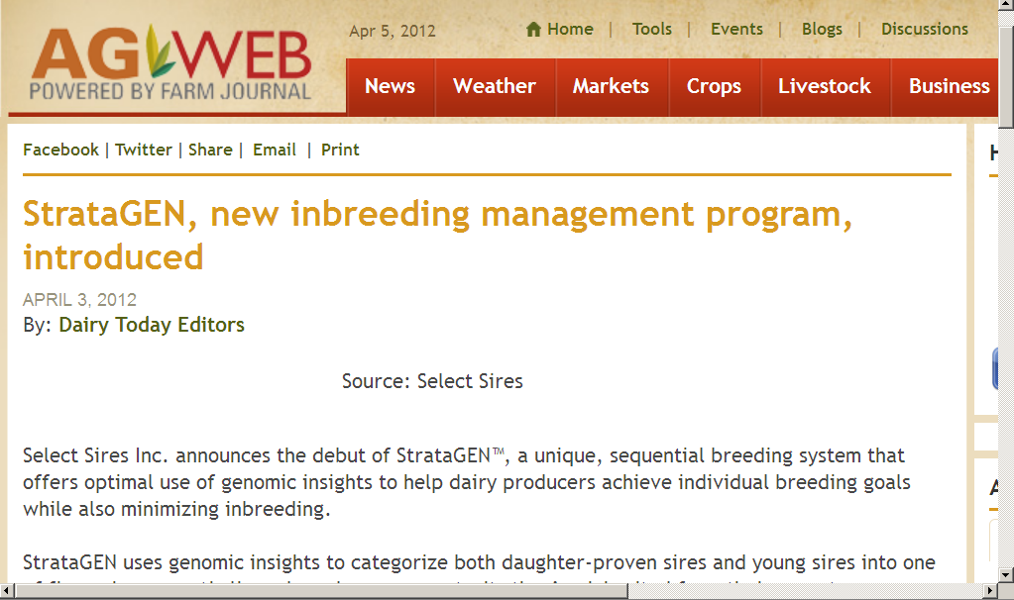
Our industry wants new genomic tools

Slide 16
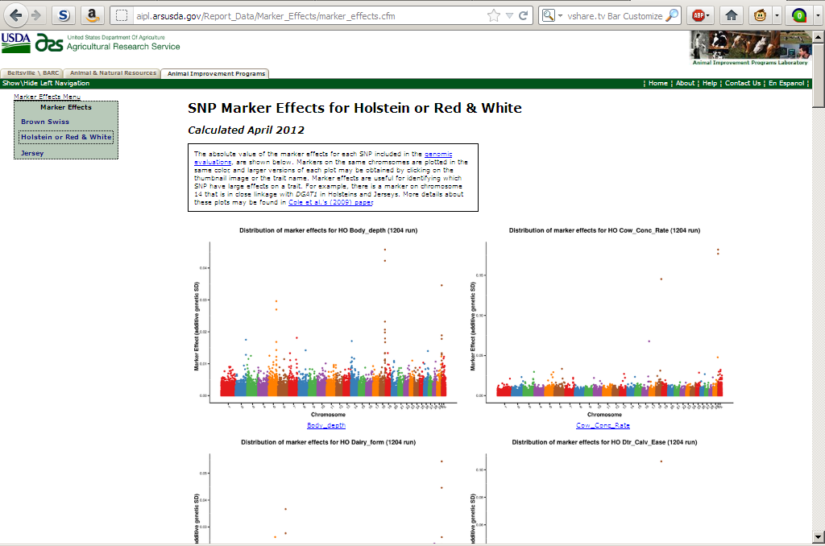
We already have some tools
http://aipl.arsusda.gov/Report_Data/Marker_Effects/marker_effects.cfm

Slide 17
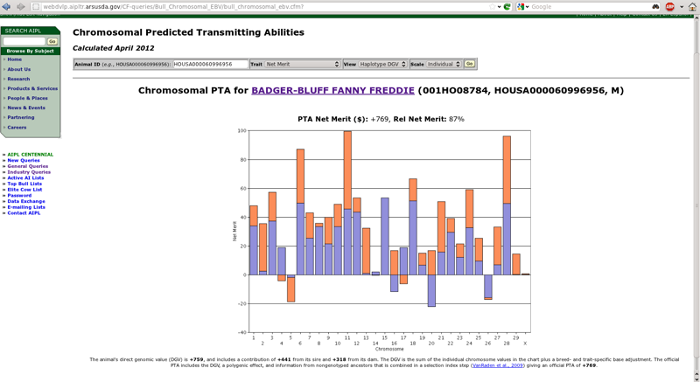
New chromosomal DGV query

Slide 18
Paternal and maternal DGV
Shows the DGV for the paternal and maternal haplotyles
  Imputed from 50K using findhap.f90 v.2
Can we use them to make mating decisions?
  People are going to do it – we need to help them

Slide 19
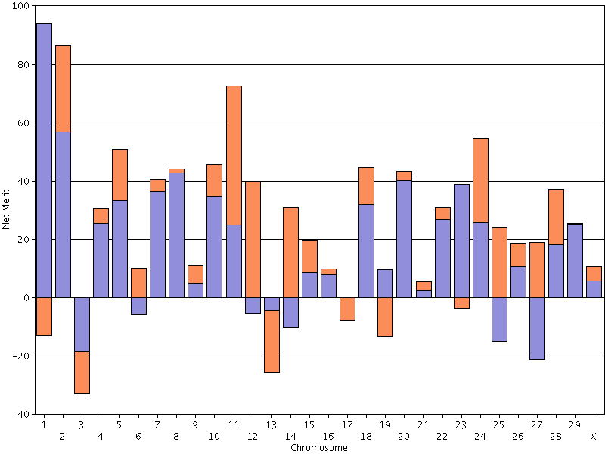
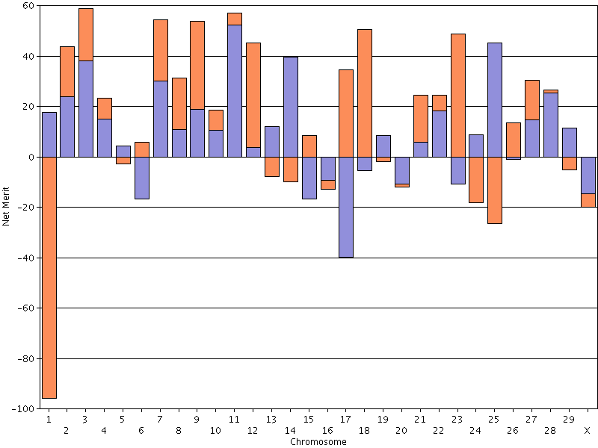
The good and the bad Chromosome 1

Slide 20
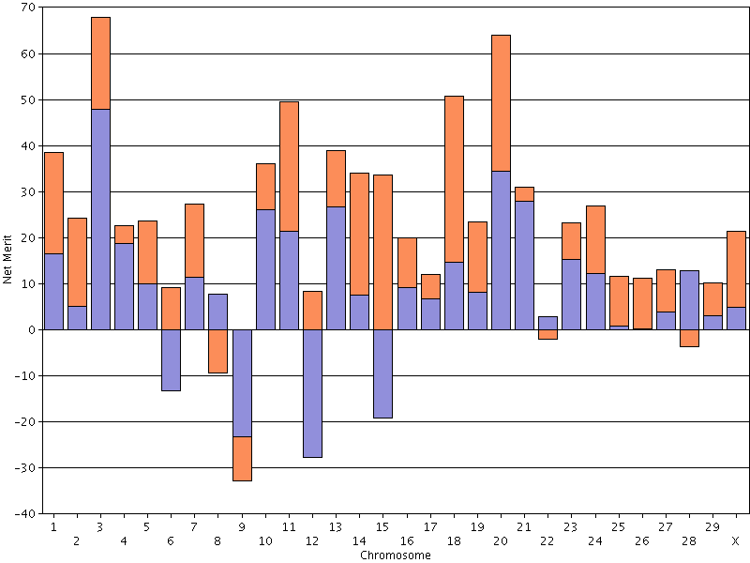
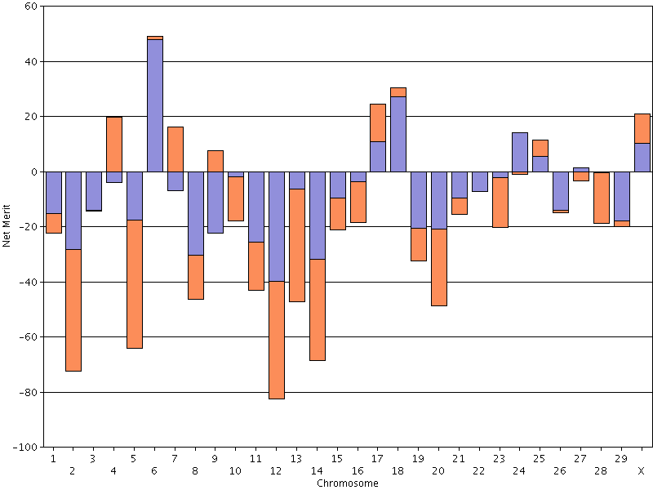
Pluses and minuses
23 positive chromosomes
19 negative chromosomes

Slide 21
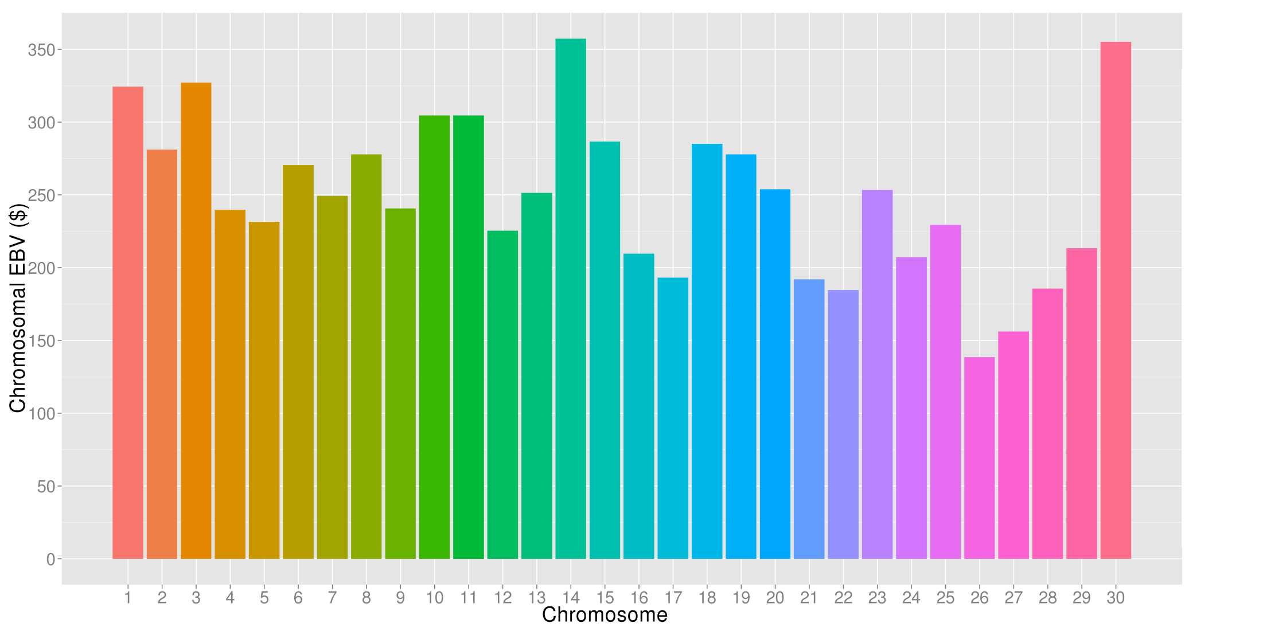
What’s the best cow we can make?
A “Supercow” constructed from the best haplotypes in the Holstein population would have an PTA(NM$) of $3,757

Slide 22
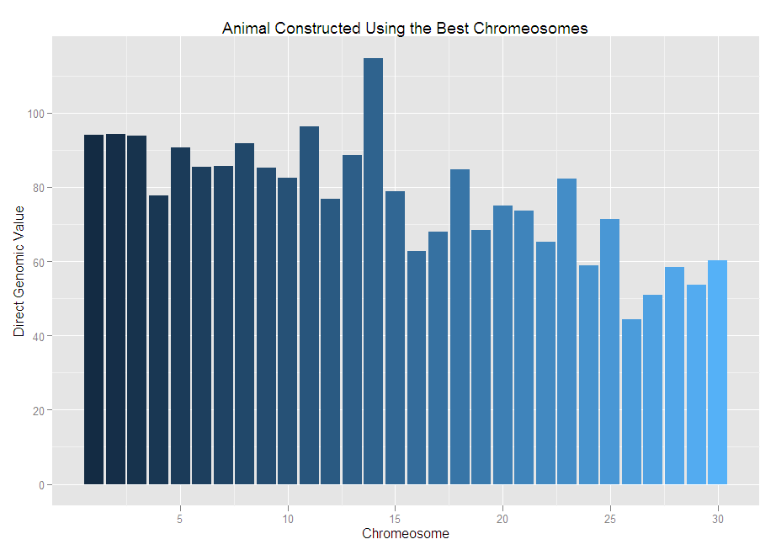
The best we can do DGV for NM$ = +2,314

Slide 23
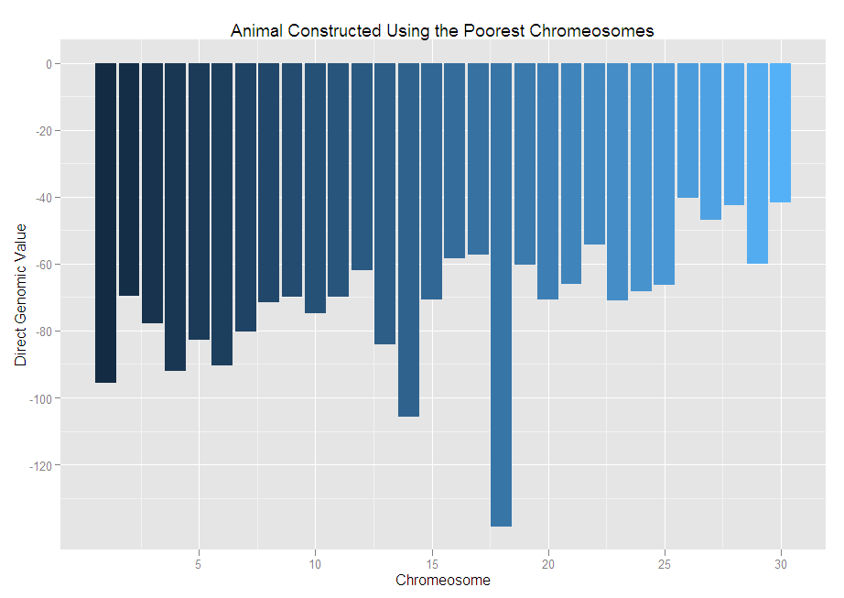
The worst we can do DGV for NM$ = -2,139

Slide 24
Indices change over time
Trait | Relative emphasis on traits in index (%)
 | PD$ 1971 | MFP$ 1976 | CY$ 1984 | NM$ 1994 | NM$ 2000 | NM$ 2003 | NM$ 2006 | NM$ 2010
Milk | 52 | 27 | –2 | 6 | 5 | 0 | 0 | 0
Fat | 48 | 46 | 45 | 25 | 21 | 22 | 23 | 19
Protein | … | 27 | 53 | 43 | 36 | 33 | 23 | 16
PL | … | … | … | 20 | 14 | 11 | 17 | 22
SCS | … | … | … | –6 | –9 | –9 | –9 | –10
UDC | … | … | … | … | 7 | 7 | 6 | 7
FLC | … | … | … | … | 4 | 4 | 3 | 4
BDC | … | … | … | … | –4 | –3 | –4 | –6
DPR | … | … | … | … | … | 7 | 9 | 11
SCE | … | … | … | … | … | –2 | … | …
DCE | … | … | … | … | … | –2 | … | …
CA$ | … | … | … | … | … | … | 6 | 5

Slide 25
Genetic-economic indices 2010 revision
Trait | Relative value (%)
 | Net merit | Cheese merit | Fluid merit
Milk (lb) | 0 | –15 | 19
Fat (lb) | 19 | 13 | 20
Protein (lb) | 16 | 25 | 0
Productive life (PL, mo) | 22 | 15 | 22
Somatic cell score (SCS, log₂) | –10 | –9 | –5
Udder composite (UC) | 7 | 5 | 7
Feet/legs composite (FLC) | 4 | 3 | 4
Body size composite (BSC) | –6 | –4 | –6
Daughter pregnancy rate (DPR, %) | 11 | 8 | 12
Calving ability (CA$, $) | 5 | 3 | 5

Slide 26
What does it mean to be the worst?
Large body size
  Eats a lot
Average fertility
Begin first lactation with dystocia
  Bull calf
  Metritis
Adequate production

Slide 27
Dissecting genetic correlations
Compute DGV for 75-SNP segments
Calculate correlations of DGV for traits of interest for each segment
Is there interesting biology associated with favorable correlations?

Slide 28
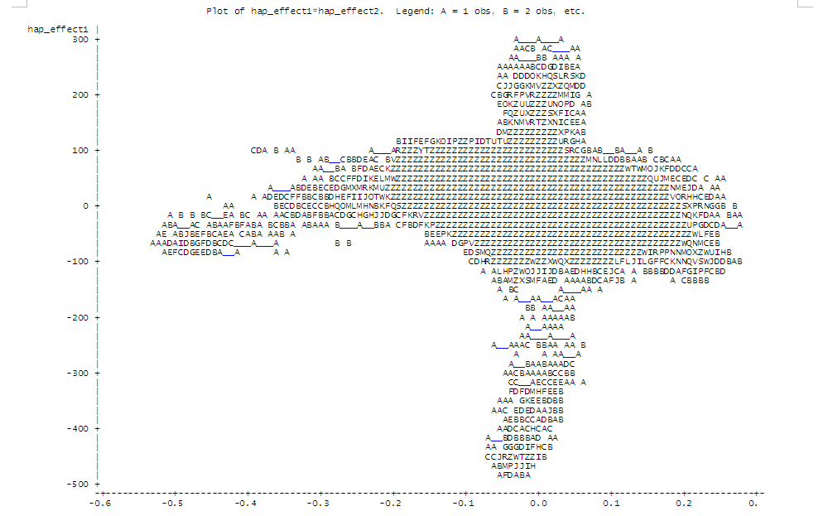
SNP segment correlations Milk with DPR
Unfavorable associations
Favorable associations
Favorable associations
Unfavorable associations

Slide 29
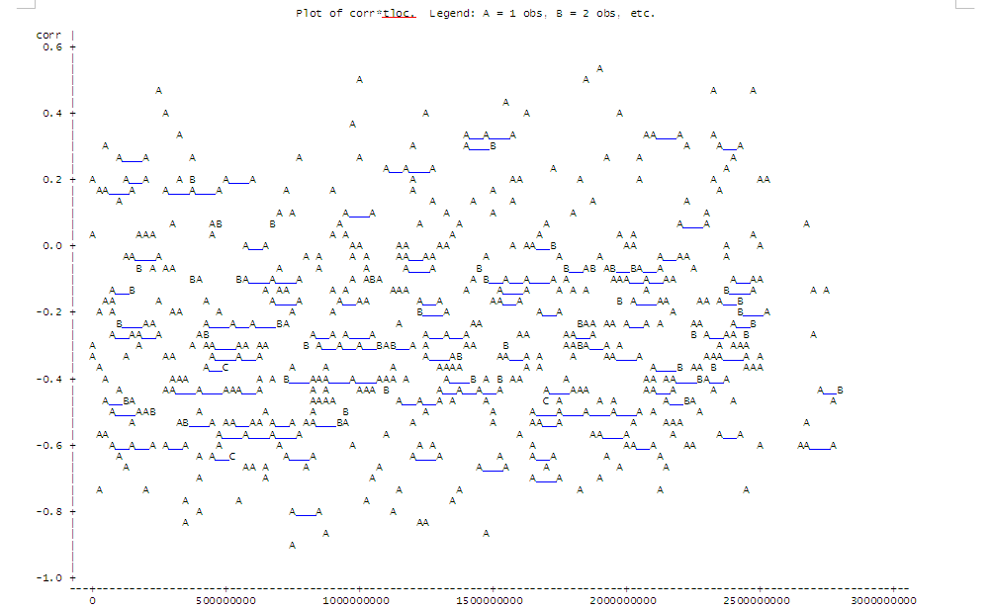
SNP segment correlations Dist’n over genome

Slide 30
Highest correlations for milk and DPR
Obs chrome seg tloc corr
1 18 449 1890311910 0.53090
2 18 438 1845503211 0.51036
3 8 233 990810677 0.49199
4 26 557 2331662169 0.47173
5 2 60 239796003 0.46507
6 29 596 2483178230 0.45252
7 14 366 1544999648 0.43817
8 2 65 269016505 0.41022
9 11 298 1255667282 0.39734
10 20 469 1971347760 0.3919

Slide 31

Gene set enrichment analysis-SNP
GWAS results
Gene pathways (G)
SNP ranked by significance (L)
Includes all SNP, S, that are included in L
SNP in pathway genes (S)
Score increases for each L_{i} in S
The more SNP in S that appear near the top of L, the higher the Enrichment Score
Score increase is proportional to SNP test statistic
Permutation test and FDR
Nominal p-value corrected for multiple testing
Pathways with moderate effects
Holden et al., 2008 (Bioinformatics 89:1669-1683. doi:10.2527/jas.2010-3681)

Slide 32
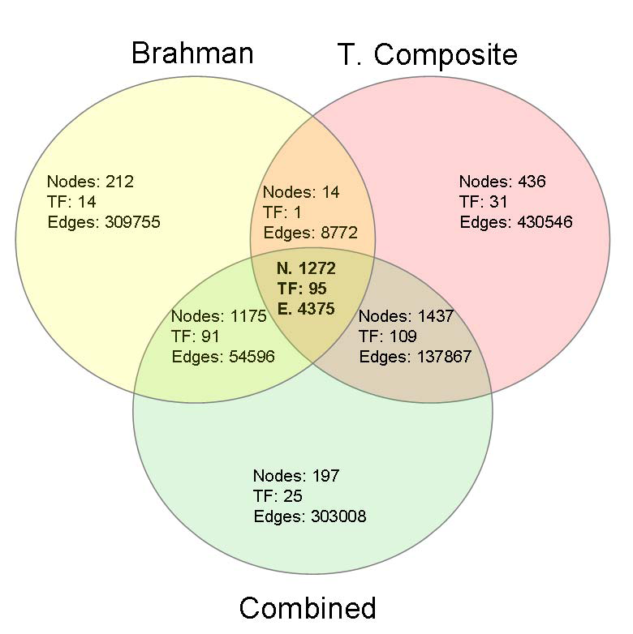
We hope to identify regulatory networks
Candidate genes and pathways that affect age at puberty common to both breeds
Fortes et al., 2011 (J. Animal Sci. 89:1669-1683. doi:10.2527/jas.2010-3681)

Slide 33
We have divergent populations
Cole et al., 2005 (J. Dairy Sci. 88(4):1529–1539)

Slide 34
What can we learn from this?
We are not going to find big QTL
We may identify gene networks affecting complex phenotypes
We’re going to learn how much we don’t know about functional genomics in the cow

Slide 35
Where do we go from here?
Non-additive effects redux?
High-density genotyping versus sequencing
Annotation – will we ever know for sure that all of these genes do?
Gene pathways – we’re all systems biologists now

Slide 36
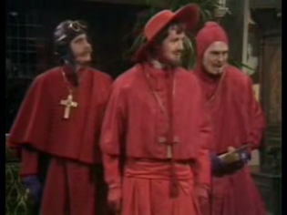
Questions?

