Slide 1
The U.S. genetic evaluation system

Slide 2
U.S. dairy population and milk yield

Slide 3
U.S. DHI dairy statistics (2011)
9.1 million U.S. cows
~75% bred AI
47% milk recorded through Dairy Herd Information (DHI)
  4.4 million cows
    86% Holstein
    8% crossbred
    5% Jersey
    <1% Ayrshire, Brown Swiss, Guernsey, Milking Shorthorn, Red & White
  20,000 herds
  220 cows/herd
  10,300 kg/cow

Slide 4
Dairy genetic evaluation program
PDCA
NAAB
DHI
AIPL
CDCB
Universities
AIPL Animal Improvement Programs Lab., USDA
CDCB Council on Dairy Cattle Breeding
DHI Dairy Herd Information (milk recording organizations)
NAAB National Association of Animal Breeders (AI)
PDCA Purebred Dairy Cattle Association (breed registries)

Slide 5
Traditional data flow
Milk testing laboratory
milk samples
DHI herd
component
percentage
somatic
cell score
test-day data
registered
pedigree data
management reports
registered pedigree data
Dairy records processing center
Breed
association
lactation records
genetic
evaluations
registered
pedigree data
grade pedigree data,
genetic evaluations
test-day data,
pedigree data,
breeding data
AIPL
bull status
AI
organization
genetic
evaluations

Slide 6
Genetic evaluation advances
Year | Advance | Gain, %
1862 | USDA established
1895 | USDA begins collecting dairy records
1926 | Daughter-dam comparison | 100
1962 | Herdmate comparison | 50
1973 | Records in progress | 10
1974 | Modified contemporary comparison | 5
1977 | Protein evaluated | 4
1989 | Animal model | 4
1994 | Net merit, productive life, and somatic cell score | 50
2008 | Genomic selection | >50

Slide 7
Animal model
1989 – present
Introduced by George Wiggans and Paul VanRaden
Advantages
  Information from all relatives
  Adjustment for genetic merit of mates
  Uniform procedures for males and females
  Best prediction (BLUP)
  Crossbreds included (2007)

Slide 8
Dairy cattle traits evaluated by USDA
Year | Trait | Year | Trait
1926 | Milk & fat yields | 2000 | Calving ease¹
1978 | Conformation (type) | 2003 | Daughter pregnancy rate
1978 | Protein yield | 2006 | Stillbirth rate
1994 | Productive life | 2006 | Bull conception rate²
1994 | Somatic cell score (mastitis) | 2009 | Cow and heifer conception rates
¹Sire calving ease evaluated by Iowa State University (1978–99)
²Estimated relative conception rate evaluated by DRMS@Raleigh
(1986–2005)

Slide 9
Evaluation methods for traits
Animal model (linear)
  Yield (milk, fat, protein)
  Type (Ayrshire, Brown Swiss, Guernsey, Jersey)
  Productive life
  Somatic cell score
  Daughter pregnancy rate
Heritability
25 – 40%
7 – 54%
8.5%
12%
4%
Sire – maternal grandsire model (threshold)
  Service sire calving ease
  Daughter calving ease
  Service sire stillbirth rate
  Daughter stillbirth rate
8.6%
3.6%
3.0%
6.5%

Slide 10
Type traits
Stature
Strength
Body depth
Dairy form
Rump angle
Thurl width
Rear legs (side)
Rear legs (rear)
Foot angle
Feet and legs score
Fore udder attachment
Rear udder height
Rear udder width
Udder cleft
Udder depth
Front teat placement
Rear teat placement
Teat length

Slide 11
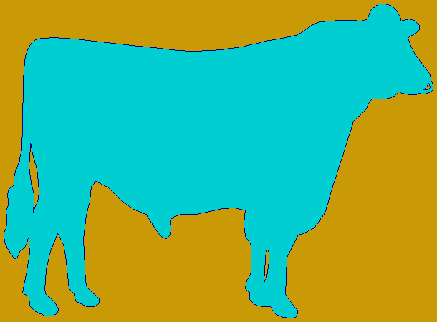

Genetic trend – Holstein milk
Phenotypic base = 11,828 kg
Sires
79 kg/yr
Cows

Slide 12
Genetic trend – Holstein fat
Phenotypic base = 432 kg
Sires
2.7 kg/yr
Cows

Slide 13
Genetic trend – Holstein protein
Phenotypic base = 356 kg
Sires
2.6 kg/yr
Cows

Slide 14
Genetic trend – Holstein productive life
Phenotypic base = 27.2 mo
0.2 mo/yr
Sires
Cows

Slide 15
Genetic trend – Holstein somatic cell score
Sires
Phenotypic base = 3.0
Cows
0.02/yr

Slide 16
Genetic trend – Holstein daughter pregnancy rate
Cows
Sires
0.1%/yr
Phenotypic base = 22.6%

Slide 17
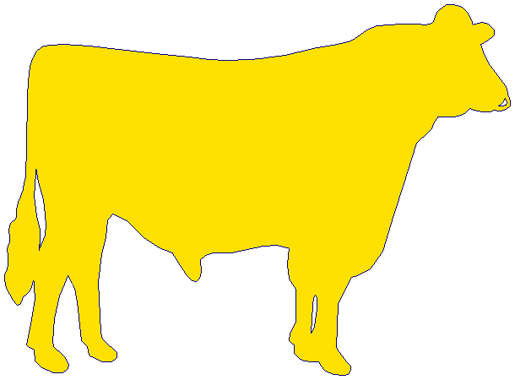
Genetic trend – Holstein calving ease
Daughter
0.18%/yr
Service-sire
phenotypic base = 7.9%
Service
sire
Daughter
phenotypic base = 7.5%
0.01%/yr

Slide 18
Genetic trend – Holstein stillbirth rate
Daughter
0.10%/yr
Service-sire
phenotypic base = 8.1%
Service
sire
0.04%/yr
Daughter
phenotypic base = 7.3%

Slide 19
Genetic-economic indices (2010)
Trait | Relative value (%)
 | Net merit | Cheese merit | Fluid merit
Milk (lb) | 0 | –15 | 19
Fat (lb) | 19 | 13 | 20
Protein (lb) | 16 | 25 | 0
Productive life (PL, mo) | 22 | 15 | 22
Somatic cell score (SCS, log₂) | –10 | –9 | –5
Udder composite (UC) | 7 | 5 | 7
Feet/legs composite (FLC) | 4 | 3 | 4
Body size composite (BSC) | –6 | –4 | –6
Daughter pregnancy rate (DPR, %) | 11 | 8 | 12
Calving ability (CA$, $) | 5 | 3 | 5

Slide 20
Index changes
Trait | Relative emphasis on traits in index (%)
 | PD$ 1971 | MFP$ 1976 | CY$ 1984 | NM$ 1994 | NM$ 2000 | NM$ 2003 | NM$ 2006 | NM$ 2010
Milk | 52 | 27 | –2 | 6 | 5 | 0 | 0 | 0
Fat | 48 | 46 | 45 | 25 | 21 | 22 | 23 | 19
Protein | … | 27 | 53 | 43 | 36 | 33 | 23 | 16
PL | … | … | … | 20 | 14 | 11 | 17 | 22
SCS | … | … | … | –6 | –9 | –9 | –9 | –10
UDC | … | … | … | … | 7 | 7 | 6 | 7
FLC | … | … | … | … | 4 | 4 | 3 | 4
BDC | … | … | … | … | –4 | –3 | –4 | –6
DPR | … | … | … | … | … | 7 | 9 | 11
SCE | … | … | … | … | … | –2 | … | …
DCE | … | … | … | … | … | –2 | … | …
CA$ | … | … | … | … | … | … | 6 | 5

Slide 21
Traditional evaluation summary
Evaluation procedures have improved
Fitness traits have been added
Effective selection has produced substantial annual genetic improvement
Indexes enable selection for overall economic merit
Fertility evaluations prevent continued decline
USDA serves the dairy industry with reliable evaluations and research to improve procedures

Slide 22
Genomic evaluation system
Provides timely evaluations of young bulls for purchasing decisions
Increases accuracy of evaluations of bull dams
Assists in selection of service sires, particularly for low-reliability traits
High demand for semen from genomically evaluated 2-year-old bulls

Slide 23
Genomic data flow
DHI herd
DNA samples
DNA samples
genomic
evaluations
DNA laboratory
DNA samples
AI organization, breed association
genotypes
genotype
quality reports
nominations,
pedigree data
genotypes
genomic
evaluations
AIPL

Slide 24


Illumina genotyping arrays
BovineSNP50
  54,001 SNPs (version 1)
  54,609 SNPs (version 2)
  45,187 SNPs used in evaluation
BovineHD
  777,962 SNPs
  Only BovineSNP50 SNPs used
  >1,700 SNPs in database
BovineLD
  6,909 SNPs
  Allows for additional SNPs
BovineSNP50 v2
BovineHD
BovineLD
Notes:
24

Slide 25
Genotyped bulls

Slide 26
Genotyped Holsteins
Date | SNP Estimation* |  |  |  | Young animals** |  |  |  | All animals
 | Bulls |  | Cows |  | Bulls |  | Heifers
04-10 | 9,770 |  | 7,415 |  | 16,007 |  | 8,630 |  | 41,822
08-10 | 10,430 |  | 9,372 |  | 18,652 |  | 11,021 |  | 49,475
12-10 | 11,293 |  | 12,825 |  | 21,161 |  | 18,336 |  | 63,615
04-11 | 12,152 |  | 11,224 |  | 25,202 |  | 36,545 |  | 85,123
08-11 | 16,519 |  | 14,380 |  | 29,090 |  | 52,053 |  | 112,042
09-11 | 16,812 |  | 14,415 |  | 30,185 |  | 56,559 |  | 117,971
10-11 | 16,832 |  | 14,573 |  | 31,865 |  | 61,045 |  | 124,315
11-11 | 16,834 |  | 14,716 |  | 32,975 |  | 65,330 |  | 129,855
12-11 | 17,288 |  | 17,236 |  | 33,861 |  | 68,051 |  | 136,436
01-12 | 17,681 |  | 17,418 |  | 35,404 |  | 74,072 |  | 144,575
02-12 | 17,710 |  | 17,679 |  | 36,597 |  | 80,845 |  | 152,831
*Traditional evaluation **No traditional evaluation

Slide 27
Calculation of genomic evaluations
Deregressed values derived from traditional evaluations of predictor animals
Random allele substitution effects estimated for 45,187 SNP (Bayes A)
A polygenic effect accounts for genetic variation not explained by SNP
Selection index combines genomic and traditional information not included in genomic
Applied to yield, fitness, calving, and type traits

Slide 28
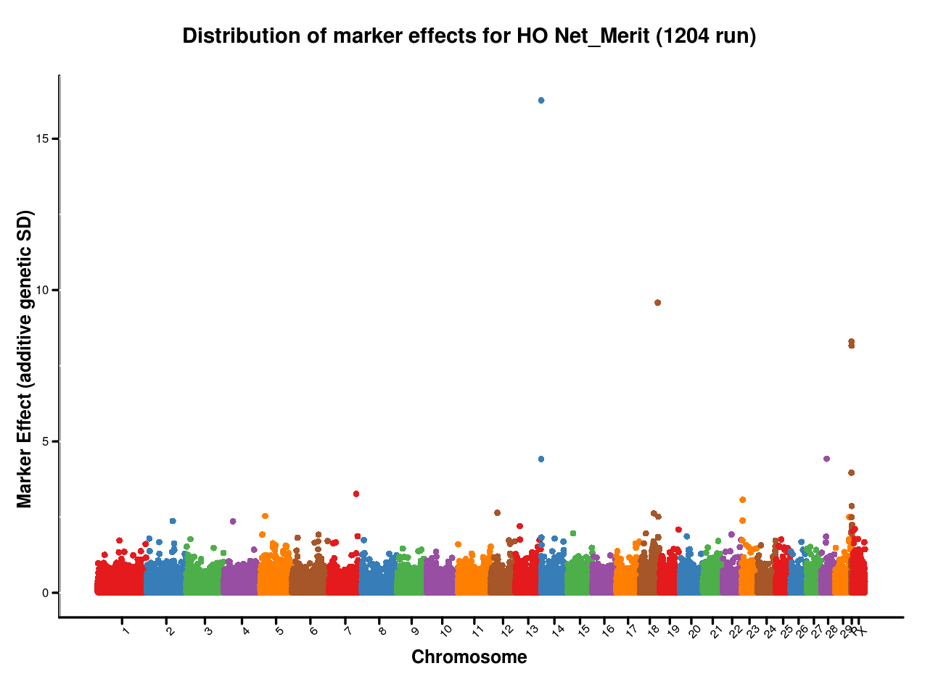
Genomic evaluation results

Slide 29
Holstein prediction accuracy
Traitª | Bias^{b} | b | REL (%) | REL gain (%)
Milk (kg) | −64.3 | 0.92 | 67.1 | 28.6
Fat (kg) | −2.7 | 0.91 | 69.8 | 31.3
Protein (kg) | 0.7 | 0.85 | 61.5 | 23.0
Fat (%) | 0.0 | 1.00 | 86.5 | 48.0
Protein (%) | 0.0 | 0.90 | 79.0 | 40.4
PL (months) | −1.8 | 0.98 | 53.0 | 21.8
SCS | 0.0 | 0.88 | 61.2 | 27.0
DPR (%) | 0.0 | 0.92 | 51.2 | 21.7
Sire CE | 0.8 | 0.73 | 31.0 | 10.4
Daughter CE | −1.1 | 0.81 | 38.4 | 19.9
Sire SB | 1.5 | 0.92 | 21.8 | 3.7
Daughter SB | − 0.2 | 0.83 | 30.3 | 13.2
a PL=productive life, CE = calving ease and SB = stillbirth.
b 2011 deregressed value – 2007 genomic evaluation.

Slide 30
Reliabilities for young Holsteins*
9000
50K genotypes
8000
3K genotypes
7000
6000
5000
Number of animals
4000
3000
2000
1000
0
40
45
50
55
60
65
70
75
80
Reliability for PTA protein (%)
*Animals with no traditional PTA in April 2011

Slide 31
Life cycle of bull
Parents selected
Dam inseminated
  Embryo
  transferred
  to recipient
  Bull born
  Genomic test
Semen collected (1 yr old)
Daughters
born (9 mo later)
Daughters calve (2 yr later)
Bull receives progeny test (5 yr old)

Slide 32
Benefits of genomics
Determine value of bull at birth
  Increase accuracy of selection
  Reduce generation interval
  Increase selection intensity
  Increase rate of genetic gain
Notes:
32

Slide 33
Genomic evaluation summary
Extraordinarily rapid implementation of genomic evaluations
Chips provide genotypes of high accuracy
Comprehensive checking insures quality of genotypes stored
Young-bull acquisition and marketing now based on genomic evaluations
Genotyping of many females because of lower cost low-density chips

