Slide 1
New applications of genomic technology in the US dairy industry

Slide 2
Overview
Past successes
Non-additive effects
Novel recessives
Whole-genome sequencing
New phenotypes
Notes:
2
2

Slide 3
Why genomic selection works in dairy
Extensive historical data available
Well-developed genetic evaluation program
Widespread use of AI sires
Progeny test programs
High-valued animals, worth the cost of genotyping
Long generation interval which can be reduced substantially by genomics
Notes:
3
3

Slide 4
Genotyped Animals (April 2013)
Chip | Traditional evaluation? | Animal sex | Holstein | Jersey | Brown Swiss | Ayrshire
≥50K | Yes | Bulls | 21,904 | 2,855 | 5,381 | 639
 |  | Cows | 16,062 | 1,054 | 110 | 3
 | No | Bulls | 45,537 | 3,884 | 1,031 | 325
 |  | Cows | 32,892 | 660 | 102 | 110
<50K | Yes | Bulls | 19 | 11 | 28 | 9
 |  | Cows | 21,980 | 9,132 | 465 | 0
 | No | Bulls | 14,026 | 1,355 | 90 | 2
 |  | Cows | 158,622 | 18,722 | 658 | 105
Imputed | Yes | Cows | 2,713 | 237 | 103 | 12
 | No | Cows | 1,183 | 32 | 112 | 8
All |  |  | 314,938 | 37,942 | 8,080 | 1,213
362,173

Slide 5
Marketed HO bulls

Slide 6
Dominance in mating programs
Quantitative model
  Must solve equation for each mate pair
Genomic model
  Compute dominance for each locus
  Haplotype the population
  Calculate dominance for mate pairs
Most genotyped cows do not yet have phenotypes
Notes:
6
6

Slide 7
Inbreeding effects
Inbreeding alters transcription levels and gene expression profiles (Kristensen et al., 2005).
Moderate levels of inbreeding among active bulls (7.9 to 18.2)
Are inbreeding effects distributed uniformly across the genome?
  Can we find genomic regions where heterozygosity is necessary or not using the current population?
Notes:
7
7

Slide 8
Precision inbreeding
Runs of homozygosity may indicate genomic regions where inbreeding is acceptable
Can we target those regions by selecting among haplotypes?
Dominance
Under-dominance
Recessives

Slide 9
Loss-of-function mutations
At least 100 LoF per human genome surveyed (MacArthur et al., 2010)
  Of those genes ~20 are completely inactivated
  Uncharacterized LoF variants likely to have phenotypic effects
How can mating programs deal with this?

Slide 10
Haplotypes affecting fertility & stillbirth
Name | Chromosome | Location | Carrier Freq | Earliest Known Ancestor
HH1 | 5 | 62-68 | 4.5 | Pawnee Farm Arlinda Chief
HH2 | 1 | 93-98 | 4.6 | Willowholme Mark Anthony
HH3 | 8 | 92-97 | 4.7 | Glendell Arlinda Chief, Gray View Skyliner
HH4 | 1 | 1.2-1.3 | 0.37 | Besne Buck
HH5 | 9 | 92-94 | 2.22 | Thornlea Texal Supreme
JH1 | 15 | 11-16 | 23.4 | Observer Chocolate Soldier
BH1 | 7 | 42-47 | 14.0 | West Lawn Stretch Improver
BH2 | 19 | 10-12 | 7.78 | Rancho Rustic My Design
AH1 | 17 | 65.9-66.2 | 26.1 | Selwood Betty’s Commander

Slide 11
Precision mating
Eliminate undesirable haplotypes
  Detection at low allele frequencies
Avoid carrier-to-carrier matings
  Easy with few recessives, difficult with many recessives
Include in selection indices
  Requires many inputs
Use a selection strategy for favorable minor alleles (Sun & VanRaden, 2013)
Notes:
11
11

Slide 12
Sequencing successes at AIPL/BFGL
Simple loss-of-function mutations
  APAF1 – Spontaneous abortions in Holstein cattle (Adams et al., 2012)
  CWC15 – Early embryonic death in Jersey cattle (Sonstegard et al., 2013)
  Weaver syndrome – Neurological degeneration and death in Brown Swiss cattle (McClure et al., 2013)

Slide 13
Modified pedigree & haplotype design
These bulls carry
the haplotype with
the largest, negative
effect on SCE:
Bull A (1968)
AA, SCE: 8
Bull B (1962)
AA, SCE: 7
MGS
Bull J (2002)
Aa, SCE: 6
Bull C (1975)
AA, SCE: 8
δ = 10
Bull E (1974)
Aa, SCE: 10
Bull K (2002)
Aa, SCE: 15
Bull J (2002)
aa, SCE: 15
MGS
Bull E (1982)
Aa, SCE: 8
Bull F (1987)
Aa, SCE: 15
Couldn’t obtain DNA:
Bull D (1968)
??, SCE: 7
Bull H (1989)
Aa, SCE: 14
Bull I (1994)
Aa, SCE: 18

Slide 14
The Aftermath
Total time (sample to sequence):
  3 weeks
  That’s assuming nothing went wrong!
  More realistic: months
Resulting data
  Large text files
  ~300 gigabytes compressed
Analysis
  Often underestimated
  Can take months as well

Slide 15
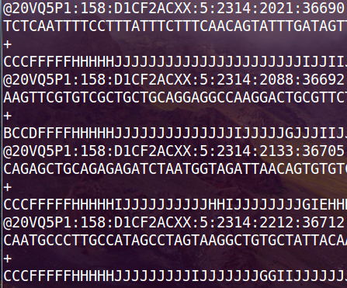
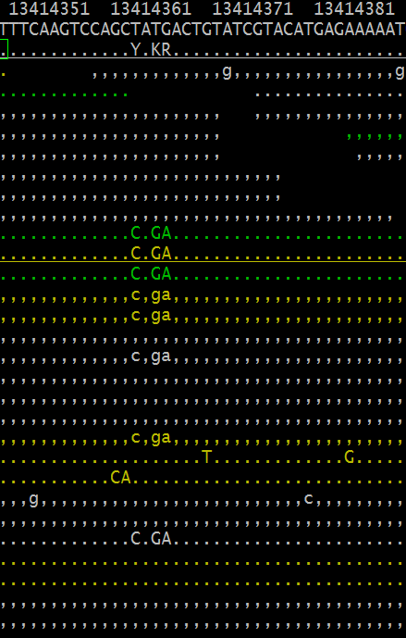
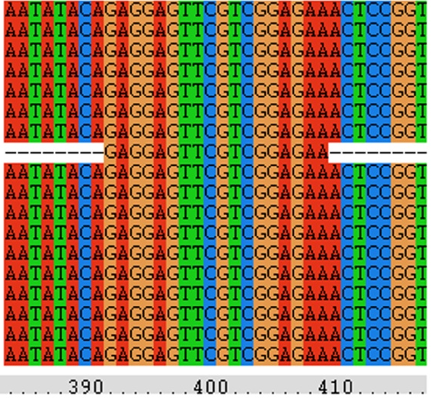
Variant detection
Raw Sequencer Output
Alignment to the Genome
Variant Detection
Alignment against reference genome
Analysis is very disk I/O-intensive

Slide 16
Things can move quickly!
Brown Swiss family with possible BH2 homozygotes (dead)
Dead calves will be
genotyped for BH2
status
If homozygous, we
will sequence in a
family-based design
Austrian group also
working on BH2
(Schwarzenbacher
et al., 2012)
Strong industry
support!
AI firm
sending
10 units
of semen
Semen
in CDDR
Owner will collect
Blood samples
Tissue samples (ears)
being processed for DNA
Owner will collect blood
samples when born

Slide 17
Challenges with new phenotypes
Lack of information
  Inconsistent trait definitions
  Often no database of phenotypes
Many have low heritabilities
  Lots of records are needed for accurate evaluation
  Genetic improvement can be slow
Genomics may help with this
Notes:
17
17

Slide 18
Reliability with and without genomics
Example: Dairy cattle health (Parker Gaddis et al., 2013)
Average reliabilities of sire PTA computed with pedigree information and genomic information, and the gain in reliability from including genomics.
Event | EBV Reliability | GEBV Reliability | Gain
Displaced abomasum | 0.30 | 0.40 | +0.10
Ketosis | 0.28 | 0.35 | +0.07
Lameness | 0.28 | 0.37 | +0.09
Mastitis | 0.30 | 0.41 | +0.11
Metritis | 0.30 | 0.41 | +0.11
Retained placenta | 0.29 | 0.38 | +0.09

Slide 19
Some novel phenotypes being studied
Age at first calving (Cole et al., 2013)
Dairy cattle health (Parker Gaddis et al., 2013)
Methane production (de Haas et al., 2011)
Milk fatty acid composition (Bittante et al., 2013)
Persistency of lactation (Cole et al., 2009)
Rectal temperature (Dikmen et al., 2013)
Residual feed intake (Connor et al., 2013)
Notes:
19
19

Slide 20
What do we do with novel traits?
Put them into a selection index
  Correlated traits are helpful
Apply selection for a long time
  There are no shortcuts
Collect phenotypes on many daughters
  Repeated records of limited value
  Genomics can increase accuracy

Slide 21
Conclusions
Non-additive effects may be useful for increasing selection intensity while conserving important heterozygosity
Whole-genome sequencing has been very successful at helping economically important loss-of-function mutations
Novel phenotypes are necessary to address global food security and a changing climate

Slide 22
Acknowledgments
Paul VanRaden, George Wiggans, Derek Bickhart, Dan Null, and Tabatha Cooper
Animal Improvement Programs Laboratory, ARS, USDA Beltsville, MD
Tad Sonstegard, Curt Van Tassell, and Steve Schroeder
Bovine Functional Genomics Laboratory, ARS, USDA, Beltsville, MD
Chuanyu Sun
National Association of Animal Breeders
Beltsville, MD
Dan Gilbert
The Brown Swiss Cattle Breeders’ Association of the USA, Beloit, WI

Slide 23

Questions?
http://gigaom.com/2012/05/31/t-mobile-pits-its-math-against-verizons-the-loser-common-sense/shutterstock_76826245/

